Slide 1
Machine2Machine
INTERNET OF THINGS

Slide 2
M2M
It refers to technologies, standards and protocols that enable the machines to communicate and interact with each other and carry out useful task
M2M can either use telemetry to do machine to machine communication whish includes telephone lines and radio waves etc
M2M can either use wired medium or wireless medium like cellular networks, ETHERNET, Wi-Fi, Bluetooth and infrared and software programs to help a network device to interpret data and make decisions
M2M allows machines and systems to work together more effectively
M2M ultimately reduces cost, boosted revenue and improved customer service

Slide 3
M2M Applications
VENDING MACHINE
Traditionally it need to be checked regularly to see the stock that they carried
If stock is less, FACILITIES MANAGER will contact the vending machine OPERATOR to order new stock that could be added into the machine
M2M vending machines will communicate stock levels straight back to the stock database and ware house
M2M SIM will provide connectivity for providing current operational status and stock items in the vending machine
M2M needs someone for refilling and maintenance no need of physical inspection

Slide 4
M2M Applications
ROBOTICS
M2M used in robotics to place inventory in warehouse and autofill shipment orders
It also helps to automate manufacturing related tasks
LOGISTICS AND FLEET MANAGEMENT
M2M can be used in fleet management to track movement of vehicles and objects and manage them efficiently
M2M helps to get information like current location ,traffic jams in route environmental conditions send them to a machine that can track vehicle

Slide 5
M2M Applications
UTILITY
M2M can be used in monitoring smart utility meters ELECTRICITY,WATER GAS etc
A smart meter being an electronic device that records consumption of electricity ,gas and water and communicate the information for monitoring bills
Smart meters can automatically send meter readings to the Utility Companies
Smart meters can give users REAL TIME FEEDBACK on their energy or waste usage

Slide 6
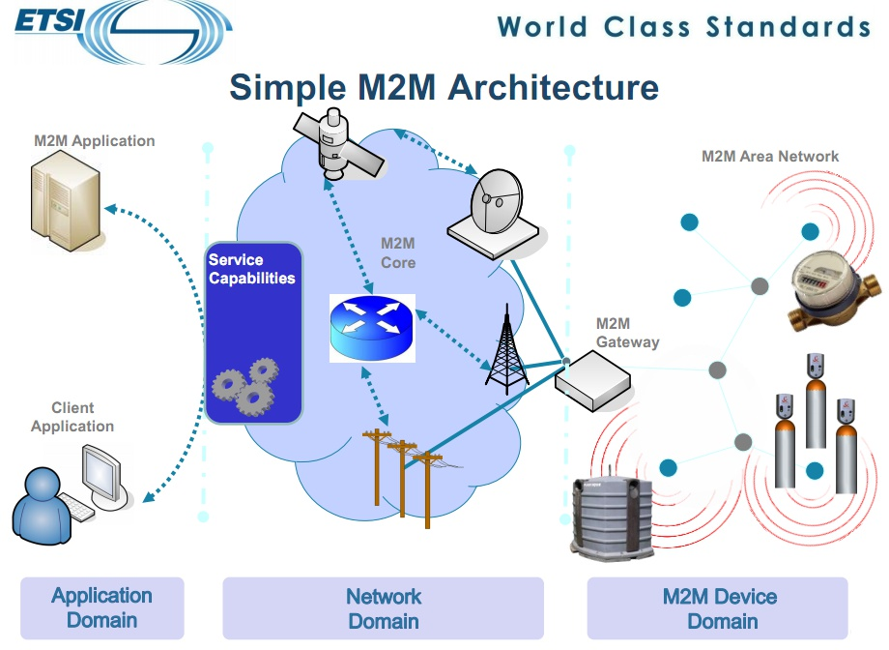
M2M Architecture

Slide 7
M2M Architecture( ETSI)
M2M DEVICE DOMAIN
An M2M area network is formed by the collaboration of a large number of devices (e.g. intelligent sensors, actuators, and smart meters) and gateways
M2M Gateway has a capacity for interconnecting M2M device to the communication network
M2M NETWORK DOMAIN
M2M communication Network provide communication between the M2M Gateways and M2M applications
This could be wired or wireless communication medium
This includes 3G, LTE,GPS,GPRS,WAN ,LAN, PAN ,WiMAX etc

Slide 8
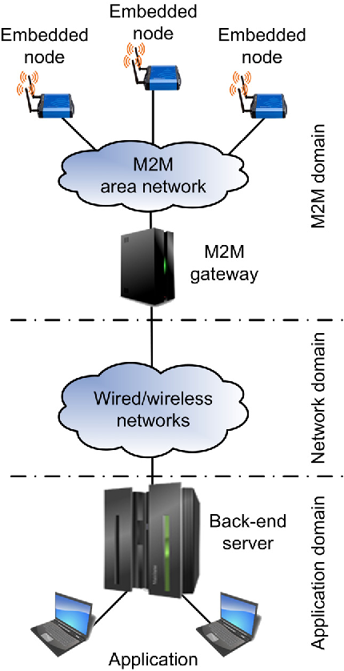
M2M Architecture
M2M APPLICATIONS
The application domain consists of a back-end server (BS) and M2M application clients.
The back-end server is the main component of the M2M system and acts as an integration point to store all the sensory information transmitted from the M2M device domain.
ETSI European Telecommunication Standards Institute

Slide 9
High End Architecture of M2M for IOT
END USER APPLICATIONS it can be used to interact with IOT devices. Applications may be on SMART PHONES, vending machine
BUSINESS LOGIC & APPLICATION INTERFACE can process collected data and expose it to end user application for consumption
M2M WIRED OR WIRELESS COMMUNICATION can use standards like ethernet Bluetooth and WiFi ,internet
M2M GATEWAY can run communication protocols to collect data from IOT devices
IoT DEVICES ( ANY DEVICE)

Slide 10
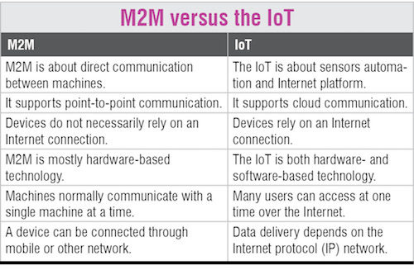
Difference between M2M and IOT

Slide 11
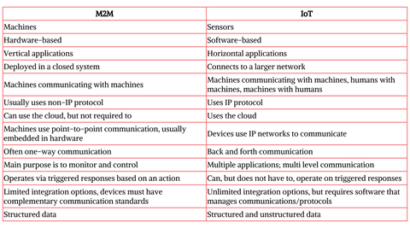
Difference between M2M and IOT

Slide 12
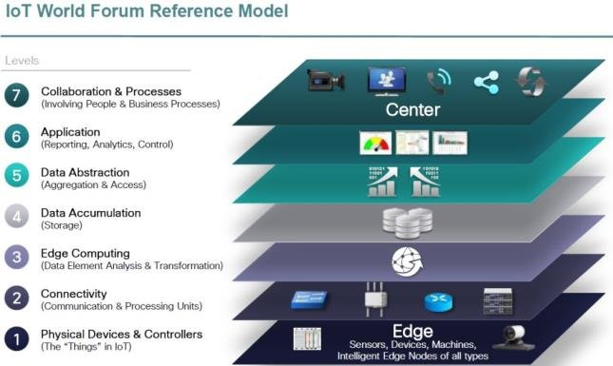
IoT World Forum Standardized Architecture

Slide 13
IoT World Forum Standardized Architecture
IoTW architectural committee led by Cisco, IBM, Rockwell Automation published seven layer reference model
It helps to visualize IOT
Each of seven layers are broken into specific functions and security

