Slide 1
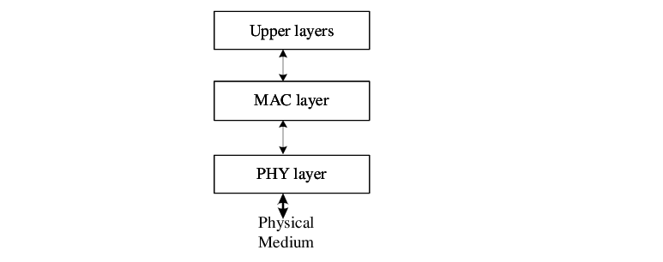
IEEE 802.15.4 (High Level Architecture)

Slide 2
IEEE 802.15.4 (High Level Architecture)
IEEE 802.15.1 standard released in 2003 adopted wide band physical layer using Direct Sequence Spread Spectrum technique (DSSS).
It provides operation in 3 frequency bands
868 MHZ in Europe.
915 MHZ in US
2.4 GHZ ISM (802.4) it is unlicensed band available for sending data, when we use 802.15.4.
27 channels are supported by the 3 bands.
868 MHZ – 1 channel
915 MHZ – 10 channels
802.4 MHZ – 16 channels
Three band provide transmission rate 20Kb/s, 40kb/s & 250 kb/s.
Later 2006/2007/2009 new bands have been added.

Slide 3
Physical layer IEEE 802.15.4
It is responsible for low-level functions like
Data transfer & reception
Whatever information present in the device digitally will be converted into analog and will be transmitted
Another physical layer device will accept this analog information convert it into digital & send to the Upper OSI layer
Energy detection of the current channel.
It helps to find out if is there any data flow going on in any physical channel
It senses the power in the channel if there is power in the channel then there is physical data transfer is going on
It is important to check energy detection before sending the data otherwise it may result into collision

Slide 4
Physical layer IEEE 802.15.4
Link quality indication
It depends on any obstacles in the link. Whatever data we are transmitting that gets delivered at the other end or not
It also depends on distance the data has to travel
More the distance poor is the LINK quality
It indicates the strength of the incoming signal
Clear channel assessment
Before sending data the clearance is taken about channel. If the channel is free then we can send data through the LINK
To check clearance bogus data is transmitted. If the channel is clear then only data will be transmitted

Slide 5
MAC layer IEEE 802.15.4
It is the interface between the physical layer and the Upper layers
MLME( Mac Layer Management Entity) is a sublayer of MAC. It maintains the database
Functions of MAC layer
Association and Disassociation between the nodes. It is for connecting and disconnecting the nodes
Acknowledge Frame Delivery whenever data is received it will send the acknowledgment
Channel access mechanism in which for every node there will be an active or inactive node. During active time data will be transmitted and during inactive time data will not be transmitted. Every node has fixed active time period

Slide 6
MAC layer IEEE 802.15.4
Functions of MAC layer
Frame Validation how much frame is getting transmitted must be validated before transmission
Guaranteed time slot management
During active mode node is transmitting the data for certain time period and receive data for certain time period. This definite time period indicates guaranteed time management slot
Any particular node is in transmitting node then other should be on receiving mode at the same time it is called as TIME MANAGEMENT
Beacon Management
Indicating other that a particular node in the active state
It is in state of transmitting and receiving data

Slide 7
Zigbee
Zigbee is a very LOW COST , very LOW POWER consuming, two-way, wireless communication standard based on IEEE802.15.4
IOT devices need a network connection
IOT devices do not have enough computing capacity and may have a battery-based power source
IOT devices are very tiny, and cannot be connected IN NETWORK CABLE
There is a need for a low-power-consuming wireless communication protocol that can connect several devices cost-effectively
Zigbee provides a mechanism for connecting IOT devices to the NETWORK wirelessly
Zigbee 3.0 is the latest version

Slide 8
Zigbee Devices
Zigbee has three types of devices or nodes which function based on the chosen NETWORK TOPOLOGY (STAR,TREE,MESH)
Zigbee Coordinator
It is responsible for initiating and maintaining the devices on the NETWORK
All other devices can communicate with the Zigbee coordinator
It also chooses the SECURITY KEYS, establishes trust among the DEVICES directly communicates with the Zigbee coordinator
It controls overall network operations
EACH NETWORK CAN HAVE ONLY ONE ZIGBEE COORDINATOR

Slide 9
Zigbee Devices
Zigbee Routers
They are meant to extend Zigbee network
They serve as an intermediary
They send and receive data from various networks and route the network traffic appropriately
They are used in MESH and TREE topologies
Zigbee End Devices
These are actual IOT devices
They send data to the parent device which could be a Zigbee coordinator or Zigbee Router

Slide 10
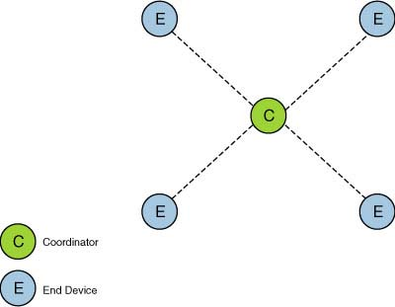
Zigbee Network Topology
STAR topology
In this topology the network is
controlled by One single device
called the Zigbee Coordinator
Zigbee coordinator is responsible for
Initiating and maintaining the devices
on the network
All other devices are called as
END DEVICES directly communicate
With the Zigbee coordinator

Slide 11
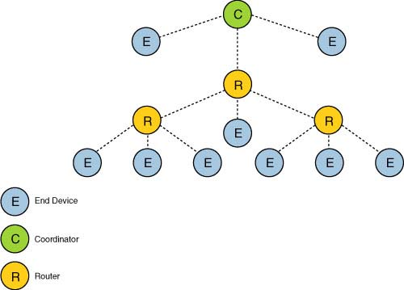
Zigbee Network Topology
TREE topology
In this Zigbee coordinator is responsible
for starting the network and for choosing
a certain key Network Parameters
Network can be extended only
through ROUTERS
ROUTERS move data and
control messages through the
network using a Hierarchical
routing strategy
Network implies beacon oriented
communication

Slide 12
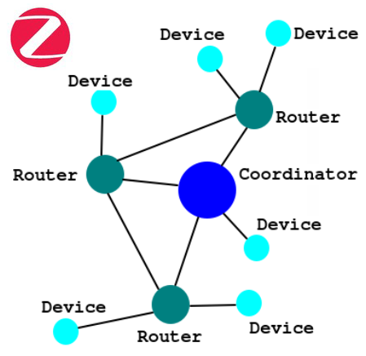
Zigbee Network Topology
MESH topology
In mesh topologies the Zigbee coordinator
is responsible for starting the network and for
choosing a certain key Network Parameters
Network can be extended only
through ROUTERS
Mesh network can allow peer-peer
communication

Slide 13
Zigbee Technical Specifications
Network Topology- STAR,MESH,TREE
Network devices –ROUTER, END DEVICE, COORDINATOR, POWER DEVICE
Network Size- IEEE 802.15.4-2011
Frequency Band-2.4 GHz/ 16 channels
Frequency band – regional operations in the 915MHz and 868 MHz
Data rate – 250Kbits/sec
Communication range- upto 300 meters
Communication range- upto 75-100 meters indoor
Support-each physical device will support 240 devices

