Slide 1



Bank App
llication Success Prediction Model
GOURI KRISHNA

Slide 2

Use case:
The model uses Binary classification to predict ,if the Bank application is successful or not successful

Slide 3
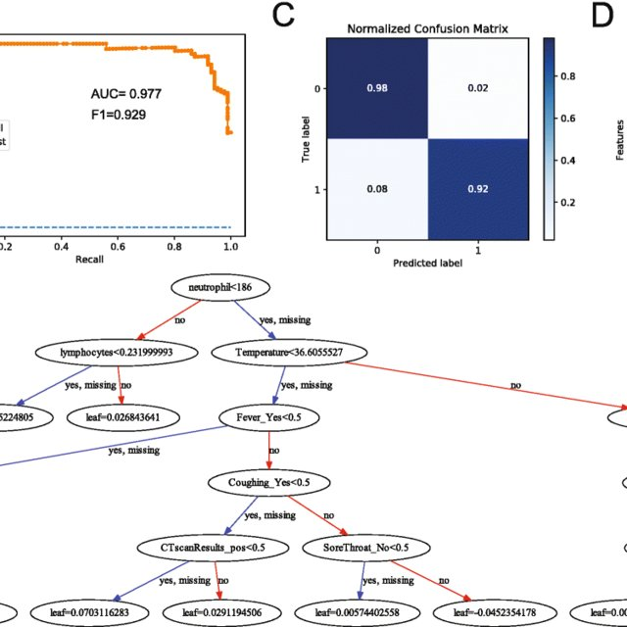
Model used
XGBOOST

Slide 4
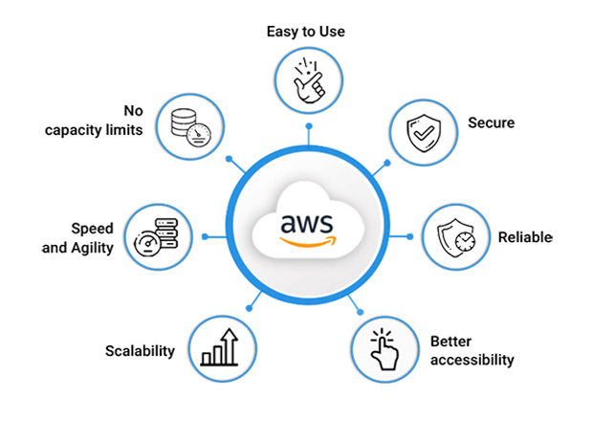

Slide 5
Components used:
Amazon Sage Maker
Lambda
API Gateway

Slide 6

Advantages of using Sagemaker for model training are:
You can use a cheap instance to host your notebook which can run 24 hours and will not cost a
Another feature of SageMaker for model training is hyper parameter tuning
Another advantage is how you can use Amazon’s own pre-built models that have been highly optimized to run on AWS services
Host the ML model in an endpoint- you can then call this endpoint from any other code written in the common languages

Slide 7
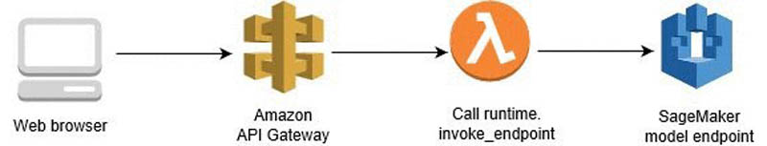
Solutions Diagram

Slide 8
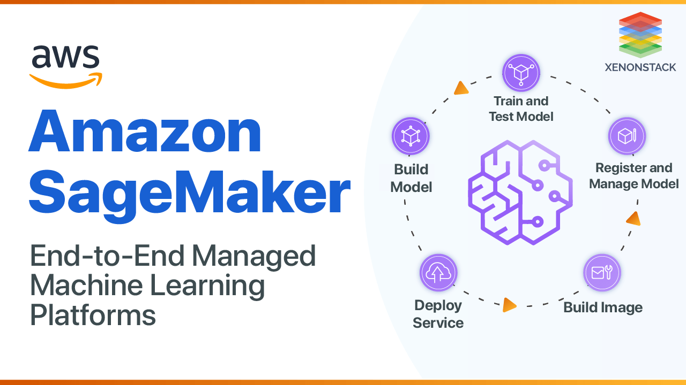
SAGEMAKER

Slide 9
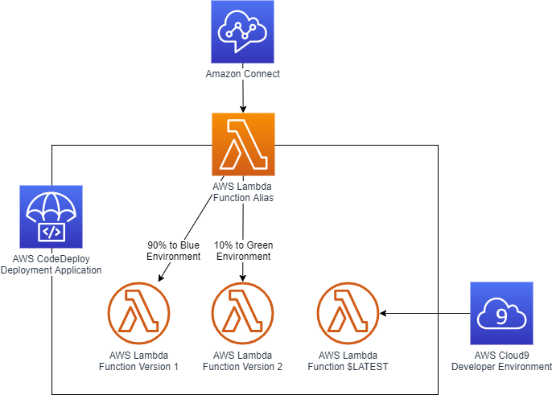
Lambda:

Slide 10


Slide 11

Thank you

