Slide 1

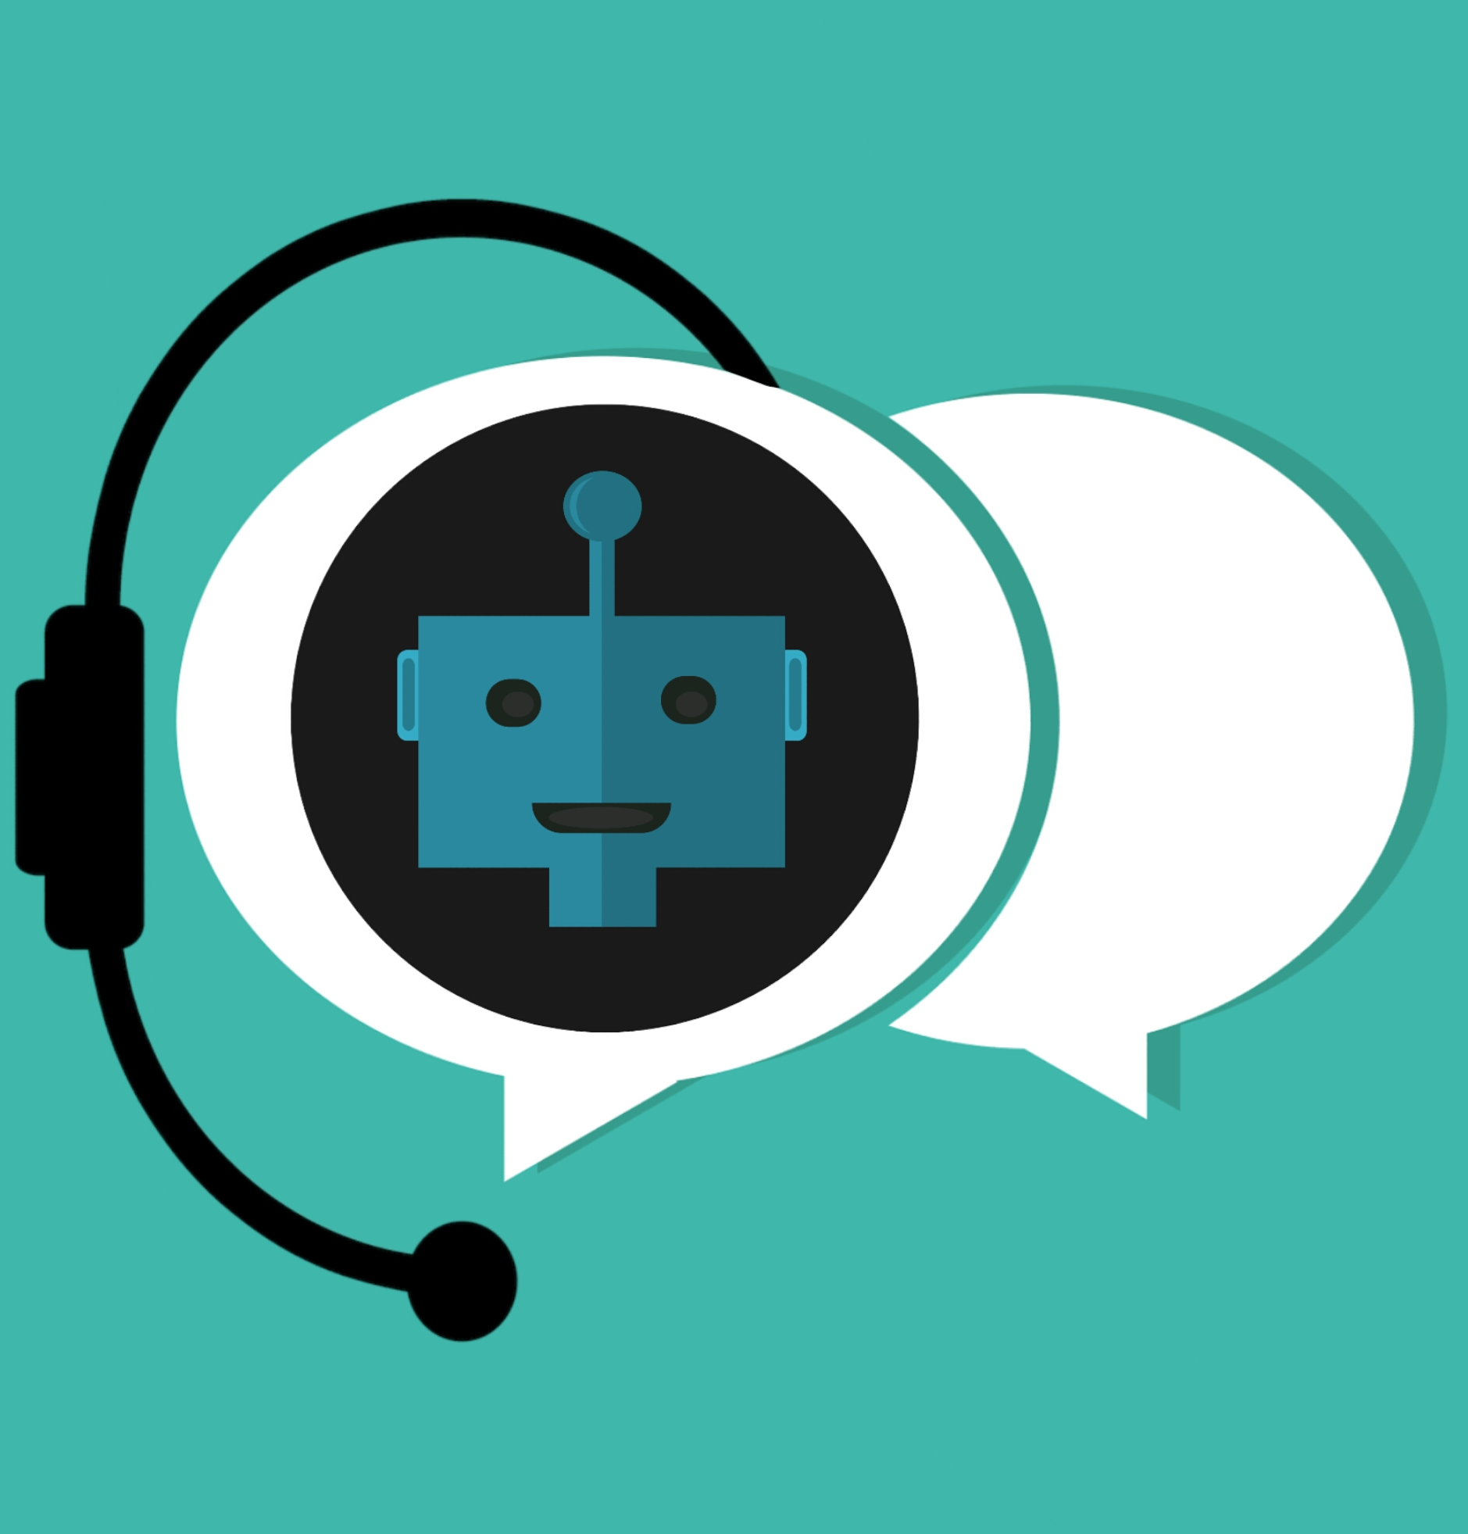


Artificial Intelligence in our daily life
Submitted by: Gaurish Gupta
Class: X A
Submitted to: Ms. Priyanka Mehta

Slide 2
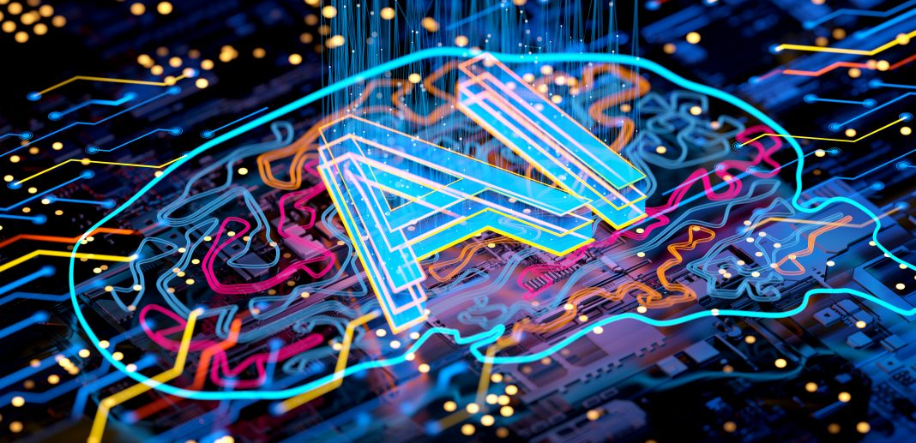
What is Artifficial Intelligence?
Artificial intelligence (AI) is a branch of computer science that enables machines to perform tasks that normally require human intelligence. AI systems can learn from data, recognize patterns, solve problems, understand language, and make decisions.
To health 2030ai is helping doctors diagnose diseases, monitor patients, develop new medicines, and improve healthcare services. It will play an important role in achieving the goals of health 2030.

Slide 3
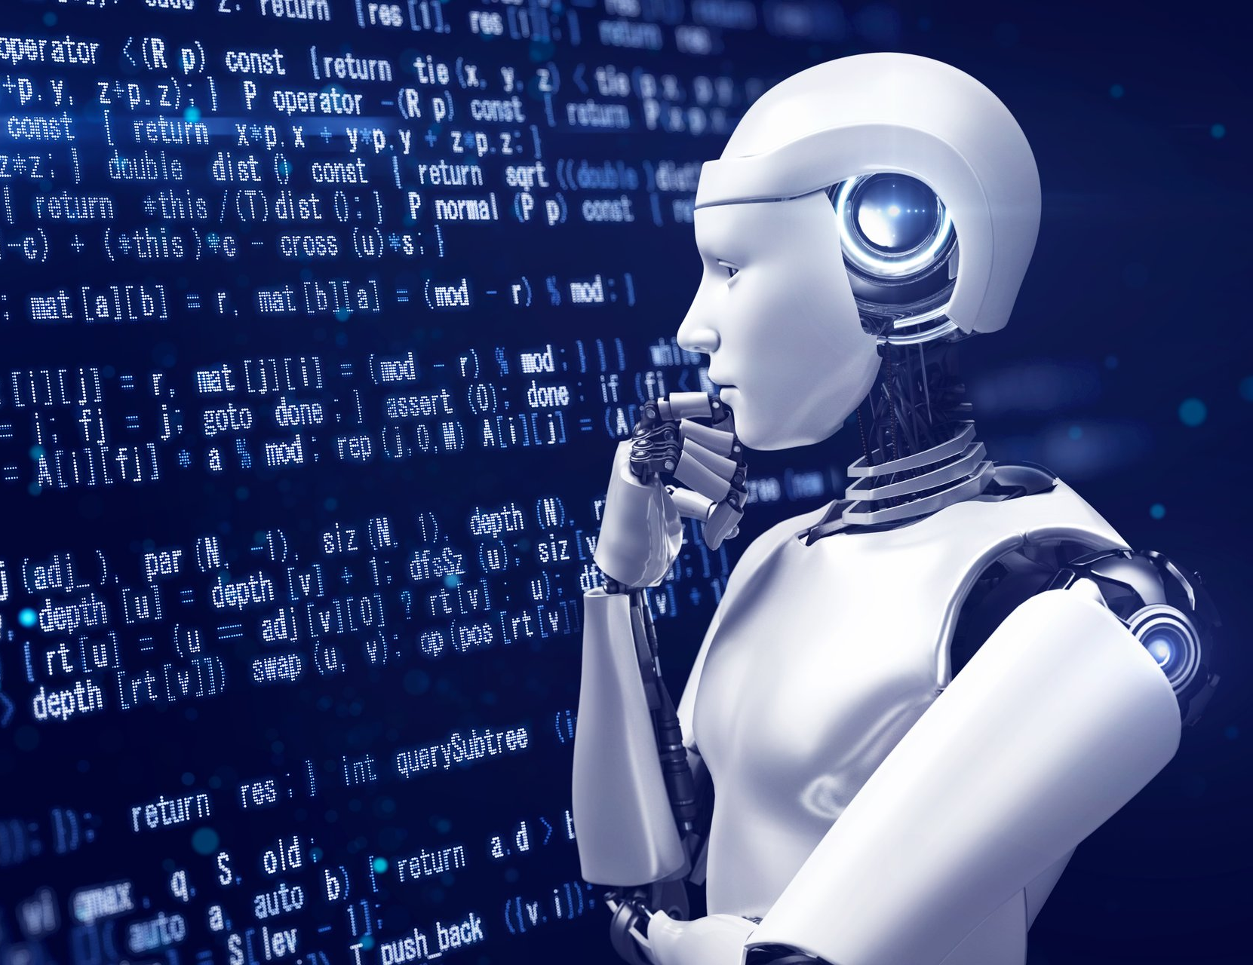
How Does AI Work?
Artificial intelligence works by learning from large amounts of data and identifying patterns. It uses algorithms and machine learning to make predictions and decisions.

Slide 4
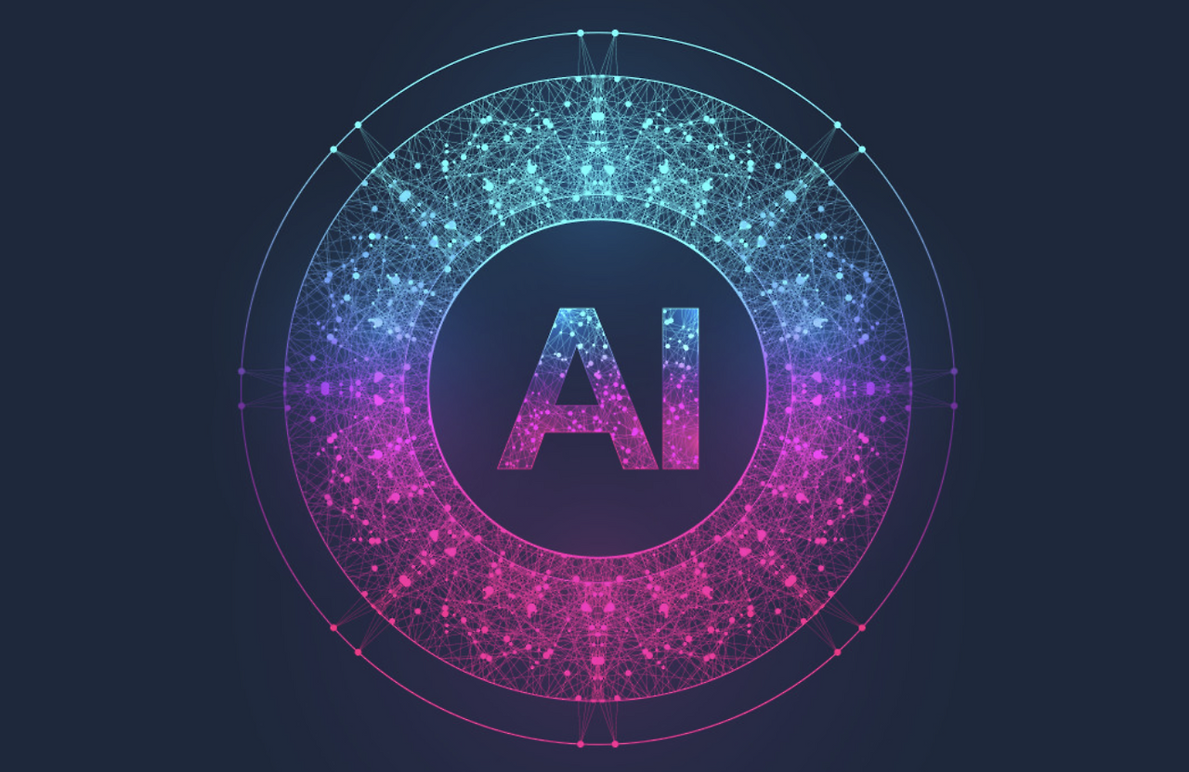
Steps Involved
Learning AI studies patterns in the data.
Processing & analysis ai- analyzes the information.
Decision making ai- provides answers, recommendations, or predictions.
Improvement ai - becomes more accurate as it receives more data.
Data collection ai- gathers information from various sources.

Slide 5
AI in Healthcare
Applications of AI in Healthcare
🩺 Disease Diagnosis Helps detect diseases such as cancer and diabetes.
🔬 Medical Imaging Analyzes X-rays, CT scans, and MRI images.
💊 Drug Discovery Assists scientists in developing new medicines.
⌚ Health Monitoring Smart watches track heart rate, sleep, and fitness.
🤖 Robot-Assisted Surgery Helps surgeons perform precise operations.
Artificial intelligence is transforming healthcare by making diagnosis faster, treatment smarter, and patient care more effective.
Benefits
✅ Faster diagnosis
✅ Better treatment planning
✅ Reduced human errors
✅ Improved patient care

Slide 6
AI in Education
Applications of AI in Education
📚 Personalized Learning AI adapts lessons according to each student's needs.
🎓 Smart Tutoring Systems Provides guidance and explanations like a personal tutor.
📝 Automatic Grading Helps teachers evaluate assignments and tests quickly.
🌐 Language Translation Assists students in understanding content in different languages.
💻 Online Learning Platforms Recommend courses and study materials based on interests.
Artificial intelligence is changing the way students learn by making education more interactive, personalized, and accessible.
Benefits
✅ Learning at your own pace
✅ Better understanding of concepts
✅ Instant feedback
✅ Improved academic performance

Slide 7
AI in Transportation
Applications of AI in Transportation
🚗 Smart Navigation Suggests the fastest routes using real-time traffic data.
🚦 Traffic Management Controls traffic signals to reduce congestion.
🚌 Public Transport Planning Optimizes bus and train schedules.
🚘 Self-Driving Vehicles Uses sensors and AI to drive safely.
📍 Route Optimization Helps delivery services save time and fuel.
Artificial Intelligence is making transportation safer, faster, and more efficient by helping people travel smartly and reducing traffic problems.
Benefits
✅ Saves travel time
✅ Reduces traffic jams
✅ Improves road safety
✅ Lowers fuel consumption

Slide 8
AI Chatbots and Virtual Assistants
Applications
💬 Chatbots Answer questions instantly . Help students learn and research topics.
🎙️ Voice Assistants Set reminders and alarms. Play music and provide weather updates.
🌐 Customer Support Assist customers 24/7.
📝 Writing Assistance Help with drafting, summarizing, and correcting text.
🌍 Language Translation Translate text and speech between languages.
AI chatbots are computer programs that can understand human language and respond to questions in a natural way. They help people find information, learn new things, and complete tasks quickly.

Slide 9
AI in Entertainment
Applications of AI in Entertainment
🎬 Movie Recommendations-Suggests movies and shows based on viewing history.
🎵 Music Recommendations-Recommends songs according to listening habits.
📺 Video Suggestions-Shows videos related to user interests.
🎮 Gaming-Creates smarter opponents and realistic game environments.
🎨 Content Creation-Assists in creating images, videos, and music.
Artificial intelligence helps provide personalized entertainment experiences by understanding users' interests and preferences.
Benefits
✅ Personalized experience
✅ Better content discovery
✅ Improved gaming experience
✅ Saves time searching for content

Slide 10
AI In Banking And Finance
AI In Shopping
🏦 Fraud Detection-Identifies suspicious transactions and prevents fraud.
💳 Online Banking Security-Uses facial recognition and fingerprint authentication.
📊 Financial Advice-Helps customers manage savings and expenses.
💬 Customer Support-AI chatbots answer banking queries instantly.
🛒 Product Recommendations-Suggests products based on previous purchases and interests.
📦 Inventory Management-Helps stores keep products in stock.
🎯 Personalized Advertisements-Shows relevant products to customers
.🚚 Smart Delivery Systems-Improves delivery speed and efficiency.

Slide 11
Advantages/Disadvantages of Artificial Intelligence
✅ Saves Time-Completes tasks quickly and efficiently.
✅ Reduces Human Errors-Improves accuracy in calculations and analysis.
✅ Works 24/7Does not require breaks or rest.
✅ Handles Large Amounts of Data-Processes information much faster than humans.
✅ Improves Decision Making-Helps in healthcare, education, business, and transportation.
❌ Privacy Concerns-Large amounts of personal data may be collected.
❌ Job Displacement-Some repetitive jobs may become automated.
❌ Dependence on Technology-People may rely too much on AI systems.
❌ High Development Cost-Creating and maintaining AI systems can be expensive.
❌ Lack of Human Emotions-AI cannot truly understand feelings and emotions.

Slide 12
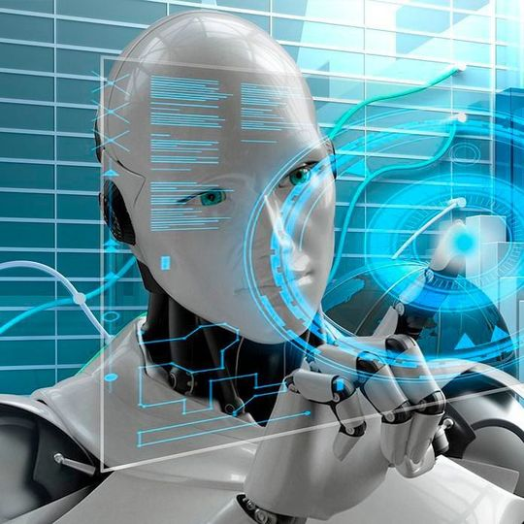
Conclusion- ARTIFICIAL INTELLIGENCE has become an important part of our daily lives. From healthcare and education to transportation, banking, entertainment, and smart homes, AI is helping people work more efficiently and solve problems more effectively.AI has the potential to create a healthier, smarter, and more sustainable future. However, it should be used responsibly to ensure that its benefits are shared by everyone.
Takeaways
✔ AI is transforming everyday life.
✔ Ai improves healthcare, education, and safety.
✔ Ai helps save time and increase efficiency.
✔ Responsible use of ai is important for society.
✔ Ai will play a major role in achieving the goals of health 2030.Thank you
Made by : Gaurish Gupta
Class X-A

