Slide 1

Project Stage – I (417527)
Project Presentation – II
SEM I
Academic Year 2026-27

Slide 2
Daemon-Based Distributed Compute Grid: A Framework for Scheduling and Executing Tasks Across Heterogeneous Nodes by
Group ID: 07
Gaurav Vibhandik , Vrushali Chaudhari , Nishant Chaugule
Guided by
GuideName:-

Slide 3
Presentation outlines
1.Abstract
2.Problem Statement
3.Motivation
4.Objectives(Product,process,resources etc)
5.Literature survey
6.Existing Methodology/ Model
7.Identified Research Gap
8.Proposed System
9.Methodology of Evaluation
10.Process Flow
11.Use of Algorithm,Technical Concept
12.Relevant mathematical model associated with the project
13.Hardware/Software Requirement
14.Risk Analysis(technical risks,Operational risks, schedule risks,business risks )
15.Project achievable in specified(Time, Cost Budget)?
16.Expected Outcomes
17.References

Slide 4
Abstract
Renting cloud servers is very expensive for running heavy computing tasks, while millions of personal computers sit idle. This project proposes DaeMon, a distributed computing platform that connects everyday computers into a shared network to run tasks using FastAPI, RabbitMQ, and Docker. Our main contribution is an automatic task coordinator: it sends jobs to available workers, checks their health in real time, and safely reassigns tasks if any worker goes offline. We test the system by measuring task execution time, recovery speed when workers disconnect, and performance under heavy workloads.
Keywords: Distributed Computing, Worker Nodes, Task Scheduling, Docker, Fault Tolerance

Slide 5
Problem Statement
Cloud computing is expensive: Renting servers from AWS or GCP is unaffordable for small teams, researchers, and students.
Unused compute power: Millions of consumer laptops and desktop GPUs sit completely idle throughout the day.
Worker nodes are unreliable: Volunteer personal computers can disconnect, crash, or go offline mid-task without warning.
Security risks: Running user code on personal machines requires strict isolation to protect hosts from untrusted execution.
Core question
Can an open network reliably run distributed tasks across unpredictable personal computers without losing work?

Slide 6
Motivation
High cloud bills prevent individual developers and students from running compute-heavy jobs.
Pooling idle everyday computers can unlock massive computing power at virtually zero extra cost.
Volunteer projects like Folding@home proved that everyday PCs can outpace supercomputers when joined together.
However, older grid platforms are complex to install, rigid, and lack modern container sandboxing and instant queues.
A plug-and-play, containerized edge grid is the missing step

Slide 7
Objectives
Product: A working distributed compute platform that connects volunteer machines to execute containerized tasks on demand.
Process: Implement an active task queue with live heartbeat tracking that reassigns jobs instantly if workers fail.
Evaluation: Measure task completion speed, worker recovery time during disconnects, and cluster throughput under load.
Resources: Python (FastAPI), Docker, RabbitMQ, Redis, MinIO, Next.js, MongoDB, GitHub.

Slide 8
Literature Survey
Sr.No | Title | Author | Publication & Year | Summery | Findings | Remarks
1 | Globally Scheduling Volunteer Computing | David P. Anderson | Future Internet 2021 | Proposes modern scheduling algorithms to distribute heavy jobs across unpredictable volunteer computers worldwide. | Dynamic deadline estimation and job matching improve task success rates across erratic consumer PCs. | Uses legacy BOINC middleware; lacks modern containerization and web queues.
2 | VECTrust: Resource Allocation in Volunteer Clouds | Ashish Pandey, Prasad Calyam | IEEE/ACM UCC 2021 | Uses KubeEdge and Docker to assign jobs to volunteer edge devices using trust scores. | Successfully executes containerized scientific tasks on volunteer edge devices with reliability checks. | Heavy control plane high RAM req. makes it unsuitable for ordinary laptops.
3 | Decentralized Application Placement in Fog | Zoltán Ádám Mann | IEEE TPDS 2022 | Schedules tasks across distributed edge nodes to prevent network bottlenecks and single-point failures. | Decentralized dispatching reduces coordination delay and scales efficiently across large network topologies. | lacks an end-to-end web platform
4 | Container Scheduling in Edge Computing | Zhiqing Tang, Fangyi Mou | IEEE TMC 2024 | Optimizes Docker container deployment and dynamic memory sharing across resource-constrained edge machines. | Intelligent container overbooking boosts edge throughput by 34% without causing system crashes. | does not handle sudden worker disconnects.

Slide 9
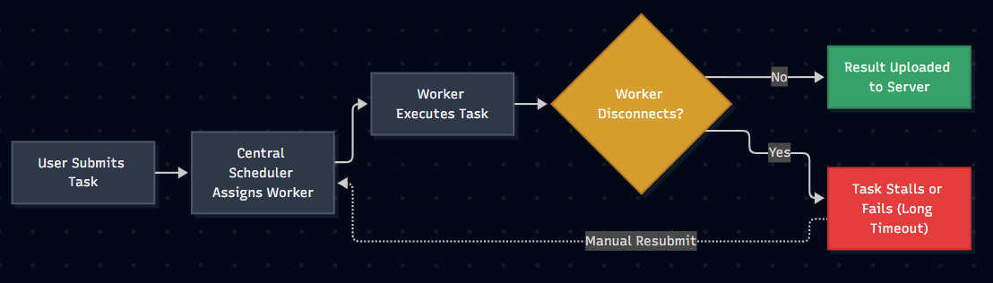
Existing Methodology/ Model
BOINC / Folding@home:
Uses client-polling for batch jobs; lacks modern container sandboxing and instant task queues
KubeEdge / MicroK8s:
Deploys containers to edge hardware, but the control plane consumes too much RAM (1GB+)
Celery / Ray:
Fast task queues for data centers, but crashes when volunteer machines drop offline
Common weakness: Worker disconnects stall or lose jobs, and existing setups are too heavy for ordinary personal computers.

Slide 10
Identified Research Gap
What exists
Gap we target
Heartbeat tracking and timeout-based job retries exist (BOINC, Celery)
Long timeout delays; no instant sub-second task reassignment when volunteer nodes disconnect.
Container orchestration platforms exist for edge hardware (KubeEdge, MicroK8s)
Heavy memory footprint (1GB+ RAM) makes them too bloated for everyday personal laptops.
Centralized task brokers send files directly through API servers (Ray, Celery)
Large payloads choke message queues; decoupled S3/MinIO artifact storage is rarely integrated
Mathematical simulation models and CLI scripts (VonEdgeSim, Nebula)
Lack real-time visual web dashboards for live cluster monitoring, node health, and logs.

Slide 11
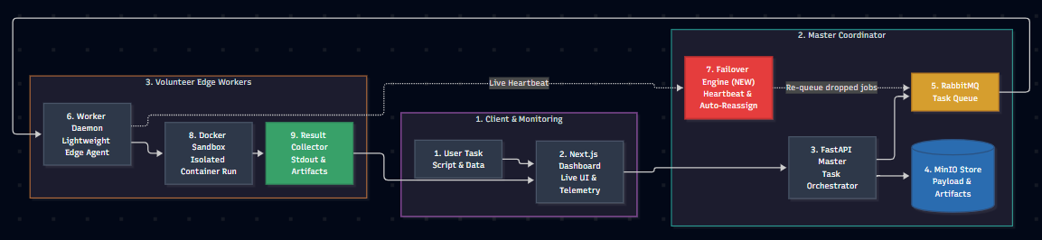
Proposed System

Slide 12
Methodology of Evaluation
Evaluation Area | Details
1. Experimental Testbed | Heterogeneous volunteer nodes (Intel i5/i7, AMD Ryzen, 8GB–16GB RAM) connected over local and wide-area networks.
2. Workload Types | Synthetic CPU stress tests + real-world data pipelines packaged into standard Docker containers.
3. Measured Metrics | • Latency: Time from submission to result. • Throughput: Jobs/minute under load. • Fault Recovery: Seconds to reassign a dropped job. • Overhead: <50MB RAM consumed on volunteer PCs
4. Success Criteria | Near-linear speedup as nodes are added, and 100% task recovery when workers abruptly disconnect.

Slide 13
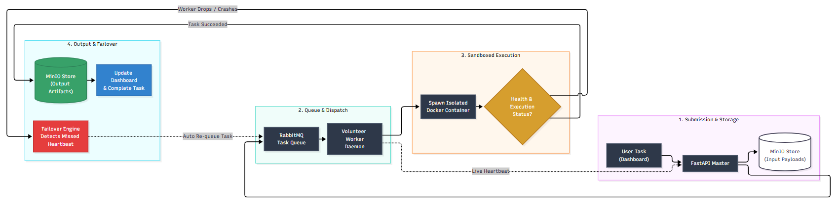
Process Flow

Slide 14
Use of Algorithm, Technical Concept
1. Dynamic Task Scheduling
Capacity-Aware Dispatch: Uses Weighted Priority Queues to assign tasks based on live worker CPU cores, available RAM, and queue load.
Active-Push Model: Replaces slow polling loops with instant orchestrator push, achieving sub-second job dispatching.
2. Heartbeat Leasing & Failover
Sliding-Window Leases: Redis TTL tracks worker pings ; marks nodes OFFLINE after 15 seconds of silence.
Zero-Loss Reassignment: Incomplete tasks on disconnected workers are automatically re-injected into RabbitMQ with high priority.
3. Decoupled Control & Data Plane
Lightweight Message Queue: RabbitMQ exclusively routes small JSON metadata (Job IDs, storage pointers) to prevent queue bloat.
4. Container Sandboxing & Isolation
Kernel Namespaces: Docker isolates execution environments (PID, Mount, Network) to block access to the host operating system.
Cgroups v2 Governance: Enforces hard CPU quotas (--cpus) and memory ceilings (--memory) so worker tasks cannot freeze host PCs.

Slide 15
Software Functional Requirements
1. Functional Requirements
Task Submission: Users can upload execution scripts, dependencies, and input datasets via the web dashboard.
Smart Scheduling: Automatically queues tasks and dispatches them to available volunteer workers.
Sandboxed Execution: Executes code inside isolated Docker containers with capped CPU and RAM limits.
Auto-Recovery: Detects disconnected workers using live heartbeats and instantly reassigns their tasks.
Results & Logs: Stores output files in MinIO and streams real-time execution logs back to the user.
2. Non-Functional Requirements
Performance: Sub-second task dispatch latency with a lightweight worker agent (<50 MB RAM).
Fault Tolerance: 100% task recovery guarantee if a worker machine suddenly crashes or goes offline.
Security: Complete container isolation to protect volunteer PCs from untrusted or malicious code.
Scalability: Easily scales across 1 to 50+ volunteer machines without modifying coordinator logic.

Slide 16
Software Requirements
Backend Framework: Python 3.11+ with FastAPI
Message Broker: RabbitMQ
Execution & Sandboxing: Docker Engine
In-Memory Cache & Heartbeats: Redis
Storage Systems: MinIO (S3-compatible object storage ) & MongoDB ( for Metadata )
Operating Systems Supported: Windows 10/11, Ubuntu/Debian Linux, and macOS.

Slide 17
Risk Analysis
1. Technical Risk (Node Churn & Network Failures)
Risk: Volunteer worker machines disconnect, sleep, or crash mid-task, risking stalled jobs or data loss.
Mitigation: Sliding-window Redis heartbeats detect drops within 15 seconds; RabbitMQ re-queues tasks automatically to healthy nodes.
2. Operational Risk (Host Security & Resource Exhaustion)
Risk: Untrusted client code could attempt unauthorized filesystem access or consume all host CPU and RAM.
Mitigation: Strict Docker container sandboxing isolates execution; Linux cgroups enforce hard ceilings on memory and CPU quotas.
3. Schedule Risk (Multi-Service Integration Complexity)
Risk: Coordinating multiple services (FastAPI, RabbitMQ, Redis, MinIO, Docker) could cause development and testing delays.
Mitigation: Modular microservice architecture decoupled via standard REST/AMQP protocols and automated using Docker Compose.
4. Business / Adoption Risk (Low Volunteer Node Retention)
Risk: Volunteers may uninstall the client if background computing degrades their daily laptop performance.
Mitigation: Ultra-lightweight daemon agent (<50 MB RAM footprint) that executes strictly within capped resource boundaries.

Slide 18
Project achievable in specified(Time, Cost Budget)?
1. Time Feasibility (Academic Schedule)
Phase I (Weeks 1–12): System architecture design, FastAPI master coordinator, RabbitMQ task queue, and basic Docker worker agent.
Phase II (Weeks 13–24): Redis heartbeat failover engine, MinIO decoupled storage, Next.js telemetry dashboard, and cluster benchmarking.
2. Cost & Budget Feasibility (Zero Financial Overhead)
100% Open-Source Stack: Built entirely using free and open-source tools (Python, FastAPI, RabbitMQ, Redis, Docker, Next.js, MinIO, and MongoDB).
Zero Infrastructure Cost: Leverages existing personal laptops and desktop PCs as volunteer worker nodes, eliminating the need for paid cloud server rentals (AWS / GCP / Azure).
3. Technical & Resource Feasibility
Hardware Availability: Standard consumer laptops provide sufficient CPU and RAM to develop, containerize, and test the distributed network locally.
Reproducible Environments: Docker Compose automates multi-container orchestration, ensuring identical setups across all team members with zero configuration mismatch.

Slide 19
Expected Outcome
1. Functional Distributed Compute Platform
A fully working end-to-end grid connecting a centralized FastAPI master orchestrator with multiple heterogeneous volunteer edge machines.
Enables seamless submission, queueing, and execution of containerized computational jobs on demand.
2. Zero-Loss Fault Tolerance & Auto-Failover
Real-time Redis heartbeat tracking that automatically identifies disconnected worker nodes within a 15-second window.
Guarantees 100% task recovery by re-queuing unfinished jobs into RabbitMQ for reassignment to healthy nodes without progress loss.
3. Secure Sandboxed Execution Environment
Robust Docker virtualization enforcing strict CPU quotas and memory ceilings via Linux cgroups v2.
Protects volunteer host machines by blocking untrusted scripts from accessing host storage, local networks, or private credentials.
4. Real-Time Telemetry & Cluster Dashboard
A responsive Next.js web application displaying live cluster health, active worker nodes, and task queue metrics.
Live streaming of execution logs (stdout/stderr) and one-click artifact downloads directly from MinIO object storage.
5. Measurable Speedup at Zero Cloud Cost
Demonstrated parallel compute speedup over a standalone single computer when running heavy data tasks.
Unlocks on-demand cluster compute capability for students and independent developers at $0 cloud rental costs.

Slide 20
References
[1] D. P. Anderson, "Globally Scheduling Volunteer Computing," Future Internet, vol. 13, no. 9, art. no. 229, Sep. 2021.
[2] A. Pandey, P. Calyam, S. Debroy, S. Wang, and M. L. Alarcon, "VECTrust: Trusted Resource Allocation in Volunteer Edge Clouds," in Proc. 2021 IEEE/ACM 14th International Conference on Utility and Cloud Computing (UCC), 2021.
[3] Z. Á. Mann, "Decentralized Application Placement in Fog Computing," IEEE Transactions on Parallel and Distributed Systems (TPDS), vol. 33, no. 11, pp. 3176–3189, Nov. 2022.
[4] Z. Tang, F. Mou, J. Lou, and W. Zhao, "Joint Resource Overbooking and Container Scheduling in Edge Computing," IEEE Transactions on Mobile Computing (TMC), vol. 23, no. 12, pp. 10903–10917, Dec. 2024.
[5] Y. Xiong, Y. Sun, L. Xing, and Y. Huang, "Extend Cloud to Edge with KubeEdge," in Proc. 2018 IEEE/ACM Symposium on Edge Computing (SEC), Seattle, WA, USA, 2018.
[6] D. P. Anderson, "BOINC: A System for Public-Resource Computing and Storage," in Proc. 5th IEEE/ACM International Workshop on Grid Computing (GRID), Pittsburgh, PA, USA, 2004.

Slide 21


