Slide 1



Project Stage – I (417527)
Bhujbal Knowledge City
Institute of Engineering
Semester-I, A.Y.-2026-27
Project Presentation For Evaluation –III
Daemon-Based Distributed Compute Grid: A Framework for Scheduling and Executing Tasks Across Heterogeneous Nodes
:: Presented By ::
:: Under the Guidance of ::
Gaurav Vibhandik
Nishant Chaugule
Vrushali Chaudhari
Prof . Sonali Jadhav

Slide 2
Contents
Bhujbal Knowledge City
Institute of Engineering
1.Abstract
2.Problem Statement
3.Objectives(Product, process, resources etc)
4.Literature survey
5.Existing Methodology/ Model
6.Identified Research Gap
7.Proposed System
8.Methodology of Evaluation
9.Process Flow
10.Use of Algorithm, Technical Concept
11.Relevant mathematical model associated with the project
12.Hardware/Software Requirement
13 Software Requirement & Specification (SRS)
14.Risk Analysis(technical risks, Operational risks, schedule risks, business risks )
15.Project achievable in specified(Time, Cost Budget)?
16.Project Modules
17.structural diagrams (class, Object, etc)(use Proper Associations in Diagrams)
18.UML Diagrams(use aggregation/ containment )
19.DFD Diagram
20. Expected Outcomes
21.References

Slide 3
Abstract
Bhujbal Knowledge City
Institute of Engineering
Running heavy computing tasks such as model training, data processing, and rendering on rented cloud servers is expensive, especially for students, small teams, and independent developers, while millions of personal computers sit idle and their processing power goes unused. This project proposes Daemon , a distributed computing platform that connects everyday computers into a shared compute network, using FastAPI for the coordinator’s API, RabbitMQ for reliable task queuing, and Docker to run each task in an isolated, consistent environment on any worker machine. Our main contribution is an automatic task coordinator that dispatches jobs to available workers, monitors their health in real time through periodic heartbeats, and safely reassigns tasks to other workers if a machine goes offline mid-task, so that no job is lost or left unfinished. We evaluate the system by measuring task execution time, recovery speed when workers disconnect unexpectedly, and overall performance under heavy concurrent workloads to understand how well the platform scales.
Keywords: Distributed Computing, Worker Nodes, Task Scheduling, Docker, Fault Tolerance

Slide 4
Problem Statement
Bhujbal Knowledge City
Institute of Engineering
Cloud computing is expensive: Renting servers from AWS or GCP is unaffordable for small teams, researchers, and students.
Unused compute power: Millions of consumer laptops and desktop GPUs sit completely idle throughout the day.
Worker nodes are unreliable: Volunteer personal computers can disconnect, crash, or go offline mid-task without warning.
Security risks: Running user code on personal machines requires strict isolation to protect hosts from untrusted execution.

Slide 5
Objectives
Bhujbal Knowledge City
Institute of Engineering
Product: A working distributed compute platform that connects volunteer machines to execute containerized tasks on demand.
Process: Implement an active task queue with live heartbeat tracking that reassigns jobs instantly if workers fail.
Evaluation: Measure task completion speed, worker recovery time during disconnects, and cluster throughput under load.
Resources: Python (FastAPI), Docker, RabbitMQ, Redis, MinIO, Next.js, MongoDB, GitHub.

Slide 6
Literature survey
Bhujbal Knowledge City
Institute of Engineering
Sr No | Title | Author | Publication & Year | Summary | Findings | Remarks
1 | Globally Scheduling Volunteer Computing | David P. Anderson | Future Internet 2021 | Proposes modern scheduling algorithms to distribute heavy jobs across unpredictable volunteer computers worldwide. | Dynamic deadline estimation and job matching improve task success rates across erratic consumer PCs. | Uses legacy BOINC middleware; lacks modern containerization and web queues
2 | Decentralized Application Placement in Fog | Zoltán Ádám Mann | IEEE TPDS 2022 | Schedules tasks across distributed edge nodes to prevent network bottlenecks and single-point failures. | Decentralized dispatching reduces coordination delay and scales efficiently across large network topologies. | Lacks an end-to-end web platform
3 | Container Scheduling in Edge Computing | Zhiqing Tang, Fangyi Mou | IEEE TMC 2024 | Optimizes Docker container deployment and dynamic memory sharing across resource-constrained edge | Intelligent container overbooking boosts edge throughput by 34% without causing system crashes. | Does not handle sudden worker disconnects.

Slide 7
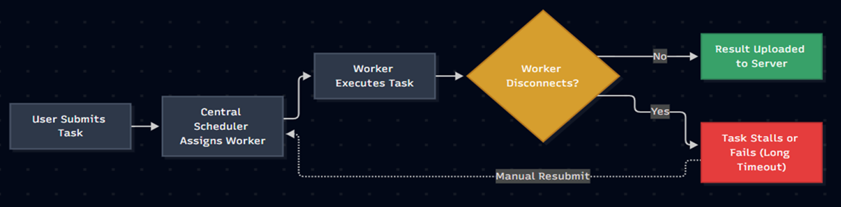
Existing Methodology/ Model
Bhujbal Knowledge City
Institute of Engineering
BOINC / Folding@home : Uses client-polling for batch jobs; lacks modern container sandboxing and instant task queues
KubeEdge / MicroK8s : Deploys containers to edge hardware, but the control plane consumes too much RAM (1GB+)
Celery / Ray : Fast task queues for data centers, but crashes when volunteer machines drop offline

Slide 8
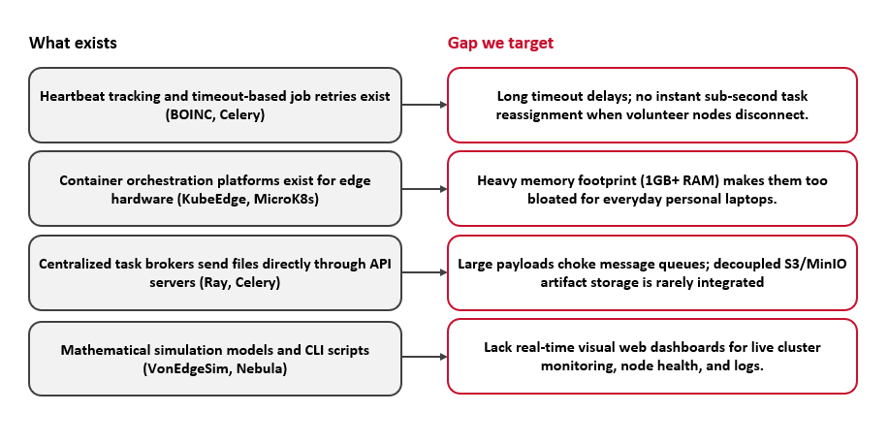
Identified Research Gap
Bhujbal Knowledge City
Institute of Engineering

Slide 9
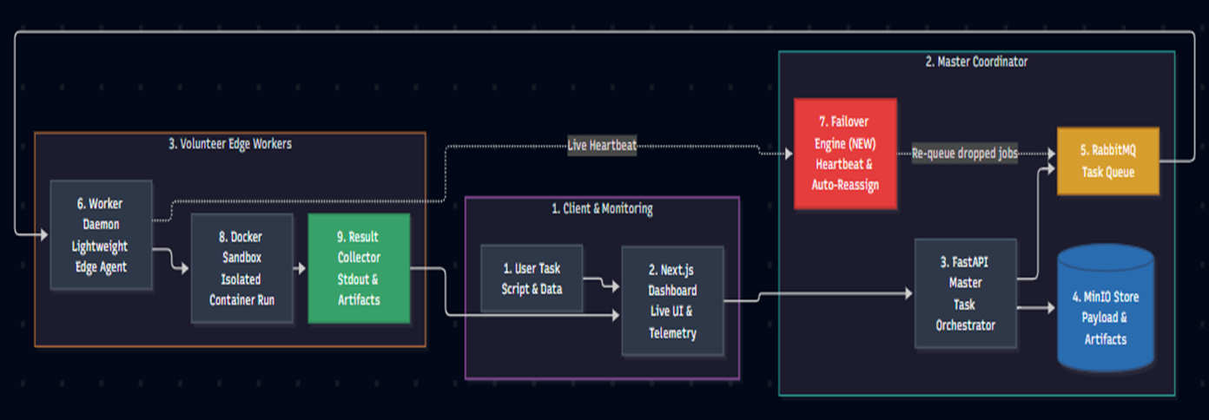
Proposed System
Bhujbal Knowledge City
Institute of Engineering

Slide 10
Methodology of Evaluation
Bhujbal Knowledge City
Institute of Engineering
Evaluation Area | Details
1. Experimental Testbed | Heterogeneous volunteer nodes (Intel i5/i7, AMD Ryzen, 8GB–16GB RAM) connected over local and wide-area networks.
2. Workload Types | Synthetic CPU stress tests + real-world data pipelines packaged into standard Docker containers.
3. Measured Metrics | • Latency: Time from submission to result. • Throughput: Jobs/minute under load. • Fault Recovery: Seconds to reassign a dropped job. • Overhead: <50MB RAM consumed on volunteer PCs
4. Success Criteria | Near-linear speedup as nodes are added, and 100% task recovery when workers abruptly disconnect.

Slide 11
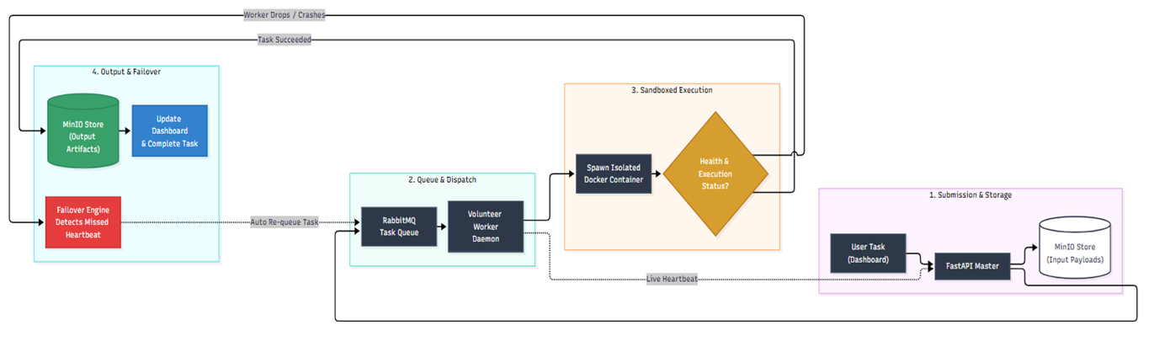
Process Flow
Bhujbal Knowledge City
Institute of Engineering

Slide 12
Use of Algorithm, Technical Concept
Bhujbal Knowledge City
Institute of Engineering
1. Dynamic Capacity-Aware Task Scheduling
    Capacity-Aware Weighted Dispatch: Uses priority queues to assign tasks based on live worker CPU cores, available RAM, and queue load.
    Active-Push Model: Master actively dispatches tasks to matched workers, replacing slow polling loops with sub-second response times.
2. Sliding-Window Heartbeat Leasing & Failover
Sliding-Window Leases: Redis TTL tracks worker pings (5s interval); automatically marks nodes OFFLINE after 15 seconds of silence.
Zero-Loss Reassignment: Incomplete tasks on disconnected workers are automatically re-injected into RabbitMQ with high priority.
3. Decoupled Control & Data Plane
Lightweight AMQP Messaging: RabbitMQ exclusively routes small JSON metadata (<2 KB) to prevent message broker congestion.
Direct Object Storage: Heavy input datasets and output artifacts stream directly via MinIO S3 storage, bypassing coordinator bottlenecks.
4. Container Sandboxing & Cgroups v2 Governance
Kernel Namespaces: Docker isolates execution environments (PID, Mount, Network, IPC) to block untrusted access to host OS.
Cgroups v2 Ceilings: Enforces hard CPU quotas (--cpus) and memory limits (--memory) ensuring worker tasks cannot freeze host PCs.

Slide 13
Hardware/Software Requirement
Bhujbal Knowledge City
Institute of Engineering
Hardware Requirements
Master Node: Quad-Core CPU (Intel i5 / Ryzen 5+), 8 GB RAM, 20 GB SSD, Gigabit LAN/Wi-Fi
Worker Nodes: Dual-Core 64-bit CPU, 4 GB RAM (min 1 GB free for daemon), 10 GB Storage
Network Infrastructure: Local Network or Internet (Open Ports: 8000, 5672, 6379, 9000)
Software Requirements & Tech Stack
Core Frameworks: Python 3.11+ (FastAPI Backend), Next.js 14 (Web Dashboard)
Container Sandboxing: Docker Engine 24+, Docker Compose v2
Message Broker: RabbitMQ 3.12+ (AMQP Task Queue with Publisher Confirms)
In-Memory Cache: Redis 7+ (Worker Heartbeats & Sliding Leases)
Storage & Database: MinIO (S3 Object Storage), MongoDB 6+ (Job Metadata)
Supported Operating Systems: Windows 10/11, Ubuntu Linux 20.04+, macOS 12+

Slide 14
Software Requirement & Specification (SRS)
Bhujbal Knowledge City
Institute of Engineering
1. Functional Requirements
        Task Submission: Web dashboard enables users to submit containerized jobs with CPU/RAM quotas and datasets.
        Capacity-Aware Dispatch: Master schedules tasks to volunteer nodes matched by available CPU cores and free RAM.
        Sandboxed Container Run: Worker daemon spawns isolated Docker containers with hard cgroup ceilings.
        Heartbeat Monitoring & Failover: Redis leases track worker health (15s TTL); unacknowledged tasks auto-requeue.
        Storage & Telemetry: Real-time execution logs stream to UI; output artifacts are saved in MinIO S3 storage.
2. Non-Functional Requirements
Performance & Responsiveness: Sub-second job scheduling with lightweight worker daemon (<50 MB RAM).
Fault Tolerance & Reliability: 100% at-least-once task execution guarantee; automated recovery on worker disconnects.
Security & Sandboxed Privacy: Strict process containment via Docker kernel namespaces blocks access to host OS.
Portability & Scalability: Standard OCI container images; cluster easily scales across 1 to 50+ volunteer machines.

Slide 15
Risk Analysis
Bhujbal Knowledge City
Institute of Engineering
1. Technical Risk (Node Churn & Network Failures)
Risk: Volunteer worker machines disconnect, sleep, or crash mid-task, risking stalled jobs or data loss.
Mitigation: Sliding-window Redis heartbeats detect drops within 15 seconds; RabbitMQ re-queues tasks automatically to healthy nodes.
2. Operational Risk (Host Security & Resource Exhaustion)
Risk: Untrusted client code could attempt unauthorized filesystem access or consume all host CPU and RAM.
Mitigation: Strict Docker container sandboxing isolates execution; Linux cgroups enforce hard ceilings on memory and CPU quotas.
3. Schedule Risk (Multi-Service Integration Complexity)
Risk: Coordinating multiple services (FastAPI, RabbitMQ, Redis, MinIO, Docker) could cause development and testing delays.
Mitigation: Modular microservice architecture decoupled via standard REST/AMQP protocols and automated using Docker Compose.
4. Business / Adoption Risk (Low Volunteer Node Retention)
Risk: Volunteers may uninstall the client if background computing degrades their daily laptop performance.
Mitigation: Ultra-lightweight daemon agent (<50 MB RAM footprint) that executes strictly within capped resource boundaries.

Slide 16
Project Achievable (Time, Cost & Budget Feasibility)
Bhujbal Knowledge City
Institute of Engineering
1. Time Feasibility (Academic Schedule)
Phase I (Weeks 1–12): System architecture design, FastAPI master coordinator, RabbitMQ task queue, and basic Docker worker agent.
Phase II (Weeks 13–24): Redis heartbeat failover engine, MinIO decoupled storage, Next.js telemetry dashboard, and cluster benchmarking.
2. Cost & Budget Feasibility (Zero Financial Overhead)
100% Open-Source Stack: Built entirely using free and open-source tools (Python, FastAPI, RabbitMQ, Redis, Docker, Next.js, MinIO, and MongoDB).
Zero Infrastructure Cost: Leverages existing personal laptops and desktop PCs as volunteer worker nodes, eliminating the need for paid cloud server rentals (AWS / GCP / Azure).
3. Technical & Resource Feasibility
Hardware Availability: Standard consumer laptops provide sufficient CPU and RAM to develop, containerize, and test the distributed network locally.
Reproducible Environments: Docker Compose automates multi-container orchestration, ensuring identical setups across all team members with zero configuration mismatch

Slide 17
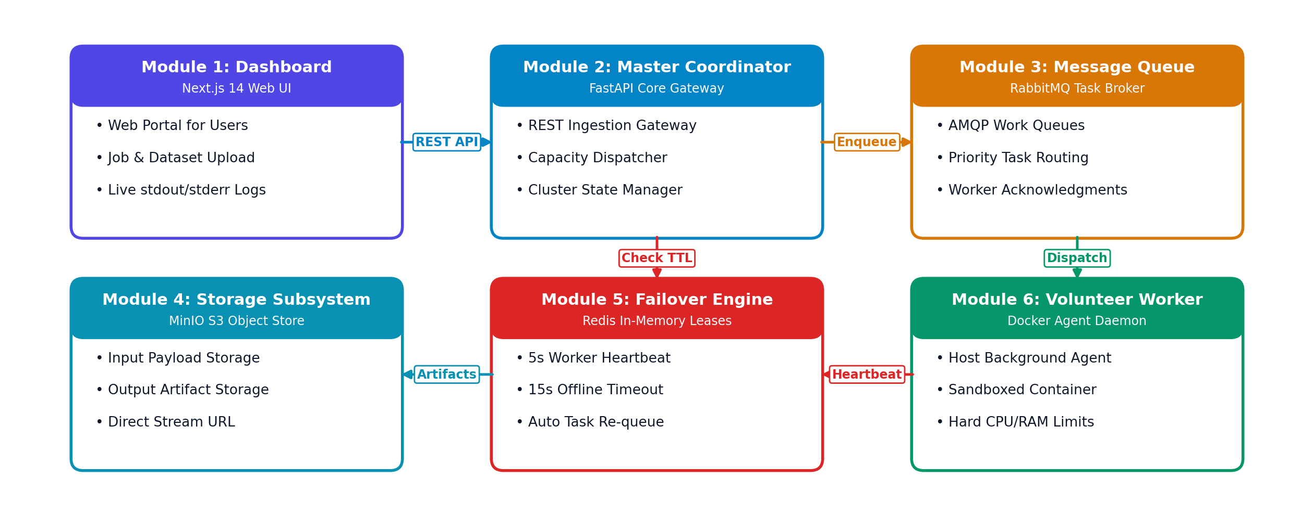
Project Modules
Bhujbal Knowledge City
Institute of Engineering

Slide 18
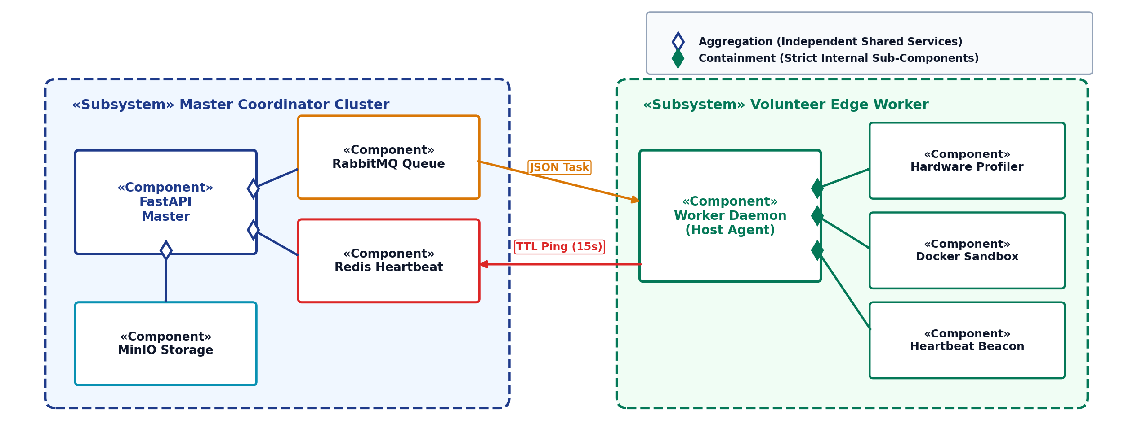
UML Component Diagram (Aggregation & Containment)
Bhujbal Knowledge City
Institute of Engineering

Slide 19
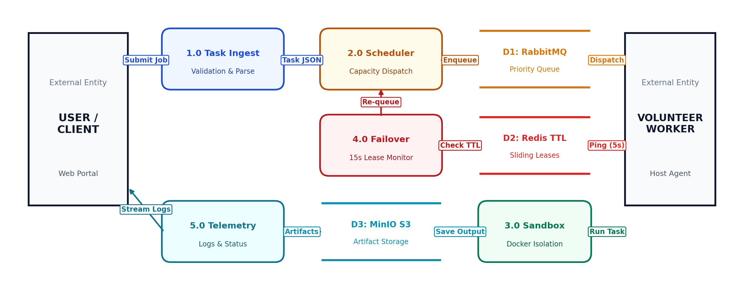
Data Flow Diagram (DFD Level 0 & Level 1)
Bhujbal Knowledge City
Institute of Engineering

Slide 20
Expected Outcome
Bhujbal Knowledge City
Institute of Engineering
1. Functional Distributed Compute Platform
• Working end-to-end grid connecting FastAPI master orchestrator with heterogeneous volunteer edge machines.
• Enables seamless submission, queueing, and containerized execution of computational tasks on demand.
2. Zero-Loss Fault Tolerance & Auto-Failover
• Real-time Redis heartbeat tracking that identifies disconnected worker nodes within a 15-second window.
• Guarantees 100% task recovery by re-queuing unfinished jobs into RabbitMQ for reassignment to healthy nodes.
3. Secure Sandboxed Execution Environment
• Robust Docker virtualization enforcing strict CPU quotas and memory ceilings via Linux cgroups v2.
• Protects volunteer host machines by blocking untrusted scripts from accessing host storage, networks, or credentials.
4. Real-Time Telemetry & Cluster Dashboard
• Responsive Next.js web application displaying live cluster health, active worker nodes, and task queue metrics.
• Live streaming of execution logs (stdout/stderr) and one-click artifact downloads directly from MinIO object storage.
5. Measurable Speedup at Zero Cloud Cost
• Demonstrated parallel compute speedup over a standalone single computer when running heavy data tasks.
• Unlocks on-demand cluster compute capability for students and independent developers at $0 cloud rental costs.

Slide 21
References
Bhujbal Knowledge City
Institute of Engineering
[1] D. P. Anderson, "Globally Scheduling Volunteer Computing," Future Internet, vol. 13, no. 9, art. no. 229, Sep. 2021.
[2] A. Pandey, P. Calyam, S. Debroy, S. Wang, and M. L. Alarcon, "VECTrust: Trusted Resource Allocation in Volunteer Edge Clouds," in Proc. 2021 IEEE/ACM 14th International Conference on Utility and Cloud Computing (UCC), 2021.
[3] Z. Á. Mann, "Decentralized Application Placement in Fog Computing," IEEE Transactions on Parallel and Distributed Systems (TPDS), vol. 33, no. 11, pp. 3176–3189, Nov. 2022.
[4] Z. Tang, F. Mou, J. Lou, and W. Zhao, "Joint Resource Overbooking and Container Scheduling in Edge Computing," IEEE Transactions on Mobile Computing (TMC), vol. 23, no. 12, pp. 10903–10917, Dec. 2024.
[5] Y. Xiong, Y. Sun, L. Xing, and Y. Huang, "Extend Cloud to Edge with KubeEdge," in Proc. 2018 IEEE/ACM Symposium on Edge Computing (SEC), Seattle, WA, USA, 2018.
[6] D. P. Anderson, "BOINC: A System for Public-Resource Computing and Storage," in Proc. 5th IEEE/ACM International Workshop on Grid Computing (GRID), Pittsburgh, PA, USA, 2004.

Slide 22

Bhujbal Knowledge City
Institute of Engineering

