Slide 1



Project Stage – I (417527)
Bhujbal Knowledge City
Institute of Engineering
Semester-I, A.Y.-2026-27
Project Presentation For Evaluation –III
Daemon-Based Distributed Compute Grid: A Framework for Scheduling and Executing Tasks Across Heterogeneous Nodes
:: Presented By ::
:: Under the Guidance of ::
Gaurav Vibhandik
Nishant Chaugule
Vrushali Chaudhari
Prof . Sonali Jadhav
:: Domain ::

Slide 2
Contents
Bhujbal Knowledge City
Institute of Engineering
1.Abstract
2.Problem Statement
3.Objectives(Product, process, resources etc)
4.Literature survey
5.Existing Methodology/ Model
6.Identified Research Gap
7.Proposed System
8.Methodology of Evaluation
9.Process Flow
10.Use of Algorithm, Technical Concept
11.Relevant mathematical model associated with the project
12.Hardware/Software Requirement
13 Software Requirement & Specification (SRS)
14.Risk Analysis(technical risks, Operational risks, schedule risks, business risks )
15.Project achievable in specified(Time, Cost Budget)?
16.Project Modules
17.structural diagrams (class, Object, etc)(use Proper Associations in Diagrams)
18.UML Diagrams(use aggregation/ containment )
19.DFD Diagram
20. Expected Outcomes
21.References

Slide 3
Abstract
Bhujbal Knowledge City
Institute of Engineering
Renting cloud servers is very expensive for running heavy computing tasks, while millions of personal computers sit idle. This project proposes DaeMon, a distributed computing platform that connects everyday computers into a shared network to run tasks using FastAPI, RabbitMQ, and Docker. Our main contribution is an automatic task coordinator: it sends jobs to available workers, checks their health in real time, and safely reassigns tasks if any worker goes offline. We test the system by measuring task execution time, recovery speed when workers disconnect, and performance under heavy workloads.
Keywords: Distributed Computing, Worker Nodes, Task Scheduling, Docker, Fault Tolerance

Slide 4
Problem Statement
Bhujbal Knowledge City
Institute of Engineering
Cloud computing is expensive: Renting servers from AWS or GCP is unaffordable for small teams, researchers, and students.
Unused compute power: Millions of consumer laptops and desktop GPUs sit completely idle throughout the day.
Worker nodes are unreliable: Volunteer personal computers can disconnect, crash, or go offline mid-task without warning.
Security risks: Running user code on personal machines requires strict isolation to protect hosts from untrusted execution.

Slide 5
Objectives
Bhujbal Knowledge City
Institute of Engineering
Product: A working distributed compute platform that connects volunteer machines to execute containerized tasks on demand.
Process: Implement an active task queue with live heartbeat tracking that reassigns jobs instantly if workers fail.
Evaluation: Measure task completion speed, worker recovery time during disconnects, and cluster throughput under load.
Resources: Python (FastAPI), Docker, RabbitMQ, Redis, MinIO, Next.js, MongoDB, GitHub.

Slide 6
Literature survey
Bhujbal Knowledge City
Institute of Engineering
Sr No | Title | Author | Publication & Year | Summary | Findings | Remarks
1 | Globally Scheduling Volunteer Computing | David P. Anderson | Future Internet 2021 | Proposes modern scheduling algorithms to distribute heavy jobs across unpredictable volunteer computers worldwide. | Dynamic deadline estimation and job matching improve task success rates across erratic consumer PCs. | Uses legacy BOINC middleware; lacks modern containerization and web queues
2 | Decentralized Application Placement in Fog | Zoltán Ádám Mann | IEEE TPDS 2022 | Schedules tasks across distributed edge nodes to prevent network bottlenecks and single-point failures. | Decentralized dispatching reduces coordination delay and scales efficiently across large network topologies. | Lacks an end-to-end web platform
3 | Container Scheduling in Edge Computing | Zhiqing Tang, Fangyi Mou | IEEE TMC 2024 | Optimizes Docker container deployment and dynamic memory sharing across resource-constrained edge | Intelligent container overbooking boosts edge throughput by 34% without causing system crashes. | Does not handle sudden worker disconnects.

Slide 7
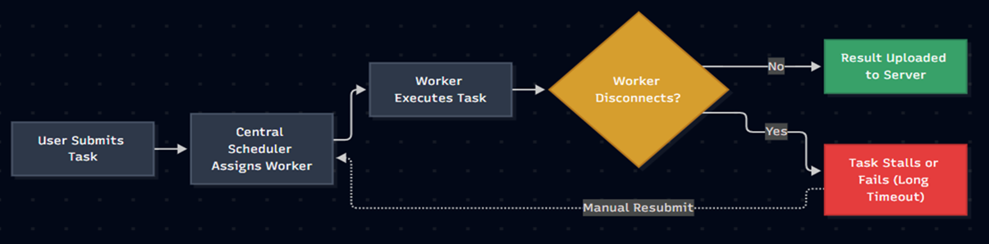
Existing Methodology/ Model
Bhujbal Knowledge City
Institute of Engineering
BOINC / Folding@home : Uses client-polling for batch jobs; lacks modern container sandboxing and instant task queues
KubeEdge / MicroK8s : Deploys containers to edge hardware, but the control plane consumes too much RAM (1GB+)
Celery / Ray : Fast task queues for data centers, but crashes when volunteer machines drop offline

Slide 8
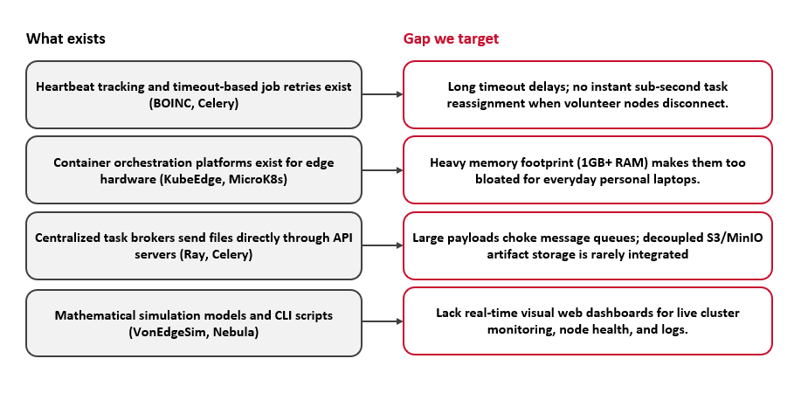
Identified Research Gap
Bhujbal Knowledge City
Institute of Engineering

Slide 9
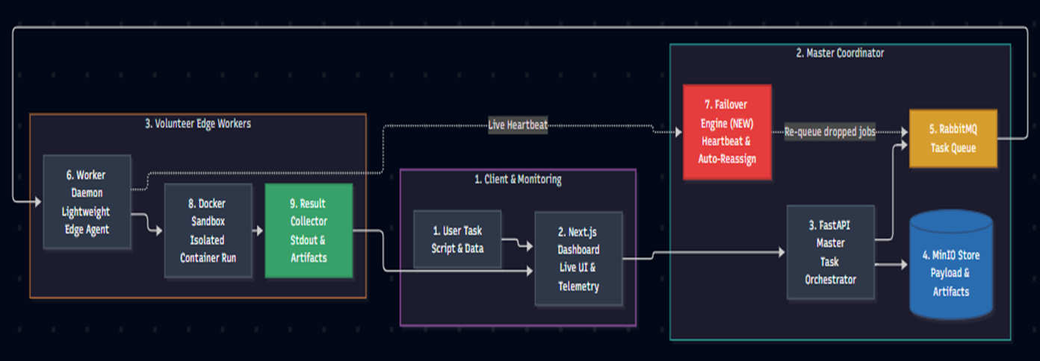
Proposed System
Bhujbal Knowledge City
Institute of Engineering

Slide 10
Methodology of Evaluation
Bhujbal Knowledge City
Institute of Engineering
Evaluation Area | Details
1. Experimental Testbed | Heterogeneous volunteer nodes (Intel i5/i7, AMD Ryzen, 8GB–16GB RAM) connected over local and wide-area networks.
2. Workload Types | Synthetic CPU stress tests + real-world data pipelines packaged into standard Docker containers.
3. Measured Metrics | • Latency: Time from submission to result. • Throughput: Jobs/minute under load. • Fault Recovery: Seconds to reassign a dropped job. • Overhead: <50MB RAM consumed on volunteer PCs
4. Success Criteria | Near-linear speedup as nodes are added, and 100% task recovery when workers abruptly disconnect.

Slide 11
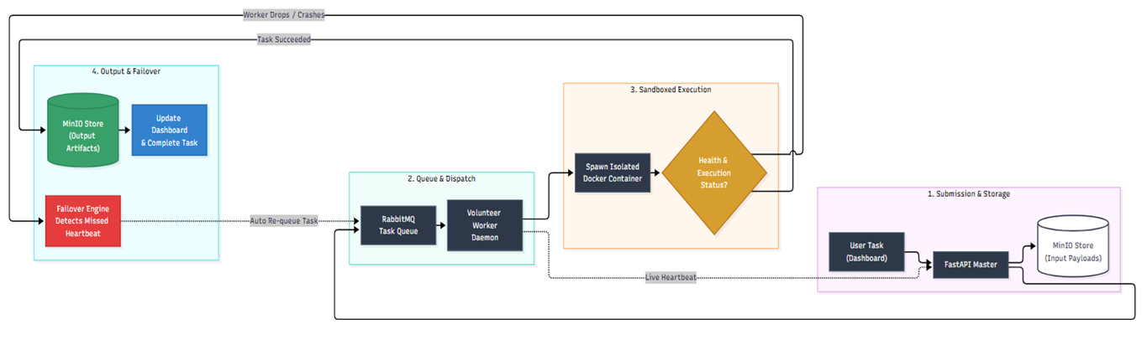
Process Flow
Bhujbal Knowledge City
Institute of Engineering

Slide 12
Use of Algorithm, Technical Concept
Bhujbal Knowledge City
Institute of Engineering
Dynamic Task Scheduling
Capacity-Aware Dispatch: Uses Weighted Priority Queues to assign tasks based on live worker CPU cores, available RAM, and queue load.
Active-Push Model: Replaces slow polling loops with instant orchestrator push, achieving sub-second job dispatching.
Heartbeat Leasing & Failover
Sliding-Window Leases: Redis TTL tracks worker pings ; marks nodes OFFLINE after 15 seconds of silence.
Zero-Loss Reassignment: Incomplete tasks on disconnected workers are automatically re-injected into RabbitMQ with high priority.
Decoupled Control & Data Plane
Lightweight Message Queue: RabbitMQ exclusively routes small JSON metadata (Job IDs, storage pointers) to prevent queue bloat.
Container Sandboxing & Isolation
Kernel Namespaces: Docker isolates execution environments (PID, Mount, Network) to block access to the host operating system.
Cgroups v2 Governance: Enforces hard CPU quotas (--cpus) and memory ceilings (--memory) so worker tasks cannot freeze host PCs.

Slide 13
Relevant mathematical model associated with the project
Bhujbal Knowledge City
Institute of Engineering

Slide 14
Hardware/Software Requirement
Bhujbal Knowledge City
Institute of Engineering
1. Functional Requirements
Task Submission: Users can upload execution scripts, dependencies, and input datasets via the web dashboard.
Smart Scheduling: Automatically queues tasks and dispatches them to available volunteer workers.
Sandboxed Execution: Executes code inside isolated Docker containers with capped CPU and RAM limits.
Auto-Recovery: Detects disconnected workers using live heartbeats and instantly reassigns their tasks.
Results & Logs: Stores output files in MinIO and streams real-time execution logs back to the user.
2. Non-Functional Requirements
Performance: Sub-second task dispatch latency with a lightweight worker agent (<50 MB RAM).
Fault Tolerance: 100% task recovery guarantee if a worker machine suddenly crashes or goes offline.
Security: Complete container isolation to protect volunteer PCs from untrusted or malicious code.
Scalability: Easily scales across 1 to 50+ volunteer machines without modifying coordinator logic.

Slide 15
Software Requirement & Specification (SRS)
Bhujbal Knowledge City
Institute of Engineering
Backend Framework: Python 3.11+ with FastAPI
Message Broker: RabbitMQ
Execution & Sandboxing: Docker Engine
In-Memory Cache & Heartbeats: Redis
Storage Systems: MinIO (S3-compatible object storage ) & MongoDB ( for Metadata )
Operating Systems Supported: Windows 10/11, Ubuntu/Debian Linux, and macOS.

Slide 16
Risk Analysis
Bhujbal Knowledge City
Institute of Engineering
1. Technical Risk (Node Churn & Network Failures)
Risk: Volunteer worker machines disconnect, sleep, or crash mid-task, risking stalled jobs or data loss.
Mitigation: Sliding-window Redis heartbeats detect drops within 15 seconds; RabbitMQ re-queues tasks automatically to healthy nodes.
2. Operational Risk (Host Security & Resource Exhaustion)
Risk: Untrusted client code could attempt unauthorized filesystem access or consume all host CPU and RAM.
Mitigation: Strict Docker container sandboxing isolates execution; Linux cgroups enforce hard ceilings on memory and CPU quotas.
3. Schedule Risk (Multi-Service Integration Complexity)
Risk: Coordinating multiple services (FastAPI, RabbitMQ, Redis, MinIO, Docker) could cause development and testing delays.
Mitigation: Modular microservice architecture decoupled via standard REST/AMQP protocols and automated using Docker Compose.
4. Business / Adoption Risk (Low Volunteer Node Retention)
Risk: Volunteers may uninstall the client if background computing degrades their daily laptop performance.
Mitigation: Ultra-lightweight daemon agent (<50 MB RAM footprint) that executes strictly within capped resource boundaries.

Slide 17
Project achievable
Bhujbal Knowledge City
Institute of Engineering
1. Time Feasibility (Academic Schedule)
Phase I (Weeks 1–12): System architecture design, FastAPI master coordinator, RabbitMQ task queue, and basic Docker worker agent.
Phase II (Weeks 13–24): Redis heartbeat failover engine, MinIO decoupled storage, Next.js telemetry dashboard, and cluster benchmarking.
2. Cost & Budget Feasibility (Zero Financial Overhead)
100% Open-Source Stack: Built entirely using free and open-source tools (Python, FastAPI, RabbitMQ, Redis, Docker, Next.js, MinIO, and MongoDB).
Zero Infrastructure Cost: Leverages existing personal laptops and desktop PCs as volunteer worker nodes, eliminating the need for paid cloud server rentals (AWS / GCP / Azure).
3. Technical & Resource Feasibility
Hardware Availability: Standard consumer laptops provide sufficient CPU and RAM to develop, containerize, and test the distributed network locally.
Reproducible Environments: Docker Compose automates multi-container orchestration, ensuring identical setups across all team members with zero configuration mismatch

Slide 18
Project Modules
Bhujbal Knowledge City
Institute of Engineering

Slide 19
structural diagrams
Bhujbal Knowledge City
Institute of Engineering
(class, Object, etc)(use Proper Associations in Diagrams)

Slide 20
UML Diagrams
Bhujbal Knowledge City
Institute of Engineering
(use aggregation/ containment )

Slide 21
DFD Diagram
Bhujbal Knowledge City
Institute of Engineering

Slide 22
Expected Outcome
Bhujbal Knowledge City
Institute of Engineering
1. Functional Distributed Compute Platform
A fully working end-to-end grid connecting a centralized FastAPI master orchestrator with multiple heterogeneous volunteer edge machines.
Enables seamless submission, queueing, and execution of containerized computational jobs on demand.
2. Zero-Loss Fault Tolerance & Auto-Failover
Real-time Redis heartbeat tracking that automatically identifies disconnected worker nodes within a 15-second window.
Guarantees 100% task recovery by re-queuing unfinished jobs into RabbitMQ for reassignment to healthy nodes without progress loss.
3. Secure Sandboxed Execution Environment
Robust Docker virtualization enforcing strict CPU quotas and memory ceilings via Linux cgroups v2.
Protects volunteer host machines by blocking untrusted scripts from accessing host storage, local networks, or private credentials.
4. Real-Time Telemetry & Cluster Dashboard
A responsive Next.js web application displaying live cluster health, active worker nodes, and task queue metrics.
Live streaming of execution logs (stdout/stderr) and one-click artifact downloads directly from MinIO object storage.
5. Measurable Speedup at Zero Cloud Cost
Demonstrated parallel compute speedup over a standalone single computer when running heavy data tasks.
Unlocks on-demand cluster compute capability for students and independent developers at $0 cloud rental costs.

Slide 23
References
Bhujbal Knowledge City
Institute of Engineering
[1] Chen, Y., & Bellavitis, C. (2020). "Blockchain disruption and decentralized finance: The rise of decentralized business models." Journal of Business Venturing Insights, 13, e00151.
[2] Schär, F. (2021). "Decentralized Finance: On Blockchain- and Smart Contract-based Financial Markets." Federal Reserve Bank of St. Louis Review, 103(2), 153-174.
[3] Zetzsche, D., Buckley, R. P., Arner, D. W., & Föhr, L. (2020). "Decentralized Finance." Journal of Financial Regulation, 6(2), 172-203​(ssrn-4016497)

Slide 24

Bhujbal Knowledge City
Institute of Engineering

