Slide 1
WELCOME
Online Quiz Web App

Slide 2

Online Quiz

Slide 3
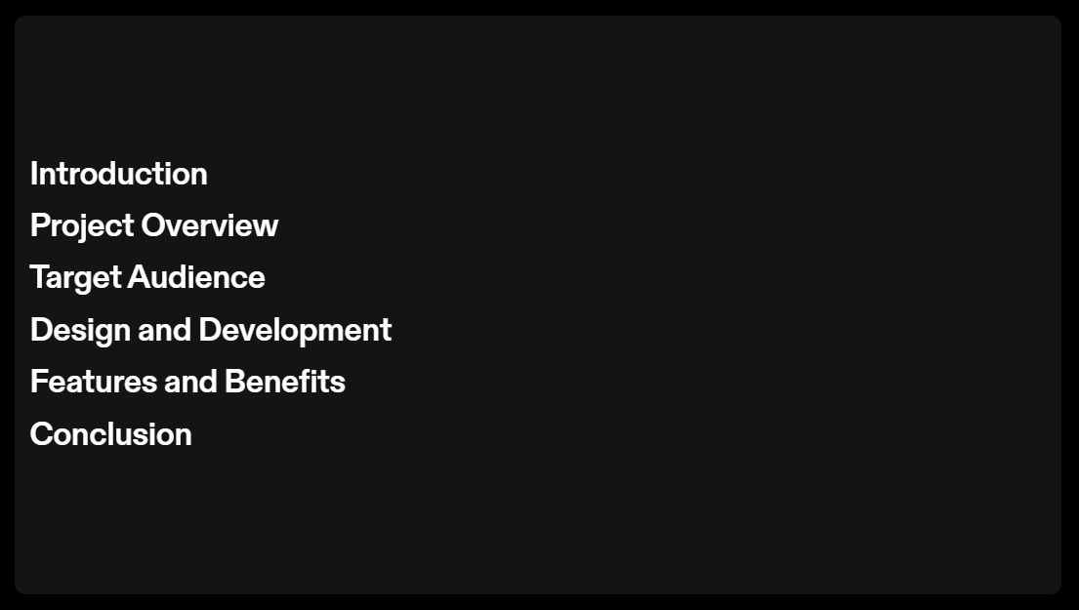
INDEX

Slide 4
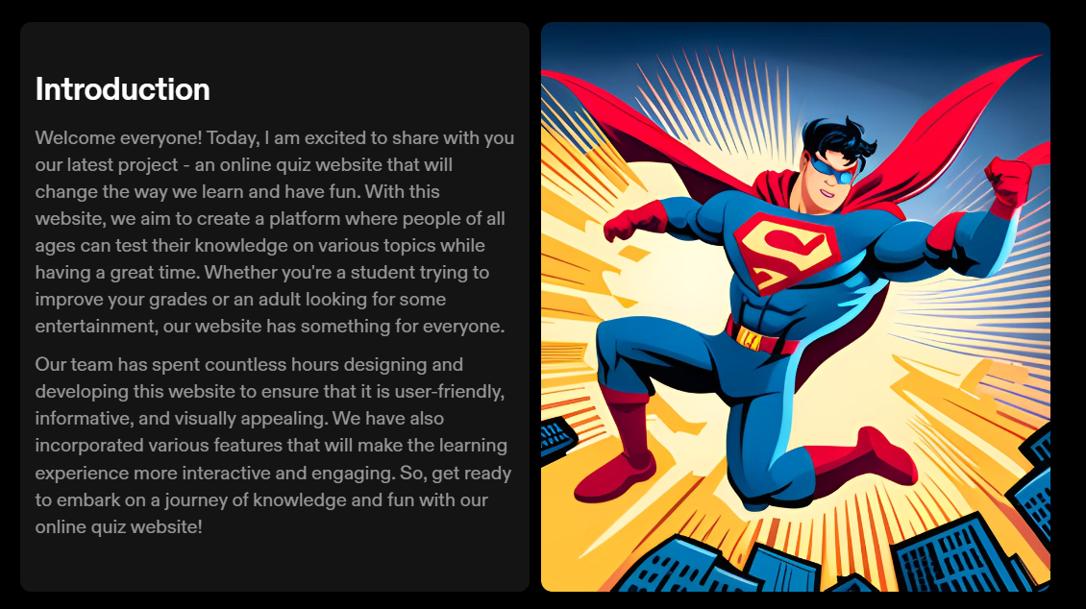
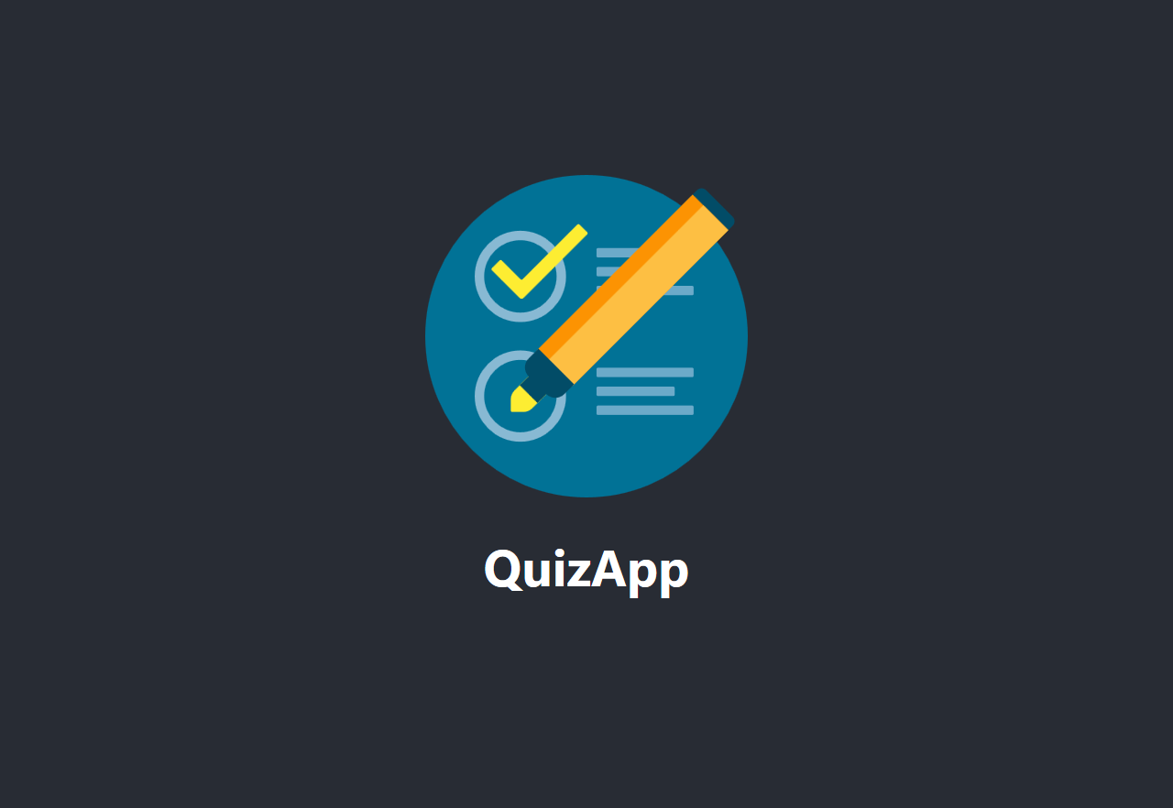
Introduction

Slide 5
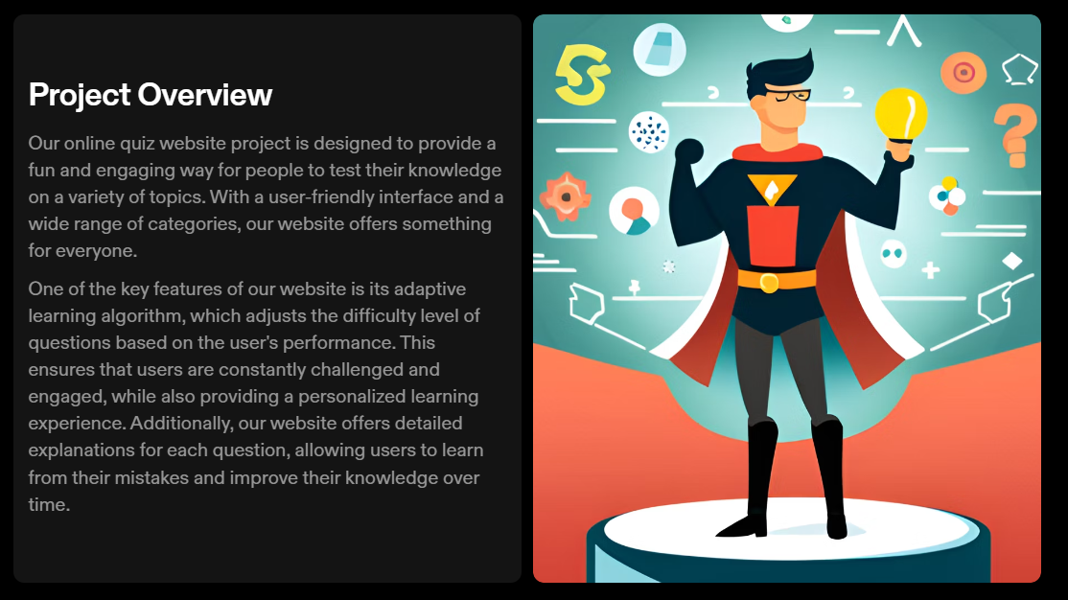
Project overview

Slide 6
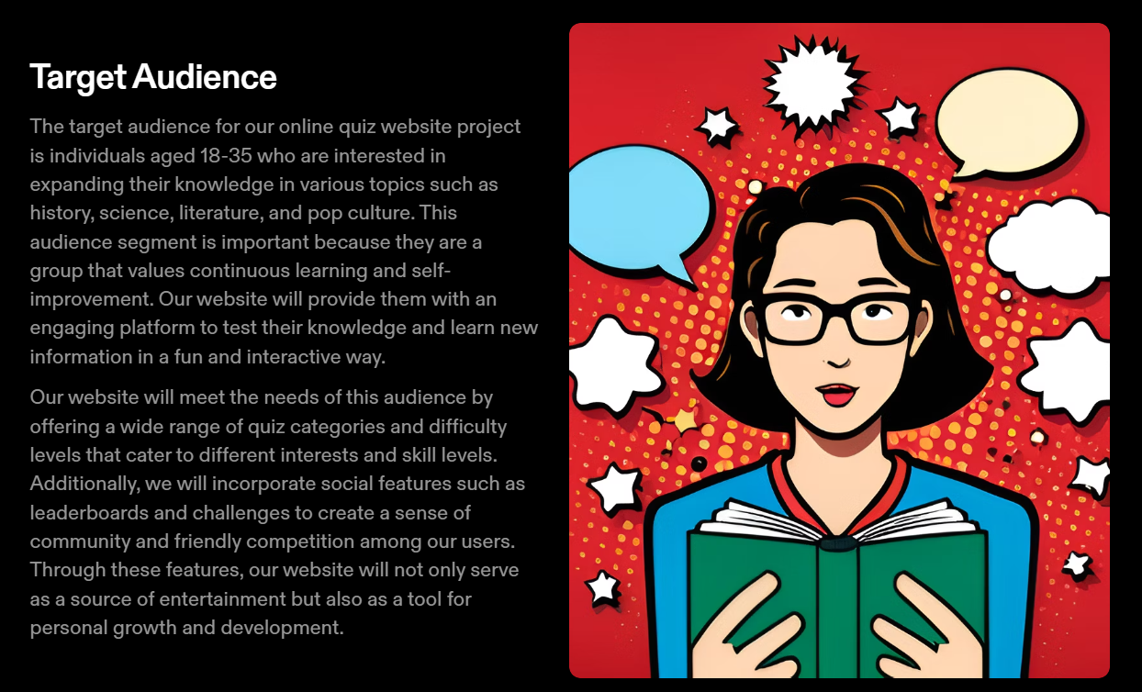
Target Audience

Slide 7
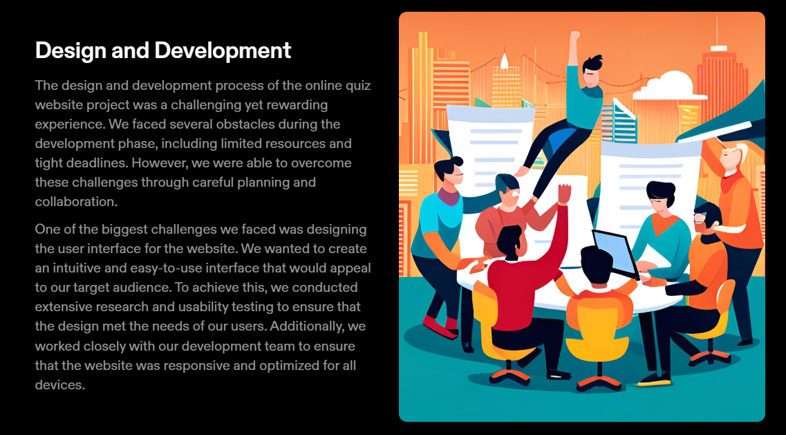
Planning

Slide 8
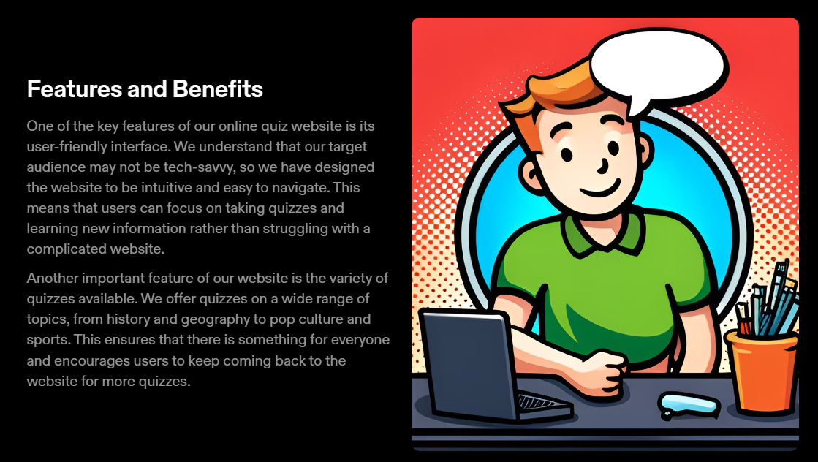
Features & benefits

Slide 9
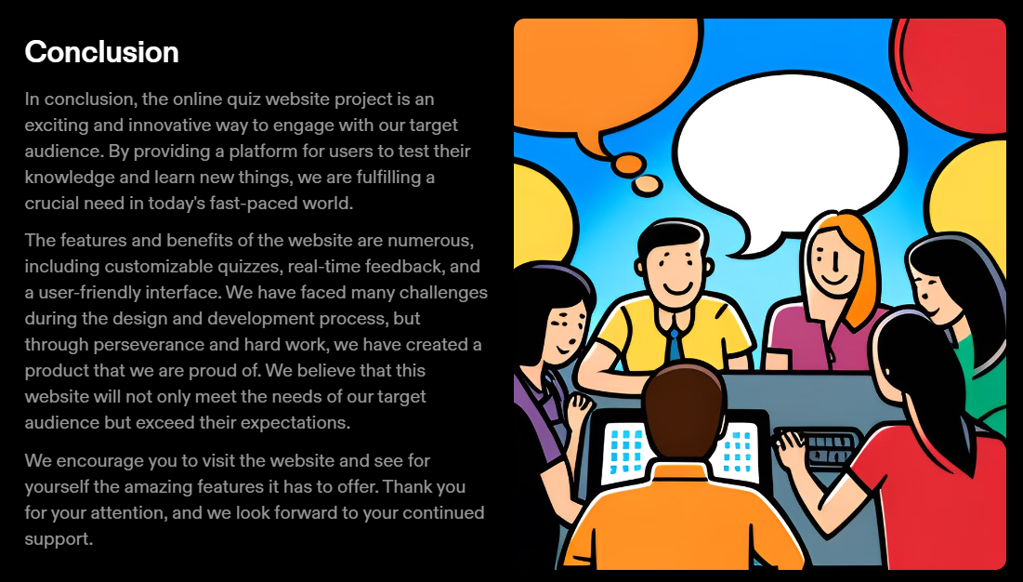
conclusion

Slide 10
Thank you

