Slide 1
Coffee fountain project

Slide 2
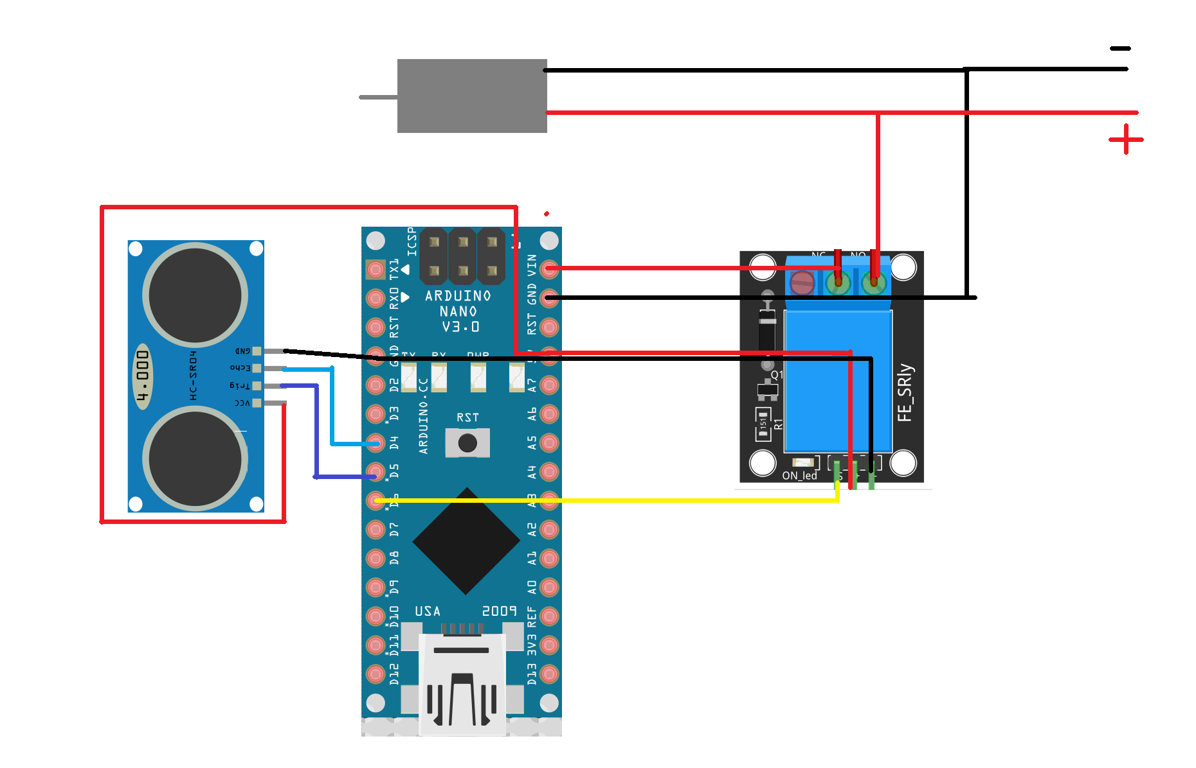
Circuit components:
Ultrasonic sensor
Battery holder
Relay module
Arduino nano
Air pump

Slide 4
3D design:

Slide 5
Git hub repository:

