Slide 1
Coffee fountain project

Slide 2
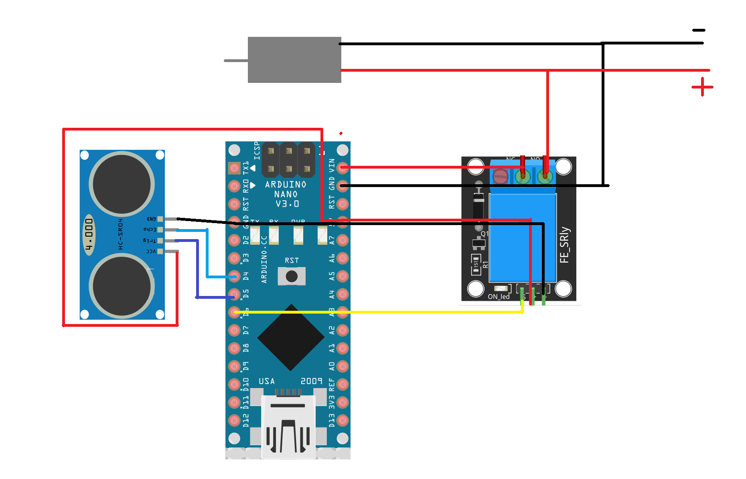
Circuit components:
Ultrasonic sensor
Battery holder
Relay module
Arduino nano
Air pump

Slide 3
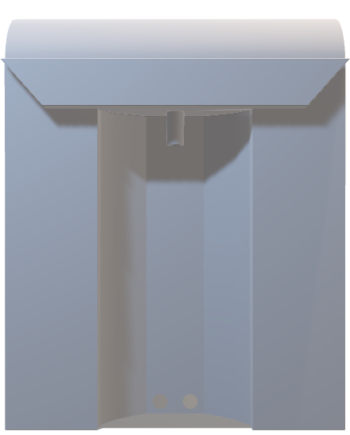
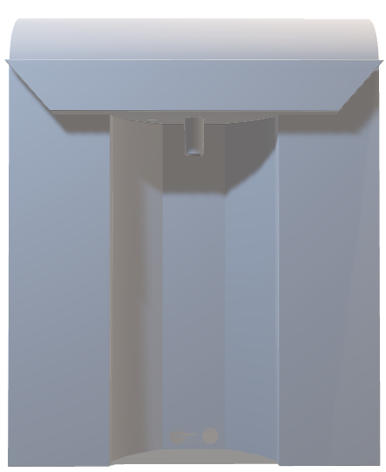
3D design:
INSIDE
OUTSIDE

Slide 4
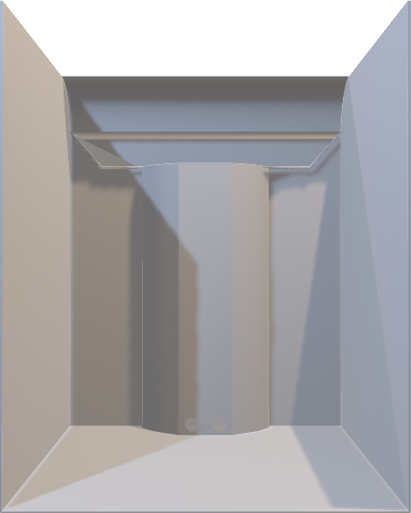

3D design:
INSIDE
OUTSIDE

Slide 5
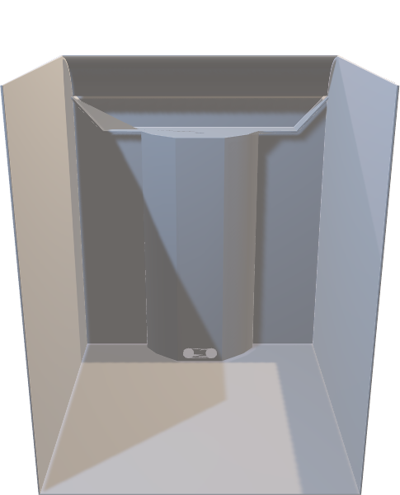
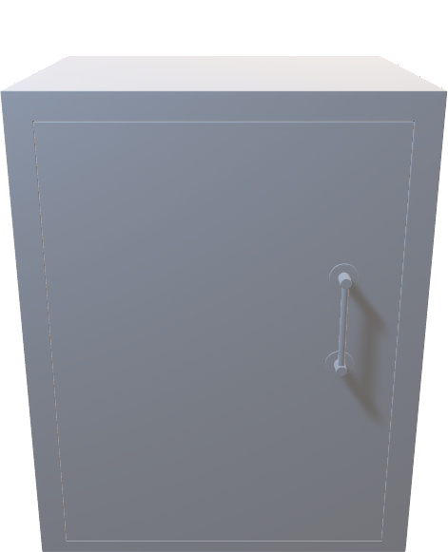
3D design:
INSIDE
OUTSIDE

