Slide 1
Loan Default Risk Analysis
and Prediction Using R
R DATA SCIENCE CASE STUDY · REVIEW-2 PRESENTATION
98.4%
PRESENTED BY
Gautam Raju
B.Tech Artificial Intelligence & Data Science
Chaitanya Bharathi Institute of Technology (CBIT)
Review-2 Presentation · 15 October 2026 · Academic Year 2026–27
A
B
C
D
E
F
G
DEFAULT RATE BY LOAN GRADE, A–G

Slide 2
Agenda
Review-2 focus: R implementation, statistical analysis, predictive modelling and evaluation.
01
Problem Statement & Objectives
02
Dataset & Preprocessing
03
Exploratory Data Analysis
04
Correlation & Statistical Tests
05
Modelling Methodology
06
Model Evaluation
07
Model Comparison & Feature Importance
09
LIME Explainability
10
Conclusion , Limitations & Future Work
Amber: completed and reported in this review · Blue: future work

Slide 3
Problem Statement & Objectives
01
Loan default creates financial risk for lenders; this project analyzes and predicts it using R.
01
COMPLETED
02
COMPLETED
03
COMPLETED
Analyze Borrower Factors
Analyze Loan Factors
Explore Default Patterns
Study income, age, employment and credit history.
Examine loan amount, interest rate and loan purpose.
Identify patterns associated with loan default.
04
COMPLETED
05
COMPLETED
06
COMPLETED
Statistical Analysis
Build Prediction Models
Evaluate Predictions
Determine important factors related to default.
Use Logistic Regression and Random Forest.
Compare models using suitable performance metrics.

Slide 4
Data Preparation
02
Kaggle Credit Risk Dataset · target loan_status: 0 = non-default, 1 = default
01
02
03
04
05
06
Original Dataset
Duplicate Removal
Unrealistic Value Handling
Categorical Conversion
Cleaned Dataset
Split & Imputation
32,581 rows × 12 variables
165 exact duplicate rows removed
ages above 100 and employment above 50 years removed
categorical variables converted to factors
32,409 rows × 12 variables
80:20 stratified split; training-median imputation
COMPLETED ✓
TRAIN / TEST SPLIT
80:20 SPLIT
165
32,409
25,928
6,481
duplicate rows removed
rows remaining
Training records
Testing records
Missing values in person_emp_length and loan_int_rate were imputed with training-set medians; none remain in either set.

Slide 5
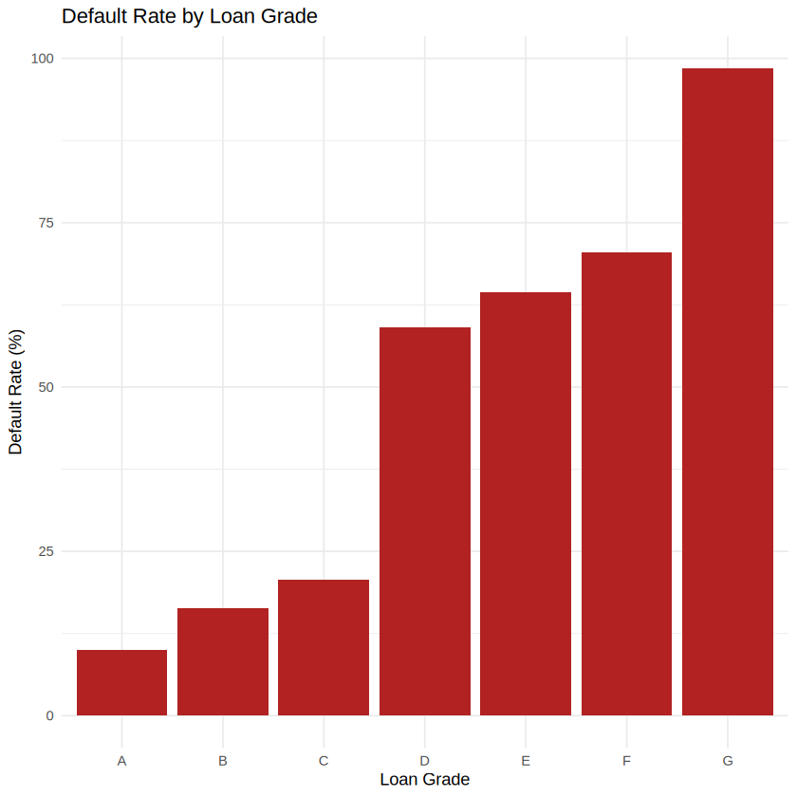
EDA: Default Status & Loan Grade
03
Observed patterns in the cleaned dataset (32,409 loans).
1. DISTRIBUTION OF LOAN DEFAULT STATUS
2. DEFAULT RATE (%) BY LOAN GRADE
Class balance: 7,088 default vs 25,321 non-default loans (21.87% default).
Loan grade: default rate rises from 9.96% (A) to 98.4% (G). Grade G has only 64 loans, so it is not representative of the wider data.

Slide 6
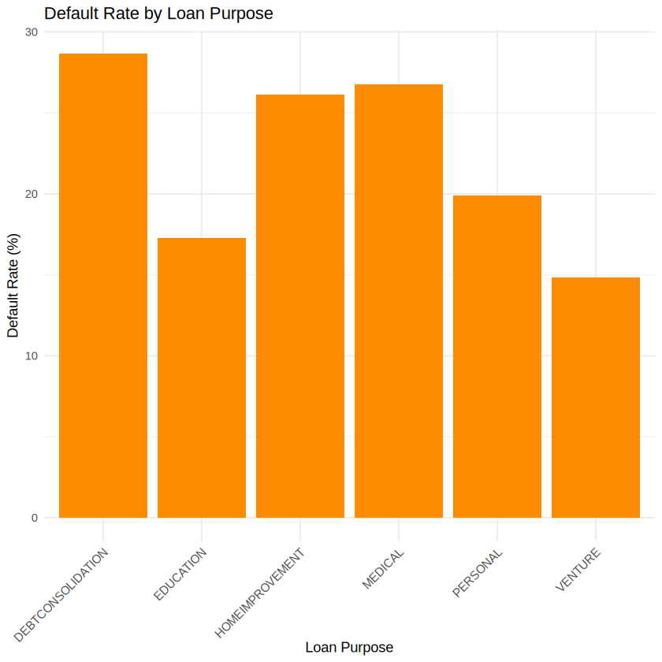
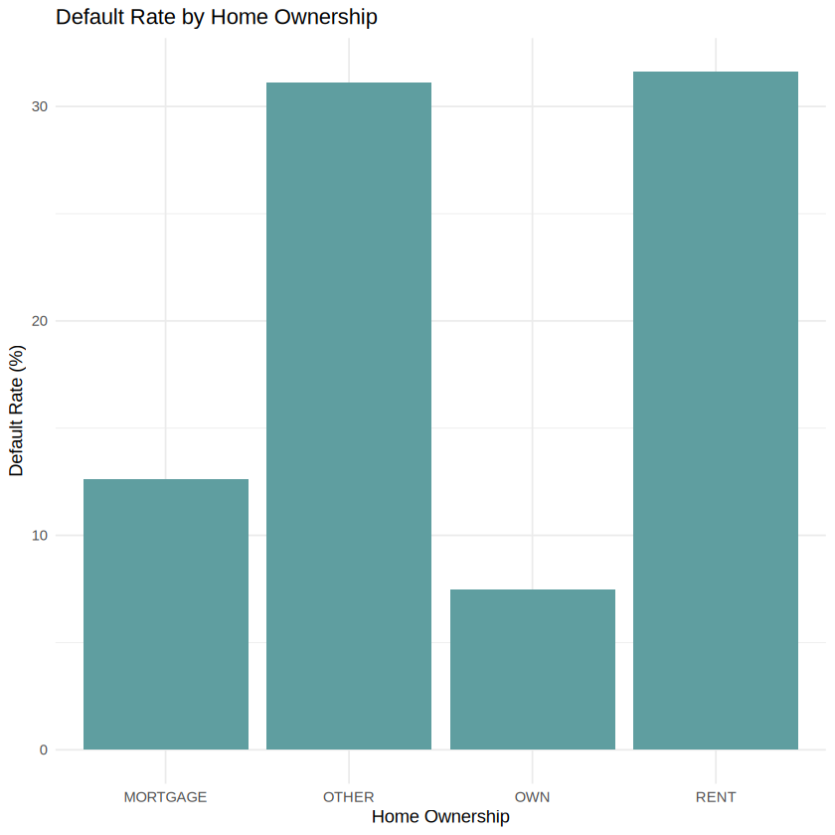
EDA: Loan Purpose & Home Ownership
03
Default rate (%) by category in the cleaned dataset (32,409 loans).
1. DEFAULT RATE (%) BY LOAN PURPOSE
2. DEFAULT RATE (%) BY HOME OWNERSHIP
Loan purpose: highest observed rate is debt consolidation (28.7%) and lowest is venture (14.9%); medical (26.8%) and home improvement (26.2%) are also high.
Home ownership: rent (31.6%) and other (31.1%) show higher default rates than mortgage (12.6%) and own (7.49%). “Other” has only 106 loans.

Slide 7
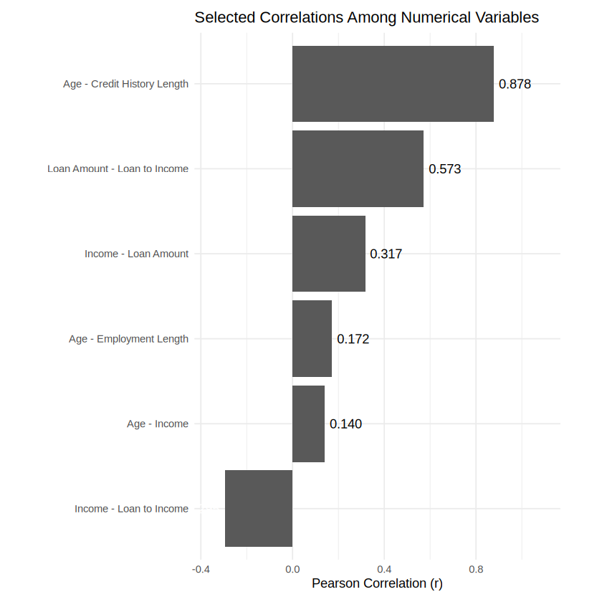
Correlation & Statistical Tests
04
Pearson correlations among numerical variables; chi-square tests for categorical variables.
SELECTED CORRELATIONS AMONG NUMERICAL VARIABLES (PEARSON r)
r = 0.878
Age ↔ Credit-history length
r = 0.573
Loan amount ↔ Loan-to-income
r = −0.295
Income ↔ Loan-to-income
CHI-SQUARE TESTS WITH LOAN STATUS
Loan grade, loan intent, home ownership and previous default history each showed a statistically significant association.
Note: correlations are among numerical variables, not with the target. Chi-square results show association, not causation; very small p-values shown as 0 are not literally zero.

Slide 8
Modelling Methodology
05
WORKFLOW IMPLEMENTED IN R · both models evaluated on the same 20% test set
01
02
03
EVALUATION METRICS
Dataset
Data Cleaning & Preprocessing
Exploratory Data Analysis
COMPLETED
Confusion Matrix
04
05
06
Accuracy
Statistical Analysis
80:20 Stratified Train / Test Split
Logistic Regression + Random Forest
Precision
Recall
07
08
09
F1-Score
Model Evaluation & RF Threshold Tuning
LIME Explainability (Random Forest)
Final Prediction & Conclusions
ROC-AUC
Steps 1–9: completed in R · LIME shown for one case; threshold tuning used the test set

Slide 9
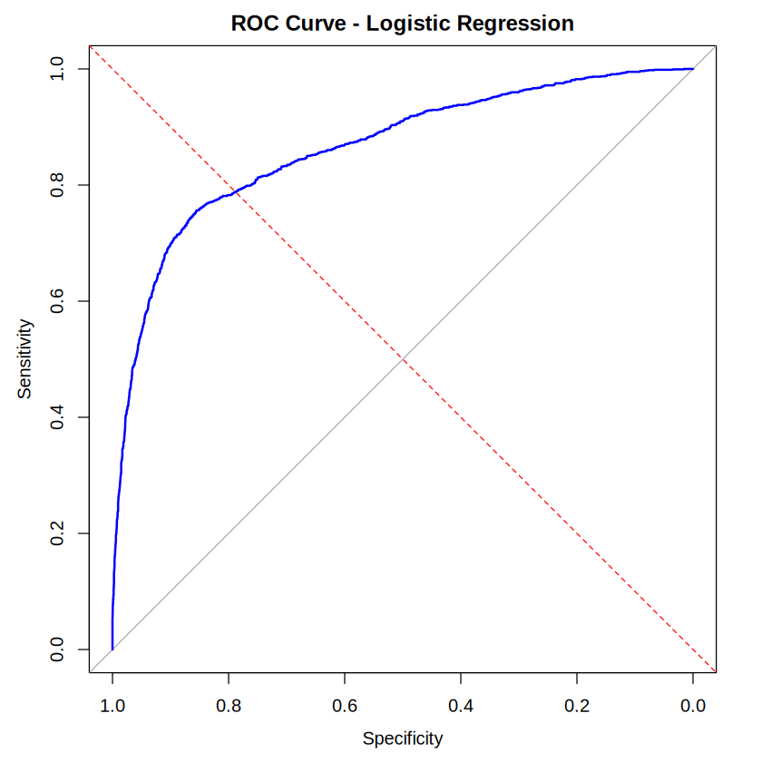
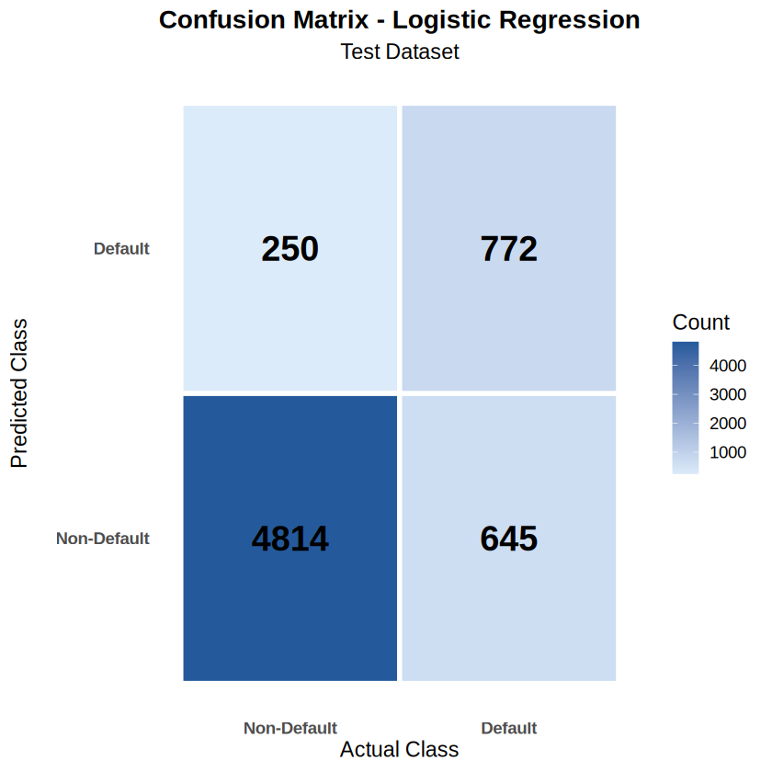
Logistic Regression: Evaluation
06
Test-set results (n = 6,481) · baseline model
CONFUSION MATRIX (TEST SET)
ROC CURVE (TEST SET)
86.19%
Accuracy
[Figure placeholder]
Paste the confusion matrix exported from R
75.54%
Precision
[Figure placeholder]
Paste the ROC curve exported from R
54.48%
Recall
0.6330
F1-score
0.8639
ROC-AUC
Reading the results: recall of 54.48% means the model misses a large share of actual defaults, even though accuracy looks high.

Slide 10
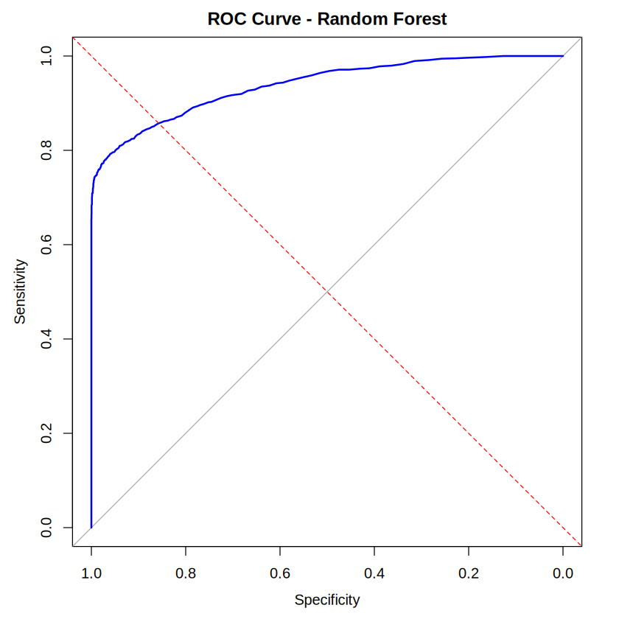
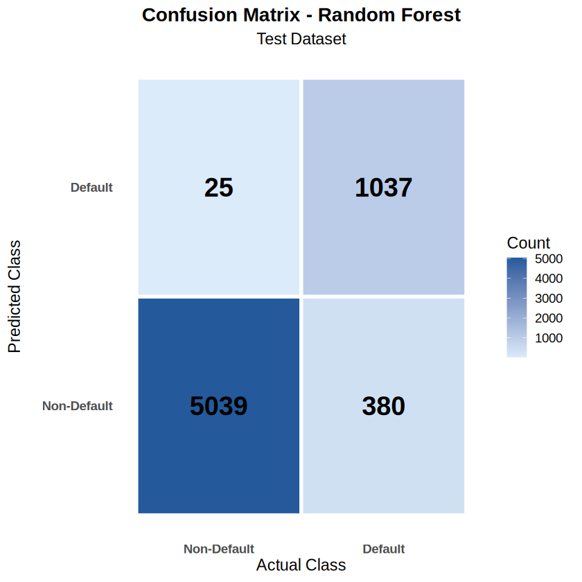
Random Forest: Evaluation
06
Baseline Random Forest — Threshold 0.50 · 300 trees · test-set results (n = 6,481)
BASELINE CONFUSION MATRIX · 0.50
BASELINE ROC CURVE · 0.50
93.75%
Accuracy
[Figure placeholder]
Paste the confusion matrix exported from R
[Figure placeholder]
Paste the ROC curve exported from R
97.65%
Precision
73.18%
Recall
0.8366
F1-score
0.9384
ROC-AUC
Reading the results: baseline precision is very high (97.65%), but recall is 73.18%, so some actual defaults are missed. Tuned threshold 0.40 results are on the next slide.

Slide 11
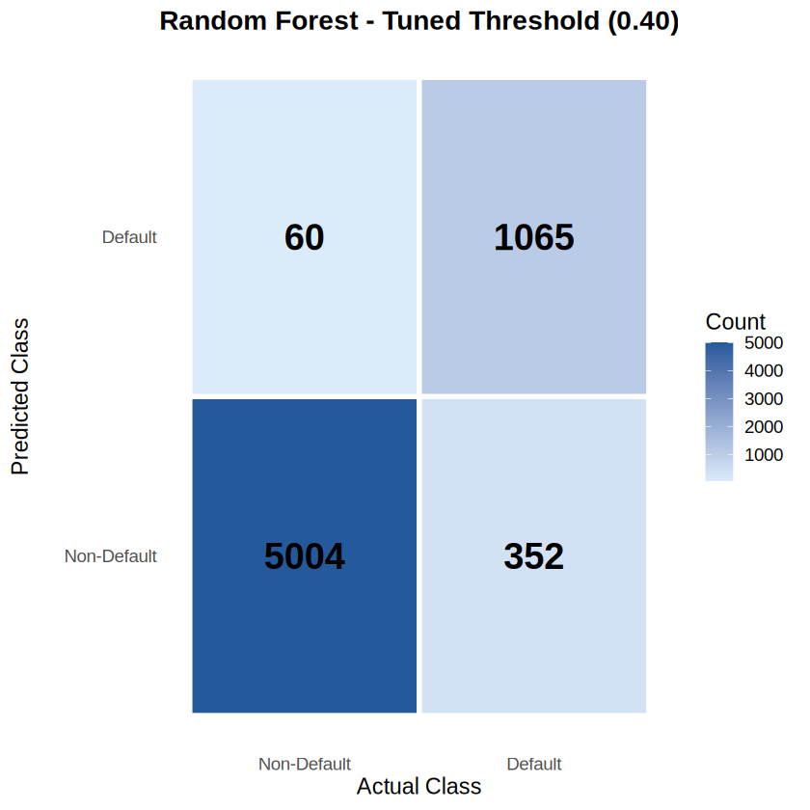
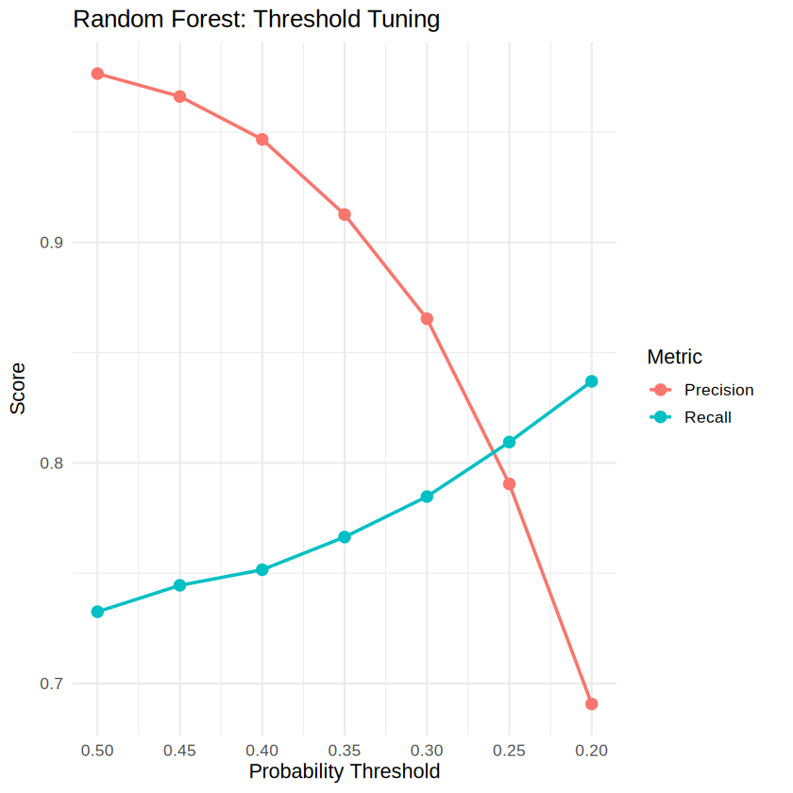
Random Forest: Tuned Threshold (0.40)
06
Tuned Random Forest — Threshold 0.40 · same test set (n = 6,481) · threshold chosen using test-set results
CONFUSION MATRIX · 0.40
THRESHOLD TUNING CURVE
93.64%
Accuracy
94.67%
Precision
75.16%
Recall
0.8379
F1-score
86.99%
Balanced accuracy
Trade-off: vs baseline (0.50), recall rose from ≈73% to 75.16% while precision fell from ≈97.65% to 94.67%: more defaults caught (1,065) but more false positives (60); 352 defaults are still missed. Threshold was chosen on the test set; a separate validation set is preferable.

Slide 12
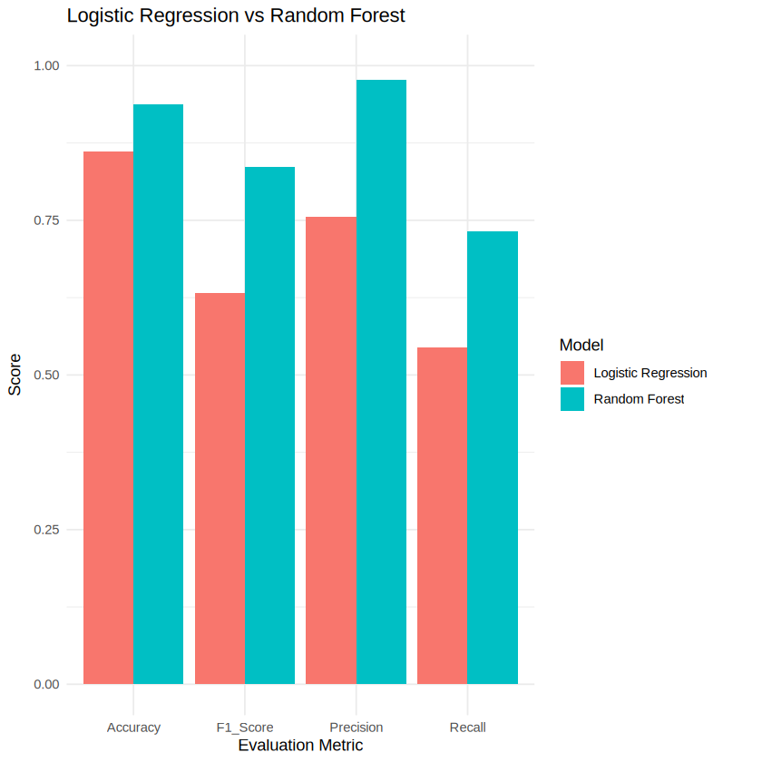
Model Comparison
07
Logistic Regression vs Random Forest on the same test set (n = 6,481).
METRIC | LOGISTIC REG. | RF BASELINE (0.50) | RF TUNED (0.40)
Accuracy | 86.19% | 93.75% | 93.64%
Precision | 75.54% | 97.65% | 94.67%
Recall | 54.48% | 73.18% | 75.16%
F1-score | 0.6330 | 0.8366 | 0.8379
ROC-AUC | 0.8639 | 0.9384 | —
METRICS (%): LOGISTIC REGRESSION VS BASELINE RF (0.50)
Baseline RF beats Logistic Regression on all 5 metrics
Limitation: Baseline RF recall is 73.18%; tuned (0.40) recall is 75.16% with lower precision, and 352 defaults are still missed. Tuned threshold was chosen on the test set; “—” = not reported. Chart shows baseline RF; F1 and ROC-AUC are ×100.

Slide 13
Random Forest Feature Importance
08
Ranked by Mean Decrease in Gini · importance reflects prediction, not causation
01
loan_percent_income
Loan-to-income ratio
07
loan_amnt
Loan amount
02
person_income
Income
08
person_emp_length
Employment length
03
loan_grade
Loan grade
09
person_age
Age
04
loan_int_rate
Interest rate
10
cb_person_cred_hist_length
Credit-history length
05
person_home_ownership
Home ownership
11
cb_person_default_on_file
Previous default on file
06
loan_intent
Loan purpose
Note: rank shows relative contribution to predictions.

Slide 14
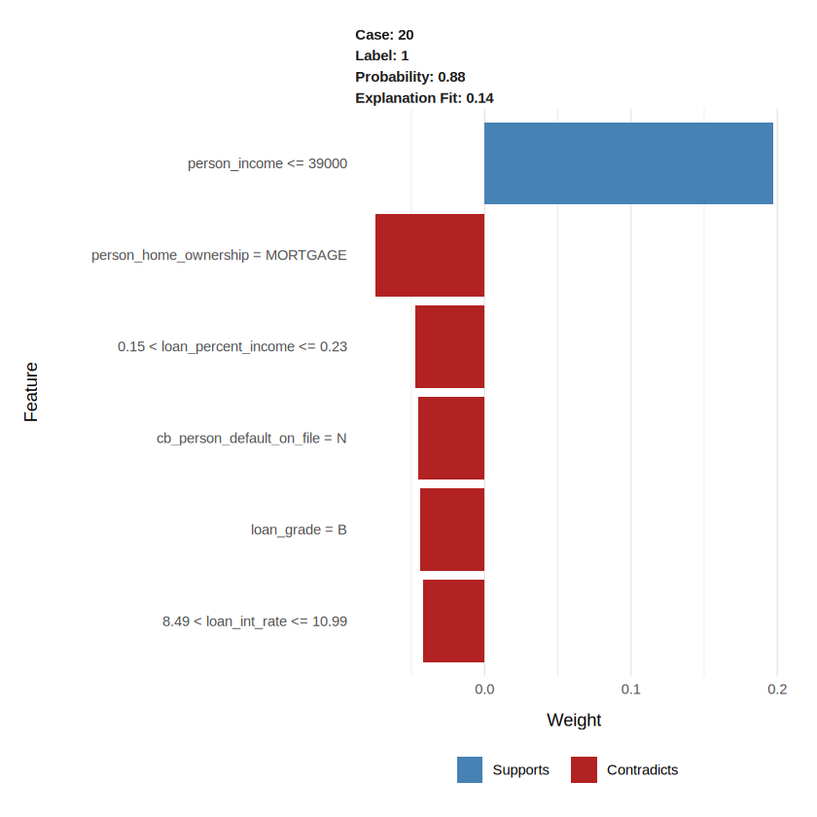
LIME Explainability
09
What is LIME?
LIME (Local Interpretable Model-agnostic Explanations) explains why a machine learning model makes a prediction for an individual loan applicant.
Case analyzed – Case 20 (LIME run in R on the Random Forest model)
Predicted class: Default (1)
Actual class: Default (1)
Probability reported by LIME: 0.88 (88%)
Explanation fit: 0.14 (low)
Important features in the explanation
Person income ≤ 39,000 — supports the default prediction.
Home ownership = MORTGAGE — contradicts the default prediction.
Loan-to-income ratio, previous default history, loan grade and interest rate also appear.
Caution: the explanation fit is only 0.14, so this individual explanation has limited fidelity and should be interpreted cautiously. It does not prove causation or fully explain the Random Forest.

Slide 15
Conclusions & Future Work
10
Summary of verified results, limitations and the remaining work.
KEY CONCLUSIONS ✓
LIMITATIONS & FUTURE WORK →
✓
21.87% of loans default (7,088 of 32,409)
→
Recall: baseline RF 73.18%; tuned (0.40) 75.16%, still missing 352 defaults
✓
Default rate rises from 9.96% (A) to 98.4% (G)
→
Imbalance: only 21.87% are defaults; class weighting did not improve recall
✓
Rent: 31.6% vs own: 7.49% default rate
Chi-square: 4 variables associated with default
→
Small groups: grade G (64), “Other” ownership (106)
✓
→
Findings are associations, not causes
✓
Logistic Regression: 86.19% accuracy, AUC 0.8639
→
Threshold chosen on test set; a separate validation set is preferable
✓
Baseline RF (0.50): 93.75% accuracy, AUC 0.9384
✓
Tuned RF (0.40): recall 75.16%, precision 94.67%
→
Future: improve LIME fidelity, evaluate more applicants, validate explanations
✓
Baseline RF beat Logistic Regression on all 5
→
Future: final report and documentation
✓
Top predictor: loan-to-income ratio
LIME implemented (case 20); explanation fit 0.14, so interpret cautiously.
✓
Imputation fitted on training data only

Slide 16
Thank You
R DATA SCIENCE CASE STUDY · REVIEW-2
98.4%
Questions & Discussion
Gautam Raju | B.Tech AI & DS | CBIT | 15 October 2026
A
B
C
D
E
F
G
DEFAULT RATE BY LOAN GRADE, A–G

