Slide 1
Quiz 2: Five Things You should know now…
Write SQL code to create table named ‘Table’ with two integer attributes: ‘a’ & ‘b’.
Write example instance of relation ‘Table’ with 4 tuples.
Table Instance
create database quizzes;
use quizzes;
create table table (a int, b int);
create table Table (a int, b int);
create table table1 (a int, b int);
insert into table1 values (1,1);
insert into table1 value (2,2),(3,3),(4,4)
select * from table1
delete from table1;
a | b
1 | 1
2 | 2
3 | 3
4 | 4

Slide 2
Quiz 2: Five Things You should know now…
3. What does ‘I’ stand for in ACID Properties of TransActions?
ISOLATION – Operations need to run without interactions from others.

Slide 3
Quiz 2: Five Things You should know now…
4. Does relation ‘Table’ have a Key?
NO
5. Describe one potential StudentDB issue?
Consistency Issues
No Key

Slide 4
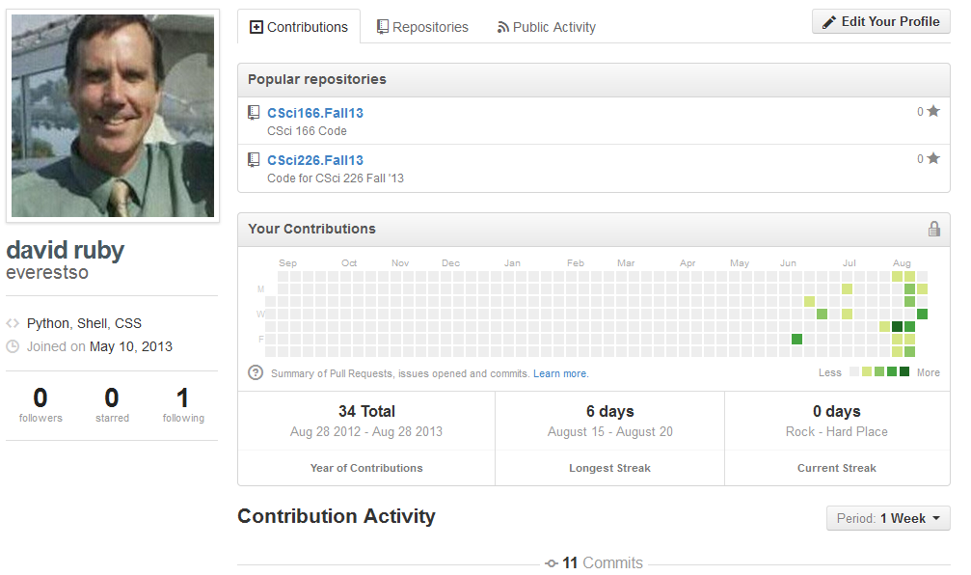
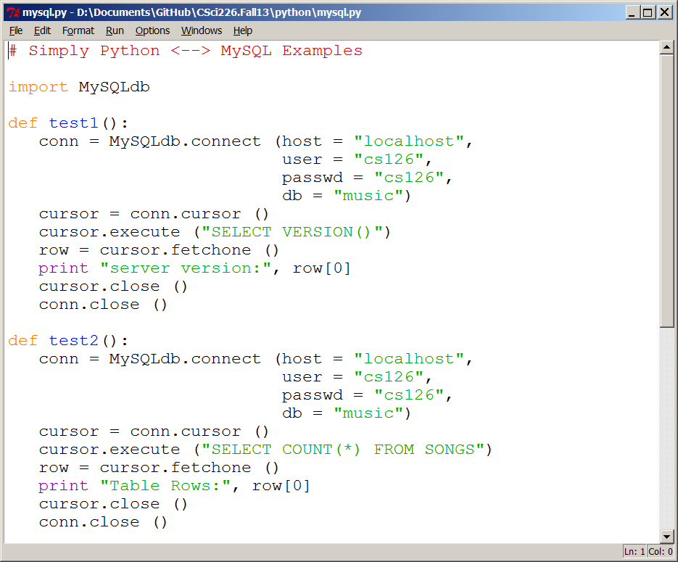
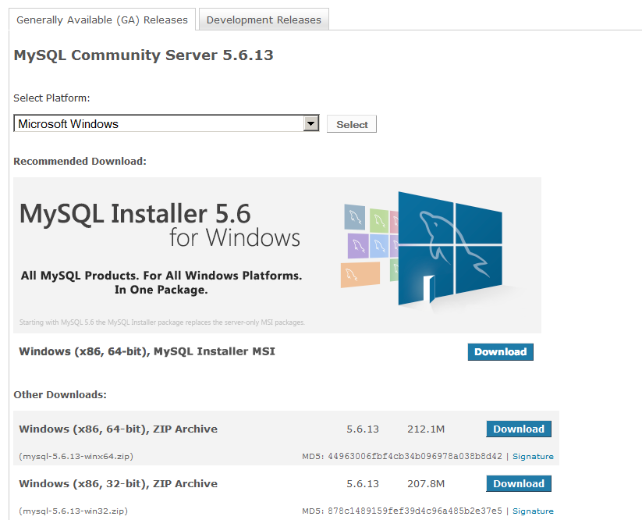
Csci 226: MySQL/Python/GIT
Review Software needed for Class
Installing GIT
Configuring Git
Installing MySQL
Installing Python
Testing Python

Slide 5

What are we doing??
Interpreting Code
Updating Code

Slide 6
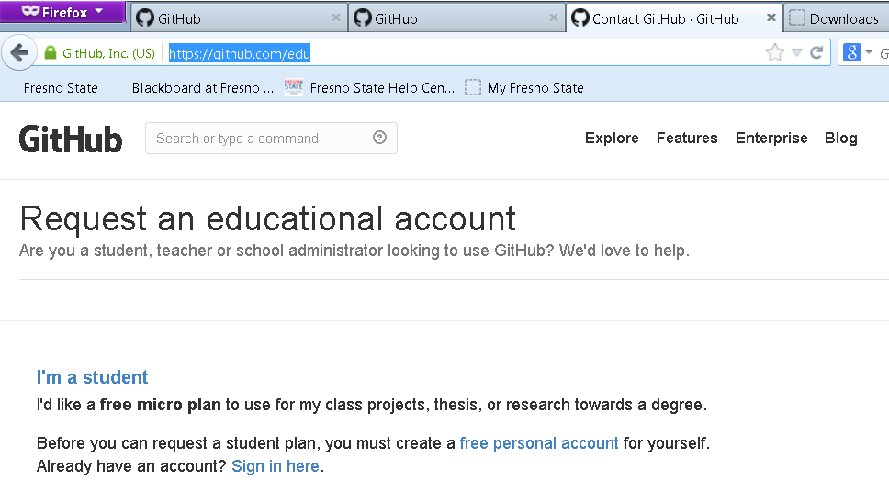
Getting GIT
https://github.com/edu

Slide 7
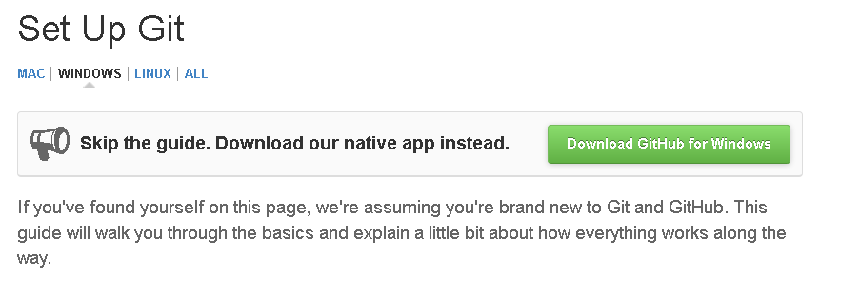
Configuring GIT
https://help.github.com/articles/set-up-git

Slide 8
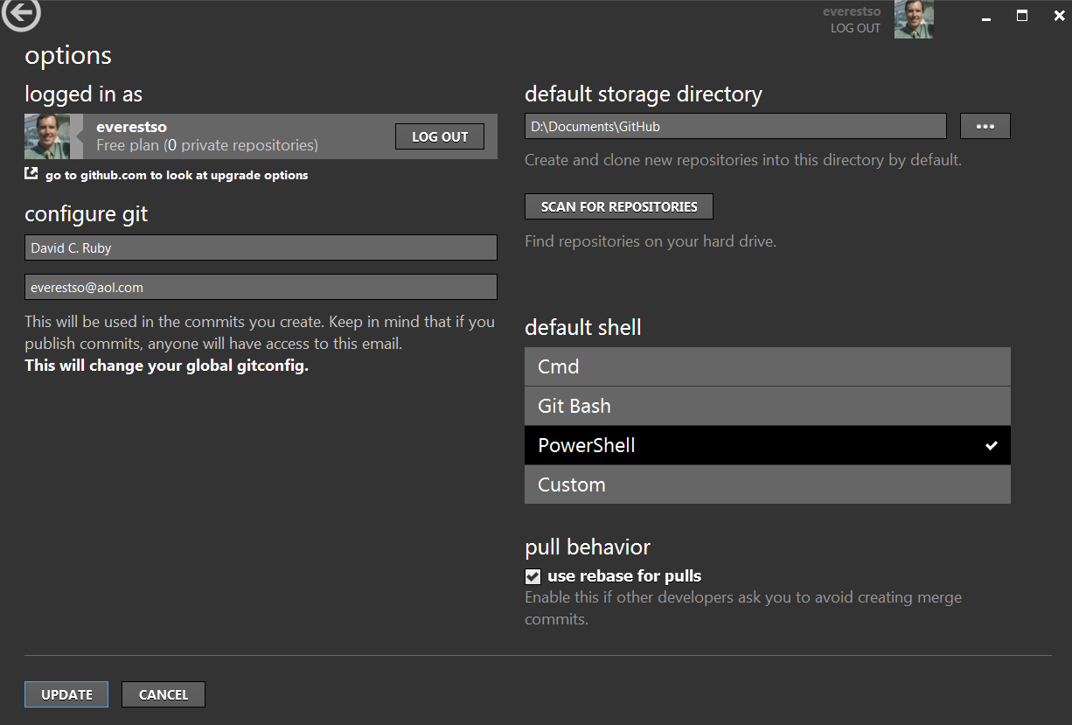
Configuring GIT

Slide 9
Getting MySQL 5.6
The link for MySQL is:
http://www.mysql.com/
In-class, Windows Assumed
Functionally equivalent assignments accepted
MySQL 5.6 software here:
http://dev.mysql.com/downloads/installer/5.6.html
The installation is straightforward. You may want to create an Admin user when installing rather that simply using ‘root’.

Slide 10
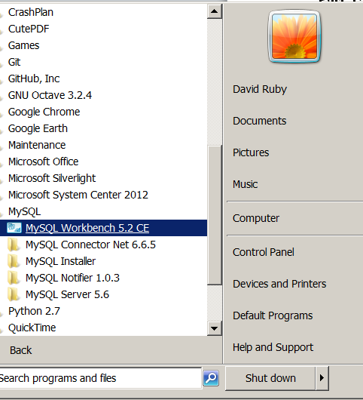
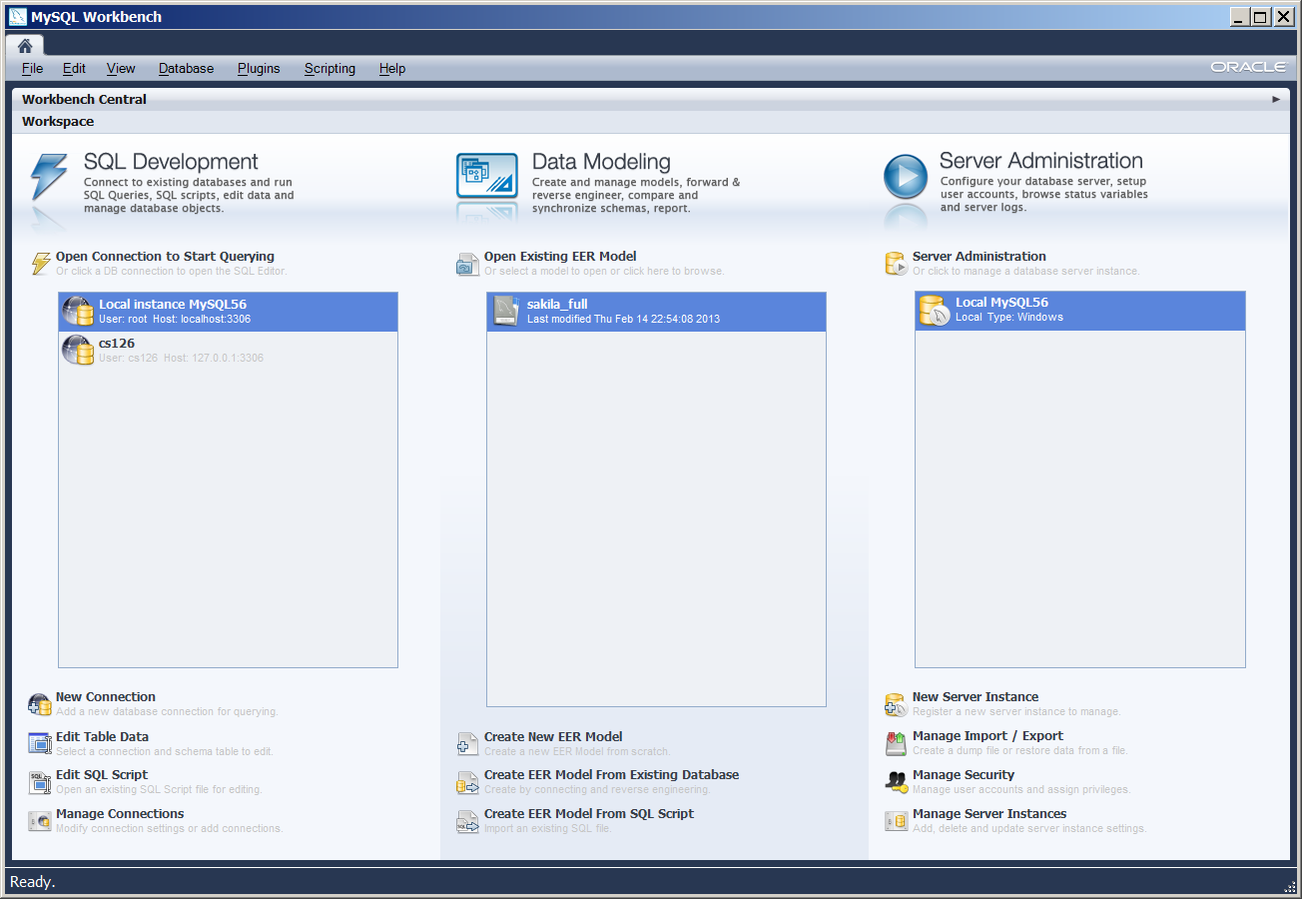
Using MySQL 5.6
MySQL Workbench

Slide 11
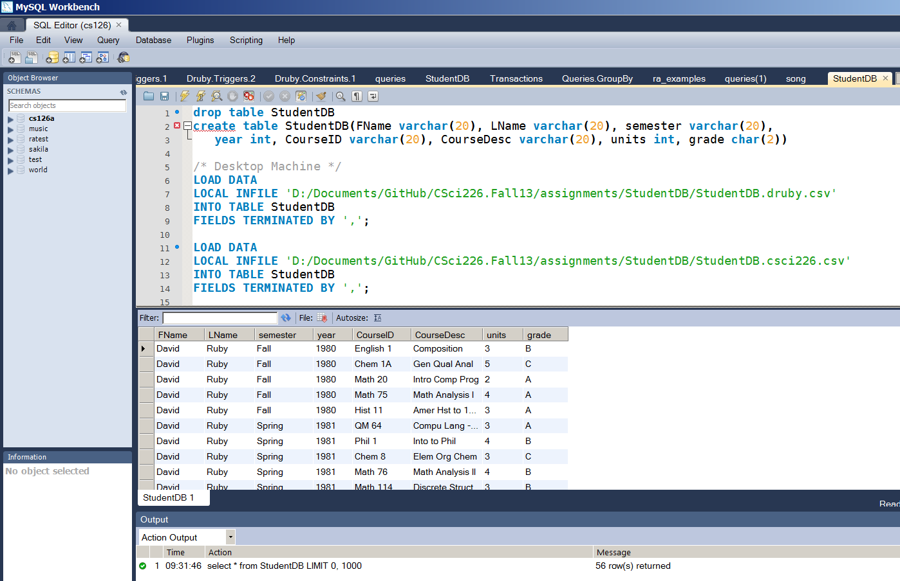
Using MySQL 5.6
MySQL Workbench

Slide 12
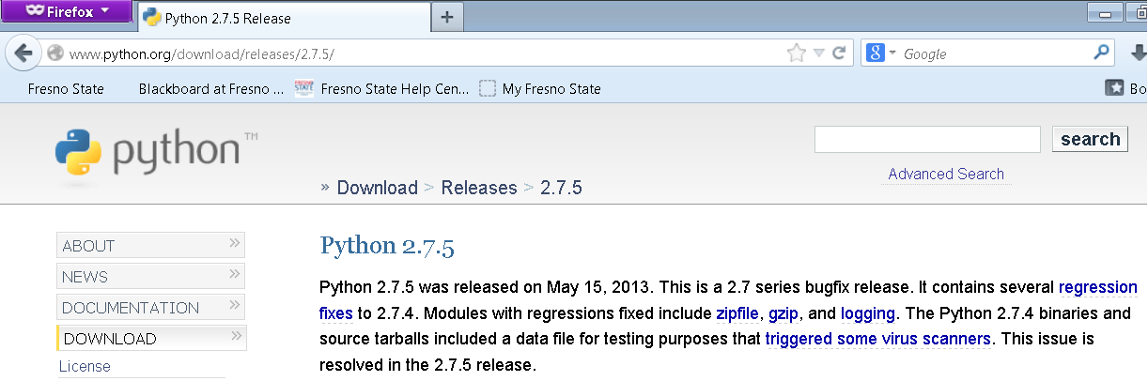
Getting Python
http://www.python.org/download/releases/2.7.5/

Slide 13

Using GIT/Python

Slide 14
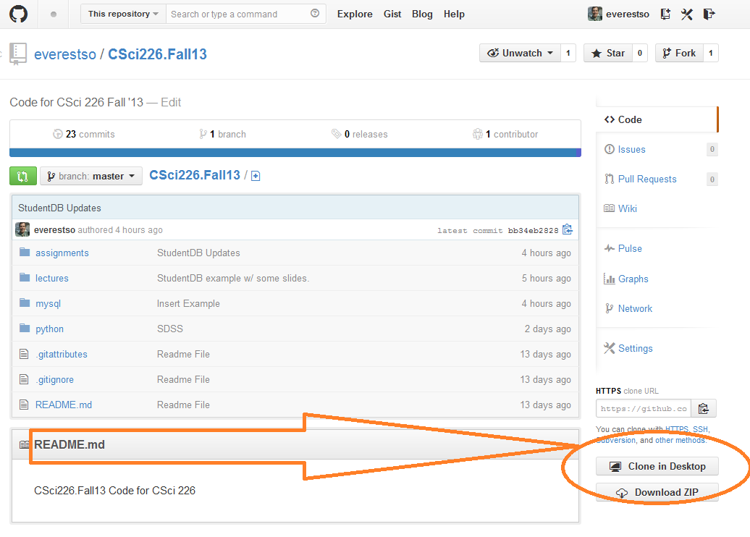
Using GIT/Python
Clone In:
https://github.com/everestso

Slide 15
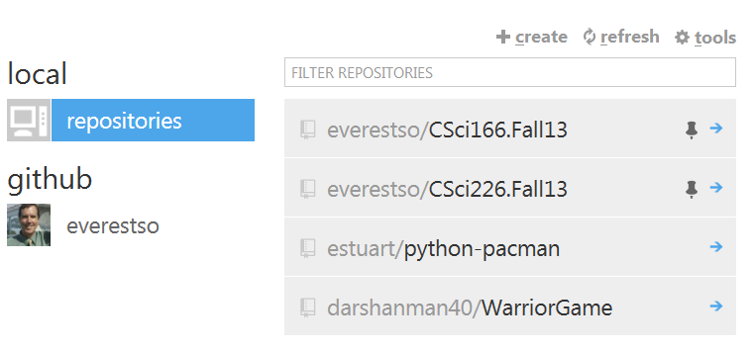
Using GIT/Python

Slide 16
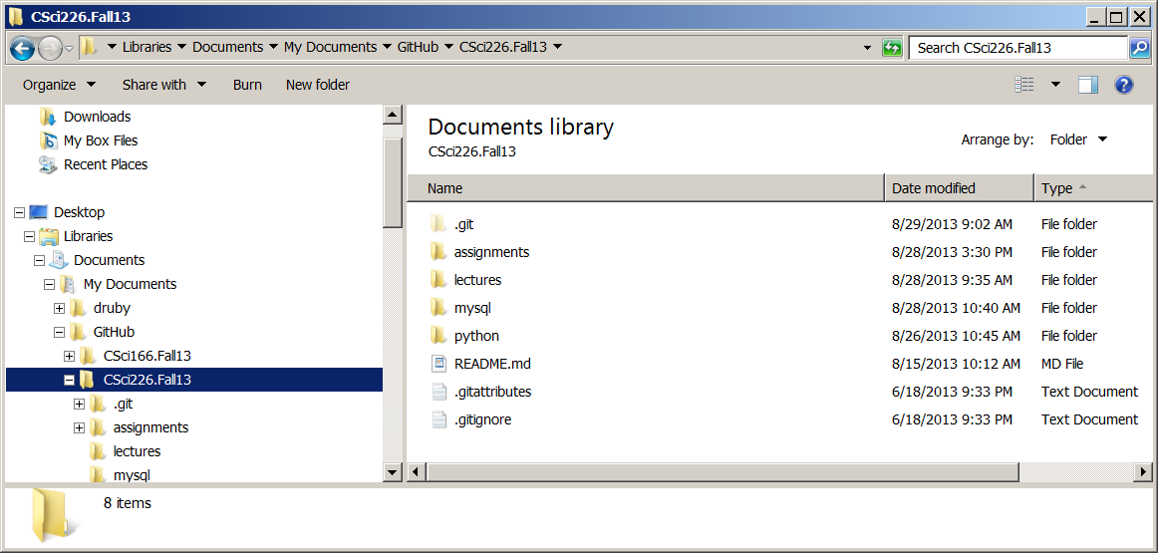
Using GIT/Python
Directories loaded onto your system after Cloned In!

Slide 17
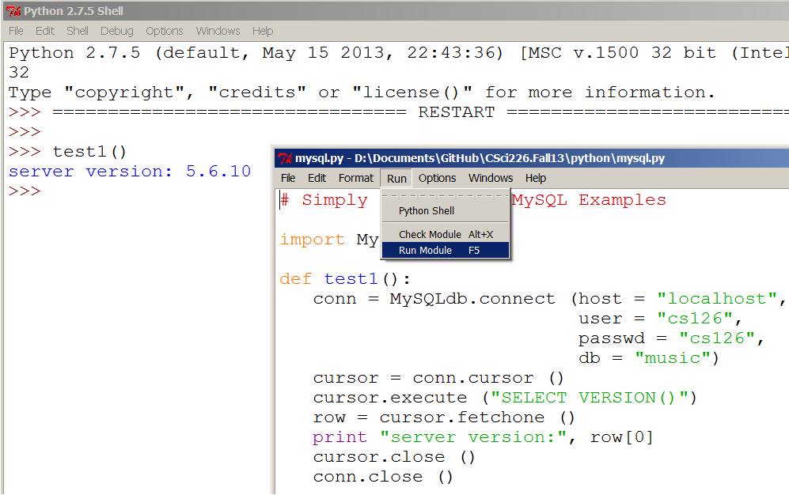
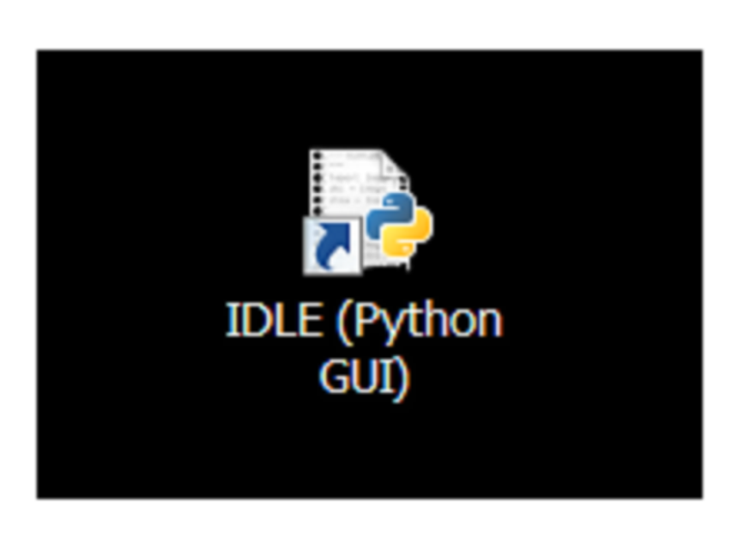
Using GIT/Python
Assignment 1:
Part 3 – Run ‘test1()’ from mysql.py

Slide 18
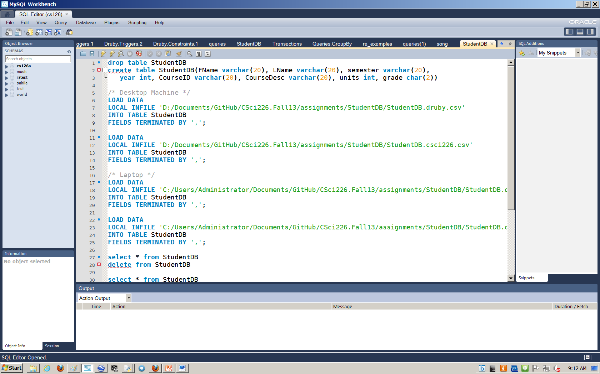
Using MySQL -- StudentDB

Slide 19
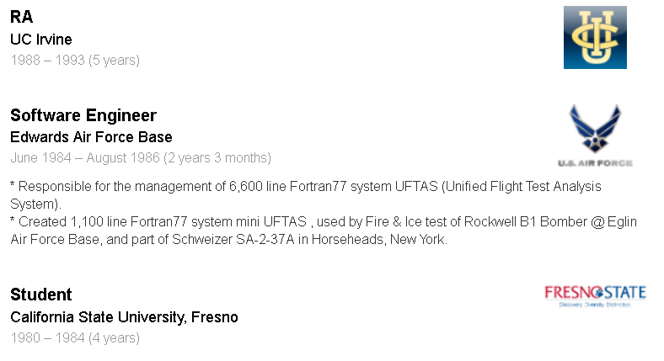
Quiz 3: Five Things You should know now…
What does the ‘A’ in ACID Properties of Transactions stand for?
What does the ‘A’ mean?
Write SQL code to create table named ‘JobHistory’ with pid as a Person ID using fields to match LinkedIn Job History below.
Give an example instance of the table JobHistory with a single tuple.
Write the SQL code to insert the single instance into the table.

