Slide 1
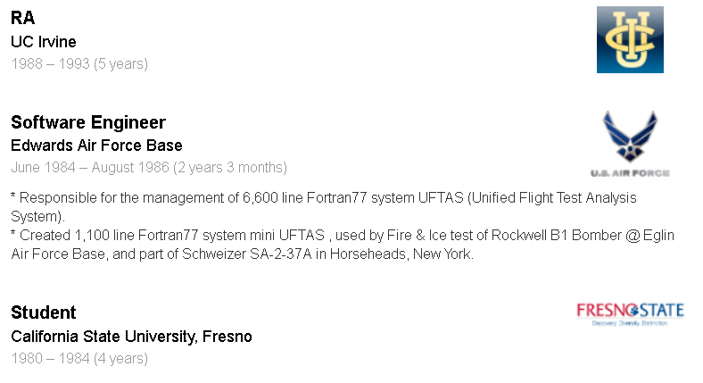
Quiz 3: Five Things You should know now…
What does the ‘A’ in ACID Properties of Transactions stand for?
What does the ‘A’ mean?
Write SQL code to create table named ‘JobHistory’ with pid as a Person ID using fields to match LinkedIn Job History below.
Give an example instance of the table JobHistory with a single tuple.
Write the SQL code to insert the single instance into the table.

Slide 2
Quiz 3: Five Things You should know now…
create table JobHistory (pid int, jobtitle varchar(40), company varchar(40), startdate date, enddate date, description varchar(512));
insert into JobHistory values (1001, "Software Engineer",
"Edwards Air Force Base", "1984-06-15", "1986-08-06",
"* Responsible for the management of 6,600 line Fortran77 "
"system UFTAS (Unified Flight Test Analysis System).\n "
"* Created 1,100 line Fortran77 system mini UFTAS , used by Fire & Ice test of Rockwell :"
"B1 Bomber @ Eglin Air Force Base, and part of Schweizer SA-2-37A in Horseheads, New York.\n" );

Slide 3
Assignment #1: Software Installation
Due: 9/6
Value:
20 Points out of 100 points for Assignments
Assignments are 20% of total grade
Remember, put the screen shots into a MS WORD doc, along with a sentence or two describing the process.
Email me the word doc sometime 9/6.

Slide 4
Presentation #1: Project Proposal
Due: 9/10 OR 9/12
Value: 30 points
Grading:
Content (30%)
Quality (30%)
Effort (30%)
Overall (10%)

Slide 5
Presentation #1: Project Proposal
This is the first in-class presentation, and is designed with several goals in mind:
Student Inroductions: By now, everyone has had a chance to hear a bit about me, the instructor, now it’s time for introductions from the students.
Current Interests/General Goals: What are your current plans, and how is grad school supporting those plans.
Project Ideas: What are your current thoughts about a class project.
Each student will be given 10 minutes, with some of the time including questions/discussions , and is expected to have at least 5 powerpoint slides, but no more than 10 slides.

Slide 6
Presentation #1: Project Proposal
Choose Date:
9/10
9/12

Slide 7
Python Introduction
Need simple language for writing and testing algorithms & data structures.
Need simple language for doing mathematical calculations.
Need simple language for manipulating file data.

Slide 8
Python Introduction
Python Gui -- IDLE: Python as a calculator
Python Nesting/Functions: Indentation Control
Classes in Python: Object oriented code
Python I/O: Some simple input/output methods in python.

Slide 9
Quiz 4: A Few Things You should learn TODAY…
Use Python as an interactive Calculator
Write Python code to initialize a variable to an array.
Write Python function that takes numbers as input and return a calculation using the values.
Loop through the values of an array.
Create a Class that is initialized with some set of member variable values.
Add a member function to a class that does a calculation using member variables.

Slide 10
Quiz 4: Five Things You should know now…
Write Python code to initialize a variable ‘x’ to an array of 3 values, all equal to 0.
Write Python function to calculate the area of a triangle given it’s base and height.
Write a Python function that takes an array as input and uses a for loop to print the contents of each item.
Create a Class triangle that is initialized with two member variable values, base and height.
Add a member function to Triangle class that calculates Area.

