Slide 1
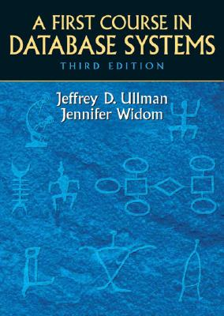

Advanced Database Systems
Chapter 2: Data Models
Data Models defined.
Look @ some Data Models
Look @ Relational Data Model
Look @ SQL in MySQL

Slide 2
What’s a Data Model
Structure of the Data
Tree, Graph
Semi-Structured (XML)
Probabilistic Graphs
Relational
Operations on the Data
Constraints on the Data

Slide 3
What’s do we get from Data Model
Efficiency!
Provide us an abstraction for data.
Operations within abstractions optimized.
Mathematical formalisms for proofs.

Slide 4
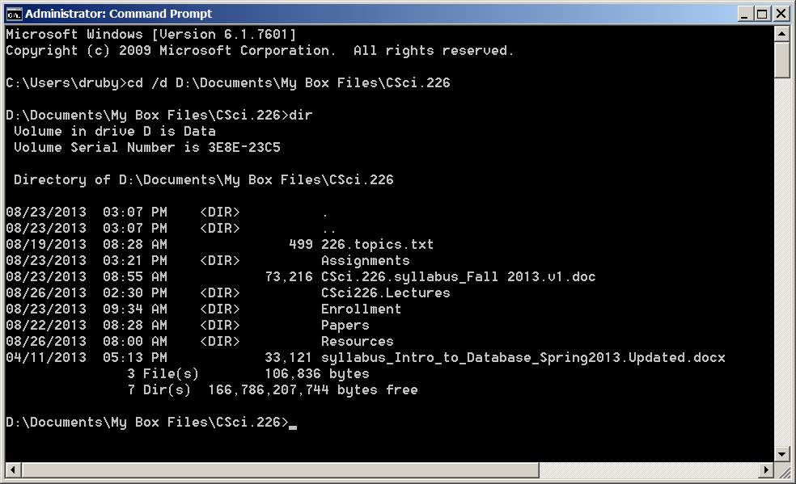
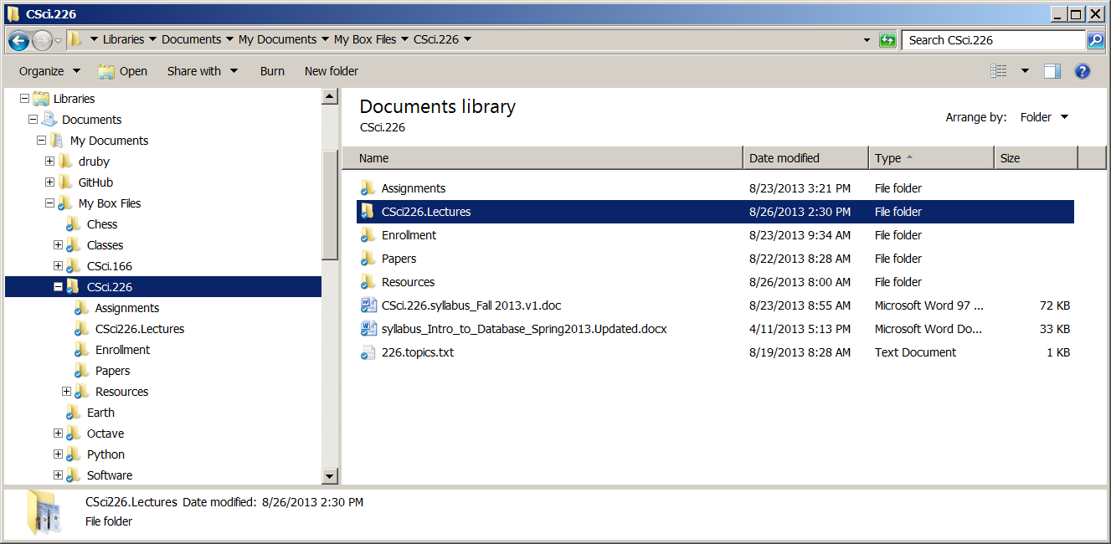
Tree Model File System
Structure of the Data
Tree
Operations on the Data
List Parent
List Children
List Contents
Change Directory (path)
Constraints on the Data

Slide 5
Semi-Structured Data (XML)
<Bookstore>
<Book ISBN="ISBN-0-13-713526-2" Price="85" Edition="3rd">
<Title>A First Course in Database Systems </Title>
<Authors>
<Auth> <FName>Jeffrey</FName> <LName>Ullman</LName> </Auth>
<Auth><FName>Jennifer</FName><LName>Widom</LName></Auth>
</Authors>
</Book>
<Book ISBN="ISBN-0-13-815504-6" Price="100">
<Remark> Buy this book bundled with "A First Course" - a great deal!</Remark>
<Title>Database Systems: The Complete Book</Title>
<Authors>
<Auth><FName>Hector</First_Name><LName>Garcia-Molina</LName></Auth>
<Auth><FName>Jeffrey</FName><LName>Ullman</LName></Auth>
<Auth><FName>Jennifer</FName><LName>Widom</LName></Auth>
</Authors>
</Book>
</Bookstore>

Slide 6
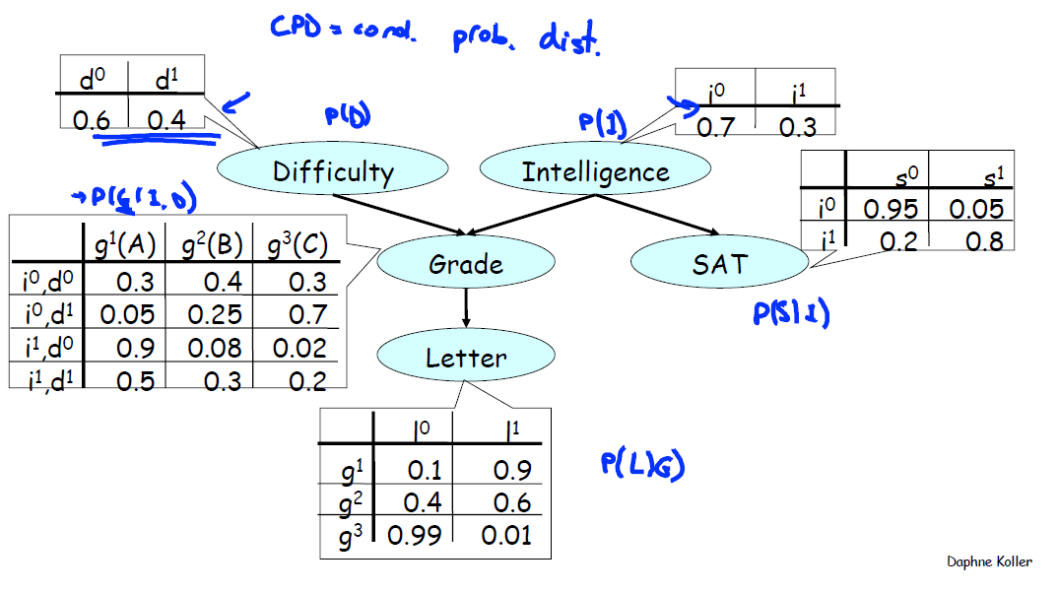
Probabilistic Graph Models
Bayesian Networks

Slide 7
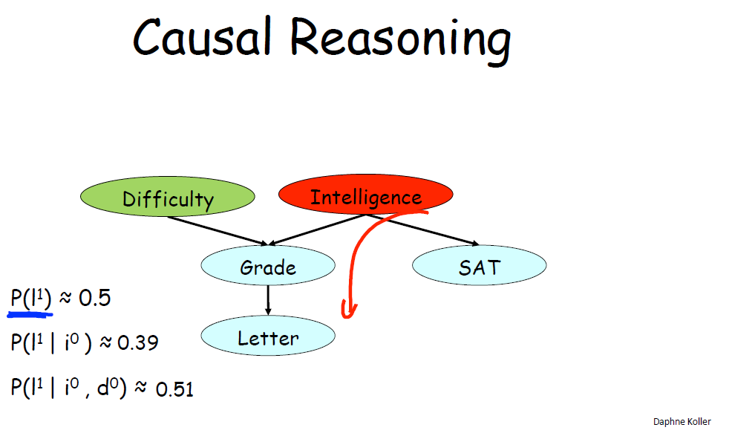
Probabilistic Graph Models
Causal Inference

Slide 8
Probabilistic Graph Models
Judea Pearl – Turing Award, 2011
For fundamental contributions to artificial intelligence through the development of a calculus for probabilistic and causal reasoning.

Slide 9
Relational Data Model
Codd 1970
Everything is a table
Every row in a table has the same columns
Relationships are implicit no pointers

Slide 10
Database Philosophy
God made the integers;
all else is the work of man.
(Leopold Kronecker, 19th Century Mathematician)
Codd made relations;
all else is the work of man.
(Raghu Ramakrishnan, DB text book author)

Slide 11
Map-Reduce Model
Unlike the Relational Data Model and other models, it is a Programming Paradigm
Existing MapReduce and Similar Systems
Google MapReduce
Support C++, Java, Python, Sawzall, etc.
Based on proprietary infrastructures and some open source libraries
Hadoop Map-Reduce
Open Source!
HDFS, Map-Reduce, Pig, Zookeeper, HBase, Hive
Used by Yahoo!, Facebook, Amazon and Google-IBM NSF cluster
Dryad
Proprietary, based on Microsoft SQL servers

Slide 12
Data Model - Relations
Structure of the Data: Relations
Physical Data Model
Conceptual Data Model
Operations on the Data:
Queries
Modification
Allows Optimizations
Constraints on the Data

Slide 13
Relational Data Model
Provides limited, yet useful, operations
Provides framework for power of languages
SQL

Slide 14
Relational Data Model Terminology
Attributes
Columns of relation
Schema
Schema of Relation= Name + {Attributes}
Schema of Database = {Schema of Relations}

Slide 15
Relational Data Model Terminology
Tuples:
Rows of relation
Domains: Attributes have domains
Relations are Sets of Tuples
Instance of Relation
Set of tuples from relation
Current Instance = Set of tuples in relation NOW

Slide 16
Relational Data Model Terminology
Key Constaints
Attribute (or set) that are GUARANTEED unique.

Slide 17
Relational Data Model SQL
Create table NAME(att1 type, att2 type …)

Slide 18
Relational Data Model SQL
Importing data from CSV file:
LOAD DATA LOCAL INFILE 'D:/Documents/GitHub/CSci226.Fall13/ assignments/StudentDB/StudentDB.druby.csv'
INTO TABLE StudentDB
FIELDS TERMINATED BY ',';

Slide 19
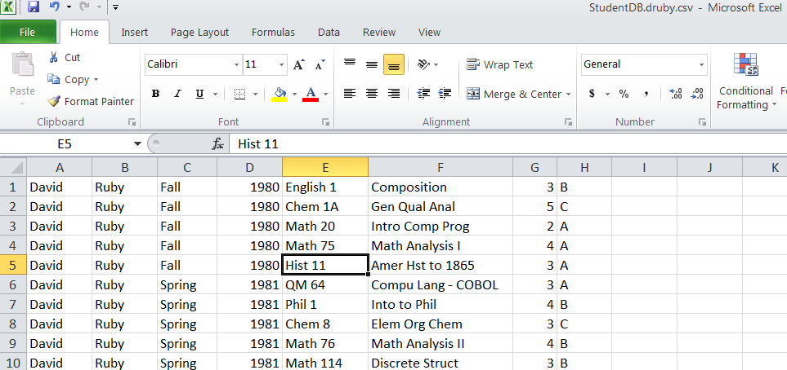
Relational Data Model MySQL Example

Slide 20
Quiz 2: Five Things You should know now…
Write SQL code to create table named ‘Table’ with two integer attributes: ‘a’ & ‘b’.
Write example instance of relation ‘Table’ with 4 tuples.
What does ‘I’ stand for in ACID Properties of TransActions?
Does relation ‘Table’ have a Key?
Describe one potential StudentDB issue?

