Slide 1
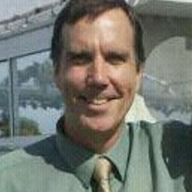
Computer Science 226,
Advanced Database Systems (3 units)
Class Instructor: David Ruby
Instructor Office Hours: After Class
Class Hours: TTh 3:30-4:15
Email: druby@csufresno.edu

Slide 2
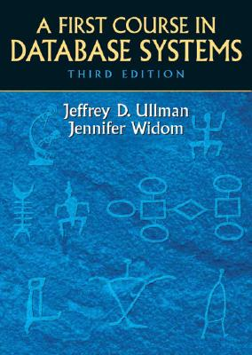
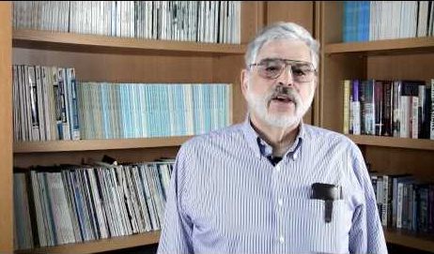
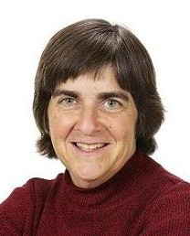
Textbooks and Materials
A First Course in Database Systems (3rd)
by Jeffrey D. Ullman & Jennifer Widom

Slide 3
Grading
In-Class Quizzes/Presentations: %20
Assignments (Programming): %20
Mid-Term: %20
Final: %20
Project: %20

Slide 4
In-Class Quizzes/Presentations
Short quizzes frequently (example questions)
Project Proposal: September 10
Status Update: November 7
Final Presentations: December

Slide 5
Assignments (Programming)
9/6: MySQL/Python/Git Installation
9/20: Assignment 2
10/4: Assignment 3
10/25: Assignment 4
11/1: Assignment 5

Slide 6
Tests
Mid-Term (20%): 10/10
Final (20%): 12/19 5:45p – 7:45

Slide 7
Project
First part of course
Think about project
Do programming assignments
Second part of course
Do project programming

Slide 8
Textbooks and Materials
A First Course in Database Systems (3rd)
by Jeffrey D. Ullman & Jennifer Widom

Slide 9

Chapter 1
Databases, Big Data, Data Mining, Data Science
What’s it all about???
8/27

Slide 10
Chapter 2: Data Models
Hierarchical
Graph
Relational
8/29

Slide 11
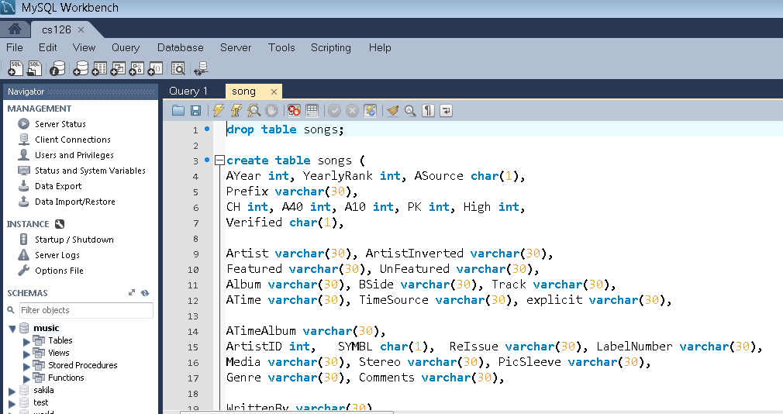
MySQL/Python 2.75/Git

Slide 12
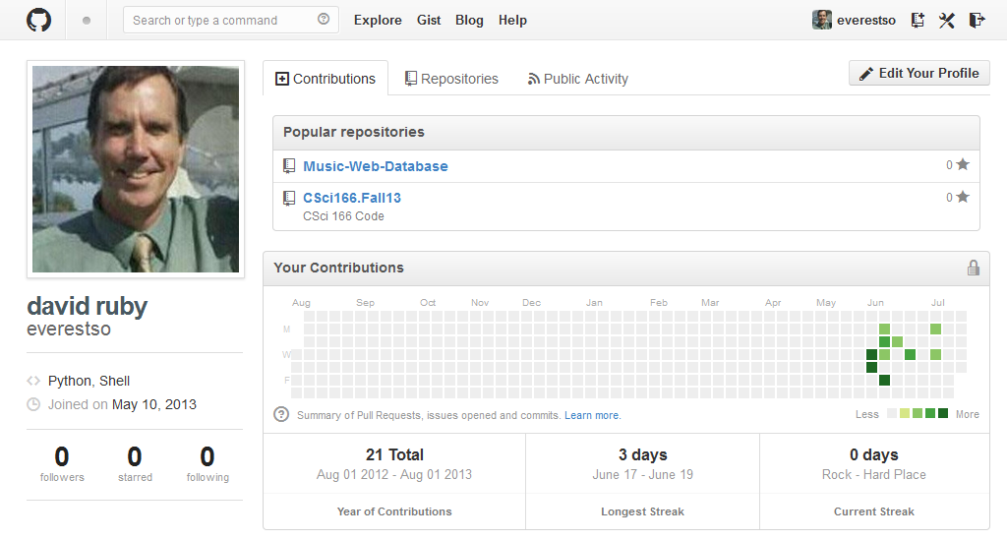
MySQL/Python 2.75/Git
https://github.com/everestso

Slide 13
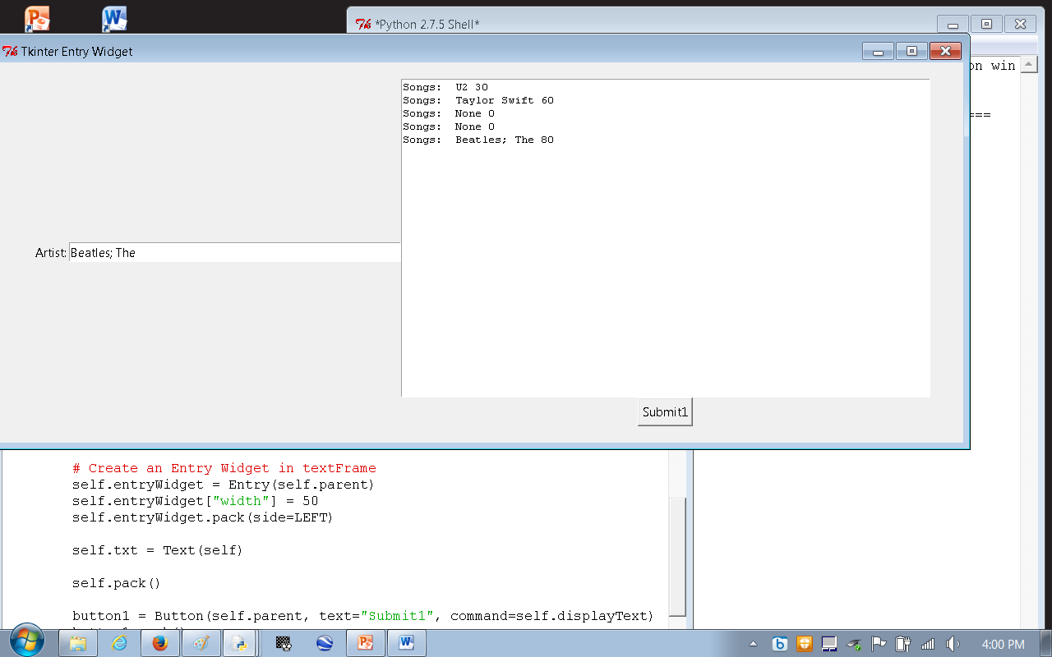
MySQL/Python 2.75/Git

Slide 14
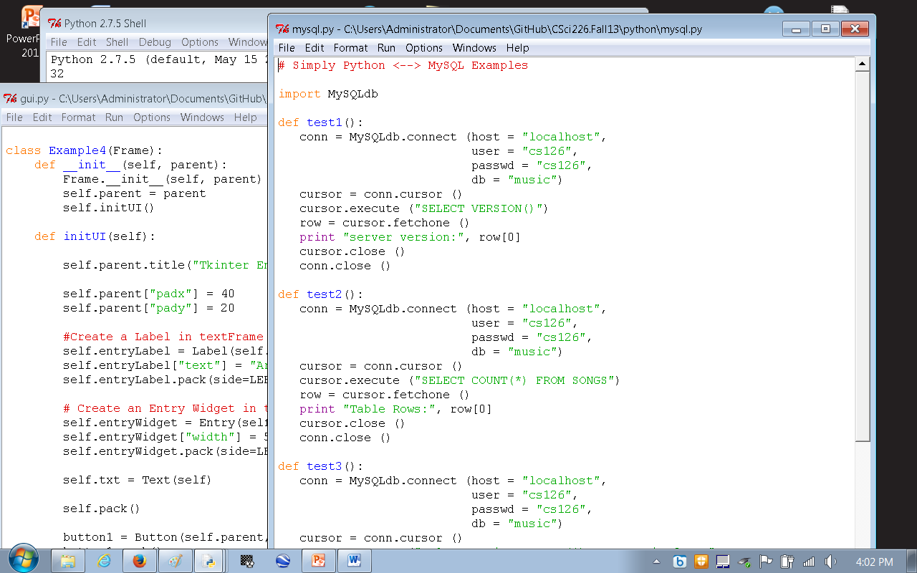
MySQL/Python 2.7.5/Git

Slide 15
MySQL/Python 2.75/Git
September 3
September 6: Assignment 1
Install MySQL 5.6
Install Python 2.7.5
Install Git
Create Student Account
Create Repository (share with me)
Run Simple Query

Slide 16
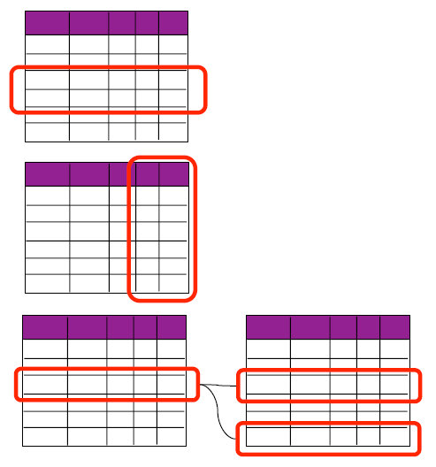
Chapter 2: Relational Data Model
Language of Relational Algebra
9/5

Slide 17
Project Proposal
9/10: Share some ideas about a project that you think could do, and would like to do.

Slide 18
Chapter 5, 6: SQL & Relational Algebra
Sept. 12, 17, 19, 24, 26
SELECT * FROM table
Data Analysis Examples
Data Mining Examples

Slide 19
Chapter 8: Views & Indexes
10/1, 10/3

Slide 20
MIDTERM
10/10: 20 Percent
Databases, Big Data, Data Science, Data Mining
Data Models
Relational Algebra
SQL
Indexes & Views

Slide 21
Chapter 6: Constraints/Triggers/ Stored Procedures
10/17, 10/22, 10/24

Slide 22
Introduction to NoSQL
10/31, 11/5

Slide 23
Status Update
11/7:
Finished first part of course..
Done a few programming assignments..
Been thinking about project..
Now….
What will you do for final project…

Slide 24
Data Mining
Data Mining Tools
11/12, 11/14, 11/19, 11/21, 11/26

Slide 25
Final Presentations
Dec. 3, 5

Slide 26
Final
12/19 3:30-5:30

Slide 27
Quiz 1: Five Things You should know now…
What language will our programming assignments be coded in ??
What percentage of your grade is covered by assignments in-class ??
Who is the author/authors of our textbook?
Where will we get and post programming assignment code?
Why are we here ?

