Slide 1
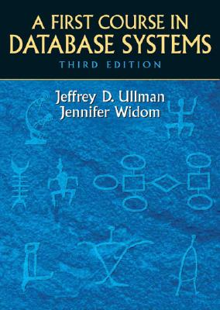

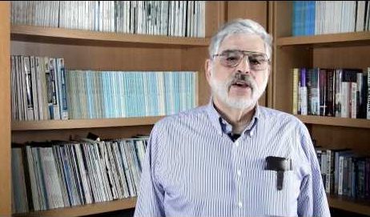

Advanced Database Systems
Chapter 1: Database World
Databases Now
Database Properties
History of Databases
Future of Database

Slide 2
Database Examples
Credit Reports (Experian/TransUnion/Equifax)
Facial Recognition (Face Print) Databases
Facebook, Picassa, etc…
FBI – 12.8 Million Mugshots in new facial recognition database.

Slide 3
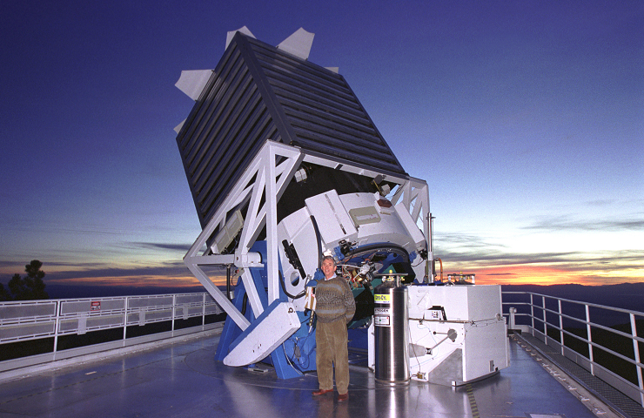
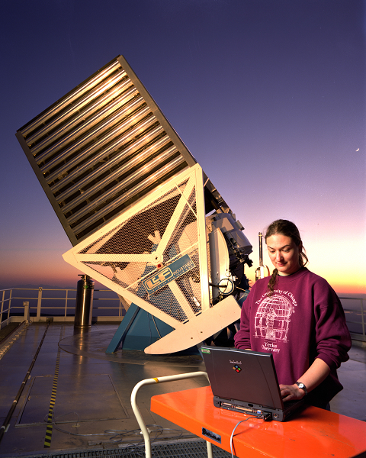
eScience
Sloan Digital Sky Survey:

Slide 4
eScience
Sloan Digital Sky Survey:
Dedicated 2.5-meter telescope
A pair of spectrographs fed by optical fibers measured spectra (hence distances) of more than 600 galaxies and quasars in a single observation
80TB (80 * 10^12 bytes) raw image data
over a 7 year period

Slide 5
SDSS Database
About the Database
http://skyserver.sdss3.org/dr8/en/help/docs/intro.asp#sqlcl
Commercial Relational Database Management system (DBMS) - Microsoft's SQL Server.
SDSS Command Line Query Tool
Author: Tamas Budavari, JHU Date: April 2003, updated January 2005 (DR3) sqlcl.py is a (very) simple Python program that can run SQL queries against SkyServer. Python runs on your favourite OS including the most exotic ones. The query goes through the same .asp page that you use in the web form or using wget.
http://skyserver.sdss3.org/dr8/en/help/download/sqlcl/default.asp

Slide 6
SDSS sqlcl.py
formats = ['csv','xml','html']
astro_url='http://skyserver.sdss3.org/dr8/en/tools/search/x_sql.asp'
public_url='http://skyserver.sdss3.org/dr8/en/tools/search/x_sql.asp'
default_url=public_url
default_fmt='csv'
def query(sql,url=default_url,fmt=default_fmt):
"Run query and return file object"
import urllib
fsql = filtercomment(sql)
params = urllib.urlencode({'cmd': fsql, 'format': fmt})
return urllib.urlopen(url+'?%s' % params)

Slide 7
Database Key Concepts
Data-Definition Language
Data-Manipulation Language (queries)
Store large amounts of data (terabytes)
1 Kilobyte = 1,000 bytes
1 Megabyte = 1,000,000 bytes
1 Gigabyte = 1,000 * 1 MB = 1,000,000,000 (10^9)
1 Terabyte = 1000 * 1GB = 1, 000, 000, 000, 000 (10^12)
1 Petabyte = 1000 *1TB = 1, 000,000, 000,000, 000 (10^15)
Durability
Concurrent Users

Slide 8
Database Management System
Two Distinct Sources of Commands:
Conventional Users/Application Programs
Database Administrator (DBA)
DDL Commands Issued by DBA
User issues: Queries, Updates, Transaction Commands

Slide 9
Database Concurrent Users / Transactions
ACID Properties of TransActions
A: Atomicity
C: Consistency
I: Isolatoin
D: Durability

Slide 10

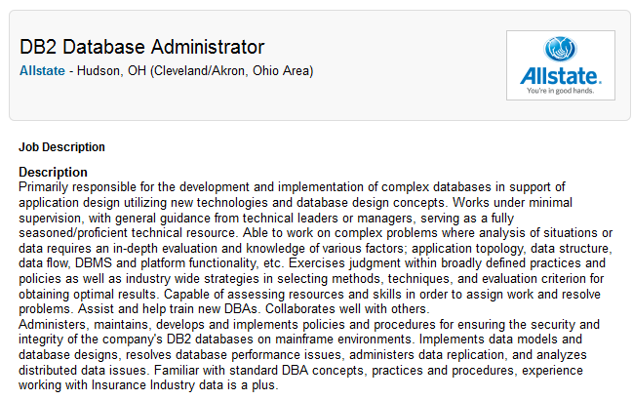
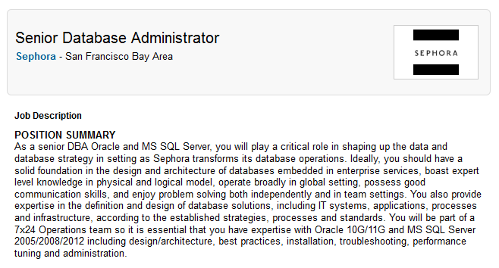
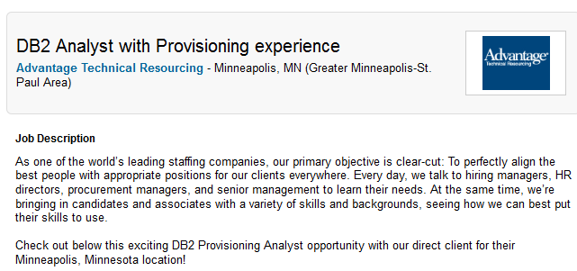
Database Roles
Database Administrator
Database Systems Programmer
Database Analyst
Database Applications Developer
Data Analyst
Data Scientist

Slide 11
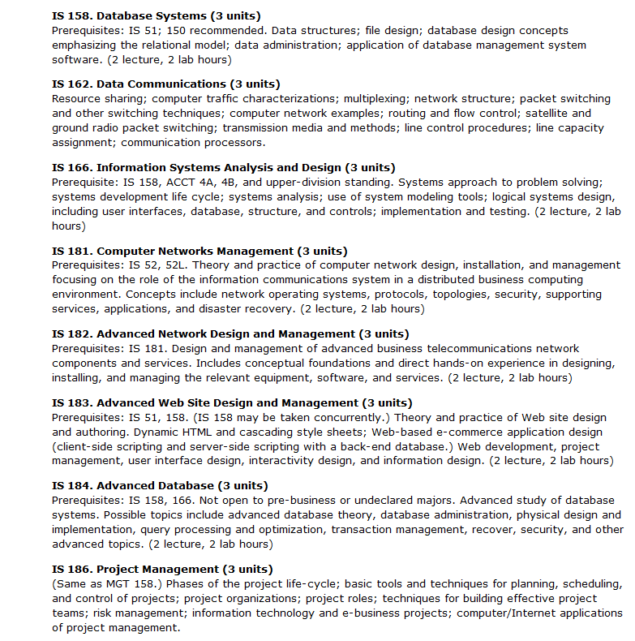
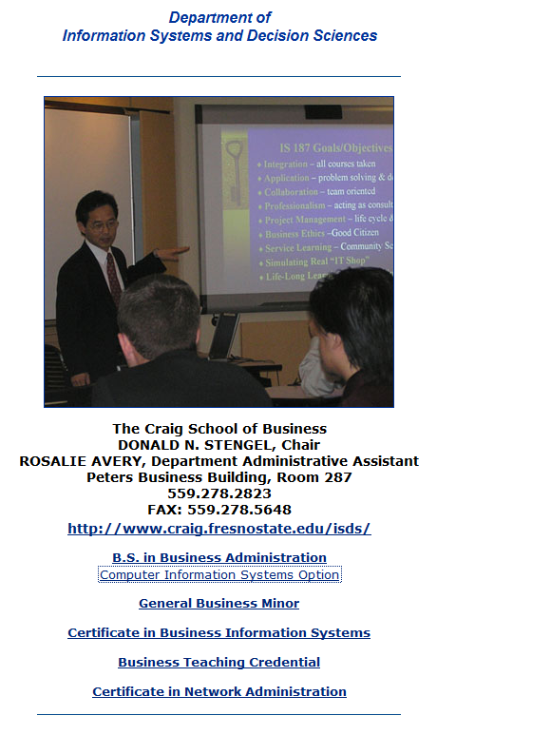
Database Work in Other Departments Information Systems/Decision Sciences

Slide 12
Database History
Early History: File System - Hierarchical
1960’s First DB’s (Banking, Reservations, Corporate Records)
Extension of File System
Hierarchical
Programmatic - Difficulty
1970: TED CODD gave the world Relations
Relations had powerful mathematical properties
Relations provided Data Abstraction
1990’s RDMS are The Norm

Slide 13
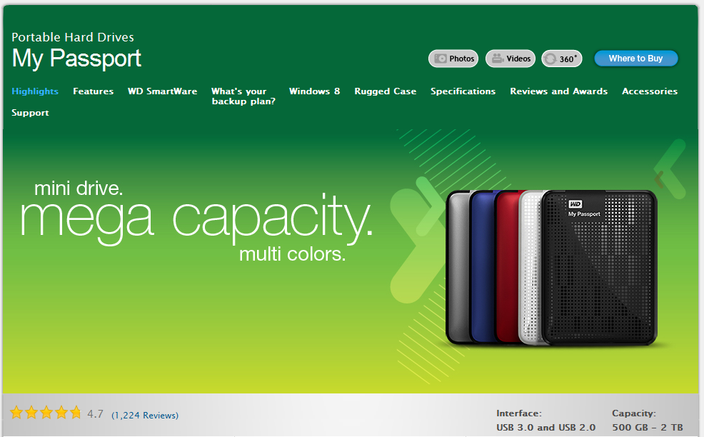
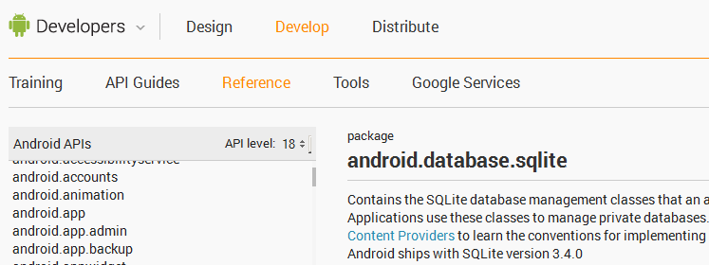
Database History
Smaller & Smaller:
MySQL for multiple PC Platforms
SQLite for Android
Terabyte Drives for PC’s

Slide 14
Database Future
Bigger & Bigger
Google holds petabytes of data from web crawsl
Information Integration
Data Warehousing
Parallelism:
Hadoop

Slide 15
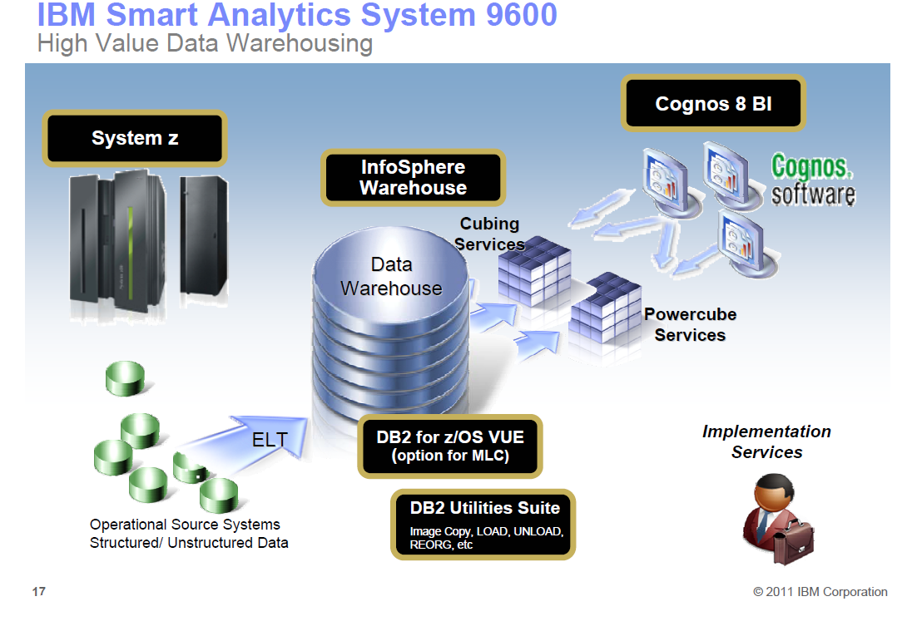
Data Warehousing

Slide 16
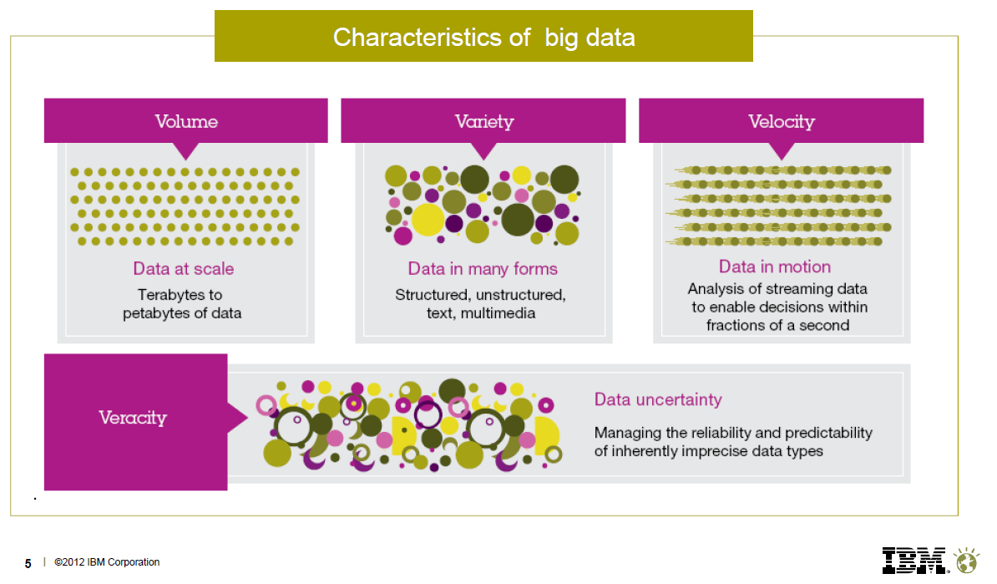
Big Data

Slide 17
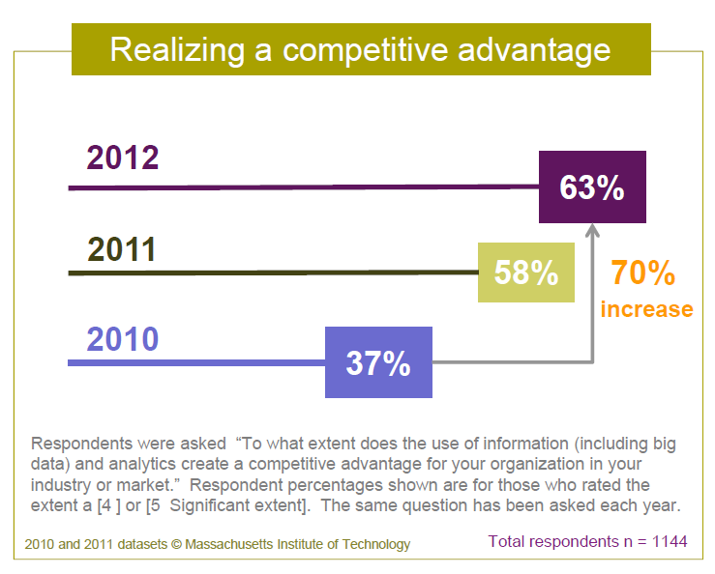
Big Data

Slide 18
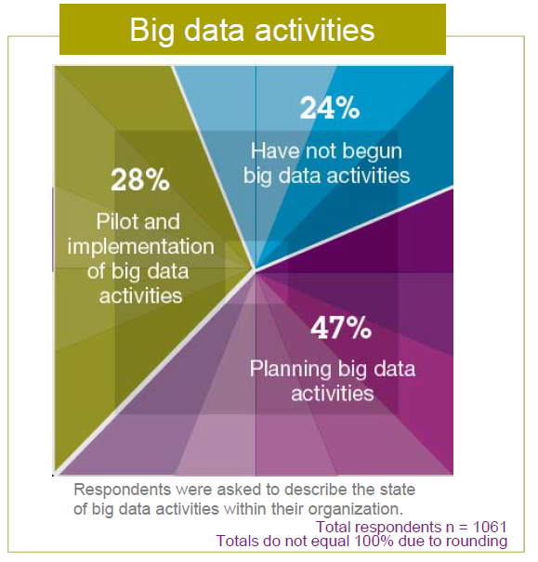
Big Data

Slide 19
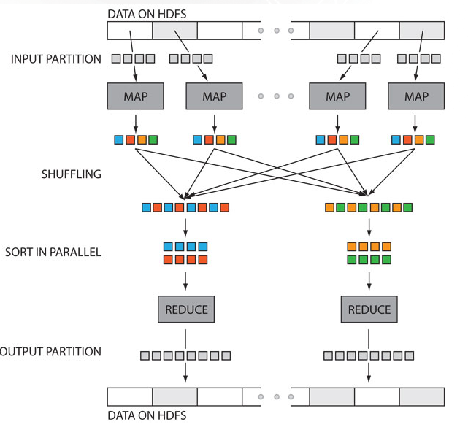
Parallelism: Hadoop
Hadoop is both a parallel computing system and a parallel database.

Slide 20
Quiz 1: Five Things You should know now…
What percentage of your grade is covered by assignments in-class ??
How may Gigabytes in a Petabyte?
What does ‘C’ stand for in ACID Properties of TransActions?
What Programming Language will assignments be in?
Why are we here?

