Slide 1
Quiz 5: Review
PROJECTION: Y := π_{L} (X)
Select a set of attributes/columns of relation
SELECTION: Y := σ_{C} (X)
Select a set of rows of a relation
Based on boolean condition C

Slide 2
Quiz 5: Review
PRODUCT: X Χ Y
Each rows of X attached to Each Possible row of Y
THETA-JOIN: R1 ⋈_{C} R2
Take Product: R1 Χ R2
Take Result: σ_{C}
NATURAL JOIN R1 ⋈ R2.
Take Product: R1 Χ R2
Take Result: σ_{C}, identical attributes are equal
Remove redundant attributes

Slide 3
Assignment 2 Review
GitHub

Slide 4
Assignment 2: Data
R1
K | A | B | C
4 | 2 | 0 | 6
5 | 2 | 0 | 5
1 | 1 | 3 | 8
2 | 1 | 3 | 7
3 | 2 | 3 | 3
R2
K | D | E
4 | 1 | 6
5 | 1 | 5
1 | 1 | 8
2 | 1 | 7
3 | 1 | 3
R5
C | C1 | C2 | C3 | C4 | C5
4 | 2 | 0 | 6 | 1 | 6
5 | 2 | 0 | 5 | 1 | 5
1 | 1 | 3 | 8 | 1 | 8
2 | 1 | 3 | 7 | 1 | 7
3 | 2 | 3 | 3 | 1 | 3
R4
B | B1 | B2
0 | 0 | 0
3 | 9 | 27

Slide 5
Assignment 2 Review
create table R1 ( K int key, A int, B int, C int);
create table R2 ( K int key, D int, E int);
create table R3 ( A int key, A1 int, A2 int, A3 int);
create table R4 ( B int key, B1 int, B2 int);
create table R5 ( C int key, C1 int, C2 int, C3 int, C4 int, C5 int);
insert into R1 (K, A, B, C) values (4, 2, 0, 6), (5, 2, 0, 5), (1, 1, 3, 8), (2, 1, 3, 7),
(3, 2, 3, 3);
insert into R2 (K, D, E) values (4, 1, 6), (5, 1, 5), (1, 1, 8), (2, 1, 7), (3, 1, 3);
insert into R3 (A, A1, A2, A3) values (2, 4, 6, 8), (1, 2, 3, 4);
insert into R4 (B, B1, B2) values (0, 0, 0), (3, 9, 27); -2 points if extra data /no key for R4
- No way to re-create the table from instructions if you have too many copies of the data.
- B should be a key
insert into R5 (C, C1, C2, C3, C4, C5) values (4, 2, 0, 6, 1, 6), (5, 2, 0, 5, 1, 5),
(1, 1, 3, 8, 1, 8), (2, 1, 3, 7, 1, 7), (3, 2, 3, 3, 1, 3);

Slide 6
SQL 2 Chapter 6
Renaming Attributes/String Constants
Subqueries
In, Not In
Exists, Not Exists
Any, All
Examples

Slide 7
Select-From-Where Statements
Always remember, and never forget:
SELECT * FROM table ;
SELECT attribute FROM table
WHERE attribute = value ;

Slide 8
Select-From-Where Statements
Always remember, and never forget:
SELECT * FROM table ;
SELECT attribute FROM table
WHERE attribute = value ;
SELECT desired attributes
FROM one or more tables
WHERE condition about tuples of
the tables

Slide 9
Renaming Attributes
SELECT product.model, pc.model, price,
'PC' AS ctype
FROM product, pc
WHERE product.maker = 'B'
AND product.model = pc.model
UNION SELECT product.model, laptop.model, price,
'laptop' as ctype
FROM product, laptop
WHERE product.maker = 'B'
AND product.model = laptop.model ;

Slide 10
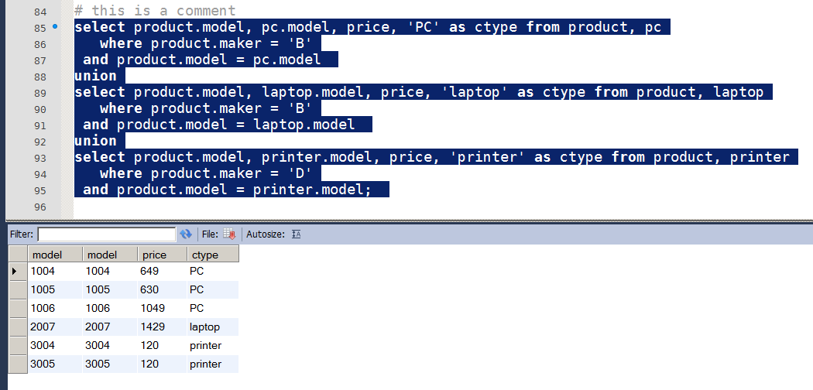
Renaming Attributes

Slide 11
Expressions in Select
SELECT product.model, pc.model,
price/100.0 as ‘price’,
'PC' AS ctype
FROM product, pc
WHERE product.maker = 'B'
AND product.model = pc.model
UNION SELECT product.model, laptop.model, price,
'laptop' as ctype
FROM product, laptop
WHERE product.maker = 'B'
AND product.model = laptop.model ;

Slide 12
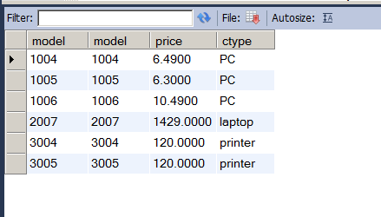
Expressions in Select

Slide 13
Subqueries
Subquery is a parenthesized SELECT-FROM-WHERE statement
Subquery places like FROM and WHERE clause.
in place of a relation in the FROM clause, we can use a subquery and then query its result.
Must use a tuple-variable to name tuples of the result.

Slide 14
Subqueries Exercise – 2.4.1
Product(maker, model, type)
PC(model, speed, ram, hd, price)
Laptop(model, speed, ram, hd, screen, price)
Printer(model, color, type, price)
Find those manufacturers that sell PC’s and inexpensive laptops(laptops less than 1000.00).

Slide 15
Subqueries
* Makers of inexpensive laptops
SELECT maker FROM product
NATURAL JOIN laptop
WHERE price < 1000;
* Makers of pc’s and inexpensive laptops
SELECT product.maker FROM product,
(SELECT maker FROM product
NATURAL JOIN laptop WHERE price < 1000) B WHERE product.maker = B.maker
AND product.ctype = 'pc';

Slide 16
The IN Operator
<tuple> IN (<subquery>)
TRUE: <tuple> is a member of <subquery> relation.
Opposite Value: NOT IN
Used in WHERE clause

Slide 17
Subqueries / IN
SELECT maker FROM product
NATURAL JOIN laptop
WHERE price < 1000;
SELECT maker FROM product
NATURAL JOIN laptop
WHERE price < 1000
AND maker IN
(SELECT maker FROM product WHERE ctype = 'pc');

Slide 18
Subqueries Exercise – 2.4.1
Product(maker, model, type)
PC(model, speed, ram, hd, price)
Laptop(model, speed, ram, hd, screen, price)
Printer(model, color, type, price)
ADD: Manf(maker KEY, makername)

Slide 19
Subqueries / IN
SELECT maker FROM product
NATURAL JOIN laptop
WHERE price < 1000;
SELECT maker FROM manf
WHERE maker IN
(SELECT maker FROM product
NATURAL JOIN laptop WHERE price < 1000)
AND maker IN
(SELECT maker FROM product WHERE ctype = 'pc');

Slide 20
Example: Exercise – 2.4.1
Product(maker, model, type)
PC(model, speed, ram, hd, price)
Laptop(model, speed, ram, hd, screen, price)
Printer(model, color, type, price)
d) Find those manufacturers that sell laptops, but not PC’s.

Slide 21
Example: Exercise – 2.4.1
Product(maker, model, type),
PC(model, speed, ram, hd, price)
Laptop(model, speed, ram, hd, screen, price)
Printer(model, color, type, price)
d) Find those manufacturers that sell laptops, but not PC’s.
SELECT maker FROM product
WHERE ctype = 'laptop'
AND maker NOT IN
(SELECT maker FROM product WHERE ctype = 'pc');

Slide 22
Example: Exercise – 2.4.1
Product(maker, model, type),
PC(model, speed, ram, hd, price)
Laptop(model, speed, ram, hd, screen, price)
Printer(model, color, type, price)
ADD: Manf(maker KEY, makername)
d) Find those manufacturers that sell laptops, but not PC’s.
SELECT maker FROM manf WHERE maker IN
(SELECT maker FROM product WHERE ctype = 'laptop')
AND maker NOT IN
(SELECT maker FROM product WHERE ctype = 'pc');

Slide 23
Example: Exercise – 2.4.1
Product(maker, model, type),
PC(model, speed, ram, hd, price)
Laptop(model, speed, ram, hd, screen, price)
Printer(model, color, type, price)
ADD: Manf(maker KEY, makername)
d) Find those manufacturers that sell laptops, but not PC’s.
SELECT maker FROM product WHERE ctype = 'laptop'
AND maker NOT IN
(select maker from product where ctype = 'pc')
GROUP BY maker; # Later Lecture

Slide 24
Movie Ratings Domain
Movies Table
create table movie_list
(mid int key, myear year, mname varchar(132));
Loading Data File
LOAD DATA LOCAL INFILE
'C:/Users/Administrator/Documents
/GitHub/CSci226.Fall13/assignments
/movie_ratings/movie_list.1.csv'
INTO TABLE movie_listFIELDS TERMINATED BY ']';

Slide 25
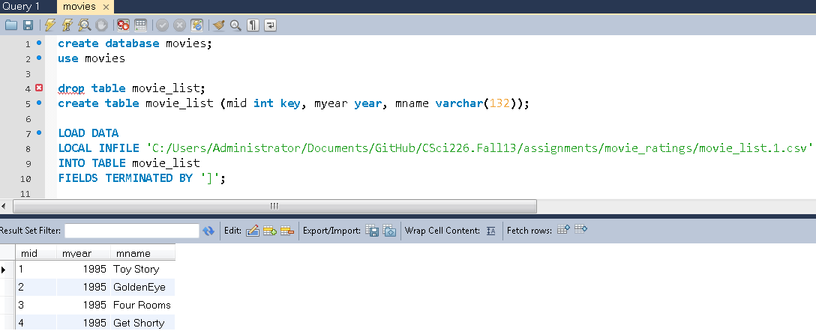
Movie Ratings Domain

Slide 26
Movie Ratings Domain
CREATE TABLE ratings (
pid int key auto_increment,
m1 int, m2 int, m3 int, m4 int, ….
….
…., m1679 int, m1680 int, m1681 int,
m1682 int) auto_increment=100,
ENGINE = MyISAM; # Needed for > 1000 Attr.

Slide 27
Movie Ratings Domain
Load sample ratings data
LOAD DATA LOCAL INFILE 'C:/Users/Administrator/Documents
/GitHub/CSci226.Fall13
/assignments/movie_ratings/ratings.1.csv'
INTO TABLE ratings
FIELDS TERMINATED BY ',‘
(m1 , m2 , m3 , m4 , ….
…..
…., m1679 , m1680 , m1681 , m1682);

Slide 28
Movie Ratings Domain
Ratings Table
CREATE TABLE movie_ratings
(pid int, mid int, rating int, key (pid, mid));
* Insert using a subquery
insert into movie_ratings
(select pid, 99, m99 as rating from ratings where m99 <>0 )
select * from movie_ratings where mid=99

Slide 29
Movie Ratings Domain
Ratings Table
CREATE TABLE movie_ratings
(pid int, mid int, rating int, key (pid, mid));
Insert using a subquery ratings data for movies (99, 313, 420, 465, 588)
INSERT INTO movie_ratings
(SELECT pid, 99, m99 AS rating FROM ratings WHERE m99 <>0 )
INSERT INTO movie_ratings
(SELECT pid, 313, m313 AS rating FROM ratings WHERE m313 <>0 );
INSERT INTO movie_ratings
(SELECT pid, 420, m420 AS rating FROM ratings WHERE m420 <>0 );
INSERT INTO movie_ratings
(SELECT pid, 465, m465 AS rating FROM ratings WHERE m465 <>0 );
INSERT INTO movie_ratings
(SELECT pid, 588, m588 AS rating FROM ratings WHERE m588 <>0 );

Slide 30
Movie Ratings Domain
Queries : Look at ratings for a group of movies.
List names for group of movies
select * from movie_list where mid in
(99, 313, 420, 465, 588)
mid | Myear | Mname
99 | 1937 | Snow White and the Seven Dwarfs
313 | 1997 | Titanic
420 | 1951 | Alice in Wonderland
465 | 1994 | Jungle Book, The
588 | 1991 | Beauty and the Beast

Slide 31
Movie Ratings Domain
Queries : Look at ratings for a group of movies.
select a.pid, a.rating, b.rating, c.rating, d.rating, e.rating
from movie_ratings a, movie_ratings b,
movie_ratings c, movie_ratings d, movie_ratings e
where a.pid=b.pid and b.pid =c.pid and c.pid = d.pid
and d.pid = e.pid and a.mid = 99 and b.mid = 313
and c.mid = 420 and d.mid = 465 and e.mid = 588

Slide 32
Movie Ratings Domain
pid | rating | rating | rating | rating | rating
137 | 5 | 5 | 5 | 5 | 5
148 | 4 | 3 | 4 | 3 | 4
184 | 5 | 4 | 4 | 4 | 3
193 | 3 | 4 | 4 | 5 | 4
229 | 5 | 5 | 5 | 5 | 4
299 | 5 | 5 | 5 | 4 | 5
379 | 2 | 3 | 3 | 3 | 5
477 | 4 | 5 | 4 | 3 | 5
492 | 3 | 4 | 3 | 4 | 4
504 | 5 | 4 | 5 | 1 | 2
571 | 3 | 5 | 3 | 3 | 3
719 | 3 | 5 | 3 | 4 | 5
741 | 2 | 5 | 4 | 4 | 5
906 | 5 | 5 | 3 | 4 | 5
1010 | 3 | 2 | 4 | 5 | 4

Slide 33
Movie Ratings Domain
pid | 99 | 313 | 420 | 465 | 588
137 | 5 | 5 | 5 | 5 | 5
229 | 5 | 5 | 5 | 5 | 4
299 | 5 | 5 | 5 | 4 | 5
906 | 5 | 5 | 3 | 4 | 5
504 | 5 | 4 | 5 | 1 | 2
184 | 5 | 4 | 4 | 4 | 3
477 | 4 | 5 | 4 | 3 | 5
148 | 4 | 3 | 4 | 3 | 4
719 | 3 | 5 | 3 | 4 | 5
571 | 3 | 5 | 3 | 3 | 3
193 | 3 | 4 | 4 | 5 | 4
492 | 3 | 4 | 3 | 4 | 4
1010 | 3 | 2 | 4 | 5 | 4
741 | 2 | 5 | 4 | 4 | 5
379 | 2 | 3 | 3 | 3 | 5

Slide 34
Movie Ratings Domain
Queries : What was average movie rating for a set of movies?
select (select mname from movie_list where mid=99) AS 'Movie',
count(*) as 'number of reviews',
avg(rating) as 'avg rating'
from movie_ratings where mid=99
UNION
select (select mname from movie_list where mid=313) AS 'Movie',
count(*) as 'number of reviews',
avg(rating) as 'avg rating' from movie_ratings where mid=313;

Slide 35
Movie Ratings Domain
Queries : What was average movie rating for a set of movies?
Movie | number of reviews | avg rating
Titanic | 350 | 4.2457
Beauty and the Beast | 202 | 3.7921
Snow White and the Seven Dwarfs | 172 | 3.7093
Alice in Wonderland | 81 | 3.6667
Jungle Book, The | 85 | 3.5647

Slide 36
Movie Ratings Domain
Queries : How many records in DB where two people equally rated the same movie.
select count(*)
from movie_ratings a, movie_ratings b
where a.mid = b.mid and
a.rating = b.rating and
a.pid < b.pid;

Slide 37
Songs Domain
Queries : List all songs by three different artists.
select artist, track from songs
where upper(artist) like upper('%eagles%' ) union
select artist, track from songs
where upper(artist) like upper('%Allman%' ) union select artist, track from songs
where upper(artist) like upper('%Clearwater%' );

Slide 38
Songs Domain: Efficiency Example
Queries : List all songs by three different artists.
MySQL query goes on and on.
Select * from songs where artist in
( select artist from songs
where upper(artist) like upper('%eagles%') UNION select artist from songs
where upper(artist) like upper('%allman%') )

Slide 39
Python Challenge 1
Automate this process in Python
Ratings Table
CREATE TABLE movie_ratings
(pid int, mid int, rating int, key (pid, mid));
Insert using a subquery ratings data for movies (99, 313, 420, 465, 588)
INSERT INTO movie_ratings
(SELECT pid, 99, m99 AS rating FROM ratings WHERE m99 <>0 )
INSERT INTO movie_ratings
(SELECT pid, 313, m313 AS rating FROM ratings WHERE m313 <>0 );
INSERT INTO movie_ratings
(SELECT pid, 420, m420 AS rating FROM ratings WHERE m420 <>0 );
INSERT INTO movie_ratings
(SELECT pid, 465, m465 AS rating FROM ratings WHERE m465 <>0 );
INSERT INTO movie_ratings
(SELECT pid, 588, m588 AS rating FROM ratings WHERE m588 <>0 );

Slide 40
Python Challenge 2
Person Table: Create dummy data
CREATE TABLE person
(pid int key, fname varchar (20), lname varchar(20), gender char(1), spouse int);
INSERT INTO person VALUES
(100, ‘John’, ‘Doe100’, ‘m’, null),
(101, ‘Jane’, ‘Doe101’, ‘f’, 102),
(102, ‘John’, ‘Doe102’, ‘m’, 101), ….

Slide 41
Insert + Subquery
INSERT INTO Transcript
(SELECT pid, semester, year, CourseID, CourseDesc, units, grade
FROM StudentDB JOIN Person
ON StudentDB.FName = Person.FName
AND StudentDB.LName = Person.Lname)

Slide 42
Query + Subquery
SELECT *
FROM Transcripts
WHERE StudentID =
(SELECT Pid
FROM Person
WHERE LName = ’Ruby’
AND Fname = ‘David’);

