Slide 1
ADAPTIVE GAIT REHABILITATION USING HYBRID RL ALGORITHMS
Final Project – Team 14 CSE 4/546: Reinforcement Learning

Slide 2
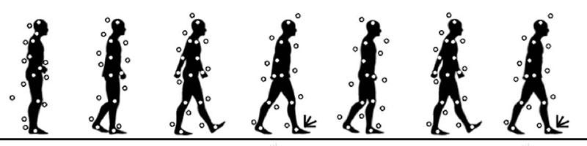
Introduction
Gait recognition – a biometric technique used to identify individuals based on their walking style.
The project aims to develop an adaptive gait rehabilitation system using a hybrid of reinforcement learning algorithms, focusing on Proximal Policy Optimization (PPO) fused with Algae algorithmic concepts.
Goal: Optimize gait patterns to meet individual patient needs for more effective rehabilitation outcomes.

Slide 3
Background
Reinforcement Learning in Rehabilitation:
RL methods can be employed to create personalized training programs for patients.
Adaptation to Individual Needs
Learning from Feedback
Optimizing Therapy
Real-Time Adjustments

Slide 4
Background
Previous Work:
Robotic exoskeletons equipped with hybrid RL can adjust to a patient's unique gait patterns, offering real-time support for effective rehabilitation.
Some studies have utilized deep reinforcement learning (DRL) framework, key-value attention-based Softmax Deep Double Deterministic policy gradients (AT_SD3) to improve gait adjustment in lower-limb exoskeletons.
Prosthetic limbs controlled by hybrid RL can adapt to a wearer's walking style, enhancing their mobility and comfort however it faced.
Some studies found a hybrid approach combining elements of both (Model-Based and Model-Free, or MBMF) yields the best performance in real-world scenarios.

Slide 5
Environment
Data:
The OU-ISIR Gait Database, Treadmill Dataset
Data Preprocessing:
Image Transformation
Image Normalization
Neural Network Architecture:
Convolutional Neural Network (CNN) with 3 Convolutional Layers with ReLU activation for image classification. Batch normalization to stabilize training and we added max-pool layer (2,2) to reduce spatial dimensions.
Fully Connected Layers with dropout of 0.5 and ReLU activation.

Slide 6
Environment
Gait Rehabilitation - PPO Environment:
Implements hybrid Algae + PPO model with multiple policies to be trained concurrently
Adam Optimizer, Learning Rate Scheduler, Cross Entropy Loss
Actor is trained on each episode with each policy
Every 5-episode an Algae method (evolve()) applies crossover and mutation among policies. Mutation on basis of simple genetic algorithm approach to evolve the policies.
AlgaePPO is trained on 50 episodes

Slide 7
Methodology
CNN + PPO Approach:
Initial experimentation utilized MNIST dataset to test this combination
Implemented an evolutionary algorithm inspired by genetic algorithms and reinforcement learning
PPO class defines methods for policy optimization, while Algae-based operations apply crossover and mutation to evolve a population of CNN models
Evolutionary Algorithm:
Leverages crossover and mutation operations to optimize neural network weights, improving model performance through evolutionary principles
Population of neural networks is initialized with random weights and evaluated for performance
Gradual improvement in model performance through iterative evolution

Slide 8
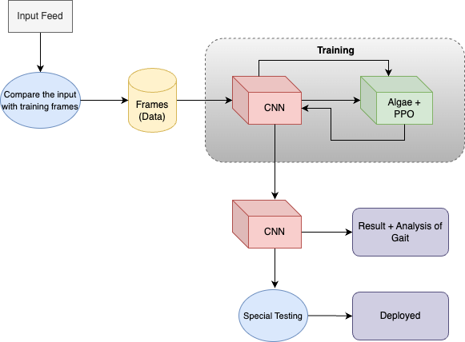
Methodology

Slide 9
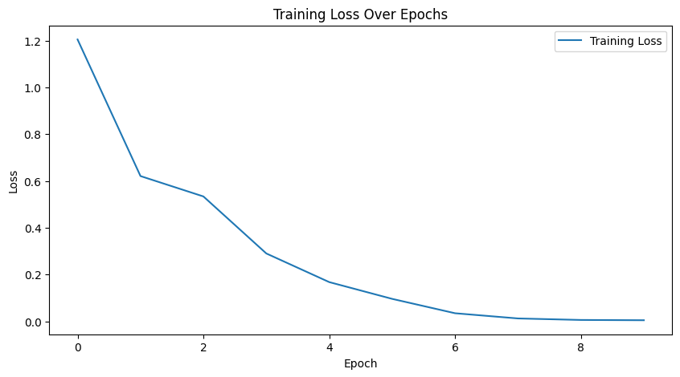
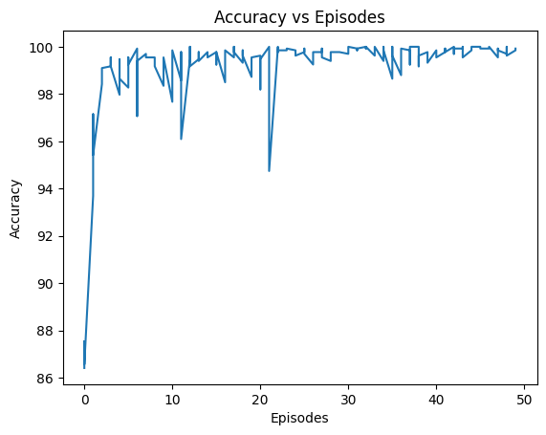
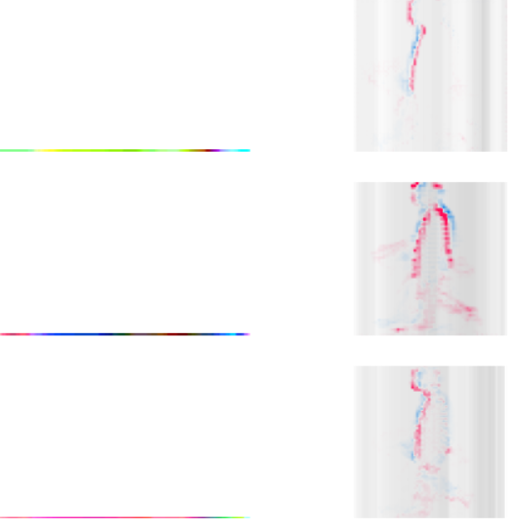
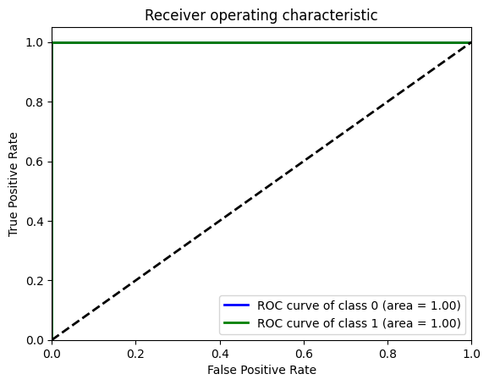
Results - Dataset D
Results Dataset B
OU-ISIR Gait Dataset Results:

Slide 10
Key Observations
Fusion of Convolutional Neural Networks (CNN) and Proximal Policy Optimization (PPO) showed a positive trend in terms of fitness, with an increasing average accuracy over 50 iterations, reaching approximately ~99%, hence showing certain amount of convergence
Evolutionary algorithm, with crossover and mutation, effectively optimized the weights of neural network models, suggesting potential for adaptive gait rehabilitation.
Initial testing on the variations of GAIT datasets demonstrated the viability of the CNN-PPO fusion, indicating a promising approach for further development in gait rehabilitation.
Next Steps:
Refine the hybrid RL algorithm, collect custom datasets, and further test and deploy in a simulated gait environment. We can also aim for continuous training and model adaptation to individual patient needs.

Slide 11
Thank you!

