Slide 1

SECURED PROCESS WITH ENHANCED COGNITIVE TECHNOLOGY FOR ELECTRONIC RECORD VERIFICATION (SPECTER)
GAUTAM GALADA | 19BCI7042
UNDER THE GUIDANCE OF DR. SIBI CHAKKARAVARTHY S

Slide 2
TABLE OF CONTENTS
COMPARATIVE ANALYSIS
WHAT MAKES LAYOUTLMV3 LARGE
EXPERIMENTAL RESULTS
PLAN OF ACTION
UPDATED MODEL ARCHITECTURE
TOOLS AND FRAMEWORK
TIMELINE
UNTIL THE NEXT REVIEW

Slide 3
COMPARATIVE ANALYSIS
 | Microsoft Lens | I Love PDF | Super.AI | LayoutLMv3
Use Case | Mobile scanning app for scanning documents, whiteboards, and business cards | Online platform for working with PDF files | Document processing with human-in-the-loop workflow | Language and layout-aware pre-trained model for processing complex documents
Functionalities | Scanning documents, whiteboards, and business cards | PDF editing, conversion, compression, merging, splitting, and securing | Industry-leading document processing with OCR, AI platform, automatic automation, guaranteed outcomes, and Data Processing Crowd | Document understanding, information extraction, document classification
OCR Technology | Yes | Basic | Yes | Yes
Language Recognition | Yes | No | Yes | Yes
Handling Complex Documents | Limited capabilities for complex documents | - | Centric towards unstructured data but works well with complex data as well | Specialized in processing complex documents

Slide 4
WHAT MAKES LAYOUTLMV3 SO LARGE?
Multimodal Transformer Architecture: LayoutLMv3 uses a unified text-image multimodal Transformer architecture with self-attention and fully connected networks. This enables it to combine text and image embeddings and learn cross-modal representations.
Text Embedding: LayoutLMv3 incorporates word embeddings and position embeddings to capture textual content and 2D layout position information. Word embeddings are initialized using pre-trained models like RoBERTa. The model includes 1D and 2D position embeddings, normalizing coordinates and using embedding layers for positional features.
Image Embedding: Instead of CNNs, LayoutLMv3 represents document images as linear projection features of image patches. These patches are obtained by resizing the image, and 1D position embeddings are added to each patch.
Relative Position and Spatial Bias: LayoutLMv3 incorporates semantic 1D relative position and spatial 2D relative position as bias terms in self-attention networks. This allows the model to capture contextual and spatial relationships between tokens and image patches.
Self-Supervised Learning Objectives: LayoutLMv3 is pre-trained using MLM, MIM, and WPA objectives. These self-supervised learning objectives enable the model to learn multimodal representations without explicit labeled data.

Slide 5

EXPERIMENTAL RESULTS
MODEL QUANTIZATION PERFORMED :
The following model quantization was performed on RoBERTa
QUANTIZATION :
Model Weights: We convert the floating-point weights of RoBERTa's layers to lower-precision fixed-point or integer formats, reducing memory usage.
Activations: Intermediate activations generated during model inference are quantized, using lower-precision formats, to improve memory efficiency and inference speed.
Other components, including biases and embeddings, can also be quantized during model quantization to achieve a further reduction in the memory footprint of RoBERTa-based models.

Slide 6
PLAN OF ACTION (200 MB)
Task | Status | Insight
Design task-specific models | ✔
Apply model compression techniques (quantization, pruning, knowledge distillation) | ✔
Explore compact model architectures (MobileBERT, TinyBERT, DistilBERT) | ✔ | Squeeze BERT
Augment data for increased diversity | ✔ | Image : Rotation, Noise injection, Background. Text : Synonyms and paraphrasing the text, working with dictionaries
Perform transfer learning with fine-tuning using a smaller base model |  | Working on building the model emphasizing MLM, MIM, WPA
Filter training data to focus on high-quality and relevant samples
Utilize efficient inference techniques (model quantization, optimization libraries)
Regularly update and refine the model to incorporate new advancements.

Slide 7
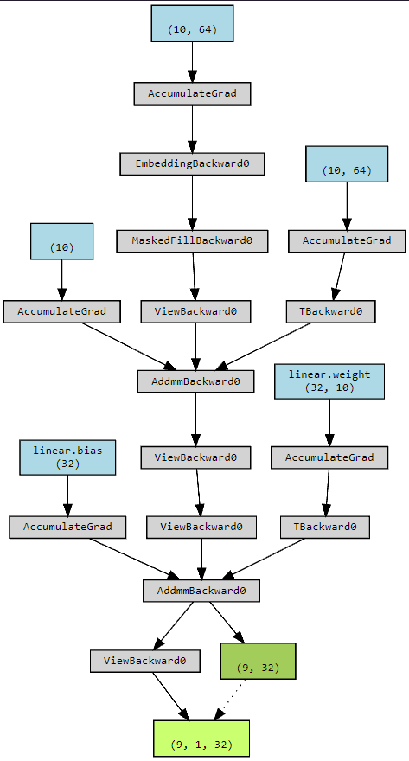
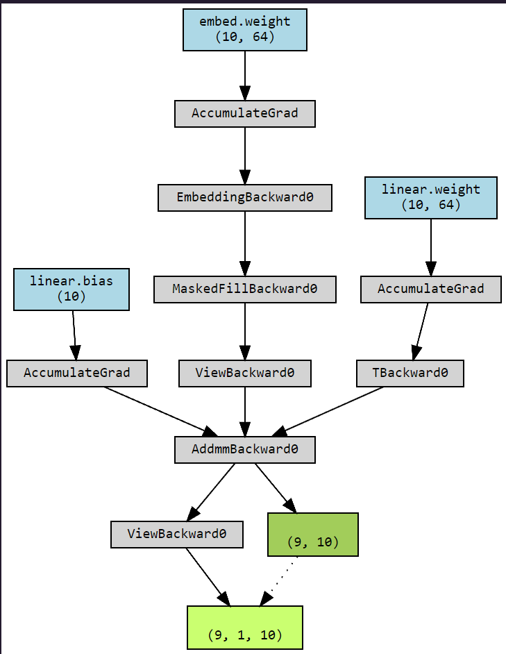
MODEL ARCHITECTURE (UNDER DEVELOPMENT)
The following modules are MLM and MIM modules
MLM : Masked Language Modeling
MIM : Masked Image Modeling
(CURRENT SIZE : 48.7 MB)

Slide 8
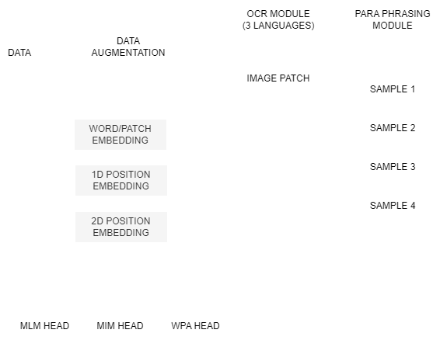
REAL-TIME INPUT AND MODEL FLOW
MLM: Masked Language Modeling (MLM) is a technique that masks words in a text and trains a model to predict the missing words based on context.
MIM: Masked Image Modeling (MIM) is a method that masks parts of an image and trains a model to predict the missing or occluded regions using surrounding visual information.
WPA: Word-Patch Alignment (WPA) is a pre-training method that aligns textual and visual elements in documents to capture the contextual relationship between text and layout, enhancing information extraction from structured documents.
SPECTER MODULE

Slide 9
TOOLS AND FRAMEWORK
FLUTTER
TESSERACT 4
UNIT TESTING (PYTHON)
1
2
3
4
5
DOCKER
FIREBASE
6
7
8
9
9
PYTORCH
TENSORFLOW
ONNX
UBUNTU ENV
ONNX

Slide 10
TIMELINE
REVIEW - 1 |  |  | REVIEW - 2 |  |  | REVIEW - 3 |  |  | PROJECT SUBMISSION
11 | MAR | 2023 | 26 | APR | 2023 | XX | MAY | 2023 | XX | MAY | 2023
THEORETICAL APPROACH (idea) |  |  | PROTOTYPE DEVELOPMENT (prototype in progress) |  |  | REDEFINING AND PIVOTING (OPTIMIZED) |  |  | PROJECT REPORT + CODEBASE

Slide 11
UNTIL THE NEXT REVIEW
BUILD THE WPA HEAD
OPTIMIZE ALL THE MODEL HEADS
TRAIN THEM ON AUGMENTED DATA
BUILD THE FEDERATED TRAINING PIPELINE
GENERATE RESULTS
GETTING THE PROTOTYPE READY

Slide 12
BUILDING AI..
THANK YOU
GAUTAM GALADA | 19BCI7042
SENIOR DESIGN PROJECT REVIEW - 3

