Slide 1
HR Attrition Dashboard
An Analytical Overview
Presented by: Gautam Narayan Rane

Slide 2
Problem Statement
Objective:
Understand and analyze employee attrition to improve retention strategies.

Slide 3
Dataset Overview
Source: HR dataset with demographics, job roles, satisfaction & attrition status
Size: Approx. 1,470 records
Time Frame: Recent employee data snapshot

Slide 4
DAX Measures Created
• Total Employees = COUNT(EmployeeID)
• Attrition Count = CALCULATE(COUNT(EmployeeID), HR[Attrition] = "Yes")
• Attrition Rate (%) = DIVIDE([Attrition Count], [Total Employees])
• Average Job Satisfaction = AVERAGE(HR[JobSatisfaction])
• Average Environment Satisfaction = AVERAGE(HR[EnvironmentSatisfaction])

Slide 5
Visuals Overview
• Bar Chart – Employees by Department
• Stacked Bar Chart – Attrition by Gender
• Line Chart – Age Group vs. Attrition
• Donut Chart – Gender Distribution
• Stacked Column Chart – Salary Bucket vs. Attrition
• Clustered Bar – Job Role vs. Satisfaction

Slide 6
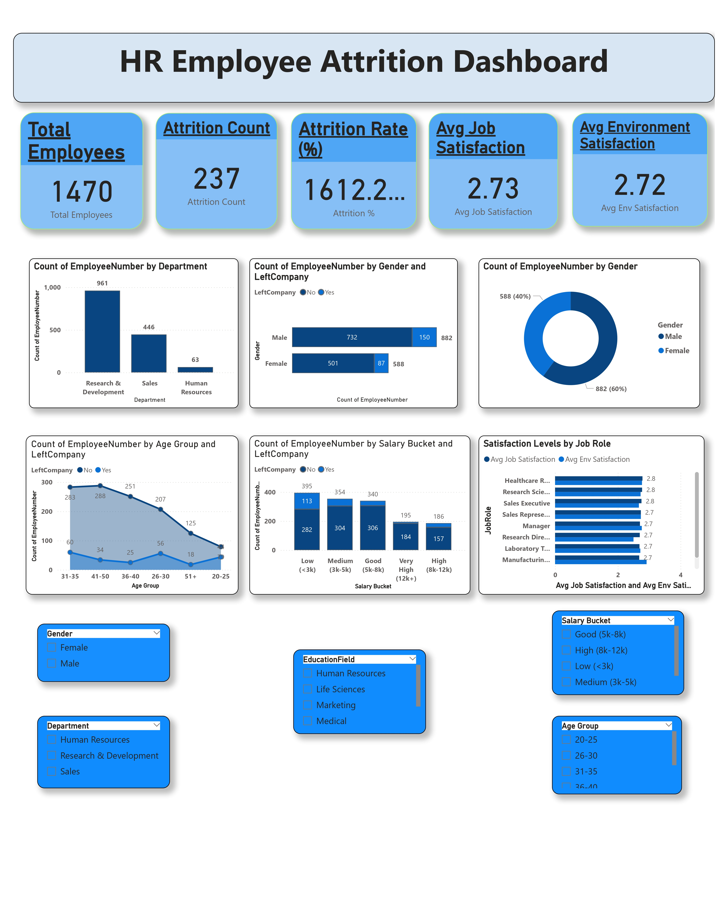

Slide 7
Key Insights
• Highest Attrition in Sales & R&D departments
• Age group 26-30 has highest attrition
• Low salary bracket (<3k) shows highest attrition
• Gender ratio: 60% Male, 40% Female

Slide 8
Business Impact / Conclusion
• Identified high-risk areas for employee attrition
• Insights help HR focus retention strategies
• Improved employee satisfaction can reduce attrition

Slide 9
Tools Used & Learnings
Tools:
• Power BI
• DAX
Learnings:
• Built end-to-end dashboard
• Gained business storytelling & data visualization skills

Slide 10
Thank you !

