Slide 1

SMART INDIA HACKATHON 2026
TITLE PAGE
Problem Statement ID – 26060
Problem Statement Title- Digital Twin Platform for India's Antarctic Research Stations (Maitri & Bharati)
Theme- Smart Automation
PS Category- Software
Team ID-
Team Name (Registered on portal) Commit Crew

Slide 2

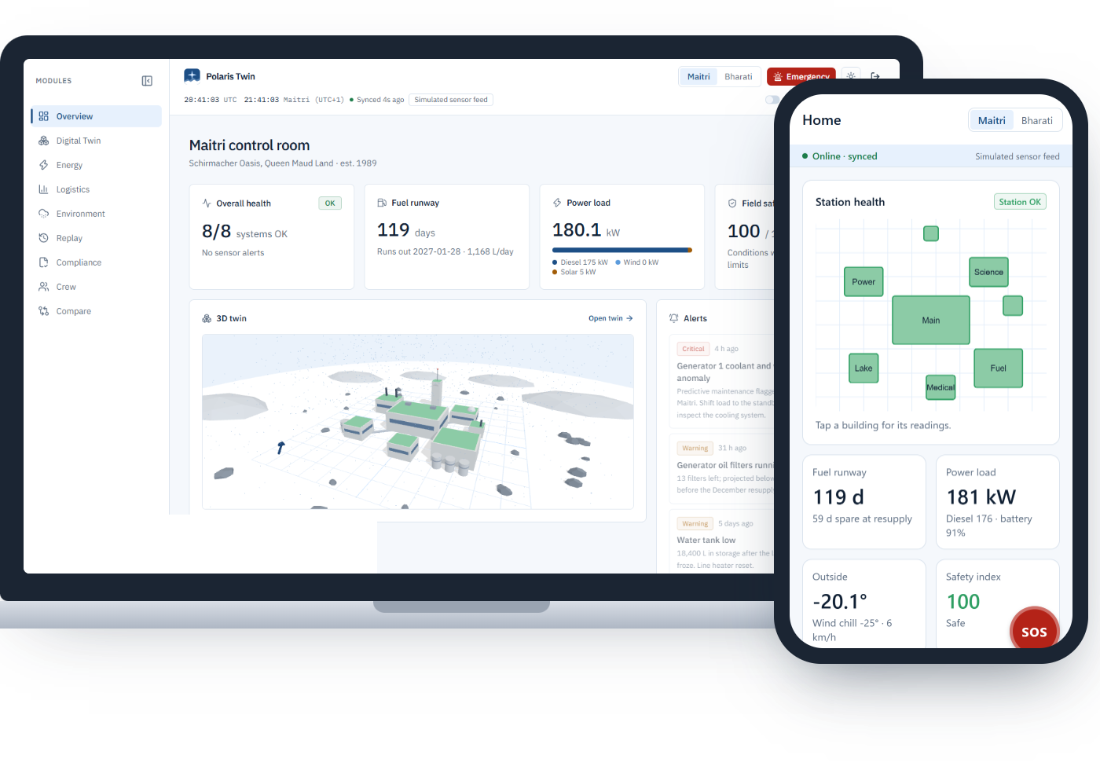

POLARIS TWIN
❖ Proposed Solution (Describe your Idea/Solution/Prototype)
A live digital twin of each station (buildings, generators, fuel, stores, weather and crew) shared by the NCPOR control room in Goa and the crew on the ice.
❖ Detailed explanation of the proposed solution
Web dashboard (NCPOR Goa): 3D twin, energy, logistics, environment, replay, compliance, compare, emergency mode.
Crew Android app: alerts, 2-second-hold SOS, field check-out, inventory scanning, wellbeing check-in.
Ask Polaris copilot: Gemini answers in English / हिंदी from live data and station SOPs.
❖ How it addresses the problem
Integrates infrastructure, energy, logistics and environment in one model for remote management.
Predicts fuel runway and generator faults before they become emergencies.
Edge-first: the station keeps working when the satellite link drops; ≈0.5 KB delta syncs.
❖ Innovation and uniqueness
Offline queue with SOS priority, built for Antarctic connectivity.
One shared logic core: web, app and copilot always show the same numbers.
Ship-delay and cold-snap what-ifs, explainable alerts with time-to-limit.
Working prototype, live today
polaris-twin-psi.vercel.app
Web dashboard + Android APK (Expo)
Simulated sensor feed; real Open-Meteo weather

Slide 3

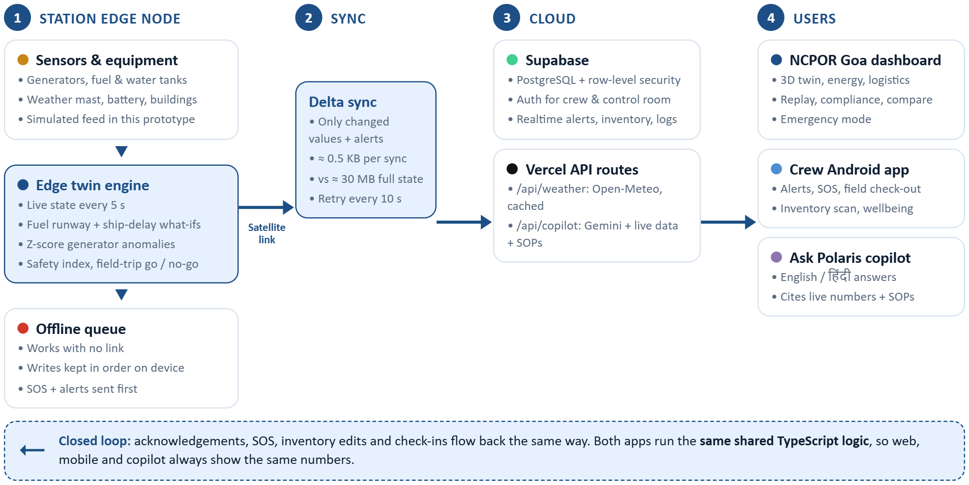








TECHNICAL APPROACH
❖ Technologies to be used
❖ Methodology and process for implementation (Flow Charts/Images/ working prototype)
Next.js 16
Web dashboard + API
React · R3F / three.js
3D digital twin
TypeScript
Shared logic core
Tailwind CSS · shadcn/ui
UI · Recharts charts
Expo (React Native)
Crew app · EAS build
Supabase
Auth · Realtime
PostgreSQL
Row-level security
Google Gemini
Ask Polaris copilot
Vercel
Hosting · Open-Meteo proxy
Process: Simulate → model the twin → predict → sync deltas → act. Prototype built and deployed; next, real sensors replace the simulator through an MQTT adapter.

Slide 4
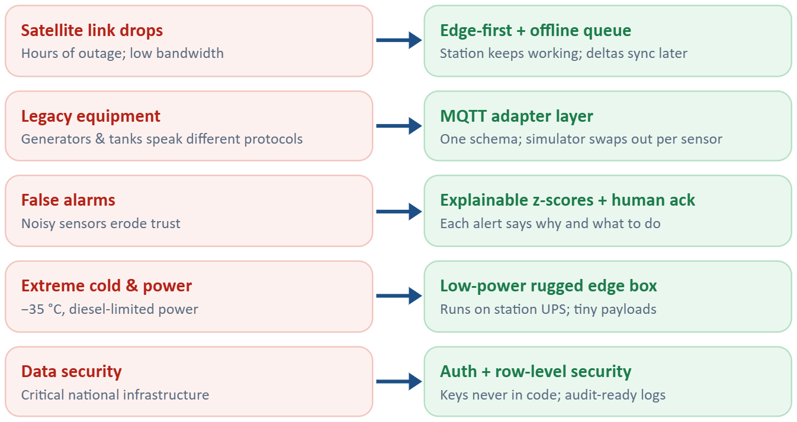
FEASIBILITY AND VIABILITY
❖ Analysis of the feasibility of the idea
Technical: end-to-end prototype already running: live website, Android APK, realtime database and AI copilot.
Bandwidth: ≈0.5 KB delta per sync instead of ≈30 MB, fits a constrained satellite link.
Cost: open-source frameworks and free tiers; one small edge box per station.
Operational: dashboard and app need no special hardware; works in English and Hindi.
❖ Phased rollout
Phase 1: pilot at Maitri with generator, fuel and weather sensors.
Phase 2: add Bharati and inventory linked to the ISEA ship manifest.
Phase 3: full building systems, maintenance history, offline voice copilot.
❖ Potential challenges and risks
❖ Strategies for overcoming these challenges
2 apps
9
≈0.5 KB
web + Android, live
dashboard modules built
per satellite sync

Slide 5
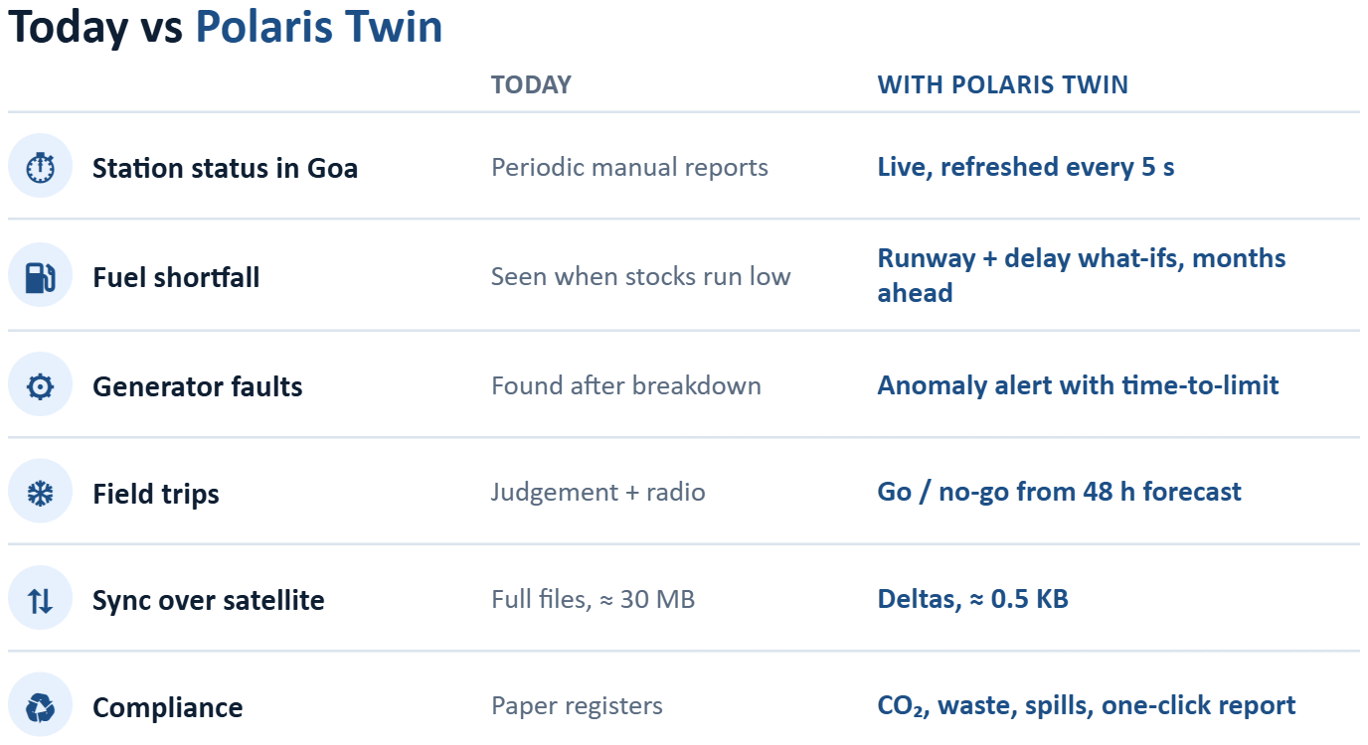
IMPACT AND BENEFITS
❖ Potential impact on the target audience
NCPOR Goa: live view of both stations, early warnings, one-click compliance reports.
Station leader & crew: SOS, overdue-trip alarms, go / no-go before every field trip.
Logistics planners (ISEA): know what runs out before resupply and plan the ship load.
MoES: data-backed planning for future stations and budgets.
❖ Benefits of the solution (social, economic, environmental, etc.)
Social: safer field work, faster emergency response, anonymous crew wellbeing tracking.
Economic: less diesel waste, fewer breakdowns, fewer emergency resupplies.
Environmental: CO₂, waste and spill tracking under the Madrid Protocol and Indian Antarctic Act 2022.
Strategic: strengthens India's polar research presence with home-grown technology.
5 s
60,000×
48 h
live refresh in Goa
smaller syncs than full state
forecast behind go / no-go

Slide 6
RESEARCH AND REFERENCES
❖ Details / Links of the reference and research work
Domain & policy
NCPOR, Ministry of Earth Sciences: ncpor.res.in
Maitri station: en.wikipedia.org/wiki/Maitri_(research_station)
Bharati station: en.wikipedia.org/wiki/Bharati_(research_station)
Protocol on Environmental Protection (Madrid Protocol): ats.aq/e/protocol.html
Indian Antarctic Act, 2022, Ministry of Earth Sciences: moes.gov.in
COMNAP, Council of Managers of National Antarctic Programs: comnap.aq
Research
M. Grieves, Digital Twin: Manufacturing Excellence through Virtual Factory Replication (white paper, 2014)
Digital twin overview: en.wikipedia.org/wiki/Digital_twin
Technology documentation
Open-Meteo weather API: open-meteo.com/en/docs
Supabase Realtime: supabase.com/docs/guides/realtime
Next.js: nextjs.org/docs
Expo EAS Build: docs.expo.dev/build/introduction
Gemini API: ai.google.dev/gemini-api/docs
Our prototype
Live dashboard: polaris-twin-psi.vercel.app
Demo login shown on the sign-in page
Scan for the live prototype

