Slide 1
Patching Automation with Ansible

Slide 2
Agenda
What is Ansible?
Advantages of Ansible
Ansible’s Feature and Capabilities
Ansible Architecture
Ansible Pre-requisites
Use Case Walkthrough and Flow chart
Ansible Installation
AWX Vs Ansible Tower
Why Open SSH?

Slide 3
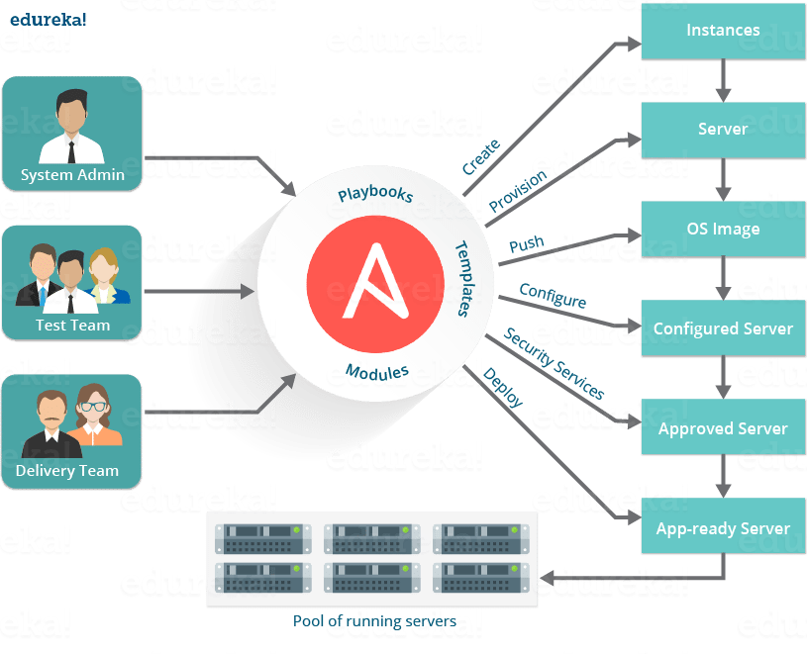
What is Ansible?
Ansible is an agentless automation tool that you install on a single host (referred to as the control node).
From the control node, Ansible can manage an entire fleet of machines and other devices (referred to as managed nodes) remotely with SSH, PowerShell remoting, and numerous other transports, all from a simple command-line interface with no databases or daemons required.

Slide 4
Advantages of Ansible
Free
Ansible is associated in nursing ASCII text file tool.
Very Straight forward to line up and use: No Special writing skills are necessary to use Ansible's playbooks.
Powerful
Ansible enables us to model even extremely complicated IT workflows.
Flexible
We can orchestrate the whole application setting in spite of wherever it’s deployed.
Agentless
We don’t have to be compelled to install the other compute codes or firewall ports on the shopper system we wish to alter.
Efficient
Being agentless makes Ansible efficient as we don’t have to worry about non-reporting client troubleshooting.

Slide 5
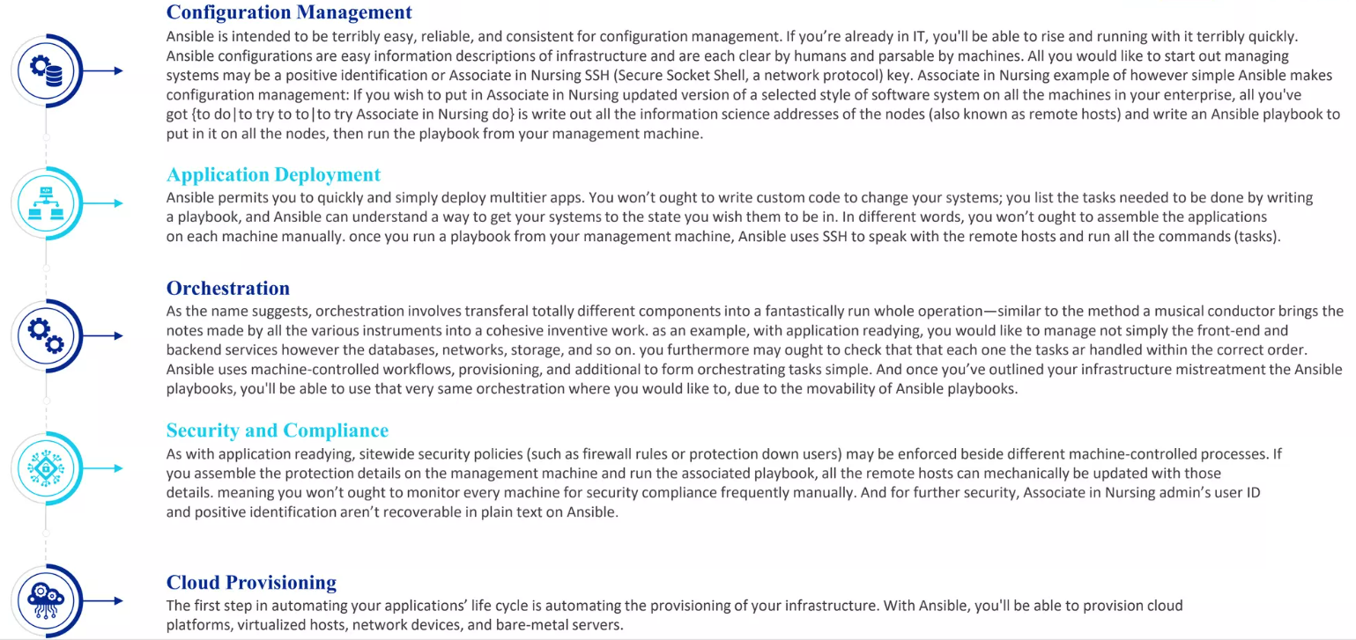
Ansible Features and Capabilities

Slide 6
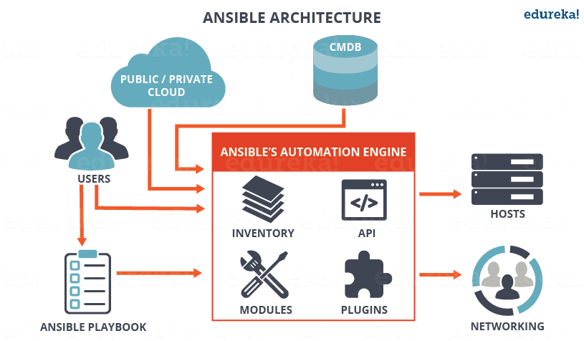
Ansible Architecture

Slide 7
AWX Vs Ansible Tower
 | Stability | Security | Access to Red Hat expertise | Upgrades
AWX | AWX is a development branch. Frequent changes are introduced and can be released with only minimal testing. This can limit adoption across an enterprise. | AWX code has not gone through full quality engineering (QE) testing and does not include signed or security- hardened images. To protect against risk, most security professionals expect a signed image and will not sanction unsigned images for enterprise use. AWX does not provide security fixes for prior releases. Any security fixes are only applied to the development stream. | Users do not have access to Red Hat’s world-class support. In addition, there are no training or consulting services available from Red Hat on AWX. | AWX contains only minimal support for upgrades between versions and is not tested for upgrades across multiple versions. Users may have to rebuild and reconfigure every time. This includes credentials, Lightweight Directory Access Protocol (LDAP) authentication, data extraction, etc.
Red Hat Ansible Tower | Customers can count on receiving the latest product versions with the stability and security they have come to expect from Red Hat. | Customers can rely on security patches and bug fixes being delivered for the entire life of the product. | Customers have access to information and support services that span the entire application infrastructure, life cycle, and architecture. Red Hat has helped customers implement some of the largest and most complex Ansible Tower deployments, sharing that knowledge to the benefit of Ansible Tower customers. Ansible Tower customers also may choose to use expert Red Hat resources for training, consulting, and building their automation practice. | Because of clear and manageable upgrade paths and product life cycles, customers are not caught off guard with mandatory updates.

Slide 8
Ansible Pre-requisites
Ansible node requirements
Ansible node (the machine that runs Ansible), we can use nearly any UNIX-like machine with Python 3.9 or newer installed. This includes Red Hat, Debian, Ubuntu, macOS, BSDs, and Windows under a Windows Subsystem for Linux (WSL) distribution. Windows without WSL is not natively supported as a control node;
A user with password less authentication enabled across all the manage nodes.
A user should have privileges to run the required commands on managed node.
Managed node requirements
The managed node (the machine that Ansible is managing) does not require Ansible to be installed.
The managed node also needs a user account that can SSH to the node with an interactive POSIX shell.

Slide 9
Ansible Installation
Update ansible node with the latest patches.
# sudo yum update -y
Check python version installed on the server and validate if it meets the requirement. (Installing Ansible — Ansible Documentation)
# sudo rpm -qa | grep python
Install python of required version.
# sudo yum install python<version_name>
Install Ansible using below command.
# sudo yum install ansible -y

Slide 10
Why Open SSH?
It is the second widely used SSH connectivity tools that are available as an open-source version on the web. This tool is appropriate for use in Windows, Linux, and Mac OS.
It encrypt all the traffic that travels between the two designated systems over the internet. It can easily encrypt all communication and passwords, to prevent any connection hijacking and eavesdropping. This ensures safe and secure communication on an unsecured network like the internet.
This suite comprises of the below-mentioned tools:
Remote operations are performed through using ssh, sftp, and scp.
Key management is done using various keys such as ssh-keygen, ssh-keyscan, ssh-add and ssh-keysign.
The service side consists of sshd, ssh-agent, and sftp-server.
Strong cryptography is provided with AES, ECDSA, Ed25519, ChaCha20.
Encryption is started before authentication, and no passwords or other information is transmitted in the clear. Encryption is also used to protect against spoofed packets. Several different ciphers and key types are available, and legacy options are usually phased out in a reasonable amount of time.
The communication happens with public and private key of ansible server. Private key is kept safe in ansible server and public key is copy pasted on managed windows nodes. Then, data that goes from ansible is encrypted by private key and decrypted at client end by public key.
Strong authentication (public keys, one-time passwords)
Strong authentication protects against several security problems: IP spoofing, fakes routes and DNS spoofing. Some authentication methods include public key authentication, one-time passwords with s/key and authentication using Kerberos (only in -portable).

Slide 11
Problem Statement
Currently, GMS Engineers are performing the Manual patching for most of the accounts which is time consuming and requires dedicated efforts.
Solution
Our team has built the automation for such scenarios like OS patching (Windows/Linux) through Ansible integrated with Jenkins using open SSH, which is password less authentication to manage all the nodes. Hence, we don’t require any elevated privileges.

Slide 12
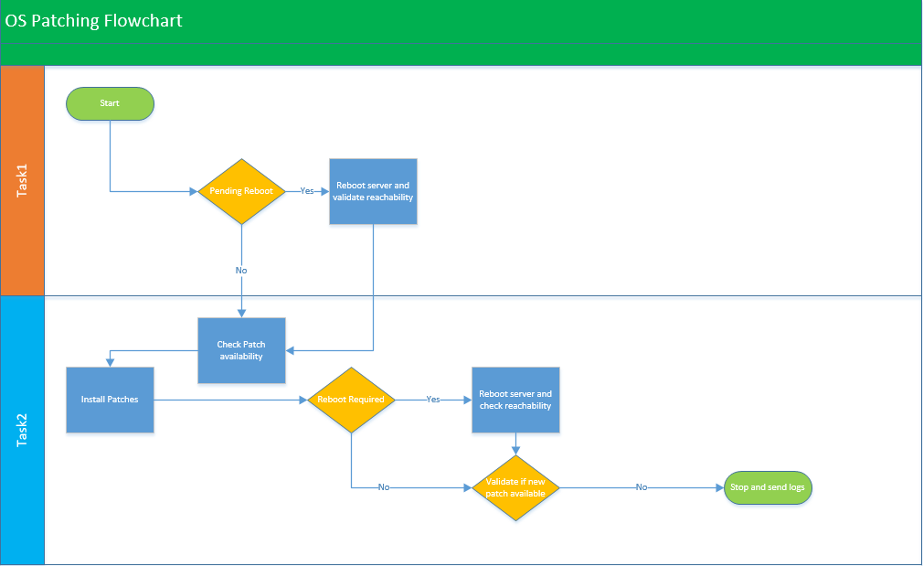
Patching Flow Chart

Slide 13
Use case Walkthrough
Using this automation, we could perform the patching of any windows server whether it’s workgroup or domain joined.
This has been tested in our lab and could perform installation of patches parallelly at once.
User will simply login to Jenkins portal from the jump server in the browser. (Microsoft Edge, Google Chrome etc.)
After that, they will trigger the playbook listed on dashboard.
Through SSH, it will go to Ansible server and run the playbooks as the background task.
Once, the job is successfully triggered. It will SSH to all the windows hosts as per the inventory and start executing the defined playbook as per the patch availability on the systems.
Patches could be pulled from any of the sources like WSUS, SCCM or directly from Microsoft update center.
Lastly, the script execution is completed, it will save the logs and share the results and patching status logs output as described on the next slide.

Slide 14
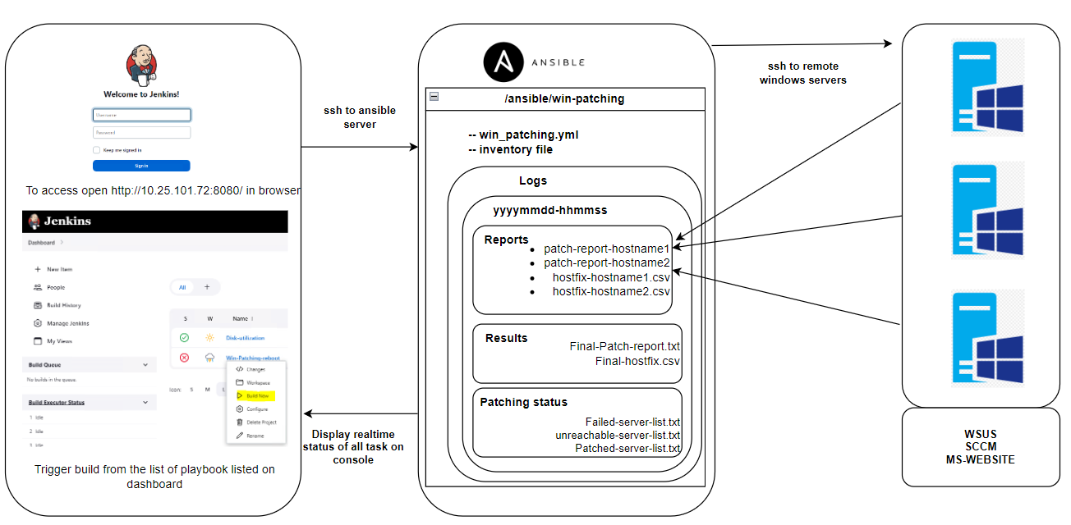

Slide 15
Thank you
Time for Quick Demo…..!!!!

