Slide 1

Design for Desktop Mockup and Mobile wireframe
By
Gautam Kumar

Slide 2
Design challenges
Requirements-1 Desktop (MOCKUPS)
Design a UI/UX MOCKUP based on the attached Dashboard wireframe
Use whatever tool you feel is relevant to make this as a WEBAPP
Requirement-2 Mobile (WIREFRAME)
The Dashboard.pdf has wireframe with reference to BROWSER, we want you to come up with mockups for iPhone as well.
You could use tools like Balsamiq or any tool of your choice
Upload your assets, pdfs on GitHub and share the link with us

Slide 3
My design approach
User Centric Design (U.C.D.) approach has been followed while designing
Understanding the business scenario & requirement
Types of user group
Persona creation (to understand the context)
Analyzing existing desktop wireframe
Sketching and wireframe creation (low fidelity)
UI, Visual Design (e.g., typography, color, assets and icons)
Final design for iPhone & Desktop
Prototype and design specification link

Slide 4
Design
Any good Website contain four important basic points in terms of usability standards.
Navigation
Presentation
Content
Interaction
These points help to catch attention of user and make them satisfied.

Slide 5
User segments
There are three types of user group
USER-1
USER-2
USER-3
Stakeholder
Who will manage and track customers saving and insurance plan
Internal peers
Other office-mate who is allocating works to stakeholders
Customers
Who is taking long term saving and insurance plan
It is important to understand for whom we are designing, otherwise design decisions could go wrong

Slide 6
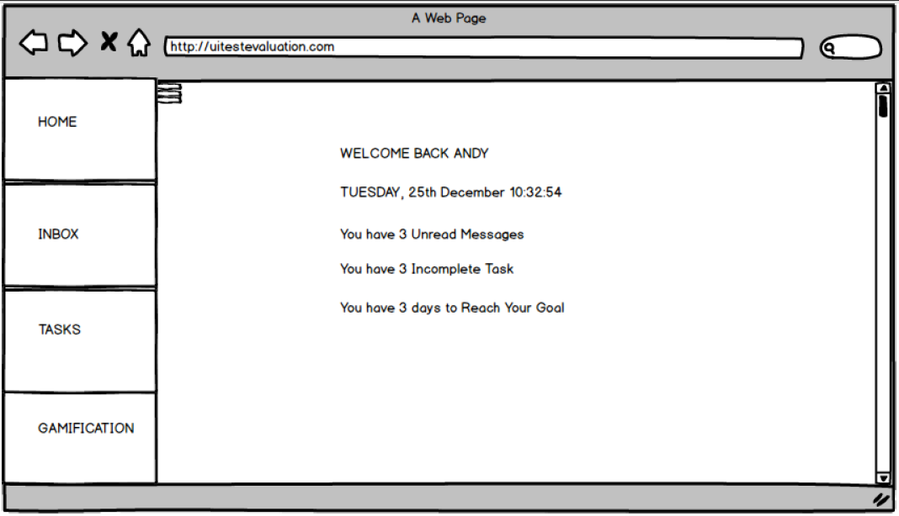
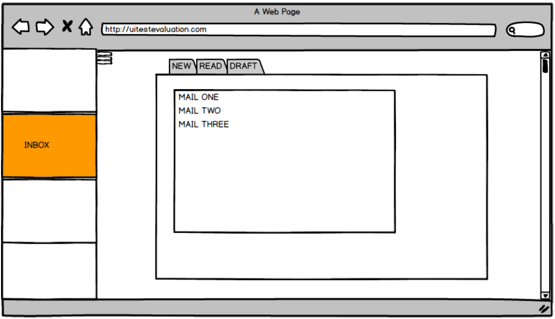
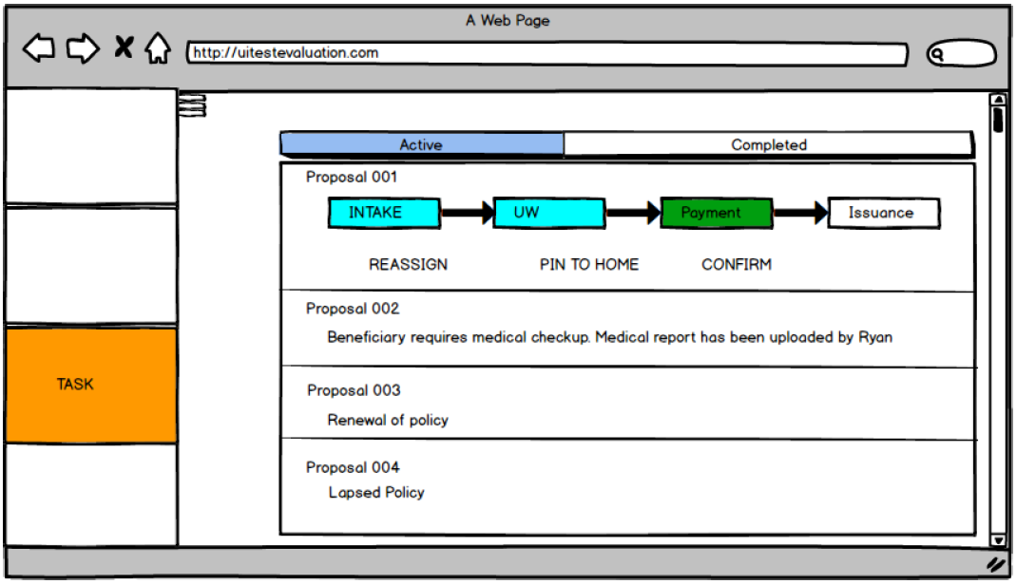
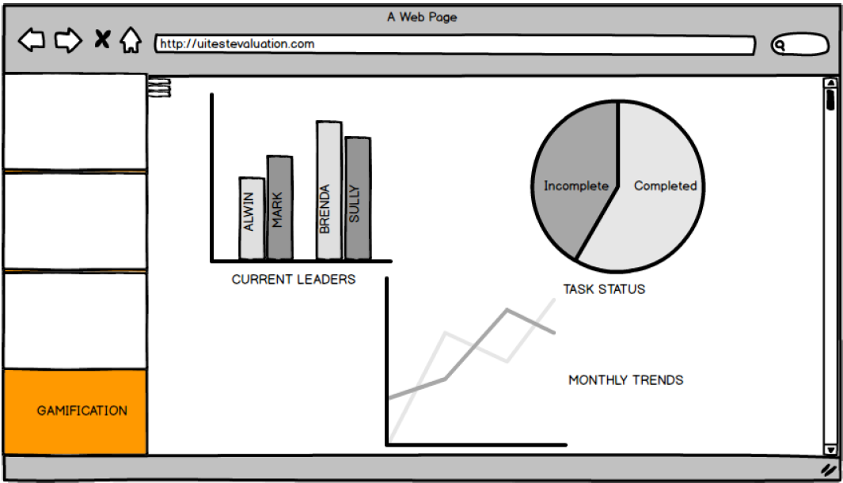
Annotation
Analysis on existing wireframe
1
Wireframe is clear, simple and easy to understand
2
Some of term is not easy for the user such as ‘gamification’ section which seems similar to ‘Dashboard concept’
3
Wireframe has very less content and it is difficult to understand the context of wireframe workflow
2
1
3
Design outcome is based on assumption & discussions with dummy users

Slide 7



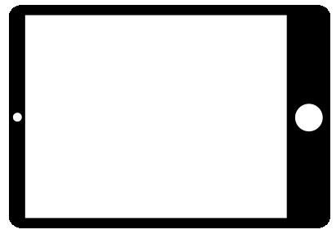
Persona
Stakeholders
USER-1
“I want simple and easy experience to track product activity, record & performance of customers ”
Raja Bajaj
Raja works for Prudential as Marketing Manager. His work is to track & manage all of his customer’s saving and protection product plans.
His job is to keep reminding to the customers about their long life plan and savings and Track monthly trends & growth performance.
He is also following his others office-mate and keep checking mails for any important assignment & requirements.
Job: Marketing Manager
Organization name: Prudential
Location: Mumbai, Maharashtra
Age: 32
Gender: Male
Martial status: Married
Income: 9 Lakh P.A
Device Used:
HE WANTS TO DO
Hobbies: Travelling, Dancing
He wants to see all the important information on one view
He wants to track monthly trends and manage easily to the customers saving and protection plans.
He wants to track customers expiry data and remind them for the payments.
He wants to be in touch with others office-mate and follow the additional requirements.
Characteristics
Social network
Active
Quick decision

Slide 8
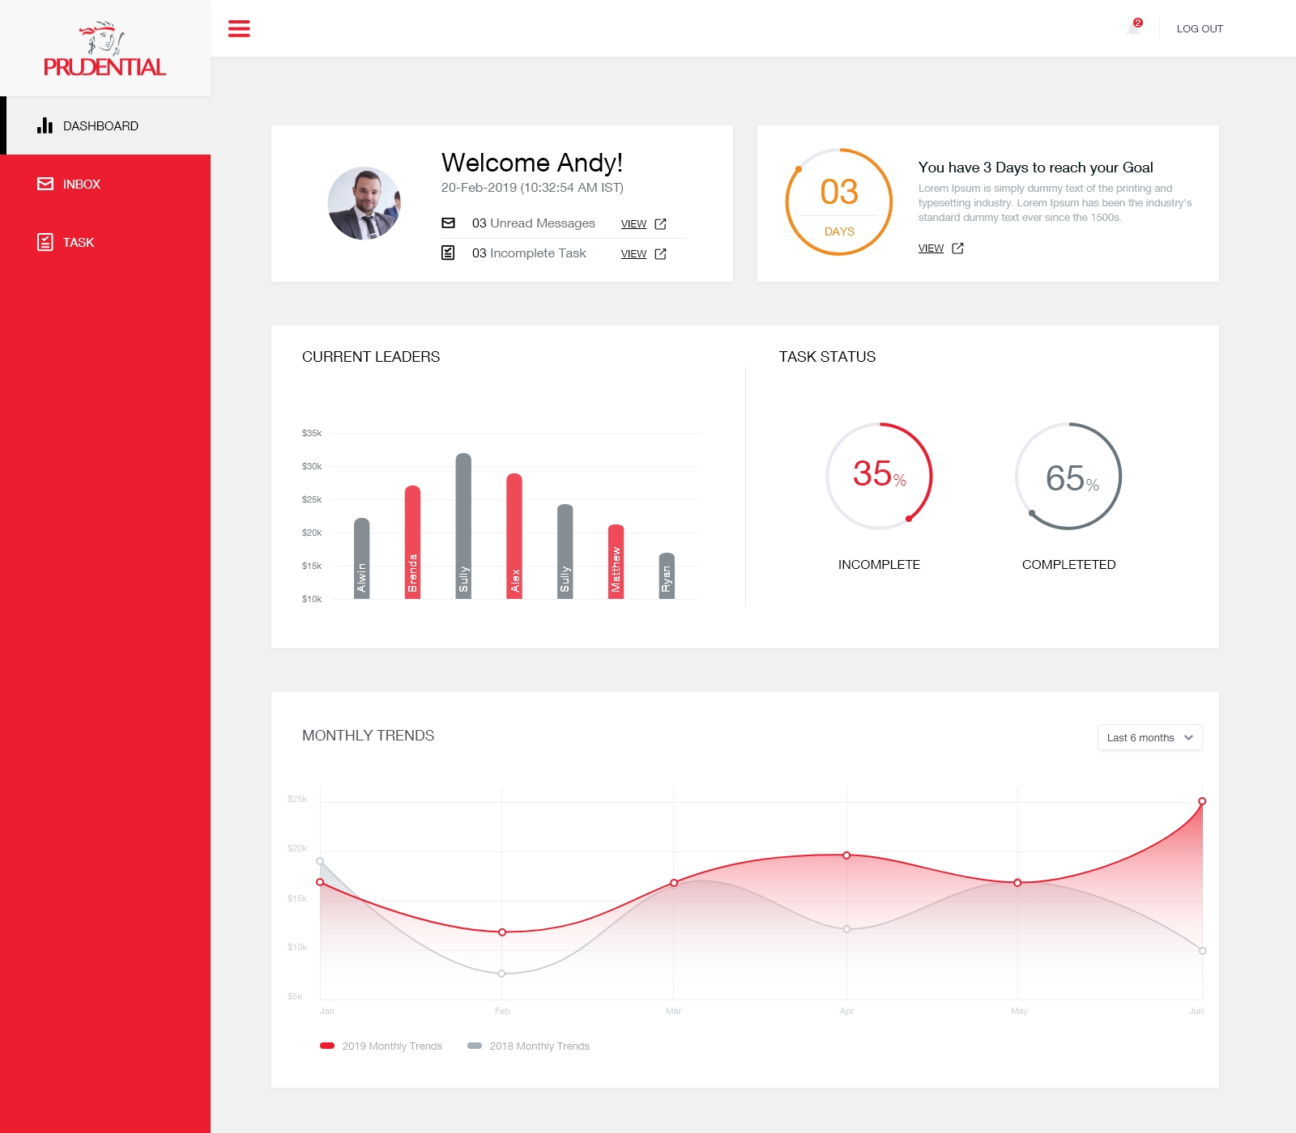
Desktop
User Interface
DASHBOARD
Home & Gamification both merged into ‘Dashboard’

Slide 9
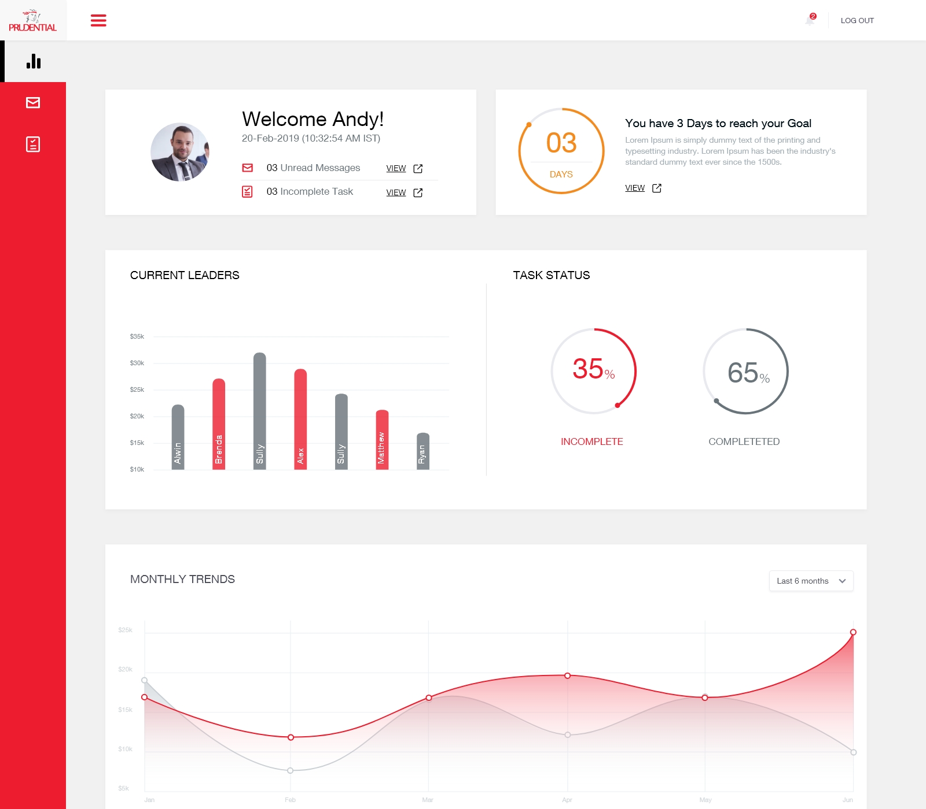
Desktop
User Interface
DASHBOARD
Hamburger expand and collapse feature for future scopes

Slide 10
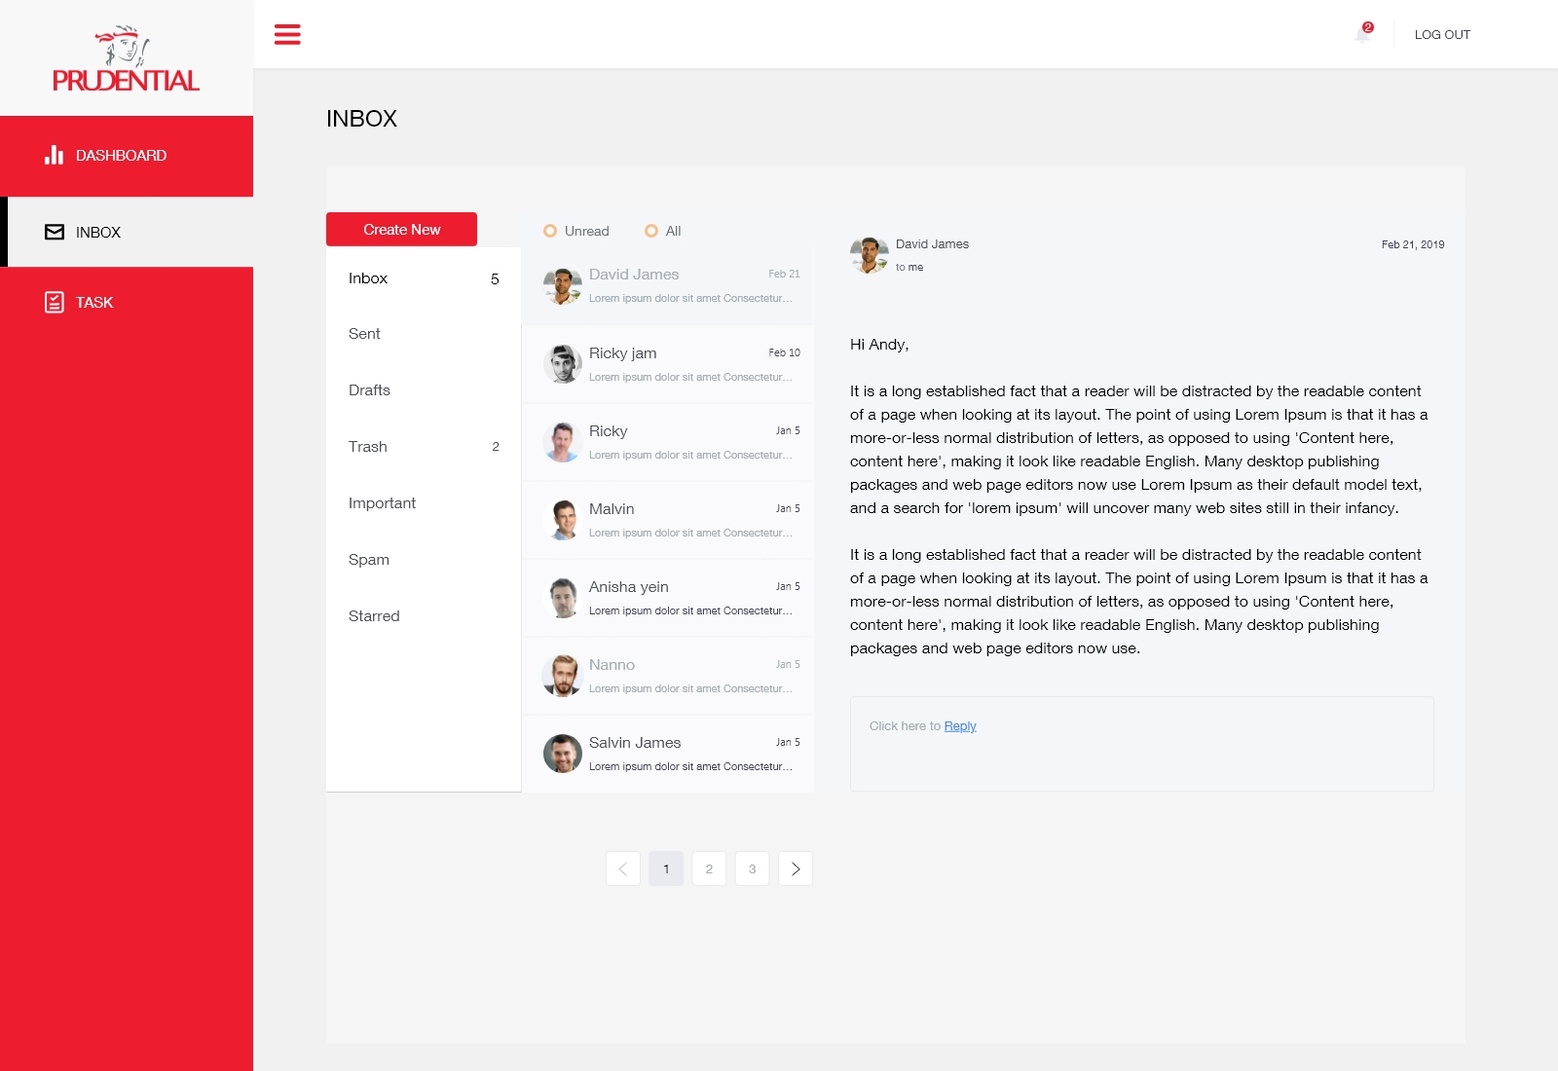
Desktop
User Interface
INBOX
Manage mail and sort by All and Unread mail feature

Slide 11
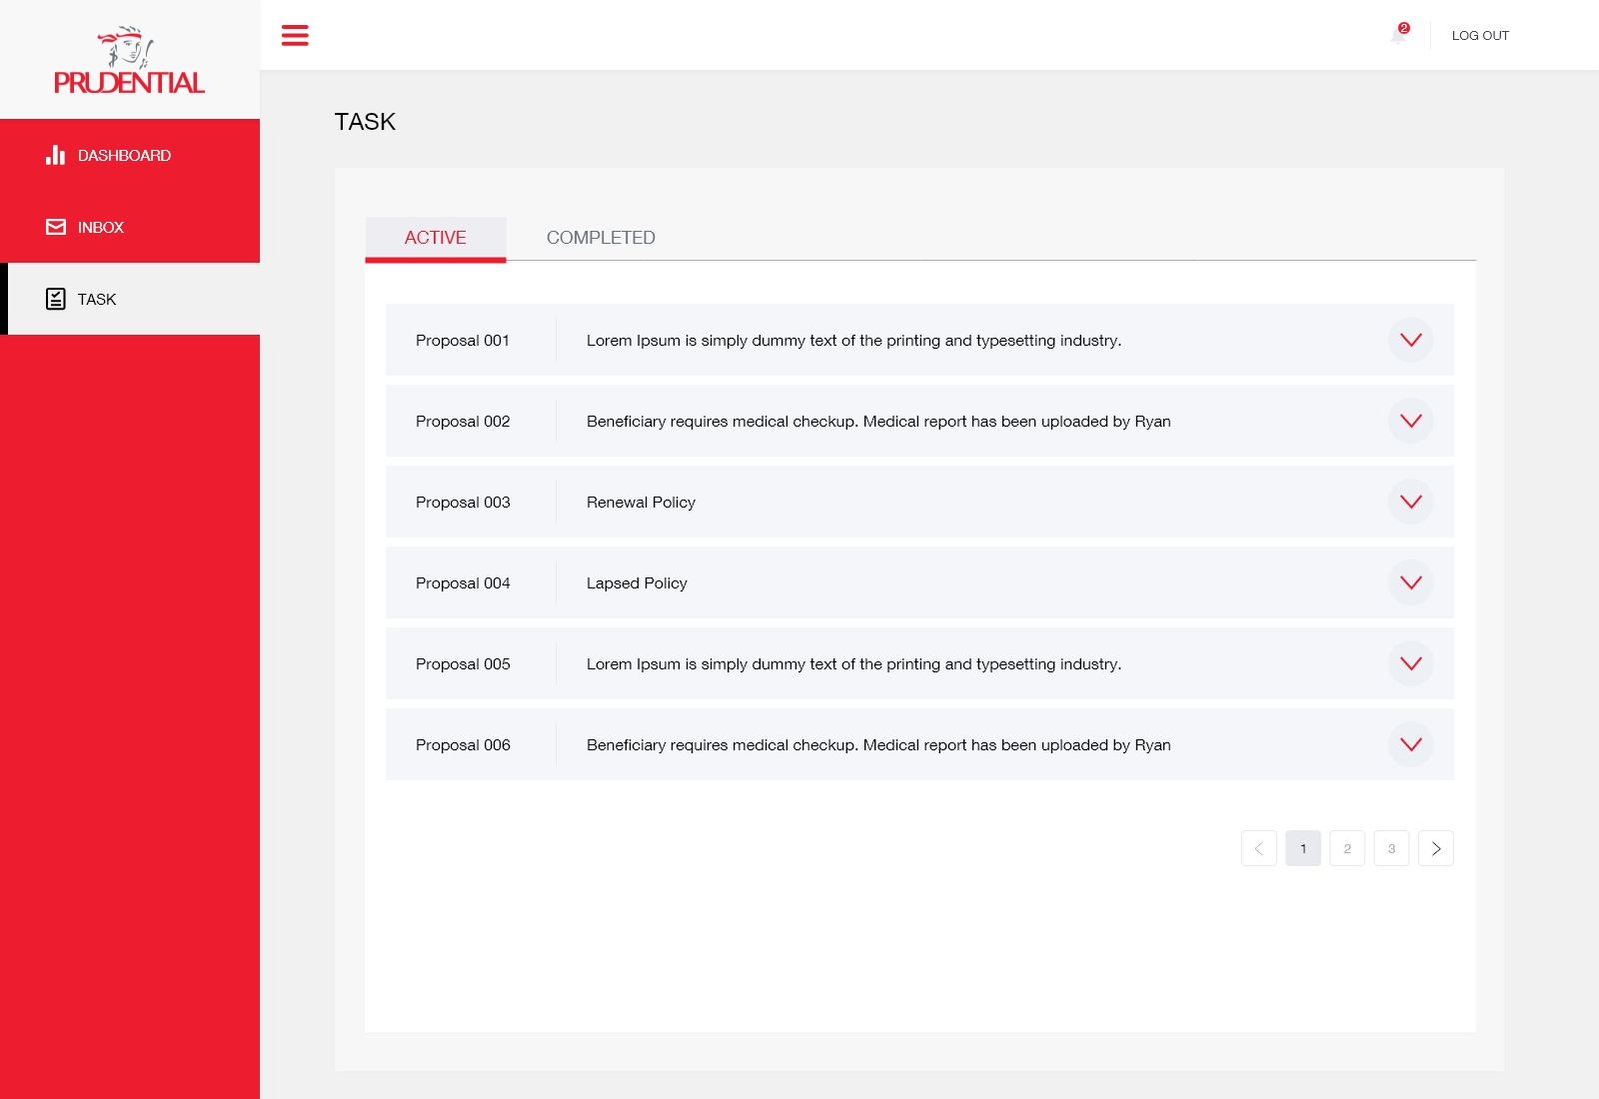
Desktop
User Interface
TASK
View all ‘Active’ task assigned proposal by other office-mate and leaders

Slide 12
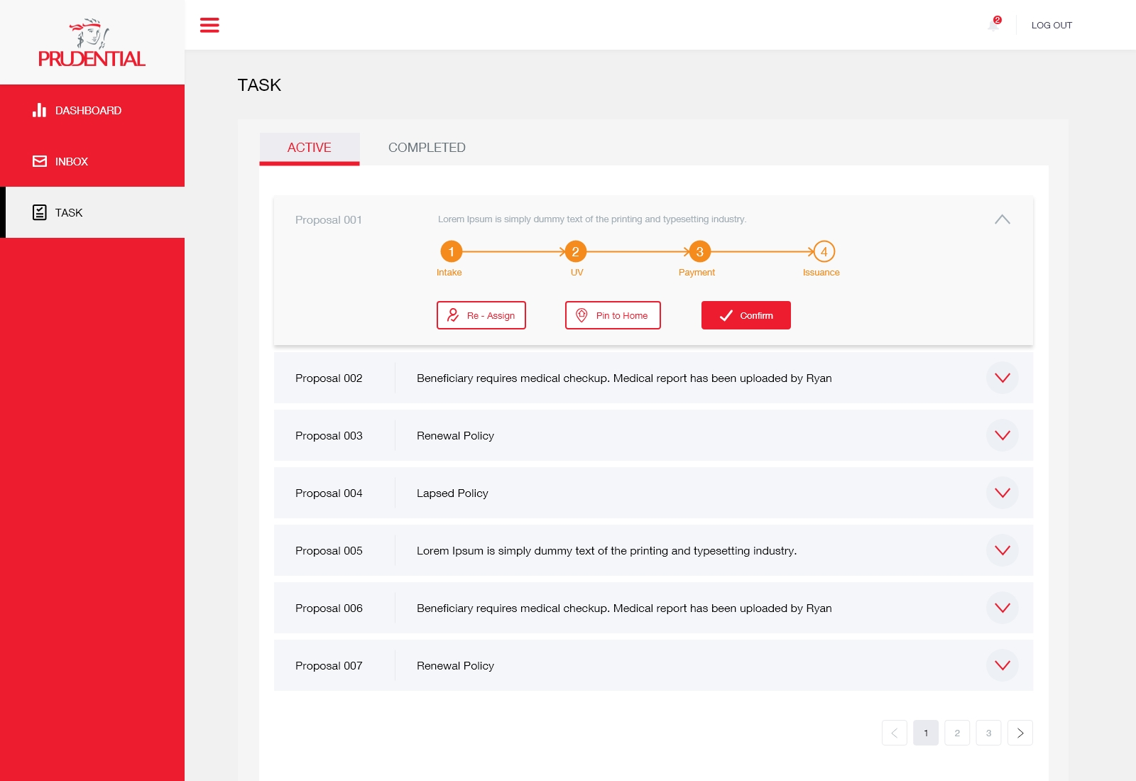
Desktop
User Interface
TASK Detail
Task detail feature-
User can take action and submit specific proposal

Slide 13
Desktop
User Interface
Functional_Prototype_XD link
https://xd.adobe.com/view/d8f6f9d9-3179-4064-7bfb-c5fdda058f6a-aec7/?fullscreen
XD_Link_Assets_Specification_guide
https://xd.adobe.com/spec/96ca90f7-940e-4fa9-77c7-bb0fbe9029bd-e0fb/

Slide 14
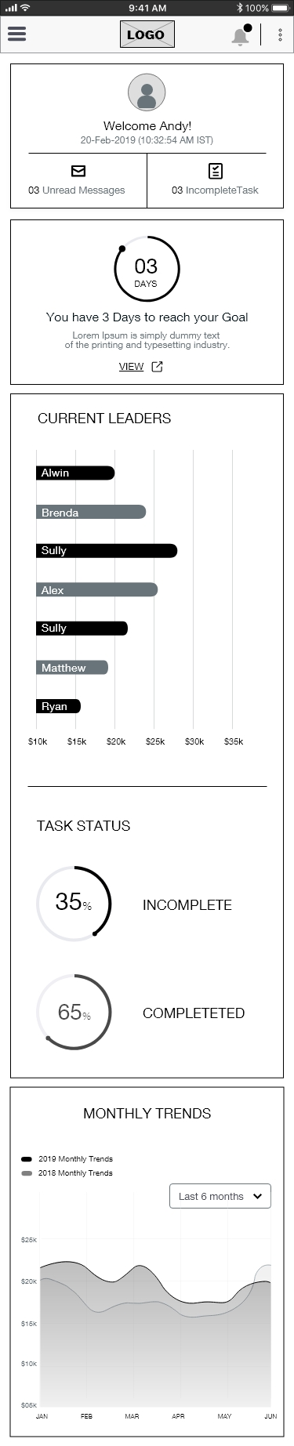
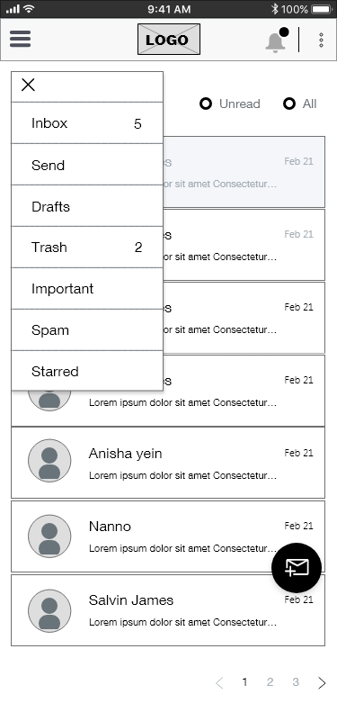
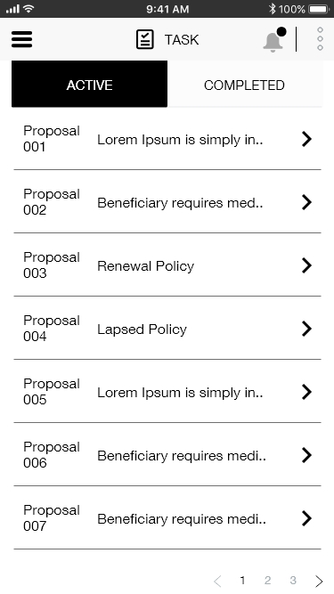
Mobile wireframe
DASHBOARD
INBOX
TASK

Slide 15
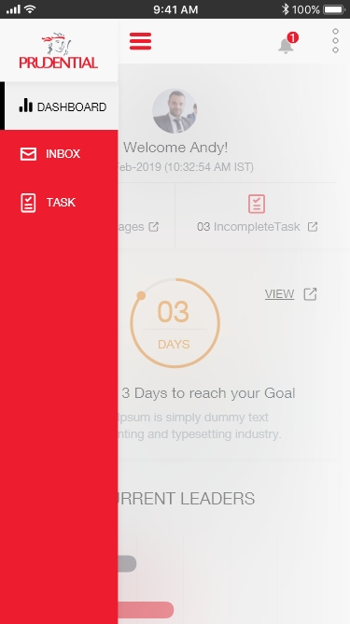
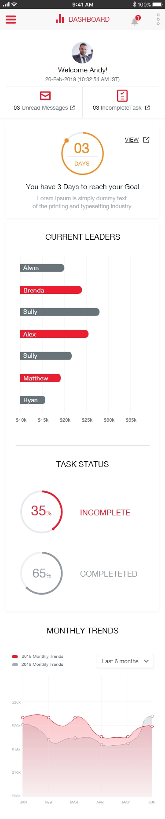
iPhone
User Interface
DASHBOARD
Hamburger expand and collapse feature
for future scopes
Home & Gamification both merged into ‘Dashboard’

Slide 16
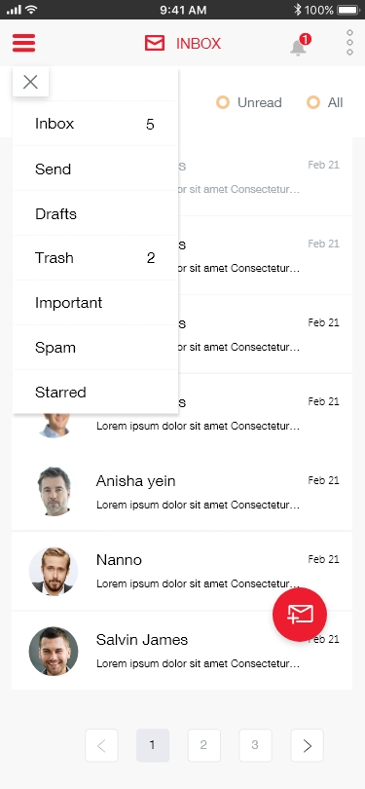
iPhone
User Interface
INBOX
Manage mail and sort by All and Unread mail feature
Compose mail option as floating button. It is the primary action for the user

Slide 17
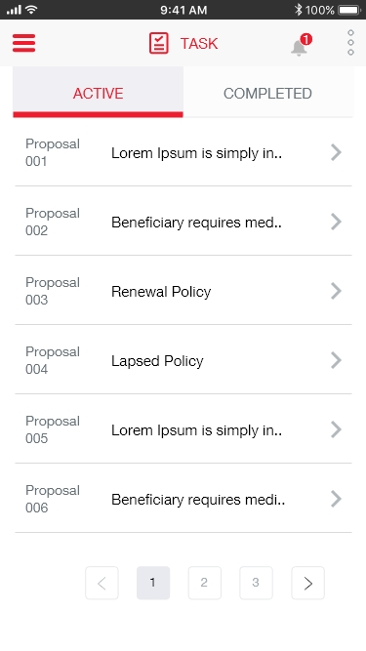
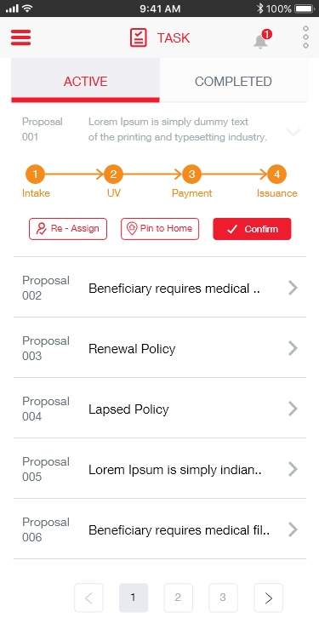
iPhone
User Interface
TASK
All completed task will moved to ‘completed’ tab. User can validate his particular task in one action
All Primary list of Active ‘TASK’ in card view user can tab to view the details

Slide 18
iPhone
User Interface
XD_Link_Assets_Specification_guide
https://xd.adobe.com/spec/44f07a8c-16a9-4066-4310-21b403590f44-32c1/screen/81509aa0-d05e-43de-8277-b9bcc426a5b6/Dashboard/

Slide 19








Icons
Used in Desktop & Mobile UI

Slide 20
Color palette
Color palette inspiration “Prudential” brand logo”
#ED1C2E
#68737a
#000000
#F58A1D
Typography
“Helvetica Neue”
Helvetica Neue is a bold and fresh-looking typeface. There is two typeface used in ‘Prudential’ existing
website Georgia and Helvetica Neue.

Slide 21



Software used
For Desktop and Mobile Interface, Wireframe, Assets, Design specifications & Prototype link
For Icons
For Presentation

Slide 22
Conclusion
The project is very interesting and it has lots of scopes and opportunities to work. There are many things to improve, iterate in terms of user experience, content, placement and labeling.
Desktop & Mobile has been designed based on assumption and feedback from peers colleague.
Since, I don’t have much context understanding of the provided wireframe and the actual users.
So, I have discussed with my friends and collogue (Dummy Users)
The design outcome of Desktop and Mobile view is based on assumptions. It does not gone through any design improvement and iterations
For Quick usability testing I have used guerilla testing with dummy users.

Slide 23
Thank You

