Slide 1
Project Report
1.
For
Social Serving food delivery System
By
Gautam Kumar(21CS30020)
Ajay Kumar Dhakar(21CS30002)
Sakshi Agrawal(21CS30045)
<MALWARE>

Slide 2
2.
Problem Definition
Inefficient food distribution:
There is currently no efficient system in place to distribute the leftover food from restaurants and hotels to those in need, resulting in a significant amount of food being wasted every day.
Lack of access to affordable food:
Many people, particularly those from low-income households, do not have access to affordable and nutritious food, which can lead to hunger and malnutrition.
Limited support for non-profit organizations:
Non-profit organizations that work towards reducing food wastage and hunger often face financial constraints and lack the necessary resources to address the problem effectively.
Lack of transparency in food donations:
Currently, there is no standard system for tracking food donations, which can lead to a lack of transparency and accountability in the distribution process. The proposed system aims to address this issue by providing a centralized platform for tracking food donations.
Food insecurity:
Many people, particularly those living in poverty, suffer from food insecurity, which is defined as the lack of access to sufficient, safe, and nutritious food. The proposed system aims to address this issue by providing a platform for accessing affordable food, particularly for those who are food insecure.

Slide 3
3.
Project Importance
This project provides a efficient way for the poor people and NGOs to order food at a cheap rate. They can ordered food at discounted rate. NGOs can order food at 40% discount while customer can order food at 20% discount.
Help the needy: By donating the leftover food to NGOs or selling it at a discounted rate, we can help feed the needy and underprivileged people who may not have access to regular meals
Encourage responsible food management: The tracking system can encourage restaurants and hotels to become more responsible in their food management practices.
Overall, this project has the potential to make a significant positive impact on society by reducing food waste, feeding the needy, promoting sustainability, and encouraging responsible food management.

Slide 4
4.
SRS and Design Documents
1.
Project scope includes developing an application to reduce food waste and provide food to those in need.
Features include login for different entities, adding details of food items and orders, payment options, and a donation option.
The software is an online-based platform that is compatible with all browsers that support Bootstrap 5, React JS, and MongoDB.
The user interface includes different functionality for different users, with a home screen and navbar, personal details, a list of available restaurants and food items, and payment options.
The software interface includes Bootstrap 5, JS, MongoDB, and Express JS.
Features include sign up, profiles, login, adding details of food items, ordering food, payment options, donation options, order history, and transaction history.
Functional requirements include user registration, profile display, and data storage in MongoDB.

Slide 5
Challenges Faced
5.
Login Authentication
Security: One of the main challenges in developing a login feature is ensuring that user authentication is secure. The system must be designed to prevent unauthorized access and ensure that user data is kept confidential.
Error handling: The login system must handle errors and exceptions gracefully, providing users with meaningful feedback in case of login failure.
Signup
User validation: One of the primary challenges is to ensure that the users entering information are real and have provided valid information(Correct Email).
Security: We need to ensure that user passwords are encrypted and stored securely,

Slide 6
6.
Home Page
Navbar: For different user the layout of navbar is different if the user is not logged in it is different and if it logged in it is different.
Responsive Nature: The Home page is made responsive which was one of the challenging task. We used bootstrap and defined some our class to make it responsive
Customer Features
Restaurant list: Customer can see the list of Restaurant which are within 10km from the user location. This is done using mapbox and adding a field geometry in the model.
Cart: User can add food to their cart they update the food in the cart. The challenges which we passed was in Online payment. We aren’t able to get razorpay api because of some issue so we directed the “payment:online” button to offline payment

Slide 7
7.
Restaurant Features
Time Window: Time window was set so that after that time Restaurant owner can’t add , update food. This is done by creating a model of portal and exporting it.
NGO Features
Online Payment: Online payment was not working for cart
Database
Data modeling: Designing the database schema that accurately represents the data and supports the required functionality.
Security: ensuring that the database and its contents are protected from unauthorized access, hacking, and other security threats.

Slide 8
8.
Reason of choosing programming language.
User(Client) Side
We mostly used Javascript and Javascript templete(ejs) as a programming language
We have decided to build a web application and for that reason Javascript is the most popular and Widely used programming language
Its Resources are easily available on internet and have a large developer community
JavaScript is designed to be fast and efficient, which is critical for building responsive and scalable web applications.
Some of the features like (Event or Onchange) enables the user to build responsive and scalable web applications
JavaScript has many integration options for third-party services and APIs, allowing us to easily incorporate new features and functionality into their web applications (Mapbox, Razorpay etc.).

Slide 9
9.
Server side
We used Mongodb and Express js for building server side. Because Mongodb is commonly used with JavaScript-based applications because of its support for JSON-like documents and dynamic schema.
MongoDB is designed to scale easily and efficiently. It can handle large volumes of data and high traffic loads without compromising on performance.
MongoDB's document-based data model provides high performance for data retrieval

Slide 10
Challenging Use Cases
10.
Goal: Food Ordering
Actor: Customer
System:
Login(Customer)
Authentication
Choose Restaurant and view menu
Choose food and add to cart
Donate to NGO
Payment online
Sefl pickup
Payment online
Payment offline

Slide 11
Actor: NGO
System:
Login(NGO)
Authentication
Choose Restaurant and view menu
Choose food and add to cart
Payment online
Payment offline
11.

Slide 12
12.
Goal: Adding food to the Menu
Actor: Restaurant
System:
Login(Restaurant)
Authentication
Add food
Fill the form
Submit
Goal: Time Window
Actor: Admin
System:
Login(Admin)
Authentication
Changing Time window
Updating time window
Submit

Slide 13
13.
Goal: Update/View User Details
Actor: (Customer, NGOs, Restaurant)
System:
Login
Authentication
User icon(Top Right)
Update Location
Goal: See All Users
Actor: Admin
System:
Login(Authentication)
All users

Slide 14
14.
Improvement that can be done
To streamline the delivery process, the project could be integrated with existing delivery services like Uber Eats
The project could be integrated with social media platforms to increase awareness and encourage more people to donate or buy food.
The project can be made more effective if it can have a user review and rating by this way buyer can have better freedom to choose the best restaurant
The project could include personalized recommendations for users based on their past orders and preferences. This would increase user engagement and loyalty, as well as drive sales for the restaurants.

Slide 15
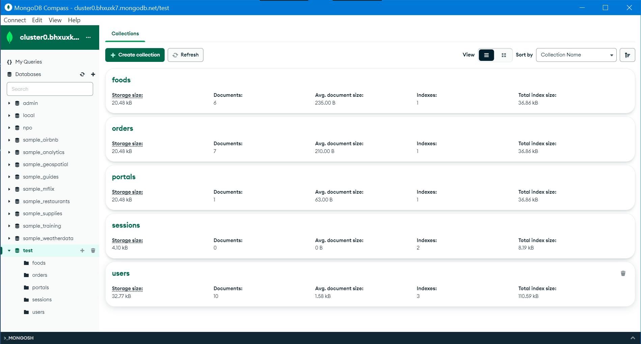
15.
Database Layout

