Slide 1
agentic ai health symptom checker
CAPSTONE PROJECT
Presented By:
1. Gautam kumar –Techno India University-B.sc(Data Science)

Slide 2
OUTLINE
Problem Statement
Proposed System/Solution
System Development Approach (Technology Used)
Algorithm & Deployment
Result (Output Image)
Conclusion
Future Scope
References

Slide 3
Problem Statement
Many individuals struggle to understand their health symptoms due to limited medical knowledge, resulting in delayed or inappropriate care. A reliable and intelligent system is required to analyze symptoms in natural language and guide users with verified medical data, improving awareness and timely intervention

Slide 4
Proposed Solution
We propose an Agentic AI-based Health Symptom Checker built using IBM Watsonx.ai. Users can describe symptoms in plain language (e.g., "I have a sore throat and fever"), and the AI agent will:
Interpret the symptoms using IBM Foundation Models
Retrieve relevant information from trusted medical sources
Classify potential conditions
Provide urgency level and self-care tips
Suggest when to consult a doctor
Support multilingual inputs (using Watson Language Translator)

Slide 5
System Approach
Watsonx.ai Foundation Model
Watsonx Agent Builder for prompt-based agent logic
Watsonx Deployment Space for model deployment

Slide 6
Algorithm & Deployment
Build the agent using IBM Watsonx.ai with the Mistral-Large foundation model.
Used Watsonx Agent Builder to configure the AI logic through a no-code visual interface.
Enabled built-in tools for reasoning and response generation (e.g., question answering, summarization).
Input symptoms in natural language; the model identifies possible conditions, urgency, remedies, and doctor consultation need
Created a Watsonx project, associated it with Watsonx.ai Runtime, and deployed the agent to a Deployment Space.
Tested the deployed agent via the Preview interface and optionally generated an API key for integration.

Slide 7
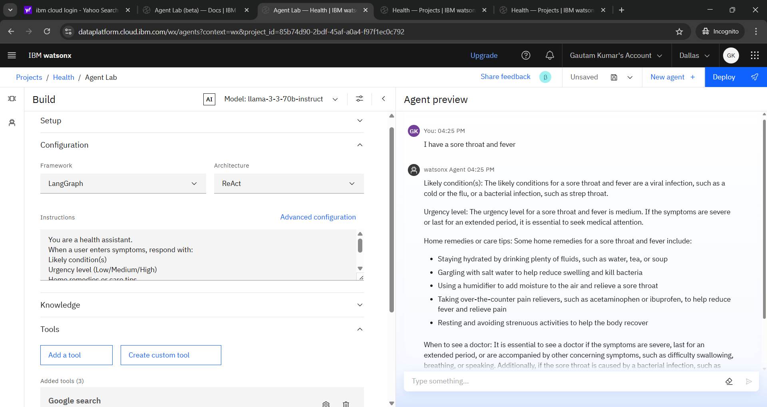
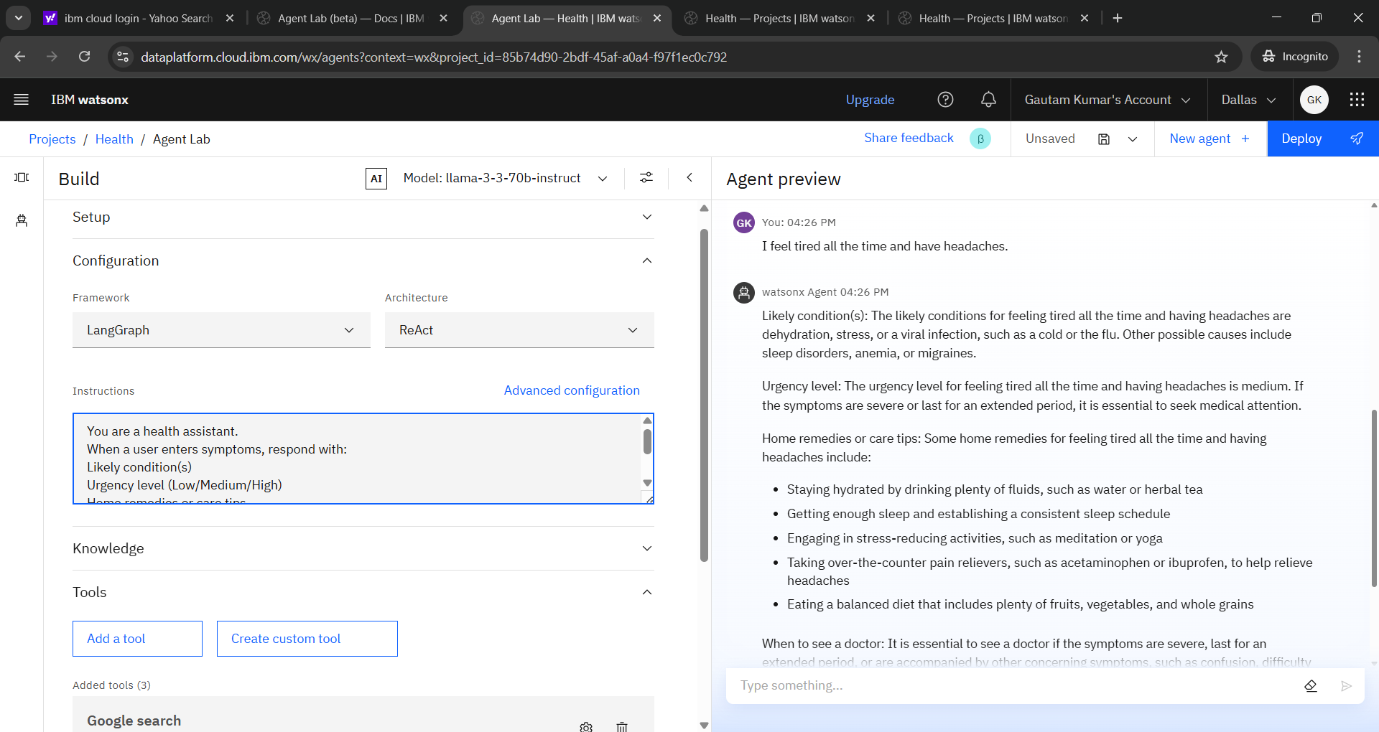
Result

Slide 8
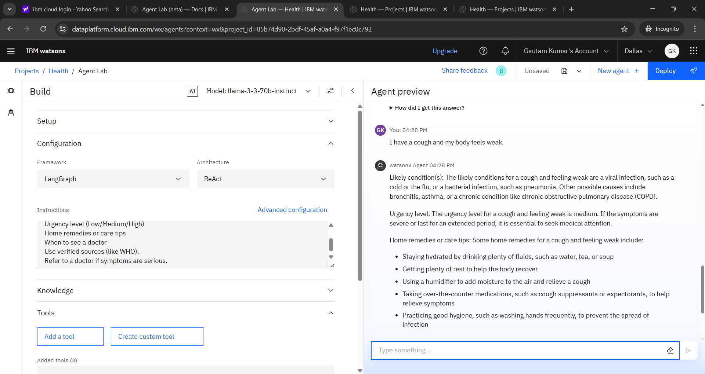
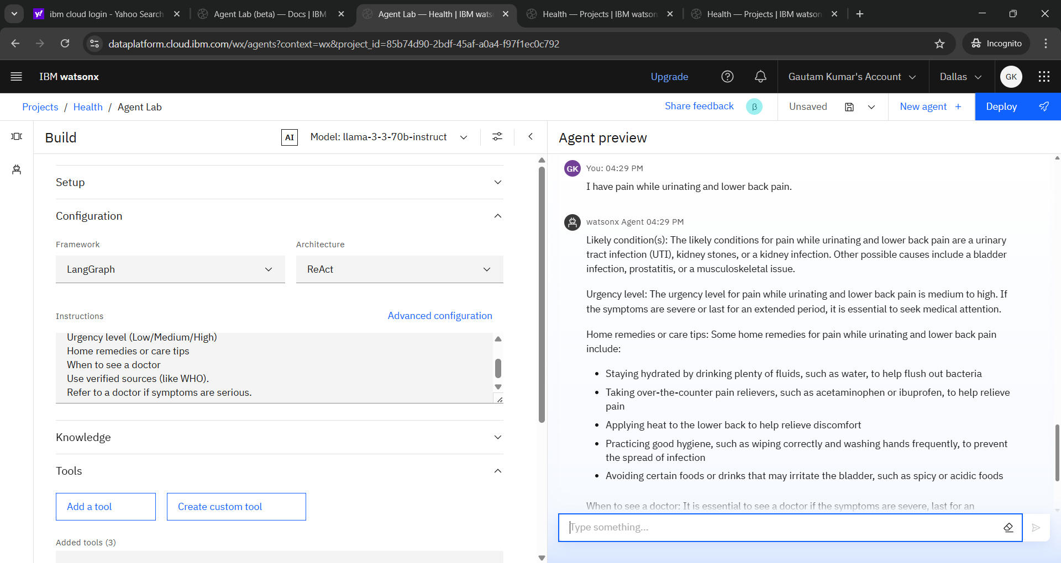

Slide 9
Conclusion
Successfully created an agentic health assistant using IBM Cloud. The model provides accurate, human-friendly advice while preventing self-diagnosis. IBM Watsonx's no-code interface accelerated development. Enables early detection and guides the user toward informed decisions.

Slide 10
Future scope
Integrate voice input and wearable health data.
Use Retrieval-Augmented Generation (RAG) for live medical data access.
Support emotional/mental health symptom checking.
Embed agent into websites or mobile apps using the API..

Slide 11
References
WHO Symptom Checker Guidelines.
IBM Watsonx.ai Documentation.
IBM Granite & Mistral Model Info

Slide 12
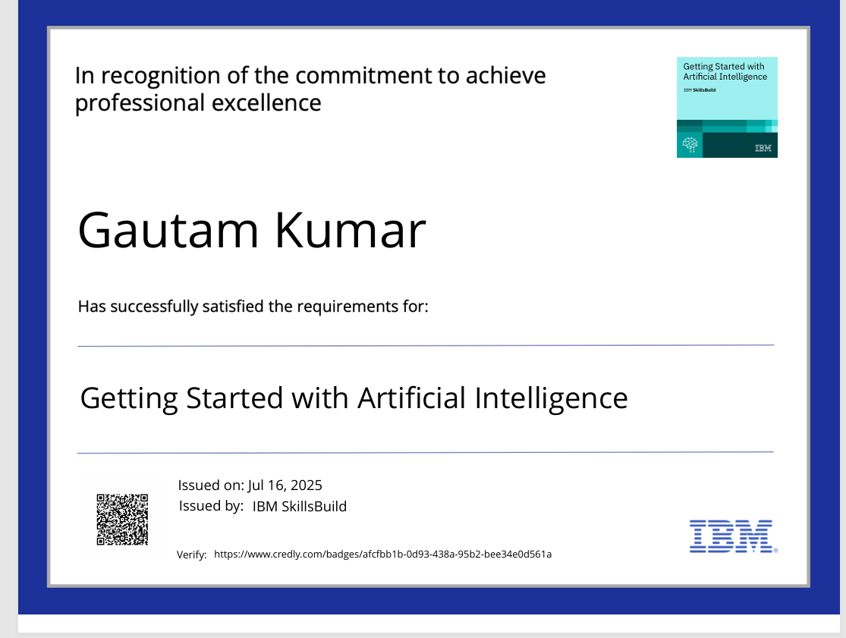
IBM Certifications

Slide 13

IBM Certifications

Slide 14
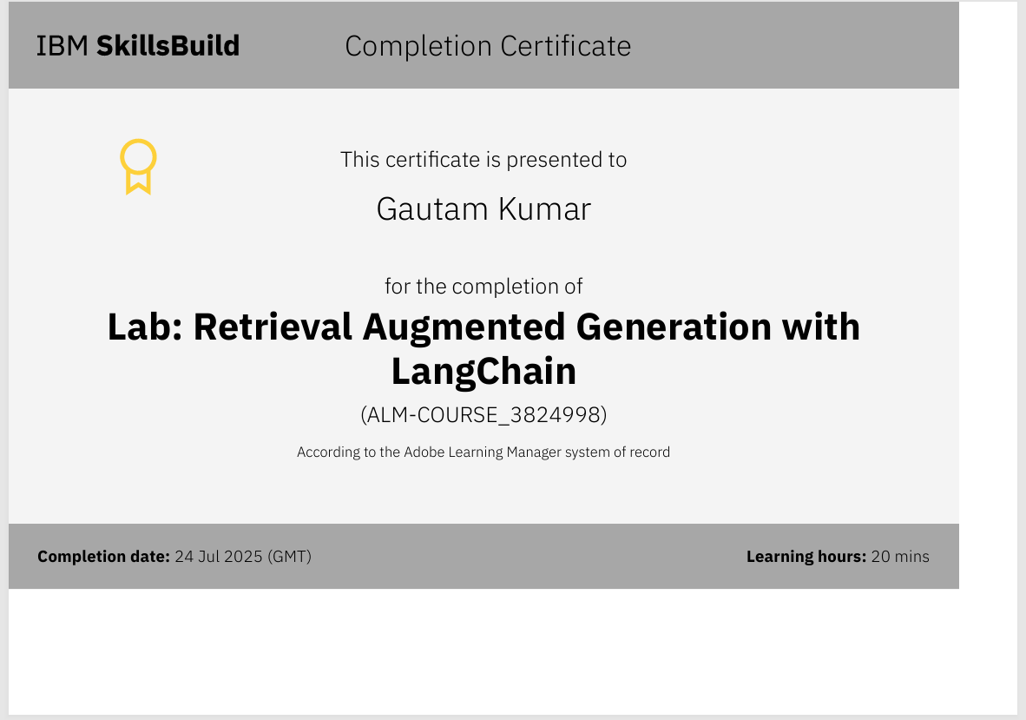
IBM Certifications

Slide 15
THANK YOU

