Slide 1
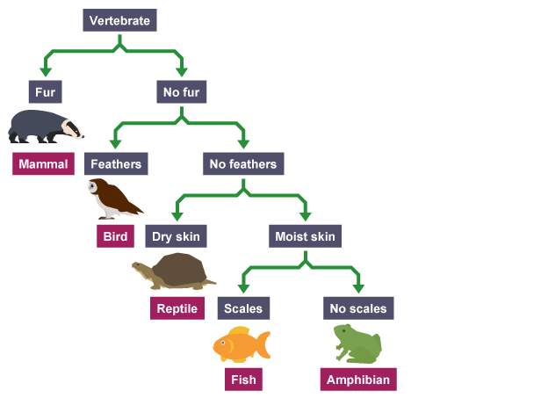
Decision tree on K means VS Decision tree alone
DataSet
DataSet
Cluster 1
Cluster2
Cluster 3

Slide 2
K means Algorithm

Slide 3
Decision tree Algorithm

