Slide 1
Sensors

Slide 2
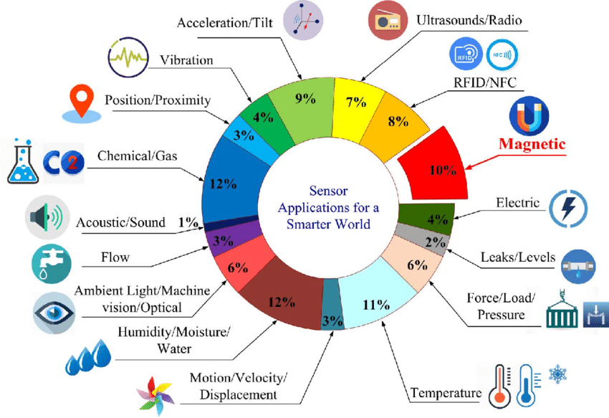
Definition
It is a device that converts signals from one energy domain to electrical domain.
2
Notes:
SAY: Before we wrap up the course, let’s review what we have learned today.
During this course, we have
<READ the bullets from the slide.>
GO to next slide.

Slide 3
Introduction
There are numerous definitions as to what a sensor is but I would like to define a Sensor as an input device which provides an output (signal) with respect to a specific physical quantity (input).
The term “input device” in the definition of a Sensor means that it is part of a bigger system which provides input to a main control system (like a Processor or a Microcontroller).
3
Notes:
SAY: Before we wrap up the course, let’s review what we have learned today.
During this course, we have
<READ the bullets from the slide.>
GO to next slide.

Slide 4
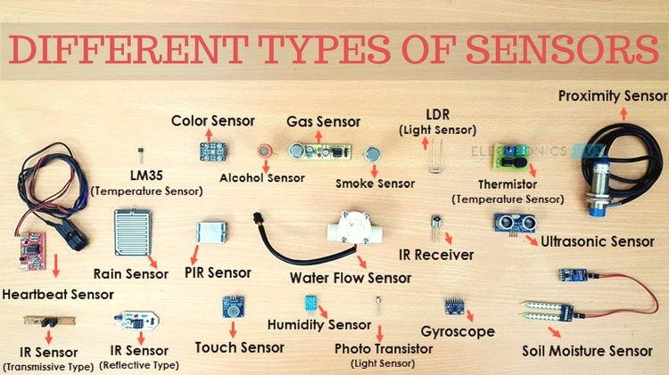
4
Notes:
SAY: Before we wrap up the course, let’s review what we have learned today.
During this course, we have
<READ the bullets from the slide.>
GO to next slide.

Slide 5
Classification of Sensors
There are several classifications of sensors made by different authors and experts. Some are very simple and some are very complex.
The following classification of sensors may already be used by an expert in the subject but this is a very simple classification of sensors.
●●●
5
Notes:
SAY:
The purpose of epidemiology in public health practice is to
discover the agent, host, and environmental factors that affect health;
determine the relative importance of causes of illness, disability, and death;
identify those segments of the population that have the greatest risk from specific causes of ill health; and
evaluate the effectiveness of health programs and services in improving population health.
GO to next slide.

Slide 6
Classification of Sensors
In the first classification of the sensors, they are divided in to Active and Passive.
Active Sensors are those which require an external excitation signal or a power signal.
Passive Sensors, on the other hand, do not require any external power signal and directly generates output response.
●●●
6
Notes:
SAY:
The purpose of epidemiology in public health practice is to
discover the agent, host, and environmental factors that affect health;
determine the relative importance of causes of illness, disability, and death;
identify those segments of the population that have the greatest risk from specific causes of ill health; and
evaluate the effectiveness of health programs and services in improving population health.
GO to next slide.

Slide 7
Classification of Sensors
The next classification is based on conversion phenomenon
i.e., the input and the output. Some of the common conversion phenomena are Photoelectric, Thermoelectric, Electrochemical, Electromagnetic, Thermooptic, etc.
●●●
7
Notes:
SAY:
The purpose of epidemiology in public health practice is to
discover the agent, host, and environmental factors that affect health;
determine the relative importance of causes of illness, disability, and death;
identify those segments of the population that have the greatest risk from specific causes of ill health; and
evaluate the effectiveness of health programs and services in improving population health.
GO to next slide.

Slide 8
Classification of Sensors
Analog Sensors produce an analog output i.e., a continuous output signal (usually voltage but sometimes other quantities like Resistance etc.) with respect to the quantity being measured.
Digital Sensors, in contrast to Analog Sensors, work with discrete or digital data. The data in digital sensors, which is used for conversion and transmission, is digital in nature.
8
Notes:
SAY:
The purpose of epidemiology in public health practice is to
discover the agent, host, and environmental factors that affect health;
determine the relative importance of causes of illness, disability, and death;
identify those segments of the population that have the greatest risk from specific causes of ill health; and
evaluate the effectiveness of health programs and services in improving population health.
GO to next slide.

Slide 9
Types of Sensors
Temperature Sensor
One of the most common and most popular sensors is the Temperature Sensor. A Temperature Sensor, as the name suggests, senses the temperature i.e., it measures the changes in the temperature.
●●●
9
Notes:
SAY:
The purpose of epidemiology in public health practice is to
discover the agent, host, and environmental factors that affect health;
determine the relative importance of causes of illness, disability, and death;
identify those segments of the population that have the greatest risk from specific causes of ill health; and
evaluate the effectiveness of health programs and services in improving population health.
GO to next slide.

Slide 10
Types of Sensors
Proximity Sensors
A Proximity Sensor is a non-contact type sensor that detects the presence of an object. Proximity Sensors can be implemented using different techniques like Optical (like Infrared or Laser), Sound (Ultrasonic), Magnetic (Hall Effect), Capacitive, etc.
●●●
10
Notes:
SAY:
The purpose of epidemiology in public health practice is to
discover the agent, host, and environmental factors that affect health;
determine the relative importance of causes of illness, disability, and death;
identify those segments of the population that have the greatest risk from specific causes of ill health; and
evaluate the effectiveness of health programs and services in improving population health.
GO to next slide.

Slide 11
Types of Sensors
Infrared Sensor (IR Sensor)
IR Sensors or Infrared Sensor are light based sensor that are used in various applications like Proximity and Object Detection. IR Sensors are used as proximity sensors in almost all mobile phones.
●●●
11
Notes:
SAY:
The purpose of epidemiology in public health practice is to
discover the agent, host, and environmental factors that affect health;
determine the relative importance of causes of illness, disability, and death;
identify those segments of the population that have the greatest risk from specific causes of ill health; and
evaluate the effectiveness of health programs and services in improving population health.
GO to next slide.

Slide 12
Types of Sensors
Light Sensor
Sometimes also known as Photo Sensors, Light Sensors are one of the important sensors. A simple Light Sensor available today is the Light Dependent Resistor or LDR.
The property of LDR is that its resistance is inversely proportional to the intensity of the ambient light i.e., when the intensity of light increases, its resistance decreases and vise-versa.
●●●
12
Notes:
SAY:
The purpose of epidemiology in public health practice is to
discover the agent, host, and environmental factors that affect health;
determine the relative importance of causes of illness, disability, and death;
identify those segments of the population that have the greatest risk from specific causes of ill health; and
evaluate the effectiveness of health programs and services in improving population health.
GO to next slide.

Slide 13
Types of Sensors
Smoke and Gas Sensors
One of the very useful sensors in safety related applications are Smoke and Gas Sensors.
Almost all offices and industries are equipped with several smoke detectors, which detect any smoke (due to fire) and sound an alarm.
●●●
13
Notes:
SAY:
The purpose of epidemiology in public health practice is to
discover the agent, host, and environmental factors that affect health;
determine the relative importance of causes of illness, disability, and death;
identify those segments of the population that have the greatest risk from specific causes of ill health; and
evaluate the effectiveness of health programs and services in improving population health.
GO to next slide.

Slide 14
Types of Sensors
Alcohol Sensor
As the name suggests, an Alcohol Sensor detects alcohol. Usually, alcohol sensors are used in breathalyzer devices, which determine whether a person is drunk or not.
Law enforcement personnel uses breathalyzers to catch drunk-and-drive culprits.
●●●
14
Notes:
SAY:
The purpose of epidemiology in public health practice is to
discover the agent, host, and environmental factors that affect health;
determine the relative importance of causes of illness, disability, and death;
identify those segments of the population that have the greatest risk from specific causes of ill health; and
evaluate the effectiveness of health programs and services in improving population health.
GO to next slide.

Slide 15
Types of Sensors
Touch Sensor
We do not give much importance to touch sensors but they became an integral part of our life.
Whether you know or not, all touch screen devices (Mobile Phones, Tablets, Laptops, etc.) have touch sensors in them
●●●
15
Notes:
SAY:
The purpose of epidemiology in public health practice is to
discover the agent, host, and environmental factors that affect health;
determine the relative importance of causes of illness, disability, and death;
identify those segments of the population that have the greatest risk from specific causes of ill health; and
evaluate the effectiveness of health programs and services in improving population health.
GO to next slide.

Slide 16
Types of Sensors
Color Sensor
A Color Sensor is an useful device in building color sensing applications in the field of image processing, color identification, industrial object tracking etc.
The TCS3200 is a simple Color Sensor, which can detect any color and output a square wave proportional to the wavelength of the detected color.
●●●
16
Notes:
SAY:
The purpose of epidemiology in public health practice is to
discover the agent, host, and environmental factors that affect health;
determine the relative importance of causes of illness, disability, and death;
identify those segments of the population that have the greatest risk from specific causes of ill health; and
evaluate the effectiveness of health programs and services in improving population health.
GO to next slide.

Slide 17
Types of Sensors
Humidity Sensor
If you see Weather Monitoring Systems, they often provide temperature as well as humidity data.
So, measuring humidity is an important task in many applications and Humidity Sensors help us in achieving this.
●●●
17
Notes:
SAY:
The purpose of epidemiology in public health practice is to
discover the agent, host, and environmental factors that affect health;
determine the relative importance of causes of illness, disability, and death;
identify those segments of the population that have the greatest risk from specific causes of ill health; and
evaluate the effectiveness of health programs and services in improving population health.
GO to next slide.

Slide 18
Types of Sensors
Tilt Sensor
Often used to detect inclination or orientation, Tilt Sensors are one of the simplest and inexpensive sensors out there.
Previously, tilt sensors are made up of Mercury (and hence they are sometimes called as Mercury Switches) but most modern tilt sensors contain a roller ball.
18
Notes:
SAY:
The purpose of epidemiology in public health practice is to
discover the agent, host, and environmental factors that affect health;
determine the relative importance of causes of illness, disability, and death;
identify those segments of the population that have the greatest risk from specific causes of ill health; and
evaluate the effectiveness of health programs and services in improving population health.
GO to next slide.

Slide 19
Advantages of Sensors
->Data Acquisition
->Automation
->Precision and Accuracy
->Cost-effectiveness
->Improved Safety
->Remote Monitoring and Control
->Environmental Monitoring
->Consumer Electronics
->Healthcare Applications
->Research and Development

Slide 20
Disadvantages of Sensors
-> Cost
-> Calibration and Maintenance
-> Interference and Environmental Factors
-> Limited Lifespan
-> Complexity of Integration
-> Power Requirements
-> Sampling Rate and Response Time
-> Compatibility and Standardization
-> Privacy and Security Concerns
-> Ethical and Social Implications

Slide 21
Conclusion
Sensors are central to industrial applications being used for process control, monitoring, and safety.
Sensors are also central to medicine being used for diagnostics, monitoring, critical care, and public health.
21
Notes:
SAY:
The purpose of epidemiology in public health practice is to
discover the agent, host, and environmental factors that affect health;
determine the relative importance of causes of illness, disability, and death;
identify those segments of the population that have the greatest risk from specific causes of ill health; and
evaluate the effectiveness of health programs and services in improving population health.
GO to next slide.

Slide 22
Reference
www.google.com
en.wikipedia.org
www.techtarget.com

