Slide 1
Enhancing DNA Data Storage with AI and Machine Learning
Revolutionizing Data Encoding, Decoding, and Error Correction
Presented by: Gautam Batta
Course: Advanced Topics in Computer Science I
Instructor: Katrina Butler
Date: December 10, 2024

Slide 2

Agenda
What is DNA Data Storage?
Video (35 Seconds)
Why is it gaining popularity?
Common Errors in DNA Synthesis and Sequencing
How Can AI Enhance DNA Data Storage?
Handling Large-Scale Data with AI
Improving Reliability, Efficiency, and Integration
Conclusion: The Future of DNA Data Storage
Questions?
Notes:
Image: PowerPoint

Slide 3
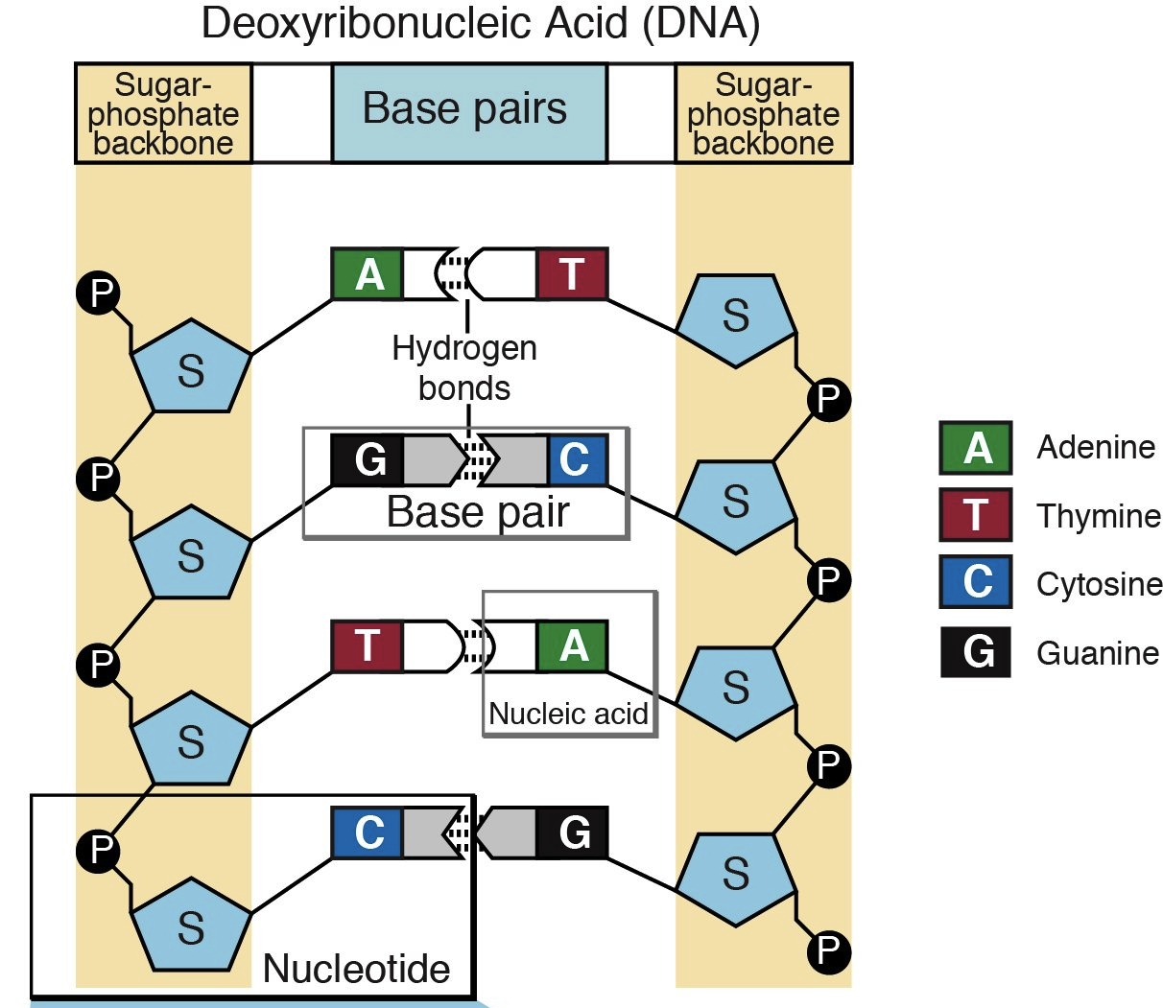
What is DNA Data Storage?
Encodes binary information into the nucleotide sequences of DNA (composed of A, T, C, and G).
Nucleotides on opposite strands of the DNA form bonds with each other, called base pairs.
DNA sequencing
Notes:
Image: https://knowgenetics.org/nucleotides-and-bases/
The pairs act like steps in a ladder, holding the two strands of DNA together. The order of the bases in a strand of DNA determines the biological instructions it contains.
The process of determining the order of nucleotides within a gene is called DNA sequencing

Slide 4
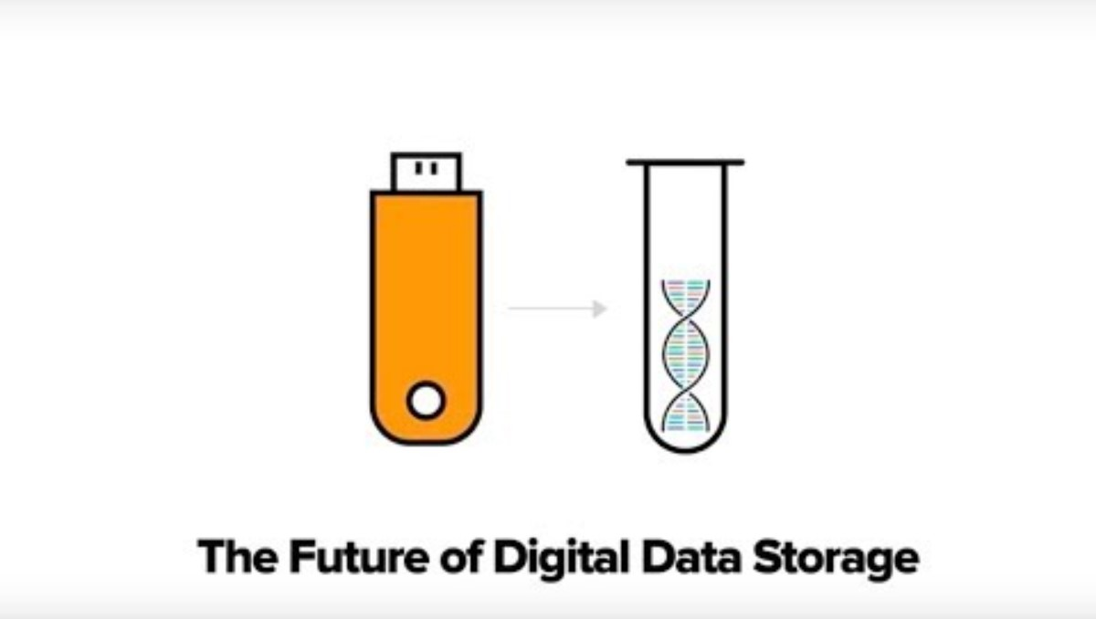
Notes:
Twist Bioscience. (2018, March 23). DNA Data Storage by Twist Bioscience. YouTube. https://youtu.be/LTnJWxCO3M4

Slide 5

Why DNA Data Storage is Gaining Popularity?
High density
Longevity
Durability
Many Applications:
- Long-Term Archival Storage
- Space
Notes:
Image: PowerPoint
High density: A single gram of DNA can store up to 215 petabytes of data.
Longevity: DNA can remain stable for thousands of years under proper conditions.
Durability: It outlasts traditional storage media like magnetic tapes or SSDs.
DNA’s unmatched storage density and durability are major factors in interest. As data generation surpasses traditional storage solutions, DNA offers a sustainable, long-term alternative. Its applications include:
Long-term archival storage with minimal energy and environmental impact.
Reduced physical space and carbon emissions in data centers.

Slide 6

Common Errors in DNA Synthesis and Sequencing
Types of Errors:
Substitutions, Insertions, and Deletions
Misreads In Base Pairs
Notes:
Image: PowerPoint
Substitutions: Replacing one nucleotide with another.
Insertions/Deletions: Adding or omitting nucleotides during synthesis or sequencing.
Base Pair Misreads: Errors in interpreting nucleotide sequences during sequencing.

Slide 7
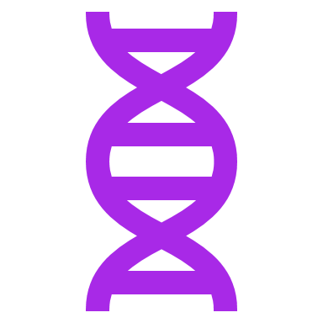
How Can AI Enhance DNA Data Storage?
Reduce Errors
Improve Accuracy and Speed
Predicts and Corrects Synthesis/Sequencing Errors
Reduces Costs
Notes:
Image: PowerPoint
DNA storage involves sequencing stored DNA and translating it back into digital data. Challenges include sequencing errors and lengthy processing times. AI can address these issues by:
Managing and interpreting the wealth of information that the DNA sequence may hold can reduce errors.
Pattern Recognition: Identifying efficient encoding strategies based on data properties. Dynamic Adjustments: Modifying encoding methods to the specific structure and requirements of data.
AI and ML error correction prevents re-synthesis expenses. Predictive Models: Anticipating and addressing potential errors before they occur.
Improving encoding and decoding processes reduce reliance on costly redundancy.

Slide 8

Handling Large-Scale Data with AI
Adaptive Algorithms
Resource Optimization
Notes:
Image: PowerPoint
Scaling DNA data storage to manage large amounts of data presents many unique challenges. AI addresses these through:
Adaptive Algorithms: Algorithms created by AI that adjust to varying data sizes and complexities.
Resource Optimization: AI can optimize data retrieval and management at scale.

Slide 9

Improving Reliability, Efficiency, and Integration
Current State (2DDNA):
- High Reliability
- Ongoing Improvements
Quality Control
Hybrid Solutions
Notes:
Image: PowerPoint
While DNA data storage is still in the experimental stage, systems like 2DDNA, have shown promising results:
2DDNA method efficiently stores images in synthetic DNA and embeds pertinent metadata as nicks in the DNA backbone.
High Reliability: Experimental tests reveal undetectable visual degradation after processing, and efficient metadata rewriting.
Ongoing Improvements: Advancements in ML and AI continue to enhance system performance for DNA processing, addressing limitations in cost, scalability, and error correction.
Reliability is critical for DNA data storage. AI-driven approaches to improving it include:
Quality Control: Continuous monitoring of the data integrity and performance of the overall system.
Hybrid Solutions: Seamlessly integrating DNA data storage with traditional digital systems to maximize efficiency and versatility.

Slide 10

Conclusion: The Future of DNA Data Storage
AI and ML can help improve encoding, decoding, error correction, and scalability.
Innovations like 2DDNA system.
Potential to permanently alter data storage paradigms.
DNA offers unparalleled density, durability, and flexibility.
Research developments may lead to integration with existing digital systems.
Notes:
Image: PowerPoint

Slide 11

Questions?
Notes:
Image: PowerPoint

Slide 12

The End

Slide 13
Citations
Twist Bioscience. (2018, March 23). DNA Data Storage by Twist Bioscience. YouTube. https://youtu.be/LTnJWxCO3M4
Pan, C., Tabatabaei, S. K., Tabatabaei Yazdi, S. M. H., Hernandez, A. G., Schroeder, C. M., & Milenkovic, O. (2022). Rewritable two-dimensional DNA-based data storage with machine learning reconstruction. Nature communications, 13(1), Article 2984. https://doi.org/10.1038/s41467-022-30140-x
WIRED. (2024, March 5). Is DNA the future of computer storage? WIRED. https://www.wired.com/sponsored/story/hsbc-frontiers-biotech-synthetic-dna-storage/
‌Church, G., & Ingber, D. (2016, April 8). DNA Data Storage. Wyss Institute. https://wyss.harvard.edu/technology/dna-data-storage/
Settlemyer, B., & Ionkov, L. (2021, May 28). DNA: The Ultimate Data-Storage Solution. Scientific American. https://www.scientificamerican.com/article/dna-the-ultimate-data-storage-solution/
Trafton, A. (2021, June 10). Could all your digital photos be stored as DNA? MIT News | Massachusetts Institute of Technology. https://news.mit.edu/2021/dna-data-storage-0610/
Schwartz, D. P. (2024, January 2). Beyond Binary: The Convergence of Quantum Computing, DNA Data Storage, and AI. Medium. https://medium.com/@douglasp.schwartz/beyond-binary-the-convergence-of-quantum-computing-dna-data-storage-and-ai-14e653c8e67e/

