Slide 1
CAPSTONE PHASE 1
FraudLens Bharat
8
1.0000
fraud classes
macro-F1
KYC, OTP, fake job, loan, courier, digital arrest and more
hybrid baseline on synthetic split
AI-based Hinglish cyber-fraud detection and complaint triage prototype
15
2
tests passed
interfaces
Phase 1 proves the core software loop: paste suspicious text, classify scam type, extract evidence, score risk, and generate a complaint-ready summary.
unit and API test coverage
FastAPI backend plus Streamlit dashboard
Gautam Manchandani | Student ID: 2023EBCS209
BITS Pilani | Supervisor: Dr. Ashok Yemineni | Academic Year 2025-2026
github.com/GautamBytes/fraudlens-bharat-phase-1

Slide 2
PROBLEM
Indian cyber-fraud evidence is messy before it becomes a case
The user usually has a mixed-language message, a phone number or URL, and fear-driven urgency - not a clean English complaint.
Mixed-language NLP gap
Evidence gets lost
Reporting friction
Scam messages often combine Hindi, English, Hinglish slang, abbreviations, and intentional spelling mistakes.
Victims may miss phone numbers, UPI IDs, URLs, email IDs, OTP-like codes, amounts, threats, and urgency signals.
Before filing, users need a structured summary that explains what happened and what identifiers were present.
Typical raw input
What Phase 1 turns it into
Dear customer, aapka KYC expire ho gaya. Account block hone se bachne ke liye abhi http://bit.ly/kycfast par verify karein. OTP share mat karo bolke phir call pe code maangte hain.
Scam type: KYC scam
Entities: URL + urgency + account threat
Risk: high, with explanation reasons
Problem framing
github.com/GautamBytes/fraudlens-bharat-phase-1

Slide 3
RESEARCH BASIS
The project is framed as a research-backed software prototype
Phase 1 converts published motivation into measurable baseline modules rather than attempting a flashy but unstable demo.
Design choices backed by literature
Phase 1 research question
Evidence
How it shapes Phase 1
Can a lightweight, explainable software pipeline classify common Indian cyber-fraud messages and extract complaint-ready evidence from mixed-language text?
NCRP / I4C context
Focus on complaint triage and structured evidence.
Hinglish cybercrime NLP
Support Hinglish/Hindi/English text, not only English.
Phishing URL detection
Add URL heuristics alongside text classification.
Success is measured through classifier metrics, entity extraction behavior, URL risk reasons, API reliability, dashboard usability, and reproducible demo cases.
Explainable AI
Return reasons, not only a label and confidence.
Research grounding
github.com/GautamBytes/fraudlens-bharat-phase-1

Slide 4
ARCHITECTURE
Phase 1 is a complete end-to-end software loop
The dashboard and API call the same analysis pipeline, so demo behavior is reproducible across UI and backend.
User input
Preprocess
Parallel signals
Risk scoring
Outputs
Pasted SMS, WhatsApp, email, or suspicious text.
>
Normalize whitespace, lowercase, preserve URLs, UPI IDs, phones.
>
TF-IDF classifier, entity extraction, URL heuristics.
>
Combine confidence, URL risk, entity and urgency signals.
>
Risk, label, entities, reasons, complaint draft, case history.
FastAPI backend
SQLite storage
Streamlit dashboard
GET /health
POST /analyze
GET /cases
GET /cases/{id}
Stores analyzed cases, prediction, risk level, extracted entities, timestamp.
Demo buttons, message analysis, entity table, reasons, recent history, complaint-ready summary.
Phase 1 deliberately excludes OCR, transformer fine-tuning, graph analytics, and screenshot analysis; those are Phase 2 extensions after the core loop is stable.
System architecture
github.com/GautamBytes/fraudlens-bharat-phase-1

Slide 5
IMPLEMENTED SCOPE
Phase 1 is not only UI - it includes data, ML, API, storage, tests, and docs
The repo is structured so every claimed capability maps to a module or reproducible artifact.
64
8
4
5
2
seed examples
label taxonomy
demo cases
test areas
runnable apps
Runs full training and demo pipeline
Common Indian cyber-fraud categories
Saved JSON outputs for repeatability
Preprocess, entities, URL, risk, API
API service and dashboard
Core modules
Runnable commands
Module
Purpose
python -m fraudlens.model_training
uvicorn fraudlens.api:app --reload
streamlit run src/fraudlens/dashboard.py
pytest
model_training.py
Train TF-IDF + Logistic Regression baseline.
model_inference.py
Load model and provide rule fallback.
entity_extraction.py
Extract URLs, phones, UPI, email, amount, OTP.
risk_scoring.py
Convert signals into low/medium/high risk.
Implementation scope
github.com/GautamBytes/fraudlens-bharat-phase-1

Slide 6
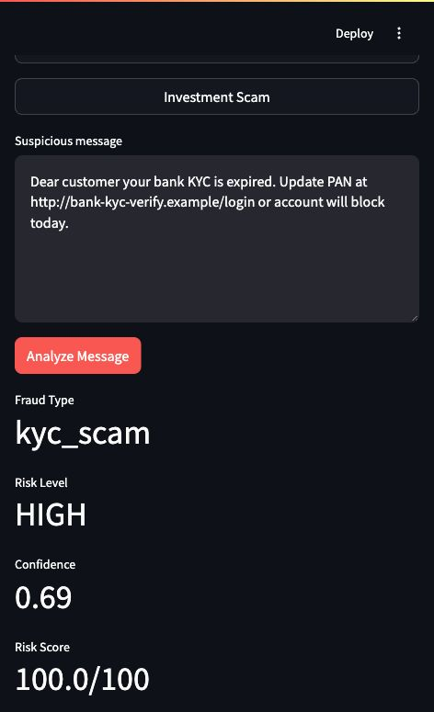
DEMO PROOF
The dashboard converts suspicious text into an analyst-style result
This is the professor-facing demo: input, predicted scam type, risk score, extracted evidence, reasons, and complaint draft.
What the demo proves
End-to-end analysis works without external APIs or paid services.
The same scam text produces a label, confidence, risk level, entities, and explanations.
Recent case history is stored locally through SQLite for repeatable review.
Demo buttons cover fake KYC, OTP phishing, fake job, and investment scam examples.
Pitch line: FraudLens Bharat does not just classify a message; it turns unstructured scam text into structured, complaint-ready evidence.
Streamlit dashboard analysis result
Product proof
github.com/GautamBytes/fraudlens-bharat-phase-1

Slide 7
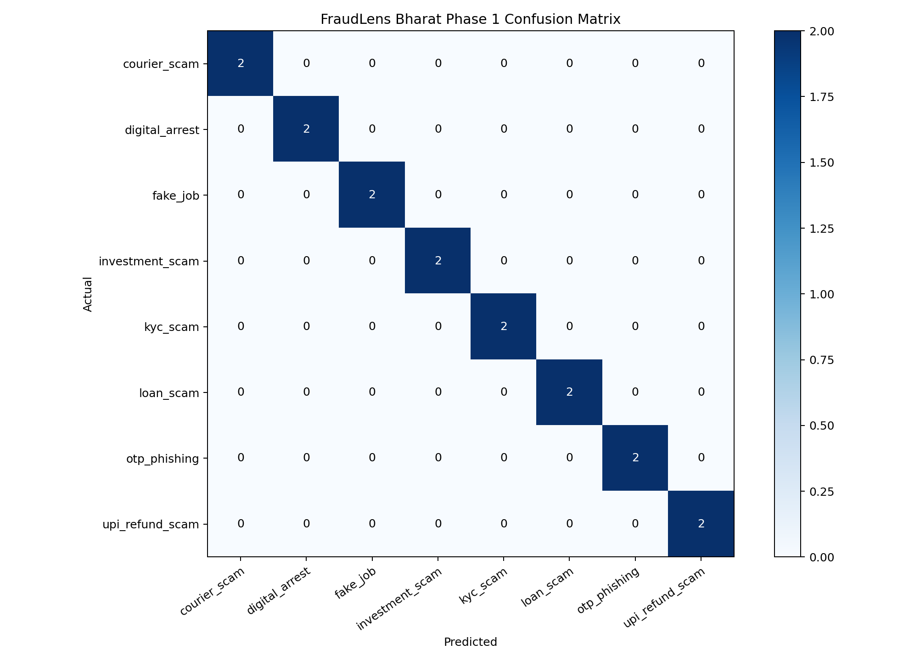
BASELINE RESULTS
The first model is intentionally simple, measurable, and explainable
TF-IDF + Logistic Regression provides a stable benchmark before Phase 2 transformer experiments.
1.0000
1.0000
16
accuracy
macro-F1
test rows
Per-class F1 highlights
fake_job
1.000
investment_scam
1.000
otp_phishing
1.000
upi_refund_scam
1.000
courier_scam
1.000
Interpretation: synthetic split is clean after marker fixes; treat as internal Phase 1 evidence, not production accuracy.
Confusion matrix generated by model_training.py
Metrics
github.com/GautamBytes/fraudlens-bharat-phase-1

Slide 8
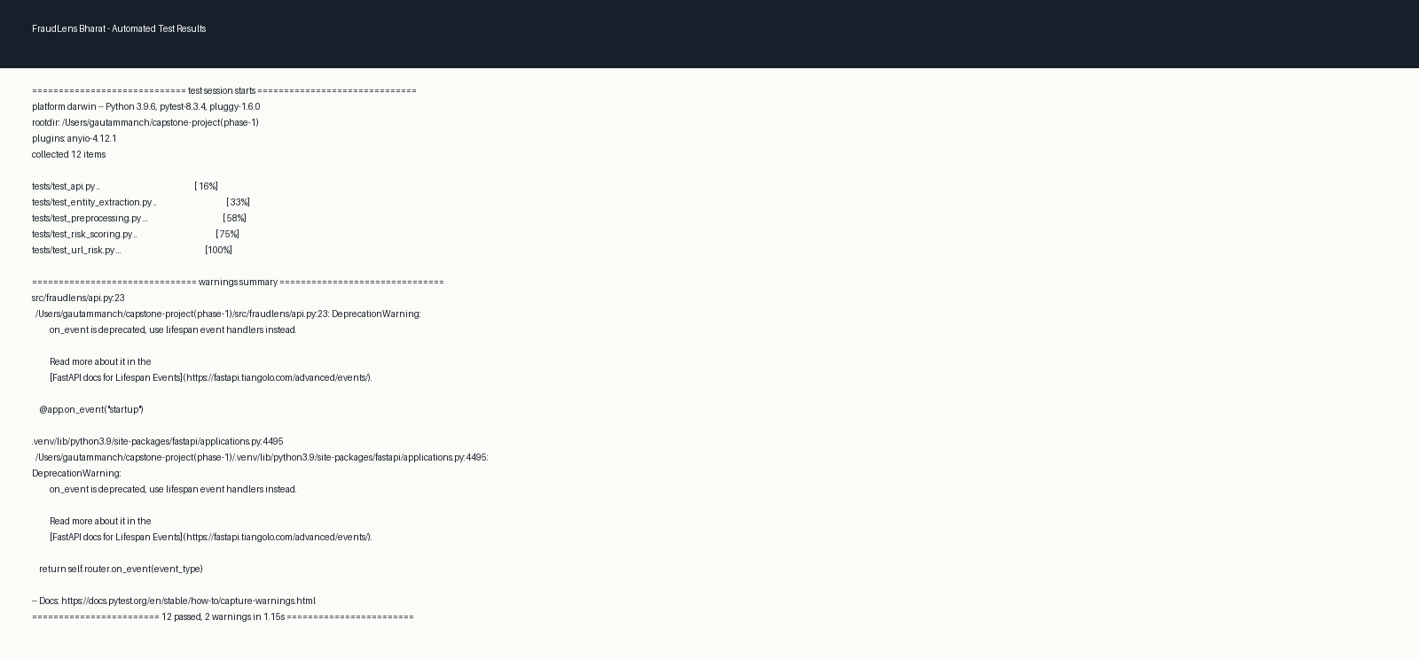
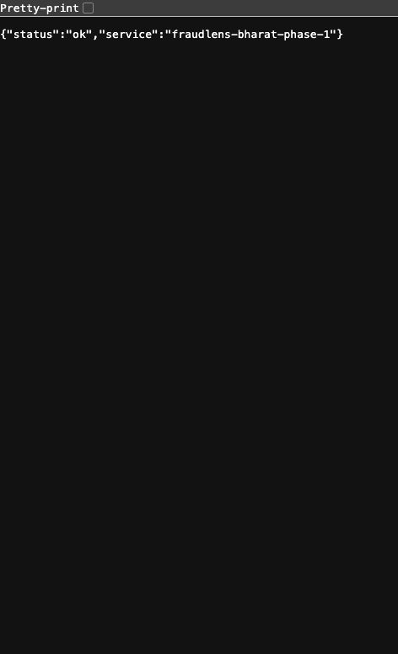
TESTING EVIDENCE
Phase 1 includes automated checks plus runnable service evidence
The goal is to show controlled progress: the core modules can be executed, tested, and defended in viva.
Test coverage
preprocessing
entity extraction
URL risk scoring
risk scoring
FastAPI analyze flow
Pytest result screenshot
API health endpoint
Acceptance criteria already met
API runs locally and /analyze returns fraud type, risk level, entities, reasons, and stored case ID.
Dashboard runs locally with 4 demo buttons and recent analysis history.
Training produces model artifacts, metrics JSON, classification report, and confusion matrix.
Validation evidence
github.com/GautamBytes/fraudlens-bharat-phase-1

Slide 9
RISK MANAGEMENT
The prototype is scoped to be useful without becoming unsafe or overclaimed
The strongest capstone pitch is honest about boundaries while showing a credible path to improvement.
Ethical guardrails
Reliability choices
Known limitations
Synthetic educational dataset
No real victim PII required
No automatic government submission
Complaint summary remains assistive
Rule-based fallback if model files are missing
Local SQLite storage
No paid APIs needed for Phase 1 demo
Explainable risk reasons
Small seed dataset
No OCR in Phase 1
No transformer fine-tuning yet
Courier/digital arrest overlap needs more data
How I will defend this in review
Phase 1 is a baseline prototype, not a production fraud detector.
The value is in the integrated pipeline, documentation, measurable evaluation, and reproducible demo evidence.
Controls and limitations
github.com/GautamBytes/fraudlens-bharat-phase-1

Slide 10
NEXT PHASE
Phase 2 turns the baseline into a stronger 6-month capstone system
The second half should improve input coverage, model quality, network intelligence, and final presentation evidence.
Month 4
Month 5
Month 5
Month 6
OCR + screenshot analysis
Transformer experiment
Graph analytics
Final hardening
Extract text from WhatsApp/SMS screenshots and route it through the same pipeline.
Compare baseline with Indic/Hinglish-capable transformer model and report macro-F1 lift.
Connect repeated phone, UPI, URL, and scam-category identifiers to expose clusters.
Larger dataset, stronger tests, final report, video demo, and viva-ready evaluation.
Feedback requested: validate the Phase 2 scope, dataset plan, evaluation metrics, and whether the current Phase 1 evidence is sufficient for the progress review.
Gautam Manchandani | 2023EBCS209 | BITS Pilani | Supervisor: Dr. Ashok Yemineni

