Slide 1


FINAL CAPSTONE PROJECT
FraudLens Bharat
Explainable cyber-fraud triage for suspicious messages and screenshots
Suspicious input → masked evidence → explainable triage → human review
369
8
2
1
automated tests
fraud categories
input modes
human decision
Gautam Manchandani · 2023EBCS209
OPEN LIVE PROJECT
BSc Computer Science · Academic Year 2025–2026
Supervisor: Dr. Ashok Yemineni
fraudlens-bharat.vercel.app
Educational prototype · synthetic evidence only · Human review required
1
Notes:
Open with the problem: victims receive unstructured suspicious messages or screenshots, but reporting requires organized evidence. FraudLens supports review; it does not make an automatic fraud verdict or file a complaint.

Slide 2

Problem, Motivation & Research Question
The project addresses the gap between a suspicious message and evidence a human can review or report.
WHY EXISTING HANDLING BREAKS DOWN
RESEARCH FRAMING
Mixed-language evidence
English + Romanized Hinglish, 36/28 rows; misspellings, urgency and impersonation complicate review.
Can a lightweight, explainable pipeline convert synthetic suspicious text and screenshots into structured, privacy-aware evidence while preserving uncertainty and human control?
Fragmented signals
Phones, UPI IDs, emails, URLs, amounts, OTPs and threat cues remain buried in text or screenshots.
TARGET USER JOURNEY
1
Submit
Paste ≤20,000 characters or upload a bounded PNG/JPEG screenshot
Opaque decisions
A label alone omits confidence, abstention, provenance, extracted evidence and the reasons behind risk.
2
Inspect
Review label, confidence, coverage, signals, URL checks and reasons
3
Decide
Keep the human verdict; edit the complaint draft before reporting
Manual reporting burden
Users must reorganize evidence into a report; the prototype returns a masked, editable complaint starting point.
4
Link
With consent, inspect masked repeats from unexpired retained cases
Design principle: organize inspectable evidence for human review; keep the verdict and complaint submission manual.
Sources: final_capstone_report.md §§1–2; NCRP [2]; Google Messages [15]
2
Notes:
Start with the reporting gap. A suspicious message is unstructured, but a useful complaint needs category, identifiers, context and an explanation. The current dataset contains 64 synthetic rows: 36 English and 28 Hinglish, across eight scam categories. FraudLens accepts pasted text or a bounded screenshot, extracts phones, UPI IDs, emails, URLs, amounts, OTP-like codes, urgency and threats, then presents the result for human review. The system never decides that a crime occurred and never files a complaint. Explain the four-step journey: submit evidence, inspect the model and rule signals, make the human decision, and optionally inspect repeated masked entities from consented, unexpired cases.
[Sources]
- Repository commit c3e8de091e838ec651cf3f7b3eb8f81bc5ba25dc: README.md; outputs/research/dataset_audit.json; docs/final_capstone_report.md.
- NCRP [2] and Google Messages [15], listed in docs/references.md.
[/Sources]

Slide 3
Objectives, Scope & Success Criteria
Each objective maps to an implemented subsystem and an observable acceptance condition.
Objective | Implemented evidence | Acceptance condition
01 · Classify | Eight Indian scam-message categories with calibrated TF-IDF inference | Return category or explicit abstention with provenance
02 · Preserve | Extract and mask phone, UPI, email, URL, amount and OTP evidence | No raw sensitive identifier in graph output or logs
03 · Explain | Confidence, coverage, abstention, risk band, reasons and URL checks | Reviewer can inspect why a result was produced
04 · Accept | Pasted text plus bounded PNG/JPEG OCR using local eng+hin Tesseract | Same analysis service handles text and extracted OCR text
05 · Connect | Consent-gated SQLite retention and repeated-entity relationship graph | Only unexpired retained cases contribute; graph stays observational
IMPLEMENTED SCOPE
EXPLICITLY OUT OF SCOPE
Next.js website + FastAPI with health/readiness
Eight-class text/screenshot triage + complaint draft
Consent-gated retention, expiry + masked graph
Docker Compose, hosted demo + reproducible evidence
Automatic NCRP filing or account/transaction action
Production, legal or victim-risk decisions
Public multi-user operation or distributed rate limiting
Transformer/GNN claims without task-specific labels
Sources: README.md; final_capstone_report.md §§3–5; automated suite at main c3e8de0
3
Notes:
Map each objective to an observable acceptance condition. Classification must return one of eight labels or explicit unknown with model provenance. Evidence extraction must keep raw sensitive identifiers out of graph storage and output. Explanations include confidence, coverage, abstention, risk band, rule reasons and URL checks. Screenshot analysis uses the same downstream service after local OCR. Storage is off by default and requires consent. Retained cases expire and only unexpired masked repeats enter the graph. The deployment boundary is an educational prototype: it supports a hosted evaluation path and a hardened local container path, but excludes automatic enforcement, legal decisions, public multi-user operations and unsupported transformer or GNN claims.
[Sources]
- Repository commit c3e8de091e838ec651cf3f7b3eb8f81bc5ba25dc: README.md; docs/final_capstone_report.md; docs/deployment_guide.md.
[/Sources]

Slide 4
Existing Solutions & Research Positioning
FraudLens is positioned as an inspectable evidence workflow; external accuracy values remain task- and dataset-specific context.
Solution / evidence | Strength | Weakness / boundary | FraudLens position
NCRP [2] Official reporting; accuracy N/A | Authoritative citizen complaint channel | Reporting starts after users organize evidence | Creates a reviewable evidence bundle and draft before manual reporting
Google Messages [15] Spam + URL protection; accuracy undisclosed | Inbox-scale warning and filtering | Decision internals and category evidence are not the project focus | Exposes category, evidence, confidence, reasons and uncertainty
HingRoBERTa [7] 74.41% accuracy; 71.49% F1 | Contextual Hinglish complaint classification | Different I4C task/data; higher compute and fine-tuning cost | Lightweight local baseline plus OCR, privacy and review workflow
Neural URL detector [9] ~97% validation accuracy | Large specialized binary URL detector | Narrow task; not message/screenshot triage | Uses URL checks as one visible signal within full-message analysis
Financial-fraud GNNs [10] No universal score | Learns patterns in labelled temporal graphs | Needs labels, time structure and imbalance controls | Observational masked repeat graph; no GNN detection claim
FraudLens Bharat 75% research candidate; 50% deployed runtime | One inspectable path from intake to complaint draft | 64 synthetic fraud-only rows; eight-row frozen test | Differentiator is end-to-end evidence handling and reproducibility
Compare: Macro-F1 + balanced accuracy · calibration/Brier · coverage + abstention · MCC · fitted bytes · privacy · explainability · workflow completeness.
Sources: NCRP [2]; Rani et al. [7]; Ghalechyan et al. [9]; financial-fraud GNN review [10]; Google Messages [15]
4
Notes:
Explain why the comparison does not rank unlike tasks as one leaderboard. NCRP is the official reporting channel, while FraudLens prepares evidence before manual reporting. Google Messages operates at inbox scale, while FraudLens exposes category, evidence, confidence, reasons and uncertainty. HingRoBERTa reports 74.41 percent accuracy and 71.49 percent F1 on a different Hinglish complaint task. The neural URL detector reports about 97 percent validation accuracy on a narrow binary URL task. Financial-fraud GNN research assumes labelled temporal graphs. FraudLens instead combines lightweight classification, OCR, evidence extraction, privacy controls and a complaint workflow. Use Macro-F1 and balanced accuracy for class fairness; Brier and ECE for confidence quality; coverage and abstention for selective prediction; MCC, confusion matrices and fitted bytes for robustness and deployability.
[Sources]
- Repository commit c3e8de091e838ec651cf3f7b3eb8f81bc5ba25dc: docs/research_methodology.md; docs/phase2_research_report.md; docs/comparative_analysis.md.
- NCRP [2], Rani et al. [7], Ghalechyan et al. [9], Cheng et al. [10], Google Messages [15], listed in docs/references.md.
[/Sources]

Slide 5

System Architecture & Data Flow
A same-origin web gateway connects the research interface to one bounded analysis service and consent-aware evidence store.
1
Evidence intake
2
Next.js gateway
3
FastAPI boundary
4
Analysis service
Text ≤20k characters or PNG/JPEG screenshot ≤4 MB.
Vercel UI, same-origin BFF, server-only FastAPI URL and optional gateway key.
Content-type, payload, image and authorization checks before analysis.
OCR/normalize → model → abstention → entities/URL signals → risk reasons → complaint draft.
TRUST BOUNDARY
Storage OFF by default · image bytes never retained · OCR text stored only with consent · expiry removes graph links · private payloads excluded from logs
DECISION AND EVIDENCE OUTPUTS
Prediction
Evidence
Human draft
Eight classes or abstain; confidence and model provenance
Masked entities, URL reasons, amount/OTP signals and risk band
Editable complaint starting point—not automatic filing
Consented SQLite evidence path
Store redacted result → enforce retention → read unexpired cases → mask identifiers again → build bounded repeated-entity links. The graph never changes prediction or risk.
Sources: README.md architecture; final_capstone_report.md §§3–5; render.yaml; web API routes
5
Notes:
Walk left to right. The input boundary accepts text up to 20,000 characters or a web screenshot up to 4 MB; the backend policy allows PNG/JPEG up to 5 MiB, 4096 by 4096 and 16 million pixels. The Next.js same-origin gateway keeps the Render origin and optional demo key server-side. FastAPI validates media type, payload size, image structure and authorization before analysis. The shared service normalizes text, runs calibrated classification with abstention, extracts entities, checks URLs, produces risk reasons and drafts the complaint. Storage remains off unless enabled or explicitly consented to. Screenshot bytes are never retained. OCR text follows the same retention policy as pasted text. The graph reads only masked repeated entities from unexpired retained cases and never changes classification or risk.
[Sources]
- Repository commit c3e8de091e838ec651cf3f7b3eb8f81bc5ba25dc: README.md; src/fraudlens/api.py; src/fraudlens/analysis_service.py; web/src/lib/server/fraudlens.ts.
[/Sources]

Slide 6
Implementation, Security & Reproducibility
The project is more than a classifier: each subsystem has an explicit contract, safety boundary and automated verification.
Inference
OCR
Evidence
Calibrated TF-IDF + Logistic Regression
Local Tesseract eng+hin
Regex + URL checks + risk rules
Verified immutable bytes; hashes bind artifacts to training + preprocessing source; validation threshold enables unknown.
PNG/JPEG, ≤5 MiB backend, ≤4096², ≤16M pixels; frame/decompression/time checks; image bytes discarded.
Regex + URL heuristics expose phones, UPI, email, URLs, amounts, OTPs, urgency and threats; identifiers are masked.
Persistence
Web/API
Release
SQLite with retention metadata
Next.js App Router + FastAPI
Pinned Python + hash-locked dependencies
Consent-gated writes; UTC retention expiry; malformed legacy timestamps purge; bounded latest-case reads and clear/delete.
Next.js same-origin BFF keeps API URL/key server-side; generic errors, request limits, /health and dependency-aware /ready.
Python 3.11.15 canonical artifacts; universal hash lock; non-root read-only containers; pip-audit and multi-version CI.
VERIFIABLE PROJECT INTERFACES
369
3
POST /analyze · POST /analyze/image · GET /graph · DELETE /cases · GET /health · GET /ready
automated tests
Python versions
Website: Evaluate · Analyze text/image · Relationships · Research · Run guide · synthetic reset
369 tests · 0 failures
3.10 · 3.11.15 · 3.12
Sources: src/fraudlens; web/src; requirements.lock; Dockerfile; .github/workflows/ci.yml
6
Notes:
Use this slide to show engineering depth. Inference loads each artifact from one immutable byte snapshot, verifies its hash and only then deserializes it, avoiding a check-then-load swap. The manifest binds the release to model training and preprocessing source hashes. OCR checks encoded type, size, dimensions, frame count, decompression risk and timeout before running local English and Hindi Tesseract. Entity extraction and URL heuristics produce visible reasons, while raw identifiers are masked before graph output. SQLite writes require consent, store UTC expiry and purge malformed or expired records. The web gateway keeps backend configuration server-side and exposes generic client errors. The release path uses a universal hash lock, a non-root read-only container, dependency audits, deterministic retraining and CI on Python 3.10, 3.11.15 and 3.12.
[Sources]
- Repository commit c3e8de091e838ec651cf3f7b3eb8f81bc5ba25dc: src/fraudlens; web/src; requirements.lock; Dockerfile; compose.yaml; .github/workflows/ci.yml.
[/Sources]

Slide 7
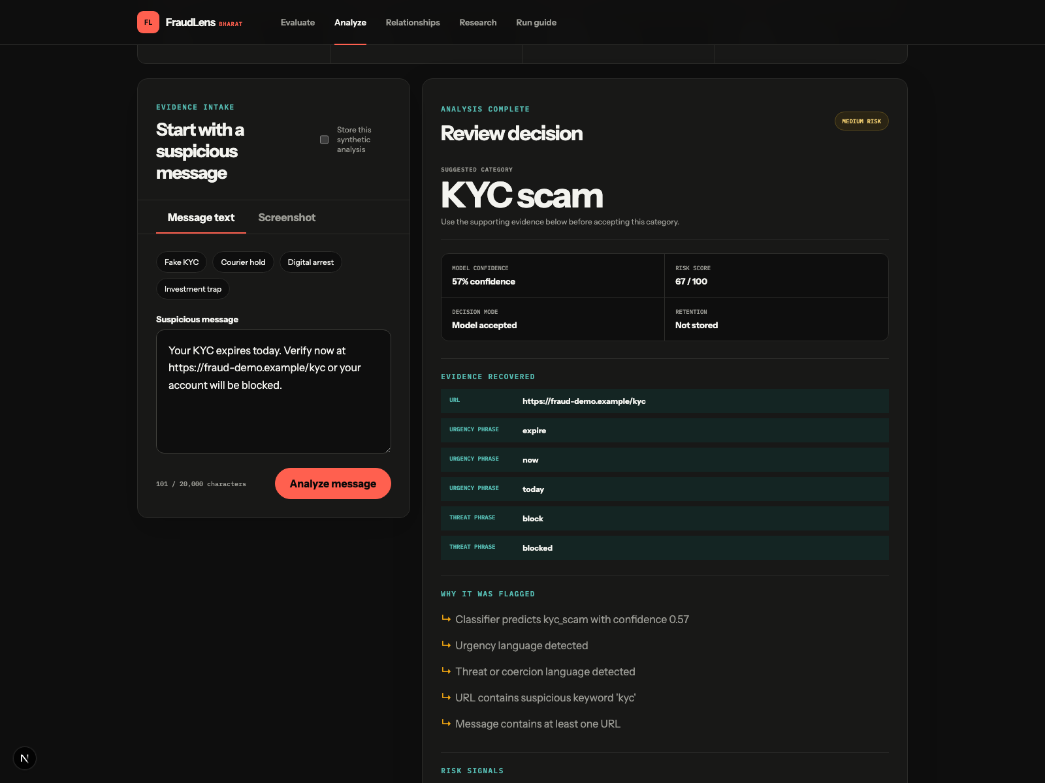
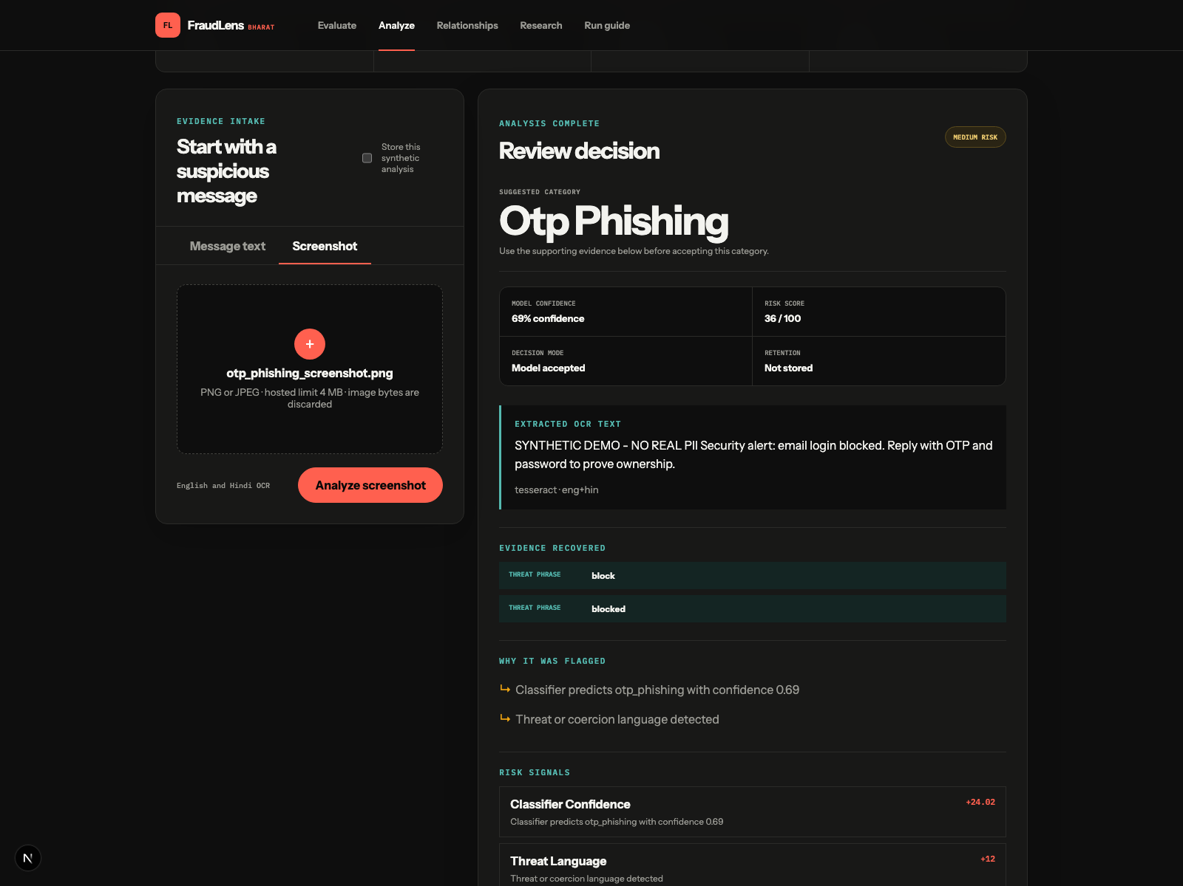
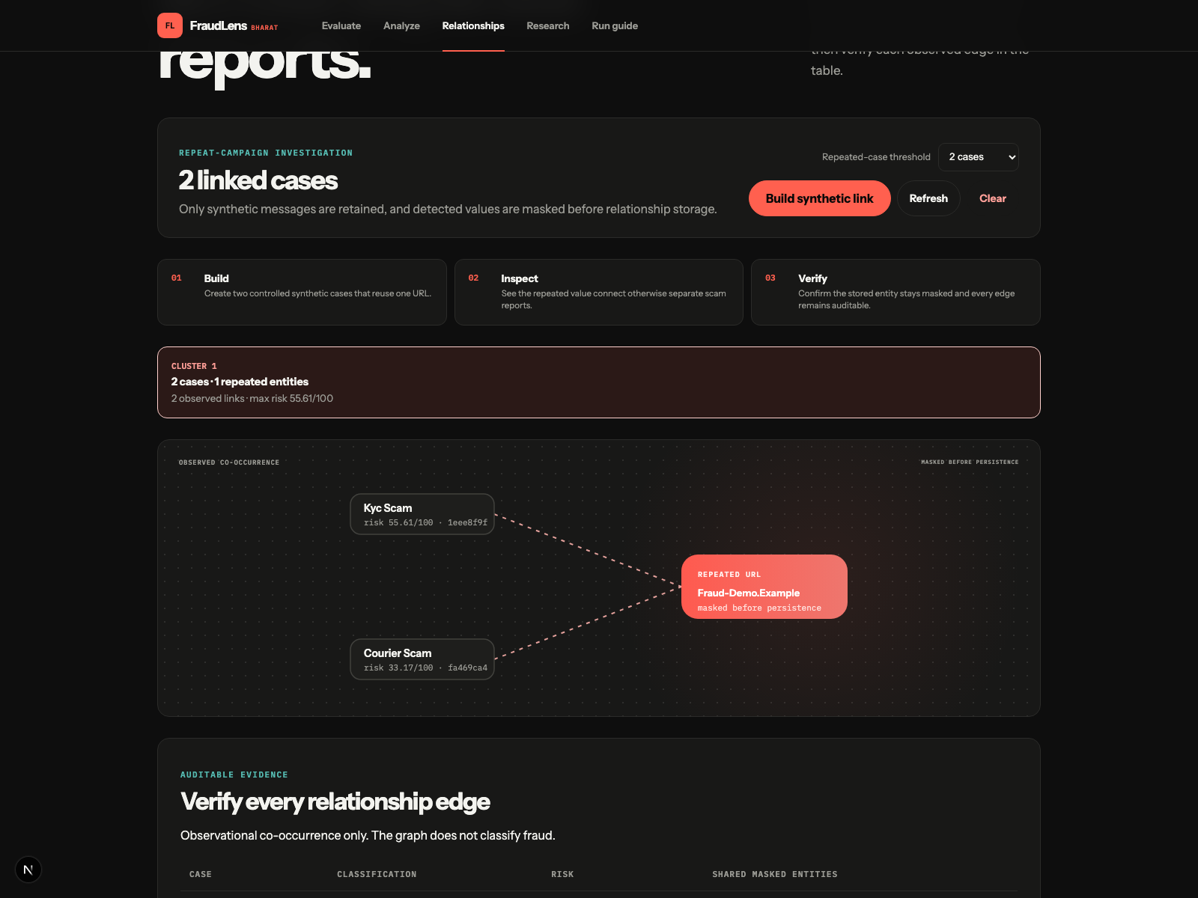
End-to-End Demonstration
The current website exposes text, screenshot and relationship workflows through one consistent review interface.
1 · Text analysis
2 · Screenshot OCR
3 · Relationship evidence
Classify a synthetic KYC message; inspect confidence, masked entities, URL reasons, risk and complaint draft.
Upload the bounded synthetic image; confirm extracted text enters the same analysis pipeline and image bytes are not retained.
Seed consented demo cases; show masked repeated entities, edge counts and explicit refresh/reset behavior.
Storage remains OFF
PNG/JPEG · 4 MB web cap
Observational · masked · bounded
Hosted demo
fraudlens-bharat.vercel.app
Use synthetic fixtures only
Analyze → Relationships → Research → Run guide
Screenshots: outputs/screenshots/final_text_analysis.png, final_ocr_analysis.png, final_entity_graph.png
7
Notes:
Demonstrate three connected workflows. First, analyze the synthetic KYC message and point out the category, confidence, masked evidence, URL reasons, risk cues and editable complaint draft. Keep storage off. Second, upload the bundled synthetic OTP screenshot. Confirm that local English and Hindi OCR extracts text, sends it through the same analysis service and never retains source image bytes. Third, open Relationships and select Build synthetic link. The demo seeds consented cases with a repeated masked entity, then shows the bounded observational graph and verification table. Refresh is explicit, reset is explicit, and the graph does not alter any prediction. The hosted route is fraudlens-bharat.vercel.app; the Run guide also documents a local Docker path.
[Sources]
- Repository commit c3e8de091e838ec651cf3f7b3eb8f81bc5ba25dc: docs/presentation/demo_video_runbook.md; outputs/screenshots; web/e2e.
[/Sources]

Slide 8

Results, Calibration & Hybrid Evidence
Internal candidate: 75.0% accuracy / 66.67% Macro-F1 (8 rows); external binary, runtime and subsystem results remain separate.
DEPLOYED CALIBRATED RUNTIME
50.0%
50.0%
accuracy
Macro-F1
8 frozen rows
deployed artifact
87.5%
12.5%
coverage
abstention
7 of 8 accepted
1 of 8 rejected
57.14%
25.5%
accepted accuracy
lower Brier
among covered rows
research calibration
Engineering verification
EXTERNAL BINARY VALIDATION
Runtime: 50.0% runtime accuracy · 87.5% coverage · 369 tests · exact artifacts · dependency audit
UCI SMS · 858 test
Calibrated character TF-IDF: 98.60% accuracy · 0.9682 Macro-F1 · 92.73% spam recall · ECE 0.0071
Character - word Macro-F1 +0.0023; 95% bootstrap CI -0.0105 to +0.0147 · not statistically decisive.
Subsystem evidence
Entity F1 94.12% · OCR label agreement 91.67% (n=24) · URL/graph F1 100%
Sources: outputs/evaluation/*; outputs/research/*; models/metrics.json · separate tasks; not directly comparable; no production-accuracy claim
8
Notes:
Present four separate evidence tracks. The internal eight-class synthetic research candidate reaches 75 percent accuracy and 66.67 percent Macro-F1; the deployed runtime separately reports 50 percent accuracy and 87.5 percent coverage. The public UCI SMS Spam Collection uses 5,574 messages and a duplicate-safe grouped split, leaving 858 held-out test messages. Calibrated character TF-IDF reaches 98.60 percent accuracy, 0.9682 Macro-F1, 92.73 percent spam recall and ECE 0.0071. The character-minus-word Macro-F1 interval crosses zero, so this is not a statistically decisive model-superiority claim. Controlled subsystem checks report entity F1, URL rules, masked graph linking, real Tesseract OCR and complaint-template completeness separately. Do not combine these tracks into one overall accuracy.
[Sources]
- outputs/evaluation/external_sms_summary.json and subsystem_summary.json.
- outputs/research/classification_summary.csv; models/metrics.json.
- UCI SMS Spam Collection [16], DOI 10.24432/C5CC84.
[/Sources]

Slide 9
Limitations, Risks & Mitigation Plan
Hybrid evidence reduces uncertainty, but field validity, same-task external data and human evaluation remain open.
Limitation | Why it matters | Planned mitigation / measurement
64 synthetic fraud-only messages; no legitimate class | Class boundaries and false positives are not representative | Collect 200+ authorized reviewed rows per fraud label plus benign controls
Eight-row frozen test; one row per class | One error moves accuracy by 12.5 percentage points | Use grouped external holdout, confidence intervals and temporal evaluation
Controlled subsystem fixtures only | Synthetic templates do not establish field or human-review quality | Add natural screenshots, blinded labels and a human draft-quality rubric
No Devanagari, drift or user study | Generalization and usability remain unknown | Create language/noise strata; supervised reviewer study and escalation rubric
Shared educational deployment | No end-user accounts, distributed limits or production operations | Restricted demo access; add session auth, rate limits and external database before expansion
Interpretation rule
Use each score only for its declared task. Binary UCI ≠ eight-class runtime; controlled subsystem fixtures ≠ field or human studies.
Sources: final_capstone_report.md §§8–10; phase2_research_report.md; evaluation_plan.md
9
Notes:
The hybrid evaluation improves the evidence base without erasing the limitations. The internal dataset still has only 64 synthetic fraud-only messages, no legitimate label and one test row per class. The external UCI benchmark is a binary spam-versus-ham task, not an external validation of the deployed eight categories. Entity, URL, graph, OCR and complaint cases are controlled synthetic fixtures; complaint checks are deterministic and are not human ratings. A stronger claim requires authorized same-label data, benign controls, temporal and source holdouts, naturally noisy screenshots, blinded annotation, inter-rater agreement, user studies and operational monitoring.
[Sources]
- docs/phase2_research_report.md §§14, 17.
- docs/evaluation_plan.md; outputs/evaluation/*.
[/Sources]

Slide 10
Conclusion, Contribution & Future Work
FraudLens Bharat is software-complete with stronger hybrid evidence; the next milestone is field-valid evaluation.
PRIORITIZED NEXT RESEARCH
COMPLETED CONTRIBUTION
1
Authorized category data
One human-controlled evidence workflow
200+ reviewed rows per label, legitimate controls and a same-task external/temporal holdout
One shared text/screenshot analysis path with calibrated abstention
Masked evidence, URL reasons, risk cues + editable complaint draft
Consent, expiry + bounded repeated-entity context
External binary validation + five subsystem benchmarks
Reproducible aggregate evidence + 369 automated tests
2
Same-task model study
Same labels, split and thresholds for character TF-IDF versus a Hinglish transformer
3
Field subsystem validation
Natural screenshots, blinded entity/URL/graph labels and a human complaint-draft rubric
369
automated tests
External: 98.60% acc · 0.9682 F1
Runtime: 50% acc · 87.5% coverage
User and operations study
4
Reviewer effectiveness, latency/RAM, access control, durable storage and drift monitoring
Final takeaway: masked, inspectable evidence supports the reviewer; the human keeps the decision.
Release 1.0 candidate · hybrid evidence verified · hosted website: fraudlens-bharat.vercel.app
10
Notes:
Close with the contribution. FraudLens Bharat now joins pasted text or screenshot intake, eight-class prediction or abstention, masked evidence, URL and risk reasons, an editable complaint draft, consented retention and repeated-entity context. The final hybrid evaluation adds duplicate-safe external binary validation, uncertainty intervals, held-out ham stress and five measured subsystem tracks. Only aggregate evidence is committed. The next work is evidence quality rather than another interface feature: authorized same-label data, natural screenshot annotation, blinded complaint evaluation, user effectiveness, latency and memory, drift monitoring and stronger deployment controls. The final verdict and complaint submission remain human decisions.
[Sources]
- README.md; docs/final_capstone_report.md; docs/phase2_research_report.md.
- outputs/evaluation/* and outputs/presentation/*.
[/Sources]

