Slide 1
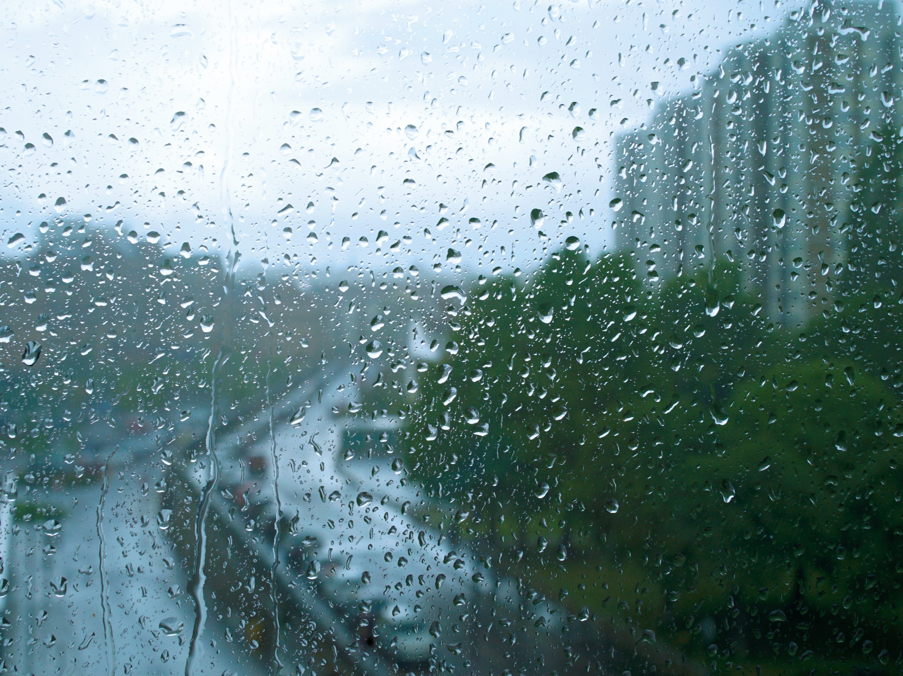
Disaster Relief and Responses
Team members:
Sandeep Deogam
Suganya Palaniappan
Gottipati Gautam
Dileep Jallipalli
Gunnala Pavan Kumar Reddy

Slide 2
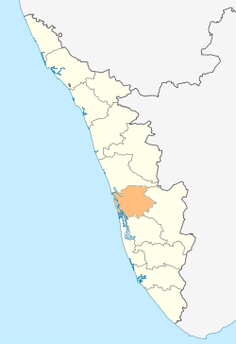
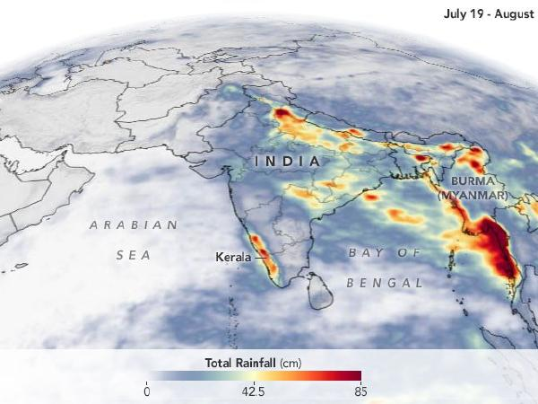
PROBLEM STATEMENT:
To find out the rainfall pattern in Kerala over last 115 years and predict the rainfall in upcoming Months/Quarters/Annual.

Slide 3

HOW CAN WE DO?
Our Approach

Slide 4
Data Pre-processing
NO
YES
Stationary
Power transformation Differencing
ACF & PACF
p,q,d
ARIMA Coefficient estimation
FIT
YES
Diagnostic Check?
Forecasting
ARIMA model
NO

Slide 5
TECHNOLOGY USED:
Machine Learning.
Time Series Analysis
TOOLS USED:
R Studio

