Slide 1
Drawing and Image Processing in Python with Myro Graphics
Dr. Paige H. Meeker

Slide 2
What can Python do without the Robots?
We can use Python to control the robots
We can also use Python to create some interesting drawings!
http://wiki.roboteducation.org/Myro_Reference_Manual

Slide 3
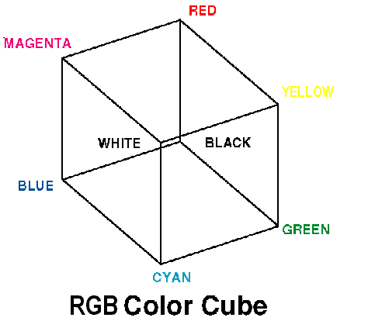
Changing Colors
Python uses the RGB Color model. That stands for red, green, and blue
The range for each color is 0-255.

Slide 4
Changing Colors
To create a new color value, assign an identifier to a new color:
redColor = color_rgb(255,0,0)
There are 256 different shades for each of the three colors. Combinations of these shades will allow you millions of color choices.
For a list of several of the RGB colors, visit: http://www.tayloredmktg.com/rgb/
Alternatively, you can use Google with "rgb color codes" as a search parameter

Slide 5
Drawing
To draw things, we need a window. We create it with:
myWin = GraphWin(title, width, height)
(remember, myWin is a variable name – it can be anything you want it to be.)
After creating the window, you can do several things to it:
myWin.setBackground(color)
myWin.close()
myWin.isClosed()
myWin.getMouse()

Slide 6
Myro Graphics Objects
You can draw lots of things using Myro:
Point
Oval
Circle
Rectangle
Image
Text
Line
Polygon

Slide 7
Point(x,y)
myPoint = Point(x,y)
Actions you can use on points include:
getX()
getY()
These actions (also called “methods”) will give you back the x and y locations of the point you reference. To use any actions, you use the identifier of the point:
myPoint.getX() #For example

Slide 8
Oval(point1,point2)
myOval = Oval(point1,point2)
Actions you can use on ovals include:
getCenter()
getP1()
getP2()
These actions (also called “methods”) will give you back the x and y locations of the point you reference. To use any actions, you use the identifier of the point:
myOval.getCenter() #For example

Slide 9
Rectangle(point1,point2)
myRectangle = Rectangle(point1,point2)
Actions you can use on rectangles include:
getCenter()
getP1()
getP2()
These actions (also called “methods”) will give you back the x and y locations of the point you reference. To use any actions, you use the identifier of the point:
myRectangle.getCenter() #For example

Slide 10
Line(point1,point2)
myLine = Line(point1,point2)
Actions you can use on lines include:
getCenter()
setArrow("first" / "last" / "both" / "none")
getP1()
getP2()

Slide 11
Circle(centerPoint,radius)
myCircle = Circle(centerPoint,radius)
Actions you can use on circles include:
getCenter()
getRadius()

Slide 12
Polygon(point1, point2, ...)
myPoly = Polygon(p1,p2,p3,…) #list of points
Actions you can use on polygons include:
getPoints() #Returns a list of points.

Slide 13
Text(anchorPoint, string)
myText = Text(anchorPoint,string)
Actions you can use on text include:
setText(string)
getText()
getAnchor()
setFace(family)
setSize(point)
setStyle('normal'/'bold'/'italic')
setTextColor(color)

Slide 14
Image(centerPoint, imageFileName)
#to read in a file (jpg, gif) and then
#convert it to an image:
dis = makePicture(pickAFile())
disPixmap = makePixmap(dis)
center = Point(150,150)
pic = Image(center,disPixmap)

Slide 15
So, to display a photo of ANY size correctly…
from myro import * #need myro for this to work!
dis = makePicture(pickAFile()) #choose any image
disPixmap = makePixmap(dis) #create a pixmap
disWidth = disPixmap.getWidth() #gets width
disHeight = disPixmap.getHeight() #gets height
center = Point(disWidth/2,disHeight/2) #need the center point
pic = Image(center,disPixmap) #Python needs an IMAGE, not a JPG or GIF
disWin = GraphWin("Cinderella",disWidth,disHeight) #make a window to display it in
pic.draw(disWin) #draw it!

Slide 16
Actions for all Graphics Objects
The following are actions to take on all the Myro graphics objects except “Image” and “Text”
setFill( color )
setOutline( color )
setWidth( pixels )
draw(aGraphWin) #Used to draw the object onto a graph window. Once drawn, updates are automatic.
undraw() #Removes the object from a graph window.
move( dx, dy ) #Relative to current location.
clone() #Returns a reference to a clone of the object.

Slide 17
Cat.py
#Cat window created by Dr. Paige Meeker
#Robot Class
#September 5, 2008
#
#Collaboration Statement: I worked on this program alone.

Slide 18
Cat.py Setting up the Window
#Import the myro library
from myro import *
#Create a window
animalWindow = GraphWin("My Animal Drawing", 300, 300)
#Change the background color of the window
#For a list of several of the RGB colors, visit:
#http://www.tayloredmktg.com/rgb/#OR
#alternatively, you can use Google with "rgb color codes" as a search parameter
lightPink = color_rgb(255,182,192)
animalWindow.setBackground(lightPink)

Slide 19
Cat.py Making a face
#create the face of the cat:
centerCatFace = Point(150,150)
face = Circle(centerCatFace,50)
catColor = color_rgb(255,105,180)
face.setOutline(catColor)
face.setWidth(10)
face.draw(animalWindow)

Slide 20
Cat.py Making ears
earPt1 = Point(125,110)
tip = Point(125,50)
earPt2 = Point(150,100)
tip2 = Point(175,50)
earPt3 = Point(175,110)
leftEar1 = Line(earPt1,tip)
leftEar2 = Line(tip,earPt2)
leftEar1.setWidth(10)
leftEar1.setOutline(catColor)
leftEar1.draw(animalWindow)
leftEar2.setWidth(10)
leftEar2.setOutline(catColor)
leftEar2.draw(animalWindow)
rightEar1 = Line(earPt2,tip2)
rightEar2 = Line(tip2,earPt3)
rightEar1.setWidth(10)
rightEar1.setOutline(catColor)
rightEar1.draw(animalWindow)
rightEar2.setWidth(10)
rightEar2.setOutline(catColor)
rightEar2.draw(animalWindow)

Slide 21
Cat.py Making eyes
eyeColor = color_rgb(0,255,0)
eyePt1 = Point(135,135)
eyePt2 = Point(165,135)
leftEye = Circle(eyePt1,10)
leftEye.setFill(eyeColor)
leftEye.draw(animalWindow)
rightEye = Circle(eyePt2,10)
rightEye.setFill(eyeColor)
rightEye.draw(animalWindow)

Slide 22
Cat.py Making the nose and mouth
nose = Circle(centerCatFace,5)
nose.setFill(catColor)
nose.draw(animalWindow)
mouthPt = Point(150,175)
mouth = Text(mouthPt,"W")
mouth.setSize(30)
mouth.setTextColor(catColor)
mouth.draw(animalWindow)

Slide 23
Disney.py
To import images into your files, use the following example.
#Disney Image window created by Dr. Paige Meeker #Robot Class #September 5, 2008 # #Collaboration Statement: I worked on this program alone. #Import the myro library from myro import * | #Create a window disneyWin = GraphWin("My Disney Images", 300, 300) dis = makePicture(pickAFile()) #show(dis) disPixmap = makePixmap(dis) center = Point(150,150) pic = Image(center,disPixmap) pic.draw(disneyWin)

Slide 24
Disney.py
#Disney Image window created by Dr. Paige Meeker #Robot Class #September 5, 2008 # #Collaboration Statement: I worked on this program alone. #Import the myro library from myro import * #Create a window disneyWin = GraphWin("My Disney Images", 300, 300) | dis = makePicture(pickAFile()) #show(dis) disPixmap = makePixmap(dis) center = Point(150,150) pic = Image(center,disPixmap) pic.draw(disneyWin) #Can also draw on the window with the picture circleTest = Circle(center,20) ccolor = color_rgb(255,182,98) circleTest.setFill(ccolor) circleTest.draw(disneyWin)

Slide 25
Gathering User Input
To ask the user for information, use the “input” command. In the parenthesis, ask a question of the user that will give the user the information they need to give back the proper answer. This is usually stored in a variable name.
<variable name> = input(<some prompt string>)
xPoint = input(“Please enter the x coordinate of the point.”)
yPoint = input(“Please enter the y coordinate of the point.”)
userPoint = Point(xPoint,yPoint)

Slide 26
Repetition aka “Looping”
Loop statements will allow repetition of events for a fixed number of times.
for <variable> in <sequence>:
<do something>
<do something>
...
We can use loop statements for lots of things. One example is animation!

Slide 27
LoopingCircles.py
#Circle window created by Dr. Paige Meeker
#Robot Class
#September 5, 2008
#
#Collaboration Statement: I worked on this program alone.
#Import the myro library
from myro import *
#Create a window
circleWin = GraphWin("My Circle Drawing", 300, 300)
#create the circle to be moved:
center = Point(150,150)
myCircle = Circle(center,50)
myColor = color_rgb(75,105,180)
myCircle.setOutline(myColor)
myCircle.draw(circleWin)
for i in range(10):
myCircle.move(5,5)
wait(1) #without this, you can’t see the movement!

Slide 28
Repetition aka “Looping”
Loop statements also allow you to specify a start point, end point, and stepping sequence
for i in range(1,10,2):
myCircle.move(-5,-5)
wait(1)
How do you think this statement will affect our circle’s movement if we add it to the code?

Slide 29
Repetition another way…
With the “for” example, we specified a number of times we wanted our actions to repeat. We can also specify repetition as the amount of time we want our actions to repeat.
while timeRemaining(10):
<do something>
<do something>
...
This will issue the commands for 10 seconds. (The 10 can be any time you want.)

Slide 30
While…
To have your while command repeat forever, type:
while True:
<do something>
<do something>
…

Slide 31
Image Processing and Perception
Dr. Paige H. Meeker

Slide 32
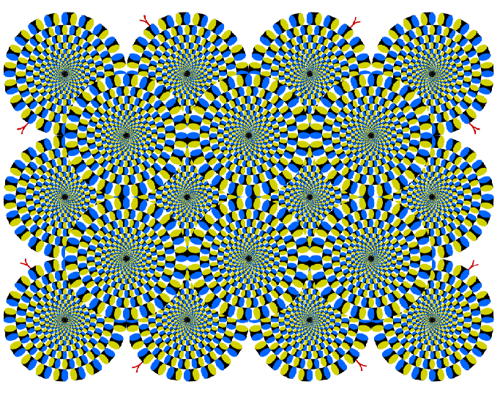

Slide 33
What’s an Image?
Images are pictures, taken by a digital camera or created in a digital program.
These images are made up of picture elements (aka pixels) that contain color values.
Manipulation of these color values can make for interesting interpretations and make existing data easier to see
The field that studies this is called “image processing.”

Slide 34
What’s an Image?
Color images are made up of 255 shades of red mixed with 255 shades of green mixed with 255 shades of blue.
It takes 3 bytes (24 bits) to hold a single pixel’s color value.
Grayscale images contains the level of gray in a pixel which can be represented in one byte (8 bits) with a number ranging from 0 to 255.

Slide 35
What’s an Image?
Most digital cameras take photos of at least 6 Megapixels.
Refers to the largest size image the camera can take
Scribbler takes photos of 0.14 megapixels
Myro supports images of type JPG and GIF

Slide 36
Myro Image Review
pic = takePicture() #Takes a photo with the Scribbler, stores it in variable “pic”
pic = takePicture(“gray”) #Takes a grayscale photo with the Scribbler
getWidth(pic) # gives the width of pic
getHeight(pic) # gives the height of pic
savePicture(pic, “NewPicName.jpg”) #saves a JPG
savePicture(pic, “NewPicName.gif”) #saves a GIF
makePicture(“directory/nameOfPic.JPGor.GIF”) #reads back in a photo that has been stored
pickAFile() #opens navigational dialog box to allow user a choice of files to load in.
show(pic) #shows the photo on the monitor

Slide 37
Robot Explorer
You can use the joyStick() function to guide your robots movements while taking photos, allowing you to remotely guide the robot. Try the following code:
joyStick()
for i in range(25):
pic = takePicture(“gray”)
show(pic)
What do you expect this code to allow you to do?

Slide 38
Animated GIFs
In chapter 5 (“Sensing the World”), we made an animated GIF – the instructions are repeated here. Looking at the last slide, can you remember how to create one?

Slide 39
Animated GIFs
First, you use the robot to create a list of pictures (through movement or rotating in place)
Use the savePicture command with the list instead of a single photo – save it to a GIF file (JPG’s are not animated)
Example:
pic1 = takePicture()
#move the robot
pic2 = takePicture()
picList = [pic1,pic2] #can have many more photos here
savePicture(picList, “AnimatedGifExample.gif”)
Open “AnimatedGifExample.gif” in any web browser to see the movie.

Slide 40
Making Photos
You can create photos – in fact, you have created drawings of your own. (See chapter 8 and or previous notes on creating images.)
Let’s see what else we can do – we can create our own photos by manipulating each of the pixels within an image.

Slide 41
Color Values
Myro has some predefined colors:
black = makeColor( 0, 0, 0)
white = makeColor(255, 255, 255)
blue = makeColor( 0, 0, 255)
red = makeColor(255, 0, 0)
green = makeColor( 0, 255, 0)
gray = makeColor(128, 128, 128)
darkGray = makeColor( 64, 64, 64)
lightGray = makeColor(192, 192, 192)
yellow = makeColor(255, 255, 0)
pink = makeColor(255, 175, 175)
magenta = makeColor(255, 0, 255)
cyan = makeColor( 0, 255, 255)

Slide 42
Making Pictures
To create a picture filled with one color:
#define some size for the width and height of the image
Width = Height = 100
#fill in “black” with any color
newPic = makePicture(width,height,black)
show(newPic)
newPic2 = makePicture(width,height,makeColor(r,g,b))
Show(newPic2)

Slide 43
Picture Commands
getPixel(x,y)
Returns the pixel at location x,y
pickAColor()
Displays a color palette allowing you to chose a new color
repaint(pictureName)
Refreshes the displayed image to allow you to see any changes that have been made
setRGB(pixel,(r,g,b))
Sets a pixel to the color specified by r,g,b (which are in the range of 0 to 255 each)
r, g, b = getRGB(pixel)
Returns the color values for red, green, and blue in pixel
getRed(pixel), getGreen(pixel), getBlue(pixel)
Returns the red, green, or blue color values in the pixel

Slide 44
Image Processing
By manipulating the pixels in an image, we can create some interesting pictures.
To make things easier, let’s make them grayscale with the “gray” function below:
def gray(v):
return makeColor(v,v,v) #returns an rgb gray color for v

Slide 45
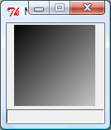
Image Processing
A range of gray? Use the previous function with the rule “pixel at x,y colored using grayscale x+y
def shadesOfGray():
MAX = 255
W = H = 100
myPic = makePicture(W,H)
show(myPic,"Shades of Gray")
for x in range (W):
for y in range (H):
color = gray((x+y)%(MAX+1))
setPixel(myPic, x, y, color)
show(myPic)

Slide 46
Image Processing
Why does this work?
Think about the values: location 0,0 will be the value 0+0 MOD (max grayscale value) or 0 – black.
How about location 100,100? (100+100 MOD 256) – light gray!
What if our image was size 123x123?
123+123 MOD 256 = WHITE

Slide 47
Image Processing
Play with the other examples in your book – play with the values and see if you can predict the results before you view them.

Slide 48
Image Processing
You don’t have to start with a blank image to create a new one.
You can use other techniques to transform existing images in interesting ways.
Let’s see how we can:
Shrink
Enlarge
Blur
Sharpen
Negative
Emboss

Slide 49
Image Processing - Shrinking
Take an input image and shrink it by a given factor.
Use the rule:
New pixel at x,y = old pixel at x*Factor, y*Factor
def shrink(pic):
show(pic,"Before")
x = getWidth(pic)
y = getHeight(pic)
F = int(ask("Enter shrink factor"))
newX = x/F
newY = y/F
newPic = makePicture(newX,newY)
for x in range(1,newX):
for y in range(1,newY):
setPixel(newPic, x, y, getPixel(pic, x*F,y*F))
show(newPic,"After")
return newPic

Slide 50
Image Processing - Enlarging
Take an input image and enlarge it by a given factor.
Use the rule:
New pixel at x,y = old pixel at x/Factor, y/Factor
def enlarge (pic):
show(pic,"Before")
x = getWidth(pic)
y = getHeight(pic)
F = int(ask("Enter enlarge factor"))
newX = x*F
newY = y*F
newPic = makePicture(newX,newY)
for x in range(1,newX):
for y in range(1,newY):
setPixel(newPic, x, y, getPixel(pic, x/F,y/F))
show(newPic,"After")
return newPic

Slide 51
Image Processing - Blurring
You can blur an image by taking the average color values of neighboring pixels
Using a neighborhood of 4:
def blur(pic):
show(pic,"Before")
w = getWidth(pic)
h = getHeight(pic)
newPic = makePicture(w,h)
for x in range(1,w-1):
for y in range(1,h-1):
n1 = getPixel(pic, x, y)
n2 = getPixel(pic, x-1, y)
n3 = getPixel(pic, x+1, y)
n4 = getPixel(pic, x, y-1)
n5 = getPixel(pic, x, y+1)
v = (getRed(n1)+getRed(n2)+getRed(n3)+getRed(n4)+getRed(n5))/5
setPixel(newPic, x, y, gray(v))
show(newPic,"After")
return newPic

Slide 52
Image Processing - Blurring
You can blur an image by taking the average color values of neighboring pixels
How would you modify the code on the previous slide to:
Calculate a color blurring instead of a grayscale one?
Calculate a blurring of a neighborhood of 8?
Calculate a blurring of a neighborhood of 15?

Slide 53
Image Processing - Sharpening
You can sharpen an image by subtracting the values instead of averaging them.
Using a neighborhood of 4:
def sharpen(pic):
show(pic,"Before")
w = getWidth(pic)
h = getHeight(pic)
newPic = makePicture(w,h)
for x in range(1,w-1):
for y in range(1,h-1):
n1 = getPixel(pic, x, y)
n2 = getPixel(pic, x-1, y)
n3 = getPixel(pic, x+1, y)
n4 = getPixel(pic, x, y-1)
n5 = getPixel(pic, x, y+1)
v = (5*getRed(n1)-(getRed(n2)+getRed(n3)+getRed(n4)+getRed(n5)))
setPixel(newPic, x, y, gray(v))
show(newPic,"After")
return newPic

Slide 54
Image Processing - Sharpening
How would you modify the code on the previous slide to:
Calculate a color sharpening instead of a grayscale one?
Calculate a sharpening of a neighborhood of 8?
Calculate a sharpening of a neighborhood of 15?

Slide 55
Image Processing – Negative and Embossing
A negative of an image is obtained by inverting the pixel values – for a grayscale image, this means subtracting each pixel value from 255.
An embossed image can be created by subtracting from the current pixel’s value the value (or fraction of the value) of a pixel two pixel’s away.
How do we implement these ideas?

Slide 56
Negative
def negative(pic):
show(pic,"Before")
W = getWidth(pic)
H = getHeight(pic)
MAX = 255
newPic = makePicture(W,H)
for x in range(W):
for y in range(H):
pixel = getPixel(pic,x,y)
v = MAX - getRed(pixel)
setPixel(newPic, x, y, gray(v))
show(newPic,"After")
return newPic

Slide 57
Emboss (full pixel value)
def emboss(pic):
show(pic,"Before")
W = getWidth(pic)
H = getHeight(pic)
newPic = makePicture(W,H)
for x in range(W-2):
for y in range(H-2):
pixel1 = getPixel(pic,x,y)
pixel2 = getPixel(pic,x+2,y+2)
v = getRed(pixel1) - getRed(pixel2)
setPixel(newPic, x, y, gray(v))
show(newPic,"After")
return newPic

Slide 58
Emboss (fraction of pixel value)
def embossFrac(pic,fraction):
show(pic,"Before")
W = getWidth(pic)
H = getHeight(pic)
MAX = 255
newPic = makePicture(W,H)
for x in range(W-2):
for y in range(H-2):
pixel1 = getPixel(pic,x,y)
pixel2 = getPixel(pic,x+2,y+2)
v = getRed(pixel1) + (MAX/fraction - getRed(pixel2))
setPixel(newPic, x, y, gray(v))
show(newPic,"After")
return newPic

Slide 59
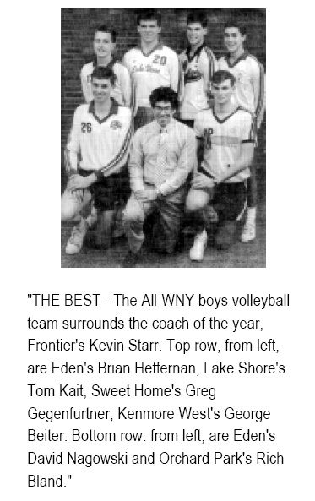
Image Understanding
We can look at a picture and be able to answer questions about it.
Given the image here
How many people are in the photo?
How many are kneeling?
Could you draw a box around each of their faces?
Now, how can you do this computationally? So the a computer or a robot can understand the photo?

Slide 60
Image Understanding
For our robots to perceive their environment visually:
First we need to take a picture
Then, we ask a question about the environment
We analyze the picture and answer our question
QUESTION: Can the robot recognize a ball? Once recognized, can the robot follow a ball wherever it goes?

Slide 61
Answering Questions…
Assume we can recognize the ball. How do we follow it?
while timeRemaining(T):
#take picture and locate ball
if <ball is to the left>
turnLeft(cruiseSpeed)
elif <ball is to the right>
turnRight(cruiseSpeed)
else:
forward(cruiseSpeed)

Slide 62
Answering Questions…
So, how do we recognize the ball?
Start at the pixel level – if we know what color the ball is, we can look for pixels that are in that color range.
The author’s ball was pink – with R=253 and G = 66 – so looking for a range within acceptable values of these would help us find the ball!
for pixel in getPixels(p):
r, g, b = getRGB(pixel)
if r > 200 and g < 100:
setRGB(pixel, (255,255,255))
else:
setRGB(pixel, (0,0,0))

Slide 63
Answering Questions…
So, how do we recognize the ball?
Using the code on the previous slide, we effectively filter out the unwanted regions of the image and can focus on the desired color.
Now, how do you turn left, right, or keep center?
We know the image is 256 pixels wide; divide this into 3 parts and assign left, right, and center!

Slide 64
Code illustrated
while timeTemaining(T):
# take picture and locate the ball
pic = takePicture()
ballLocation = locateBall(pic)
if ballLocation <= 85:
turnLeft(cruiseSpeed)
elif ballLocation <= 170:
forward(cruiseSpeed)
else:
turnRight(cruiseSpeed)

Slide 65
Blobs
This kind of threshold filtering is called “blob filtering”
Our robots can define blobs
First, take a picture
Then, display the picture and using your mouse, define a rectangular region that contains the desired blob.
Once defined, you can use the command “takePicture(“blob”)
Use the blob image to control the robot (this time, resulting blob is black)
You can also use the getBlob() command:
onPixels, avgX, avgY = getBlob()

Slide 66
Object Recognition
Other computations on images include edge detection and object recognition.
Can you think of features in today’s digital cameras that use object recognition?

Slide 67
Next Steps?
Type in these code segments and try them out on your own images. Do you get what you expect?

