Slide 1



Week 1: Introduction
Unit 1: Course Introduction

Slide 2

Target audience and course requirements
Course Introduction
Target audience
Application developers
Operation experts
IT decision makers
Course requirements for hands-on exercises
Basic programming skills, ideally in Java and JavaScript
Basic knowledge of how to use an IDE, ideally SAP Web IDE
No prior experience with SAP Cloud Platform necessary
3

Slide 3


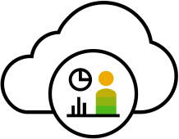







Course Introduction
SAP Cloud Platform – Main use cases
USE CASES
Extend Cloud & On-Prem Apps
Experience People & Data
Build Differentiating Digital Apps
Integrate Apps, Data & Processes
SAP SuccessFactors
SAP S/4HANA Cloud
S/4
SAP C/4HANA
C/4
RUN WITH
INTEGRATE
Customer Apps
₃rd
Party
SAP Fieldglass
SAP
Partner Apps
Apps, Data, and Processes outside SAP Cloud Platform
SAP Concur
RUN ON
SAP Ariba
NEO
AWS Microsoft Azure Google Cloud Alibaba Cloud ²
2) planned innovations / future direction
3

Slide 4

Course Introduction
Course overview
Week 1: Introduction
Week 2: Your First Cloud Application
Week 3: SAP Cloud Application Programming Model Week 4: Additional Services
3

Slide 5
Thank you.
Contact information:
open@sap.com

Slide 6





Follow all of SAP
www.sap.com/contactsap
© 2019 SAP SE or an SAP affiliate company. All rights reserved.
No part of this publication may be reproduced or transmitted in any form or for any purpose without the express permission of SAP SE or an SAP affiliate company.
The information contained herein may be changed without prior notice. Some software products marketed by SAP SE and its distributors contain proprietary software components of other software vendors. National product specifications may vary.
These materials are provided by SAP SE or an SAP affiliate company for informational purposes only, without representation or warranty of any kind, and SAP or its affiliated companies shall not be liable for errors or omissions with respect to the materials. The only warranties for SAP or SAP affiliate company products and services are those that are set forth in the express warranty statements accompanying such products and services, if any. Nothing herein should be construed as constituting an additional warranty.
In particular, SAP SE or its affiliated companies have no obligation to pursue any course of business outlined in this document or any related presentation, or to develop or release any functionality mentioned therein. This document, or any related presentation, and SAP SE’s or its affiliated companies’ strategy and possible future developments, products, and/or platforms, directions, and functionality are all subject to change and may be changed by SAP SE or its affiliated companies at any time for any reason without notice. The information in this document is not a commitment, promise, or legal obligation to deliver any material, code, or functionality. All forward-looking statements are subject to various risks and uncertainties that could cause actual results to differ materially from expectations. Readers are cautioned not to place undue reliance on these forward-looking statements, and they should not be relied upon in making purchasing decisions.
SAP and other SAP products and services mentioned herein as well as their respective logos are trademarks or registered trademarks of SAP SE (or an SAP affiliate company) in Germany and other countries. All other product and service names mentioned are the trademarks of their respective companies.
See www.sap.com/corporate-en/legal/copyright/index.epx for additional trademark information and notices.

Slide 7
Week 1: Introduction
Unit 2: Introducing SAP Cloud Platform

Slide 8
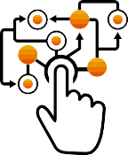






Introducing SAP Cloud Platform
The digital era is evolving into the intelligence era
Mainframe & PCs
Client Server & Internet
Cloud, Mobile & Big Data
Intelligent Technologies
Industrial Automation
Business Process Automation
Digital Transformation
Intelligent Enterprise
Transistors & silicon revolution
Large-scale mainframe computing adoption Emergence of PCs Plant floor
automation
Widespread PC adoption
Broadband Internet
ERP & business process technologies
Mobile &
smartphone ubiquity
Cloud computing Social networks Big Data
Machine learning &
artificial intelligence
IoT & distributed computing Blockchain
2

Slide 9
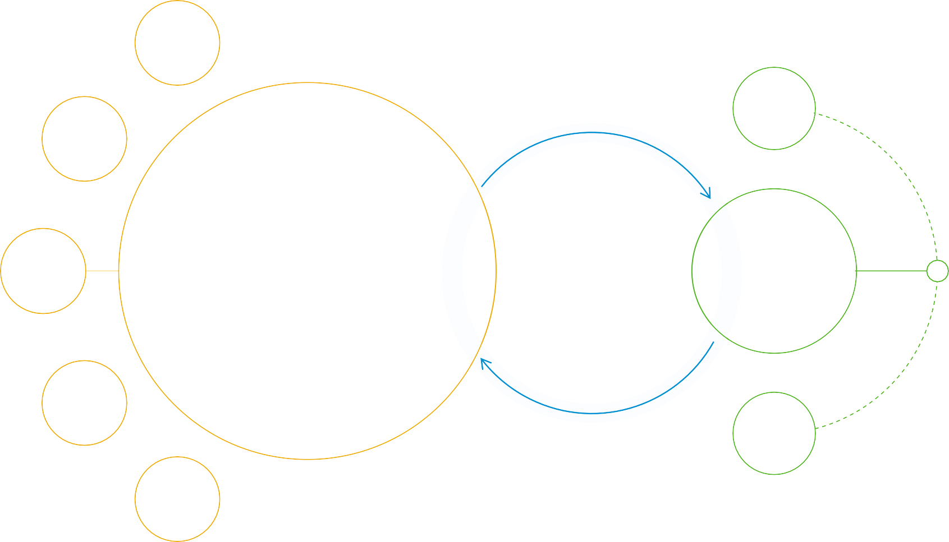










Introducing SAP Cloud Platform
The Intelligent Enterprise
Network & Spend Management
Cloud Platform
People
Engagement
Intelligent
Technologies
Digital Platform
Digital Core
Intelligent Suite
AI
Machine Learning Analytics
IoT
Manufacturing & Supply Chain
Customer
Experience
Data Management
3

Slide 10


Introducing SAP Cloud Platform
Digital platform
Collaboration Services
Security Services
Cloud Platform
Marketplace
UX Services
SAP Cloud Platform
Best-in-class digital platform for new app development, extensions, and integration
Portal
Mobile Services
SAP API Business Hub
Big Data Services
SAP Leonardo ML Services
Analytics Services API Management
SAP Leonardo IoT Services
Integration Services
Digital
Platform
SAP Data Services
Metadata & Lifecycle Management
Unified data management to capture real-time value from different types of data
Smart Data Integration
SAP Data Hub
SAP CP Big Data Services
Integration Services
Object Store (S3, Swift…)
Smart Data Access
Data Management
SAP HANA Engines Orchestration & Governance
Streaming Analytics SAP HANA
Third Party (Spark/Hadoop)
SAP Vora Distr. Engines
Data Lifecycle Management
Unlock Data-Driven Intelligence and Innovation
Manage data from any source, in any format – and rapidly develop, integrate, and extend intelligent applications
– with an open digital platform.
4

Slide 11

Introducing SAP Cloud Platform
SAP Cloud Platform – Main use cases
USE CASES
Extend Cloud & On-Prem Apps
Experience People & Data
Build Differentiating Digital Apps
Integrate Apps, Data, & Processes
SAP SuccessFactors
SAP S/4HANA Cloud
S/4
SAP C/4HANA
C/4
RUN WITH
INTEGRATE
Customer Apps
₃rd
Party
SAP Fieldglass
SAP
Partner Apps
Apps, Data, and Processes outside SAP Cloud Platform
SAP Concur
RUN ON
SAP Ariba
NEO
AWS Microsoft Azure Google Cloud Alibaba Cloud ²
2) planned innovations / future direction
5

Slide 12






Why multi-cloud matters
Introducing SAP Cloud Platform
CO-LOCATION WITH
CLOUD ASSETS
COMPLIANCE / LEGAL REQUIREMENTS
SERVICE AVAILABILITY
2
AWS Microsoft Azure Google Cloud Alibaba Cloud
2) planned innovations / future direction
6

Slide 13

Introducing SAP Cloud Platform
Further reading
i
Additional Material
SAP Cloud Platform Web site
Blueprints and scenarios
SAP Cloud Platform help documentation SAP Cloud Platform Community
7

Slide 14

Introducing SAP Cloud Platform
What you’ve learned in this unit
The role of SAP Cloud Platform in the Intelligent Enterprise
The main use cases of SAP Cloud Platform
Why multi-cloud matters
8

Slide 15
Thank you.
Contact information:
open@sap.com

Slide 16
Follow all of SAP
www.sap.com/contactsap
© 2019 SAP SE or an SAP affiliate company. All rights reserved.
No part of this publication may be reproduced or transmitted in any form or for any purpose without the express permission of SAP SE or an SAP affiliate company.
The information contained herein may be changed without prior notice. Some software products marketed by SAP SE and its distributors contain proprietary software components of other software vendors. National product specifications may vary.
These materials are provided by SAP SE or an SAP affiliate company for informational purposes only, without representation or warranty of any kind, and SAP or its affiliated companies shall not be liable for errors or omissions with respect to the materials. The only warranties for SAP or SAP affiliate company products and services are those that are set forth in the express warranty statements accompanying such products and services, if any. Nothing herein should be construed as constituting an additional warranty.
In particular, SAP SE or its affiliated companies have no obligation to pursue any course of business outlined in this document or any related presentation, or to develop or release any functionality mentioned therein. This document, or any related presentation, and SAP SE’s or its affiliated companies’ strategy and possible future developments, products, and/or platforms, directions, and functionality are all subject to change and may be changed by SAP SE or its affiliated companies at any time for any reason without notice. The information in this document is not a commitment, promise, or legal obligation to deliver any material, code, or functionality. All forward-looking statements are subject to various risks and uncertainties that could cause actual results to differ materially from expectations. Readers are cautioned not to place undue reliance on these forward-looking statements, and they should not be relied upon in making purchasing decisions.
SAP and other SAP products and services mentioned herein as well as their respective logos are trademarks or registered trademarks of SAP SE (or an SAP affiliate company) in Germany and other countries. All other product and service names mentioned are the trademarks of their respective companies.
See www.sap.com/corporate-en/legal/copyright/index.epx for additional trademark information and notices.

Slide 17
Week 1: Introduction
Unit 3: Architecture and Capabilities

Slide 18







Main use cases
Architecture and Capabilities
EXPERIENCE
People & Data
BUILD
Differentiating Digital Apps
EXTEND
Cloud &
On-Premise Apps
SAP
INTEGRATE
Apps, Data, & Processes
Customer Apps
Partner Apps
₃rd Party
BUSINESS APPS
UNIFIED DIGITAL PLATFORM
2

Slide 19


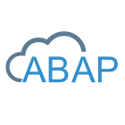

Architecture and Capabilities
High-level architecture
Cloud Applications
SAP Applications
Customer-Specific Applications 3rd-Party Applications
Open Marketplace / Open APIs
Marketplace & API Business Hub
Data Mgmt Rates & Measures
Analytics Integration
Master Data | Globalization
LOBs & Industries | Commercialization
ML | Blockchain
Mobile/UX | Security
Output Mgmt
...
Data Mgmt
...
Business Services
Technical Services
Data Foundation
SAP HANA Data Management Suite
NEO
Environments
AWS Microsoft Azure Google Cloud Alibaba Cloud ²
Multi-cloud
2) planned innovations / future direction
3

Slide 20
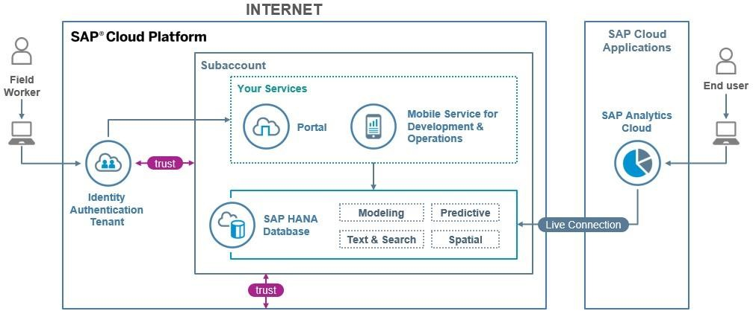
Architecture and Capabilities
Scenario 1 – Supporting sustainable farms with SAP Analytics Cloud
4

Slide 21
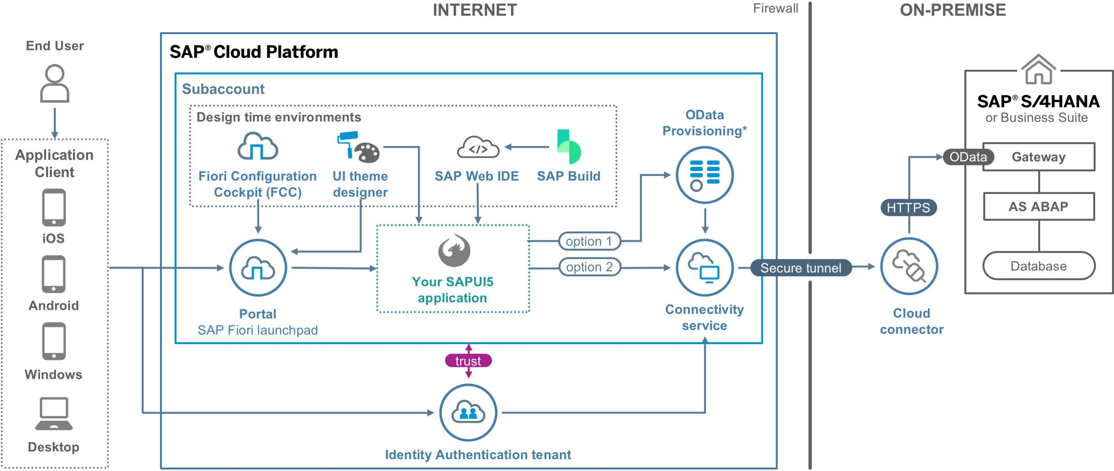
Scenario 2 – Build a custom SAP Fiori-like app for SAP S/4HANA
Architecture and Capabilities
5

Slide 22
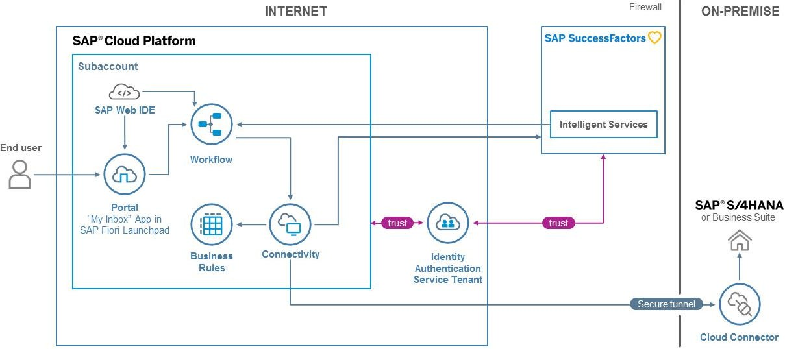
Architecture and Capabilities
Scenario 3 – Automate employee onboarding processes with Workflow
6

Slide 23

Hands-on/demo
Architecture and Capabilities
SAP Cloud Platform Web Site
Explaining the Web site with the different categories
Blueprints and Scenarios
Getting started with different SAP Cloud Platform scenarios
Customers
SAP Cloud Platform success stories
7

Slide 24

Architecture and Capabilities
Further reading
i
Additional Material
SAP Cloud Platform Web Site
Blueprints and Scenarios
SAP Cloud Platform Capabilities
Scenario: Build a Custom Fiori-like App for SAP S/4HANA Scenario: Supporting Sustainable Farms with
SAP Analytics Cloud
Scenario: Automate Employee Onboarding Processes with Workflow
8

Slide 25
Architecture and Capabilities
What you’ve learned in this unit
The high-level architecture of SAP Cloud Platform
The capabilities of SAP Cloud Platform
Getting started with scenarios in SAP Cloud Platform
9

Slide 26
Thank you.
Contact information:
open@sap.com

Slide 27
Follow all of SAP
www.sap.com/contactsap
© 2019 SAP SE or an SAP affiliate company. All rights reserved.
No part of this publication may be reproduced or transmitted in any form or for any purpose without the express permission of SAP SE or an SAP affiliate company.
The information contained herein may be changed without prior notice. Some software products marketed by SAP SE and its distributors contain proprietary software components of other software vendors. National product specifications may vary.
These materials are provided by SAP SE or an SAP affiliate company for informational purposes only, without representation or warranty of any kind, and SAP or its affiliated companies shall not be liable for errors or omissions with respect to the materials. The only warranties for SAP or SAP affiliate company products and services are those that are set forth in the express warranty statements accompanying such products and services, if any. Nothing herein should be construed as constituting an additional warranty.
In particular, SAP SE or its affiliated companies have no obligation to pursue any course of business outlined in this document or any related presentation, or to develop or release any functionality mentioned therein. This document, or any related presentation, and SAP SE’s or its affiliated companies’ strategy and possible future developments, products, and/or platforms, directions, and functionality are all subject to change and may be changed by SAP SE or its affiliated companies at any time for any reason without notice. The information in this document is not a commitment, promise, or legal obligation to deliver any material, code, or functionality. All forward-looking statements are subject to various risks and uncertainties that could cause actual results to differ materially from expectations. Readers are cautioned not to place undue reliance on these forward-looking statements, and they should not be relied upon in making purchasing decisions.
SAP and other SAP products and services mentioned herein as well as their respective logos are trademarks or registered trademarks of SAP SE (or an SAP affiliate company) in Germany and other countries. All other product and service names mentioned are the trademarks of their respective companies.
See www.sap.com/corporate-en/legal/copyright/index.epx for additional trademark information and notices.

Slide 28
Week 1: Introduction
Unit 4: Building Your First Application
– Getting an Account

Slide 29








Building Your First Application – Getting an Account
Understanding SAP Cloud Platform accounts
Each subaccount holds:
Resources that can be consumed by apps
Users allowed to work in the subaccount
Apps deployed and running in the subaccount
Data written by apps running in the subaccount
Configuration for apps running in the subaccount
SAP Cloud Platform
Global Account
Region
Subaccount
Each subaccount is assigned to a Global account and resides in a Region.
Resources
Users
Apps
Data
Configuration
2

Slide 30






Building Your First Application – Getting an Account
Applications in accounts…
Are managed by users
Consume resources
Create / consume data
Consume configuration
Run in a defined region
Region
Users
Provide and
Runs in Manage
b Apps
Consume
Create / Consume
Data
Resources
Consume
Configuration
3

Slide 31
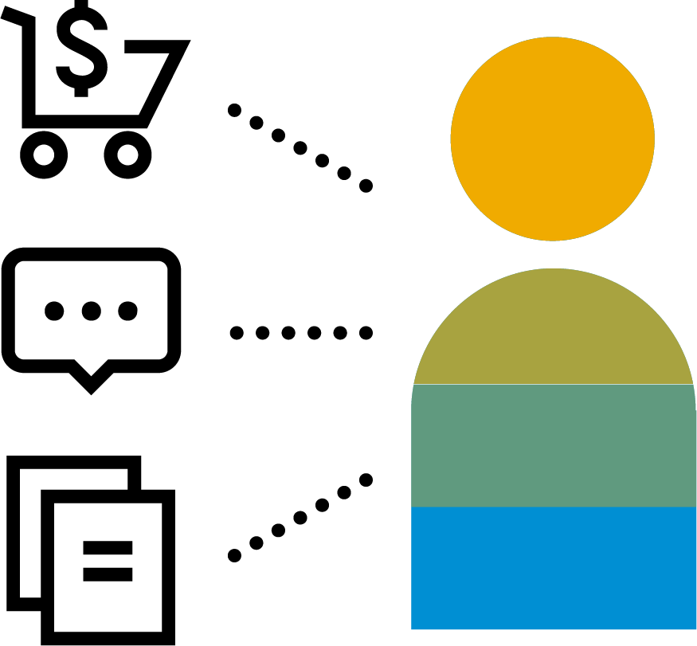
About SAP Cloud Platform trial accounts
Building Your First Application – Getting an Account
Only one trial account per user
Expires after 30 days, but can be extended to a limit of 90 days
Create subaccounts and manage members in your trial account
Use production and beta services
Includes 4 GB of memory for applications and 8 GB of instance memory
2 configured on-premise systems with the Cloud connector
NO service-level agreement with regard to the availability of the
platform
HDI containers in a shared SAP HANA database
Applications stop automatically after a certain period of time
4

Slide 32
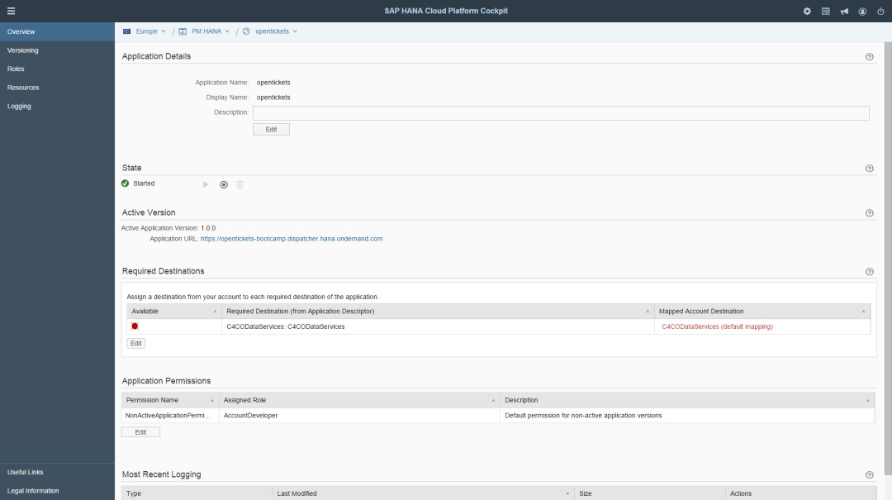
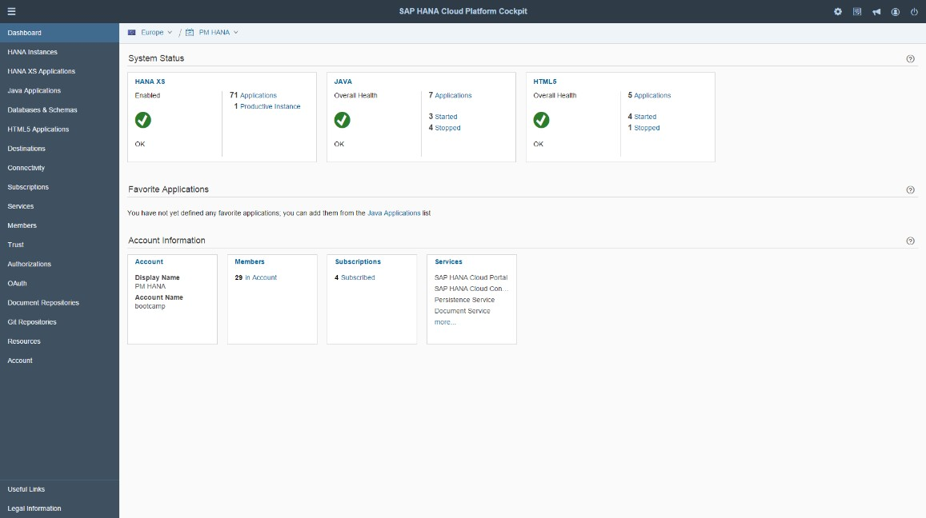
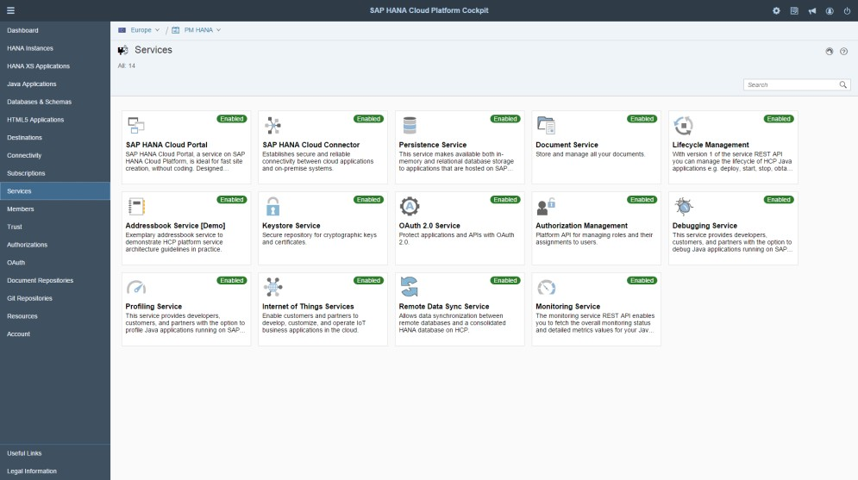
SAP Cloud Platform cockpit
Building Your First Application – Getting an Account
The SAP Cloud Platform cockpit is the consolidated destination for all operational needs, from configuration to deployment and monitoring on SAP Cloud Platform.
Key capabilities
Entry point to SAP Cloud Platform on the Web
SAP Cloud Platform and application configuration
Deployment of applications
Monitoring of resources, databases, and applications
Benefits
Complete overview and access point of SAP Cloud Platform
Easy Web-based operations administration
5

Slide 33

Hands-on/demo
Building Your First Application – Getting an Account
SAP Cloud Platform Web site
Creating a free trial account
Explaining the SAP Cloud Platform cockpit
Accounts
Applications
Service Marketplace
Service instances
Useful links
− …
6

Slide 34
Building Your First Application – Getting an Account
Further reading
i
Additional Material
Help documentation:
Getting Started with SAP Cloud Platform
Help documentation:
Trial Accounts in the Cloud Foundry Environment
Help documentation:
About Trial Accounts in the Cloud Foundry Environment
Help documentation:
SAP Cloud Platform Cockpit
SAP Cloud Platform Web site
Getting a trial account
7

Slide 35
Building Your First Application – Getting an Account
What you’ve learned in this unit
SAP Cloud Platform accounts
Apps in SAP Cloud Platform
How to create an SAP Cloud Platform trial account
The limitations of SAP Cloud Platform trial accounts
The SAP Cloud Platform cockpit
8

Slide 36
Thank you.
Contact information:
open@sap.com

Slide 37
Follow all of SAP
www.sap.com/contactsap
© 2019 SAP SE or an SAP affiliate company. All rights reserved.
No part of this publication may be reproduced or transmitted in any form or for any purpose without the express permission of SAP SE or an SAP affiliate company.
The information contained herein may be changed without prior notice. Some software products marketed by SAP SE and its distributors contain proprietary software components of other software vendors. National product specifications may vary.
These materials are provided by SAP SE or an SAP affiliate company for informational purposes only, without representation or warranty of any kind, and SAP or its affiliated companies shall not be liable for errors or omissions with respect to the materials. The only warranties for SAP or SAP affiliate company products and services are those that are set forth in the express warranty statements accompanying such products and services, if any. Nothing herein should be construed as constituting an additional warranty.
In particular, SAP SE or its affiliated companies have no obligation to pursue any course of business outlined in this document or any related presentation, or to develop or release any functionality mentioned therein. This document, or any related presentation, and SAP SE’s or its affiliated companies’ strategy and possible future developments, products, and/or platforms, directions, and functionality are all subject to change and may be changed by SAP SE or its affiliated companies at any time for any reason without notice. The information in this document is not a commitment, promise, or legal obligation to deliver any material, code, or functionality. All forward-looking statements are subject to various risks and uncertainties that could cause actual results to differ materially from expectations. Readers are cautioned not to place undue reliance on these forward-looking statements, and they should not be relied upon in making purchasing decisions.
SAP and other SAP products and services mentioned herein as well as their respective logos are trademarks or registered trademarks of SAP SE (or an SAP affiliate company) in Germany and other countries. All other product and service names mentioned are the trademarks of their respective companies.
See www.sap.com/corporate-en/legal/copyright/index.epx for additional trademark information and notices.

Slide 38

Week 1: Introduction
Unit 5: Building Your First Application – Pushing the App to Cloud Foundry

Slide 39












Building Your First Application – Pushing the App to Cloud Foundry
SAP Cloud Platform domain model
1
Global
Account*
User Account
Home
n
n
Region**
Neo Environment
Environment
1
Organization
n
Subaccount
n
Subaccount
n
Neo application subscriptions
Space
Cloud Foundry applications
n
n
Neo applications
Cloud Foundry
services
n
n
Neo services
*Note: Global accounts can be two types: trial and enterprise
**Note: Each sub-account is present within one Data-center (SAP or Partner)

Slide 40


Multiple runtimes and languages with SAP Cloud Platform
Building Your First Application – Pushing the App to Cloud Foundry
SAP Cloud Platform is now a polyglot PaaS
‟Polyglot: a person who knows and is able to use several languages”
Dictionary
Multi-language
Enterprise support for selected buildpacks
Cloud Foundry community buildpacks
Bring your own buildpack

Slide 41
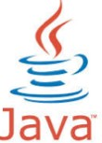







Multiple runtimes and languages with SAP Cloud Platform
Building Your First Application – Pushing the App to Cloud Foundry
With the Cloud Foundry environment, SAP Cloud Platform enables the use of additional programming languages and frameworks via buildpacks
…
Java
Develop, deploy, and operate Java applications
e.g. complex integration projects
Node.js
Benefit from multiple Node.js packages available
Develop and run Node.js applications in the cloud
Python
Build and deploy your Python applications
Selection of Python packages are also available
HTML5
Develop and run HTML5 applications
Benefit from multiple SAPUI5 code templates
<your choice>
Bring your own language and runtime of choice
Choose from existing community buildpacks or develop your own

Slide 42
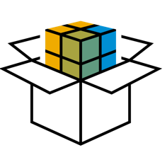



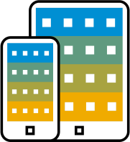
How applications are staged and started
Building Your First Application – Pushing the App to Cloud Foundry
Staging is the process of creating an application package (droplet) that contains all needed components for the application to run (e.g. runtime, drivers, additional libraries, etc.).
+
staging
buildpack
droplet
+
start
droplet
rootfs
application

Slide 43



Multiple runtimes and languages with SAP Cloud Platform buildpacks explained
Building Your First Application – Pushing the App to Cloud Foundry
Buildpacks are responsible for setting up the environment and injecting dependencies for your app
Every buildpack is just a zip file with 3 scripts: detect, compile, and release
The staging phase where buildpacks come into play consists of 3 steps: executing the 3 scripts
1. Detect: Decide which buildpack can handle the app (if not specified explicitly)
2. Compile: Create the droplet
for the application
3. Release: Create a metadata file that tells CF Cloud Controller how to start the application

Slide 44
Application deployment process: $ cf push
Building Your First Application – Pushing the App to Cloud Foundry
UPLOAD
STAGE
START
upload application
build droplet
start app container

Slide 45




Start, Restart, and Restage
Building Your First Application – Pushing the App to Cloud Foundry
‘
Start
Restart
Restage
Download droplet
Stop & start with the already
compiled droplet
Stop, compile new droplet, start
Start app container
Use start coming with the
buildpack
Provide specific start
command for your app
Compiles new droplet without
app source update
Refreshes the app
environment
e.g. configuration change
Restage updates the env used
by the buildpack

Slide 46




Bring Your Own Language – System buildpacks with community support
Building Your First Application – Pushing the App to Cloud Foundry
There are a number of system buildpacks (beyond Java, Node.js, Python) available in the Cloud Foundry
environment that enable you to leverage various programming languages and frameworks*
Learn more about system buildpacks*:
PHP: https://docs.cloudfoundry.org/buildpacks/php/index.html
.NET Core: https://docs.cloudfoundry.org/buildpacks/dotnet-core/index.html
Go: https://docs.cloudfoundry.org/buildpacks/go/index.html
Ruby: https://docs.cloudfoundry.org/buildpacks/ruby/index.html
Binary: https://docs.cloudfoundry.org/buildpacks/binary/index.html
Staticfile: https://docs.cloudfoundry.org/buildpacks/staticfile/index.html
…
*There is only community support, SAP does not provide Enterprise Support for these buildpacks

Slide 47

How to use a custom buildpack
Building Your First Application – Pushing the App to Cloud Foundry
In case you use a language or framework that is not available with Cloud Foundry system buildpacks or you need to change the configuration or enable additional features of an existing buildpack, you can use a custom buildpack:
A community or third-party provided buildpack
Customize an existing buildpack
Develop your own buildpack
The custom buildpack is provided as a Git Repository URL in the application push configuration.

Slide 48
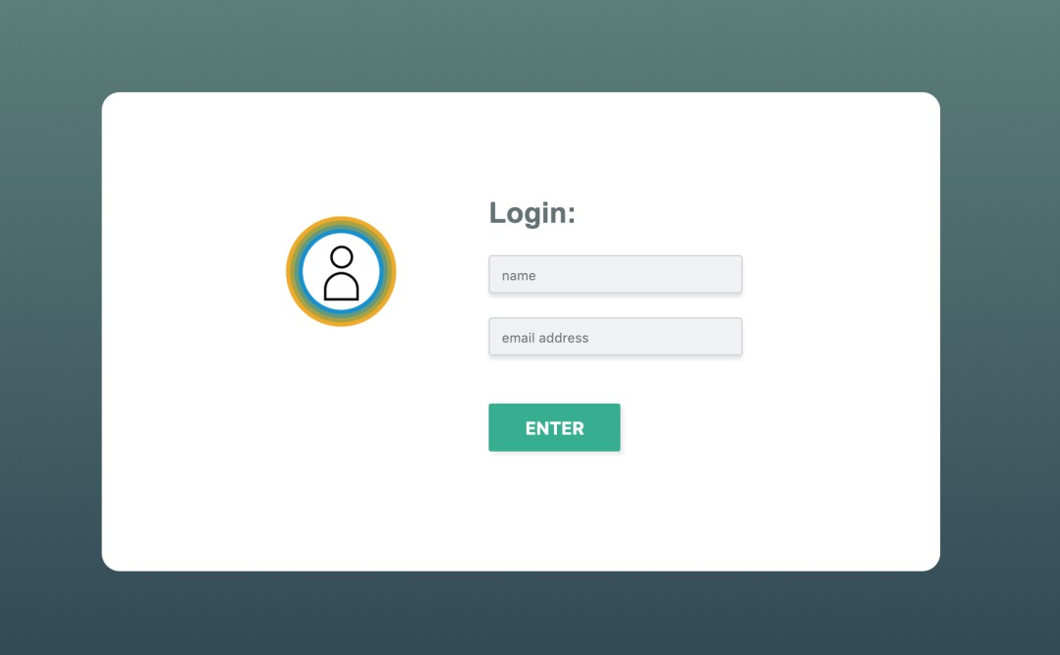
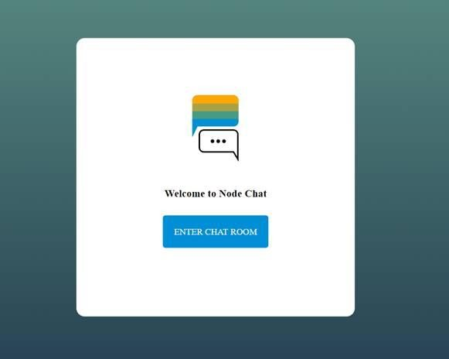


Demo scenario – Simple chat room app
Building Your First Application – Pushing the App to Cloud Foundry
Simple chat room
Node.js & HTML5
https://github.com/SAP/cloud-sample-node-chat/

Slide 49
Building Your First Application – Pushing the App to Cloud Foundry
Further reading
i
Additional Material
SAP Cloud Platform Web site
Getting a trial account Cloud Foundry buildpacks
Staging apps on Cloud Foundry Deploy apps on Cloud Foundry

Slide 50
Building Your First Application – Pushing the App to Cloud Foundry
What you’ve learned in this unit
SAP Cloud Platform domain model
Runtimes supported on SAP Cloud Platform
Polyglot apps and BYOL support on SAP Cloud Platform
Pushing, staging, starting apps on SAP Cloud Platform Cloud Foundry environment
Developing your first Node.js app

Slide 51
Thank you.
Contact information:
open@sap.com

Slide 52

Follow all of SAP
www.sap.com/contactsap
© 2019 SAP SE or an SAP affiliate company. All rights reserved.
No part of this publication may be reproduced or transmitted in any form or for any purpose without the express permission of SAP SE or an SAP affiliate company.
The information contained herein may be changed without prior notice. Some software products marketed by SAP SE and its distributors contain proprietary software components of other software vendors. National product specifications may vary.
These materials are provided by SAP SE or an SAP affiliate company for informational purposes only, without representation or warranty of any kind, and SAP or its affiliated companies shall not be liable for errors or omissions with respect to the materials. The only warranties for SAP or SAP affiliate company products and services are those that are set forth in the express warranty statements accompanying such products and services, if any. Nothing herein should be construed as constituting an additional warranty.
In particular, SAP SE or its affiliated companies have no obligation to pursue any course of business outlined in this document or any related presentation, or to develop or release any functionality mentioned therein. This document, or any related presentation, and SAP SE’s or its affiliated companies’ strategy and possible future developments, products, and/or platforms, directions, and functionality are all subject to change and may be changed by SAP SE or its affiliated companies at any time for any reason without notice. The information in this document is not a commitment, promise, or legal obligation to deliver any material, code, or functionality. All forward-looking statements are subject to various risks and uncertainties that could cause actual results to differ materially from expectations. Readers are cautioned not to place undue reliance on these forward-looking statements, and they should not be relied upon in making purchasing decisions.
SAP and other SAP products and services mentioned herein as well as their respective logos are trademarks or registered trademarks of SAP SE (or an SAP affiliate company) in Germany and other countries. All other product and service names mentioned are the trademarks of their respective companies.
See www.sap.com/corporate-en/legal/copyright/index.epx for additional trademark information and notices.

Slide 53
Week 1: Introduction
Unit 6: Understanding Applications on Cloud Foundry

Slide 54
Understanding Applications on Cloud Foundry
Monolith vs microservices
process
A
A
A
B
A
B
A B
service
C
D C D
A
C
B
D
Each microservice runs in separate processes / containers. This enables them to
Be deployed individually and frequently
(Auto)scale independently to varying loads
Communicate with other services with remote APIs (REST calls, message queues)
Be developed by independent teams

Slide 55








Understanding Applications on Cloud Foundry
Landscape design
SAP Cloud Platform
Global Account
Region
Subaccount – Cloud Foundry Organization
Space – DEV
Space – QA
Space – PROD
Resources
Users
Resources
Users
Resources
Users
Apps
Apps
Apps
Data
Configuration
Data
Configuration
Data
Configuration

Slide 56
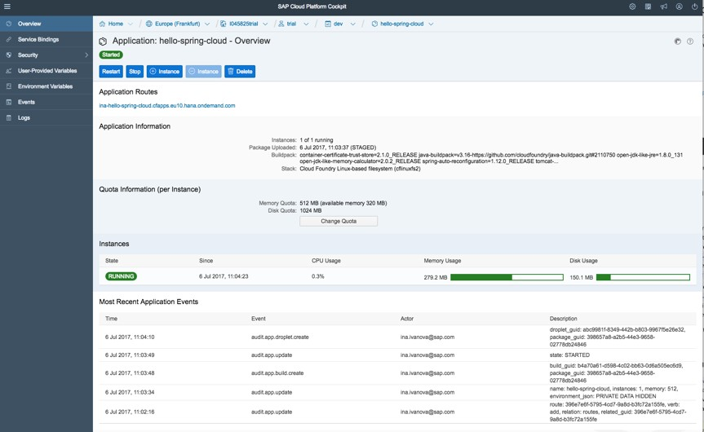
Metrics, logs, events: $ cf app $ cf events $ cf logs
Understanding Applications on Cloud Foundry
Visible in cockpit and Cloud Foundry
command line interface (CF CLI)
Metrics
CPU, memory, and disk usage
App events
create, update, start, stop, crash
Logs
Kibana dashboard

Slide 57

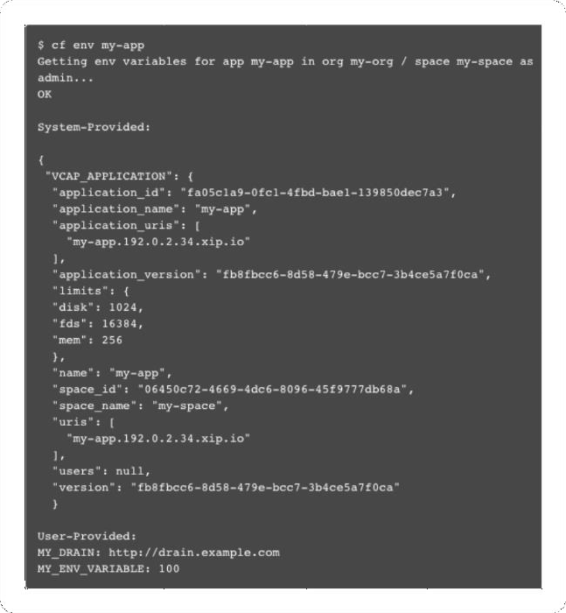

Scaling apps and environment variables $ cf scale $ cf env
Understanding Applications on Cloud Foundry
Environment variables
Required to deploy app to Cloud
Foundry
Application-specific env variables
Access env variables via CF CLI,
cockpit, and programmatically
Horizontal scaling
Increase/decrease number of running instances of your app
Cockpit: +/- Instance
CF CLI: $ cf scale [app] [instances]
Vertical scaling
Change the resources (disk space or memory) to all app instances
Cockpit: Change Quota
CF CLI: $ cf scale [app] [disk] [memory]

Slide 58

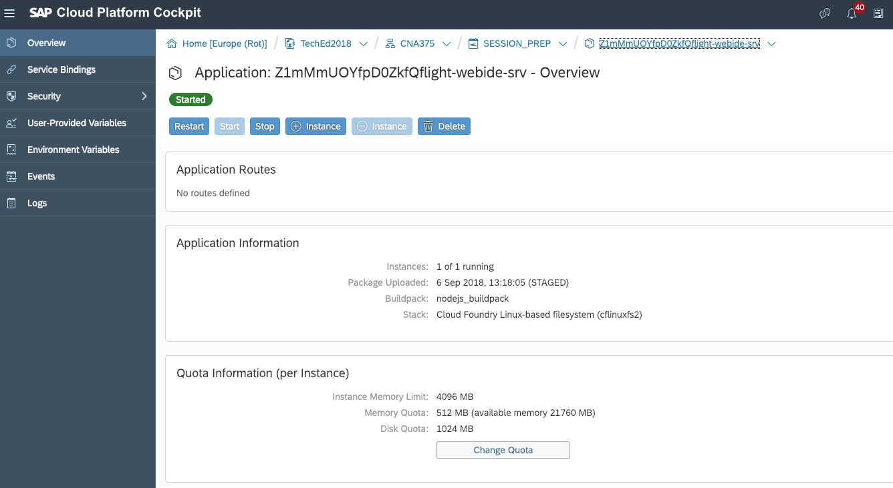
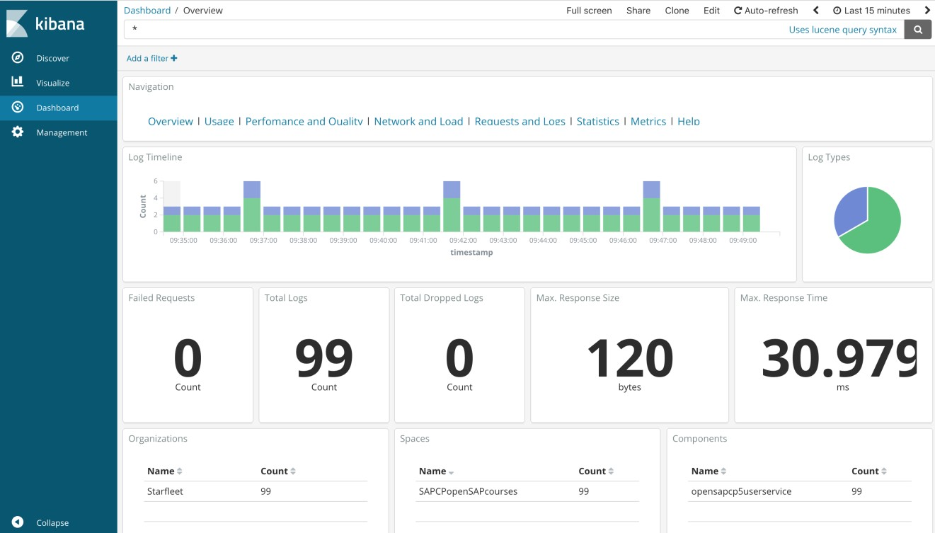
Hands-on/demo
Understanding Applications on Cloud Foundry

Slide 59







Business application @ SAP Cloud Platform Cloud Foundry environment
Understanding Applications on Cloud Foundry
A logical view of a sample business app:
Consists of multiple microservices, which are
deployed as separate applications
Each microservice can be developed in a different language
Microservices use multiple backing services
SAP Cloud Platform
Environment
Your Application
any buildpack
Your Service 1
service instance
App Autoscaler
Your Service 2
service instance
App User
PostgreSQL
Your Service 3
service instance
Redis
Admin

Slide 60



Understanding Applications on Cloud Foundry
Runtime-agnostic services model
application
service
instance
service instance
application
service instance
application
Create service instance
Select a service and service plan
and create the instance
Provisions a dedicated resource
for you to use
Bind service
Bind service instance to app
Credentials of the service instance are added to VCAP_VARIABLES
Use the service
One service instance can be
used from multiple apps
For some services, there are libraries that ease service consumption

Slide 61
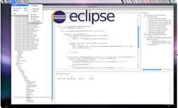

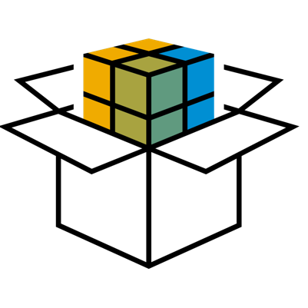

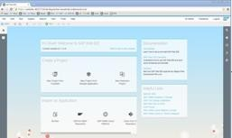







Design multi-target applications
Understanding Applications on Cloud Foundry
1 Develop & Build
module
Developers
SAP Web IDE
module
…MTAs help you to
have a common lifecycle across all modules
and configuration
maintain versions for the different modules
manage dependencies
2
Archive
module
module
3
Deploy
module
When you develop a complex business application…
composed of multiple software pieces (“modules”)
written in different languages or paradigms
using different tools, IDEs, and technologies
SAP Cloud Platform Administrator
Various target
runtimes

Slide 62





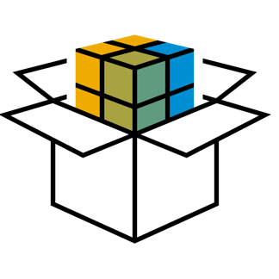


Lifecycle Management – Multi-target applications in the Cloud Foundry environment
Understanding Applications on Cloud Foundry
Subaccount – QA
Subaccount – PROD
1
Develop & Build
Resources
Users
Resources
Users
Subaccount – DEV
Apps
Apps
Data
Configuration
Data
Configuration
Resources
Users
…
Apps
3 Deploy & Test
Automated blue-green
deployment
Data
Configuration
4
Deploy & Run
Subaccount – PROD
Resources
Users
Apps
Data
Configuration

Slide 63



Understanding Applications on Cloud Foundry
Application update: Blue-Green deployment (1/2)
At any time only one production environment,
let’s say blue, is live
As you prepare a new release of your software you
do final stage of testing in the green environment
router
router
blue
green
blue
green
Release 2
Release 1
Release 1

Slide 64

Understanding Applications on Cloud Foundry
Application update: Blue-Green deployment (2/2)
Once the software is working in the green environment,
you switch the router so that all incoming requests go there
The blue environment is now available for
you to deploy your next release
router
router
blue
green
blue
green
Release 1
Release 2
Release 3
Release 2

Slide 65
Understanding Applications on Cloud Foundry
Further reading
i
Additional Material
SAP Cloud Platform Cloud Foundry Environment
Developing apps on Cloud Foundry Logging & metrics in Cloud Foundry
SAP Cloud Platform Multi-Target Applications
Blue Green Deployment
Blue-Green deployment of Multi-Target Applications

Slide 66
Understanding Applications on Cloud Foundry
What you’ve learned in this unit
Microservices architectures
SAP Cloud Platform landscape design
Logging, monitoring, scaling apps on Cloud Foundry
Services on SAP Cloud Platform
Multi-target applications (MTA)
Lifecycle management of MTAs on Cloud Foundry
Blue-Green deployment

Slide 67
Thank you.
Contact information:
open@sap.com

Slide 68
Follow all of SAP
www.sap.com/contactsap
© 2019 SAP SE or an SAP affiliate company. All rights reserved.
No part of this publication may be reproduced or transmitted in any form or for any purpose without the express permission of SAP SE or an SAP affiliate company.
The information contained herein may be changed without prior notice. Some software products marketed by SAP SE and its distributors contain proprietary software components of other software vendors. National product specifications may vary.
These materials are provided by SAP SE or an SAP affiliate company for informational purposes only, without representation or warranty of any kind, and SAP or its affiliated companies shall not be liable for errors or omissions with respect to the materials. The only warranties for SAP or SAP affiliate company products and services are those that are set forth in the express warranty statements accompanying such products and services, if any. Nothing herein should be construed as constituting an additional warranty.
In particular, SAP SE or its affiliated companies have no obligation to pursue any course of business outlined in this document or any related presentation, or to develop or release any functionality mentioned therein. This document, or any related presentation, and SAP SE’s or its affiliated companies’ strategy and possible future developments, products, and/or platforms, directions, and functionality are all subject to change and may be changed by SAP SE or its affiliated companies at any time for any reason without notice. The information in this document is not a commitment, promise, or legal obligation to deliver any material, code, or functionality. All forward-looking statements are subject to various risks and uncertainties that could cause actual results to differ materially from expectations. Readers are cautioned not to place undue reliance on these forward-looking statements, and they should not be relied upon in making purchasing decisions.
SAP and other SAP products and services mentioned herein as well as their respective logos are trademarks or registered trademarks of SAP SE (or an SAP affiliate company) in Germany and other countries. All other product and service names mentioned are the trademarks of their respective companies.
See www.sap.com/corporate-en/legal/copyright/index.epx for additional trademark information and notices.

