Slide 1
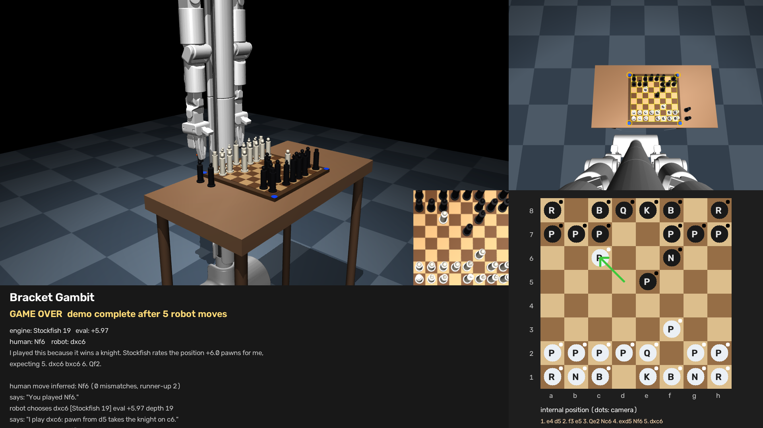
Bracket Gambit
BracketBot plays chess against you — camera, Stockfish, and its own arm
A physically embodied chess opponent built on the Bracket Bot SDK (bbos).
Perception → legal-move inference → Stockfish →
pick-and-place → verification, every turn.
Bracket Gambit · 1

Slide 2
What the judges see
One turn of the game, as the robot experiences it
1 Observe
2 Human moves
3 Infer the move
Head camera reads the board.
Setup verified: 16 white / 16 black.
"My turn is complete" — Enter,
web button, or the wake word.
Occupancy change matched
against every legal move.
4 Validate
5 Think
6 Announce
Illegal / ambiguous? The robot
says which squares are wrong.
Stockfish 19 over UCI,
adjustable skill, 1 s per move.
"I play Nf3: knight from g1 to f3."
"Why?" → grounded explanation.
7 Move the piece
8 Verify
9 Repeat
Pick by the shaft, carry, place;
captures go to a tray first.
Re-read the board; the internal
position advances only on a match.
Check, mate and the end of the demo
announced; arm parks safely.
Bracket Gambit · 2

Slide 3
Bracket Bot capabilities → what Bracket Gambit uses
From the handout / SDK demos (demos/view_*.py, daemon.py, constants.py)
Bracket Bot capability | SDK channel / API | In Bracket Gambit
Head camera | camera.head.jpeg | ✔ board reading: ArUco corners → homography → 64 squares
Right / left 7-DOF arm + gripper | arm_*.state/.ctrl/.torque, cfg.ik (hybrid_ik) | ✔ right arm: IK straight-line pick & place, grasp check from the gripper angle; left arm idle
Speaker | speaker.audio (PCM) | ✔ announces moves, check/mate, help requests (espeak-ng); chimes fallback
Microphone + wake word | mic.audio, wakeword.state | ✔ wake word = "my turn is complete" (no speech-to-text in the SDK → other commands via keys/web)
LED | led.ctrl | ✔ phase colours: waiting / looking / thinking / moving / needs help
Depth camera (point cloud) | camera.points | ◐ used in the earlier pick-by-voice demo; chess uses the 2-D homography instead
Navigation / base drive | — (not in the demos we had) | ✖ robot parked by hand; the sim's roll-up is simulation-only
IMU, Quest teleop, USB tree | imu.*, quest.*, usb.tree | ✖ not needed
MuJoCo simulation | chopped_urdf_v2 (CAD-accurate URDF) | ✔ every manipulation and vision path validated there first
Bracket Gambit · 3

Slide 4
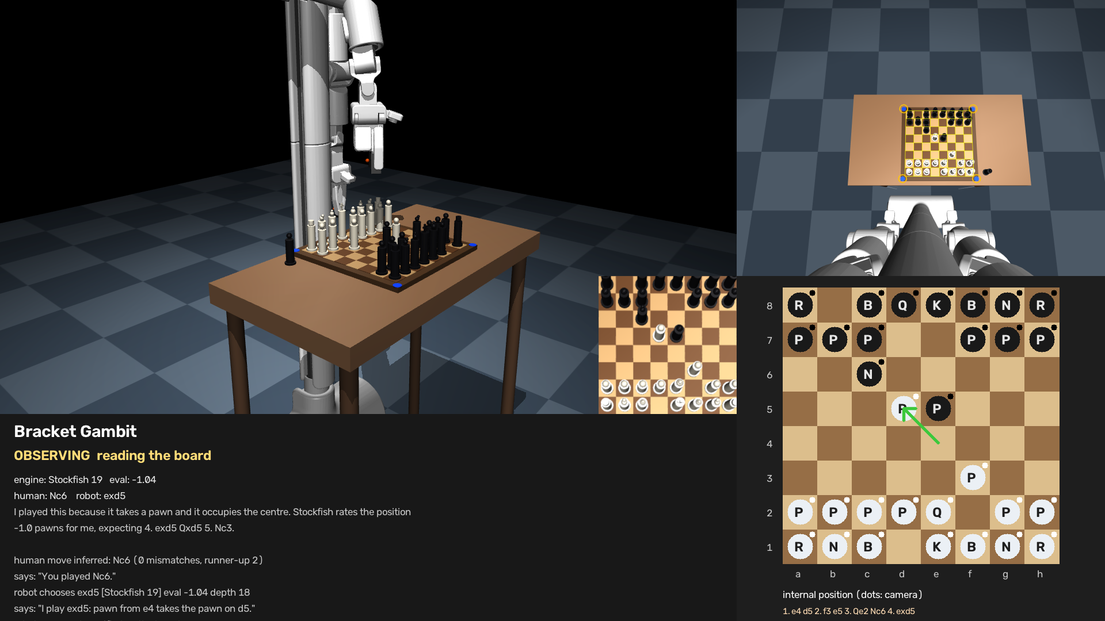
Perception: from a camera frame to 64 squares
No piece recognition needed — occupancy + colour is enough to play
▸ Corner markers four ArUco tags (ids 0–3) fix the board's homography every turn — any camera angle, no calibration of intrinsics
▸ Rectify the board is warped to a 400×400 top-down view; each square is sampled in a band at its centre (where the piece base sits)
▸ Reference diff an empty-board photo taken at calibration; a square is occupied if it differs — works for any board or piece colours
▸ Colour learned, not hard-coded the black/white split is learned from the 32 pieces of the starting position (Otsu)
▸ Robustness found by testing a tall far-rank piece smears into the square behind it; the sample band was chosen by sweeping rendered positions (0 errors vs 4–11)
Right: head camera with the detected grid; bottom: internal position, dots = what the camera saw
Bracket Gambit · 4

Slide 5
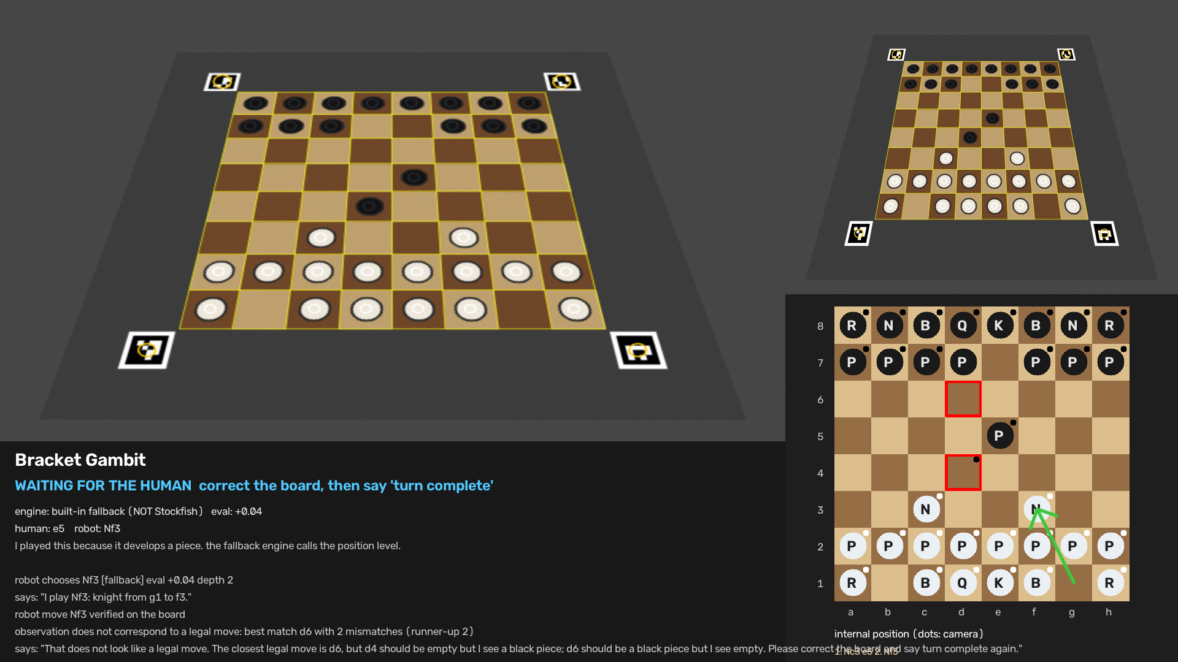
Understanding the human's move
Legal-move matching instead of tracking hands
▸ Diff against legal moves for every legal move, predict the occupancy and count mismatching squares; accept only a unique zero-mismatch match
▸ Captures, castling, en passant fall out naturally — the occupancy pattern identifies them
▸ Rejection with reasons "c6 should be empty but I see a black piece" — the robot waits for a corrected board instead of guessing
▸ No change / hand in view detected and reported; the camera view is re-read on the next signal
▸ "What did you see?" the robot repeats the counts and its last inference on request
A pawn moved to an impossible square: the closest legal move and the offending squares (red) are reported
Bracket Gambit · 5

Slide 6
The brain: Stockfish, kept honest
Strength you can dial; explanations grounded in the position
▸ Stockfish 19 over UCI python-chess, Skill Level 0–20, time per move configurable; the same engine the strongest programs use
▸ Physical constraints fed back promotions are not executable by the gripper → the best non-promoting move is chosen instead
▸ "Why did you play that?" one or two sentences built from facts of the move (capture, check, development, centre, threats) plus Stockfish's evaluation and principal variation — never invented intent
▸ Labelled fallback if the binary is missing a small built-in searcher plays, and every status line says "fallback (NOT Stockfish)"
"I played this because it takes a pawn. Stockfish rates the position +1.6 pawns for me, expecting 3. cxd6 e5 4. Nc3."
"I play Nf3: knight from g1 to f3."
Bracket Gambit · 6

Slide 7
Manipulation: deliberate, verified, recoverable
Validated in MuJoCo with the robot's CAD-accurate URDF
▸ Pick by the shaft approach from above, pads oriented diagonally so the claws clear the neighbours; lift and carry at conservative speeds
▸ Captures first the captured piece goes to a tray beside the board before the attacker moves; castling moves king then rook
▸ Grasp verification sim — lift height + contact; real arm — gripper angle after closing ("did I actually get it?")
▸ Retry, then ask a miss is retried at the position the camera saw the piece; a second miss parks the arm and asks the human to finish the step, then re-verifies
▸ Never trust, always look the chess position is updated only after the camera confirms the physical board
End of the recorded game: two black pieces carried to the tray (left of the board); every placement within 1 mm
Bracket Gambit · 7

Slide 8
Safety and control
Fail safely around people, the board and the hardware
IDLE
OBSERVING
WAITING
THINKING
ANNOUNCING
MOVING
VERIFYING
RECOVERING
NEEDS HELP
PAUSED
STOPPED
▸ Emergency stop 'e' in the terminal, the red web button, or Ctrl-C sets a flag polled every 20 ms control tick; torque is cut on all joints; the daemon also cuts torque if the controller disappears
▸ Before any motion the whole straight line is solved by IK and checked against a workspace box — an unreachable target never leaves the arm half-way
▸ Three control surfaces terminal keys · phone-friendly web page (port 8010, doubles as spectator display) · wake word — voice is never a dependency
▸ Status everywhere LED colour per phase, spoken status, live display with board map, camera overlay, engine line and event log
▸ Dry run first on the robot, `play --robot` prints every waypoint and moves nothing until `--execute`
Bracket Gambit · 8

Slide 9
Results and validation
What has actually been run
Evidence | Result
Simulated game (this deck's video), Stockfish 19 | 1. e4 d5 2. f3 e5 3. Qe2 Nc6 4. exd5 Nf6 5. dxc6 — two captures to the tray, every human move inferred with 0 mismatches, placements ≤ 1 mm, 0 illegal contacts
Earlier 6-move simulated game | two captures to the tray, 0 collisions, 0 helper resets
Vision fixtures (real sim renders, 7 positions) | 64/64 squares correct in every position, every move inferred
Unit + integration tests | 30 tests: vision, engine, manipulation planning/retries, full loop with a mock robot (illegal move, no change, failed grasp → help, pause/e-stop)
Web UI / e-stop path | exercised end-to-end against the mock game
Real robot | backend written against the daemon sources; NOT yet run on hardware (see next slide)
Bracket Gambit · 9

Slide 10
What is real, simulated, and still to verify
We would rather tell you than have you find out
 | Status
Vision, move inference, Stockfish, state machine, retries, UI | ✔ implemented and tested (synthetic + sim renders + mock robot)
Arm pick-and-place, captures, verification | ✔ verified in MuJoCo with the robot's URDF; real-arm backend uses the same sequence through the daemon's IK
Base rolling up to the table | ◐ simulation only — no base-drive channel in the SDK we had; robot is parked by hand
Speech, wake word, LED, e-stop on hardware | ◐ implemented on the documented channels; hardware-unverified
Promotion, arbitrary start positions, gestures with the arms, left arm | ✖ omitted on purpose to protect the core loop
Feasibility on the physical Bracket Bot | reach ≈ 24 cm deep → 3 cm squares; ~3.9 Nm shoulder vs 30 g pieces fine; main risk: the self-balancing base leaning as the arm extends → prop it for the demo
Bracket Gambit · 10

Slide 11
Next steps
In priority order
▸ 1 Bring-up on the robot check → calibrate (reference image, teach a1/h1/a8, gripper angles) → dry run → execute; 7-item hardware checklist in STATUS.md
▸ 2 Grip current as a second grasp signal detect a slipping piece during the carry
▸ 3 Camera-refined pick position on every move today only on the retry
▸ 4 Left arm for the a/b files if the parked pose cannot reach them; the interface already routes each transfer through pick/place
▸ 5 Expressive gestures look at the player, a thinking sway — behind a flag, verified separately from manipulation
▸ 6 Castling and en passant on the physical board, promotion via a piece swap, resume after an e-stop, coaching mode
Bracket Gambit · 11

Slide 12
Bracket Gambit
Play a game against the robot.
uv run python gambit.py play --sim --moves 4 # laptop, MuJoCo
uv run gambit.py play --robot --execute --moves 6 # on the robot, after calibrate
Code: gambit.py + bracket_gambit/ · Docs: README, DEMO_SCRIPT, STATUS · Tests: uv run pytest tests
Built on the Bracket Bot SDK (bbos), MuJoCo, OpenCV, python-chess and Stockfish 19.
Bracket Gambit · 12

