Slide 1
Project Aurora: Q1 2026 Review
Helios Energy Lab steering committee, 2026-04-02

Slide 2
Highlights
Room-temperature retention above 88% after 1000 cycles
  Best cell: AUR-C101 (E-5 + FEC) at 91.4%
E-5 baseline failed at 45 °C;
high-temperature testing moved to E-7
Pilot-line pouch tooling ordered
Notes:
Mention that the steering committee approved an extra EUR 85,000 for the E-7 qualification on 2026-03-19.

Slide 3
E-7 Retention at 45 °C

Slide 4
Milestones
ID | Milestone | Due | Status
M1 | Baseline chemistry frozen | 2026-02-15 | Done
M2 | 45 °C stability demonstrated | 2026-05-30 | At risk
M3 | Pilot line 100-cell batch | 2026-09-30 | On track

Slide 5
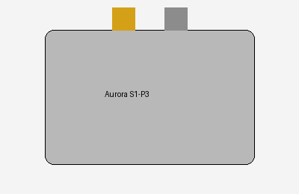
Pouch Cell Prototype
Capacity: 50 Ah
Assembled on the pilot line, 2026-03-28

Slide 6
Backup: E-5 Gas Analysis
CO₂ and C₂H₄ detected after failure, consistent with EC decomposition

