Slide 1

WEB SCRAPPING AND EXPLORATORY DATA ANALYSIS
ON
HP LAPTOPS

Slide 2
ABOUT US
Name : Rayapudi Gautam Kumar
Qualification: B.Tech (EEE)
Experience: Fresher
Name : Tadicharla Rama Chaitanya
Qualification: B.Tech (EEE)
Experience: Fresher

Slide 3
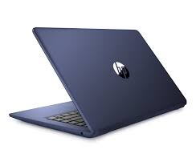
Problem Statement
The objective of this project is to analyze the hp laptops and suggest a laptop with better features according to the customer’s affordability.

Slide 4
CONTENTS
Introduction
Problem Statement
Web scraping
Tools Used
Website
Steps For Collecting Data
Raw Data
Steps For Cleaning Data
Cleaned Data
Data Visualization
Challenges Faced
Observation
Conclusion

Slide 5
Introduction
HP- HP Inc. is an American multinational information technology company headquartered in Palo Alto, California, that develops personal computers (PCs), printers and related supplies, as well as 3D printing solutions.
Data Description
In this project we will analyze the laptops of hp and we scrap the data from the below website
https://www.hp.com/in-en/shop/catalogsearch/result/index/?p=1&product_list_limit=24&q=laptop
The datasets contains the following information:
Product Name - Name of the product
Processor - Type of processor
RAM - The size of RAM(in GB)
Hard Drive - The size of Hard drive(in GB)
OS - Operating System of the laptop
Screen Size - Screen size of the laptop(in cms)
Additional Features - Additional Features of the laptop(eg.,Backlit Keyboard, Camera Quality, Type of speakers used etc.)
Processor_Type - Type of the processor
Original Price - Original price of the product
GST - GST laid on the product
Offer Percentage - The off on product in %
Price Saved - The total price saved on the product
Price - The final price of the product
Product ID - The product ID of the product
Data Shape:-
number of rows: 360
number of columns: 13

Slide 6
Webscraping
The Internet has the massive volume of data that can use the collect the data and analysis on the data.
The collected data may unstructured or semistructured data.
We have used Beautiful Soup in our project to scrap the data from website
STEPS:
Find the URL to scrape the data
Request the server for the response
Inspect the page
Identify the data to extract
Store the data in required format

Slide 7


TOOLS USED
Web scraping
Python
Request
BeautifulSoup
Data Cleaning and Manipulation
Numpy
Pandas
Regular Expression
Data Visualization
Matplotlib
Seaborn

Slide 8
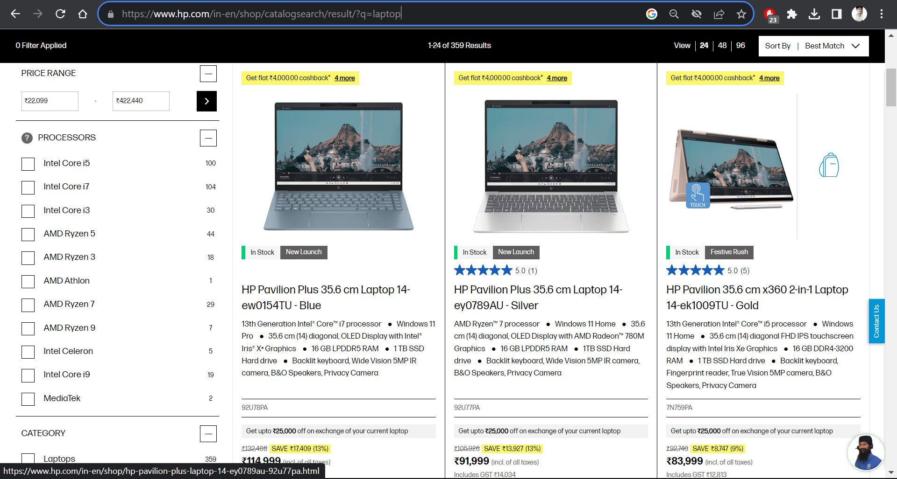
Website
https://www.hp.com/in-en/shop/catalogsearch/result/index/?p=1&product_list_limit=24&q=laptop

Slide 9
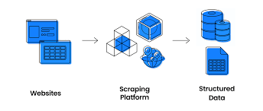
Steps for collecting Data
Select the website to scrape the data
Import the necessary libraries(if not found install the library)
After scraping check for the every column length.
If length is same of all the columns make it as a DataFrame.
Finally Save it in a required format (we saved it in pickle format)

Slide 10
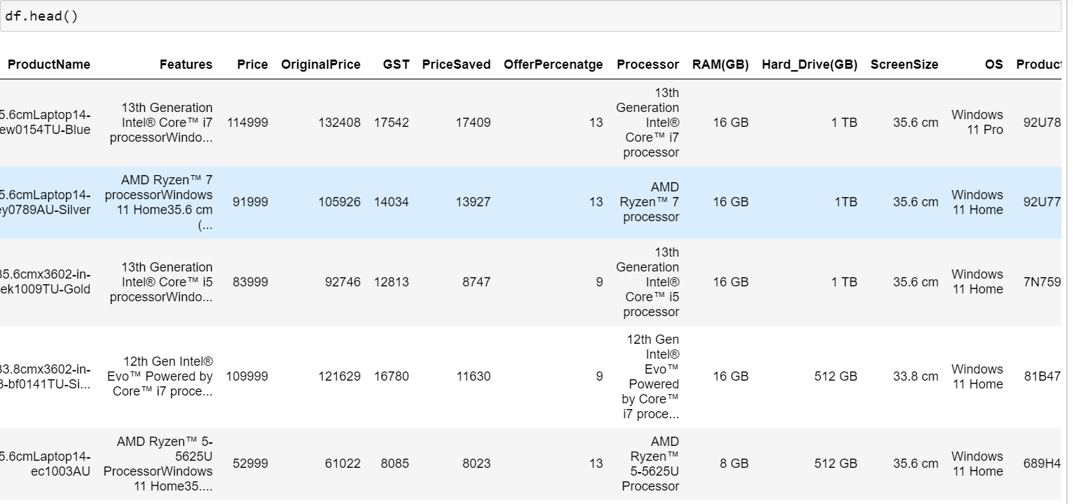
Raw Data

Slide 11
Steps For Cleaning Data and Manipulating Data
Checking for null values.
Check for Duplicates.
Checking and removing special characters.
Data type conversion.
Checking for missing values and perform based on criteria.

Slide 12
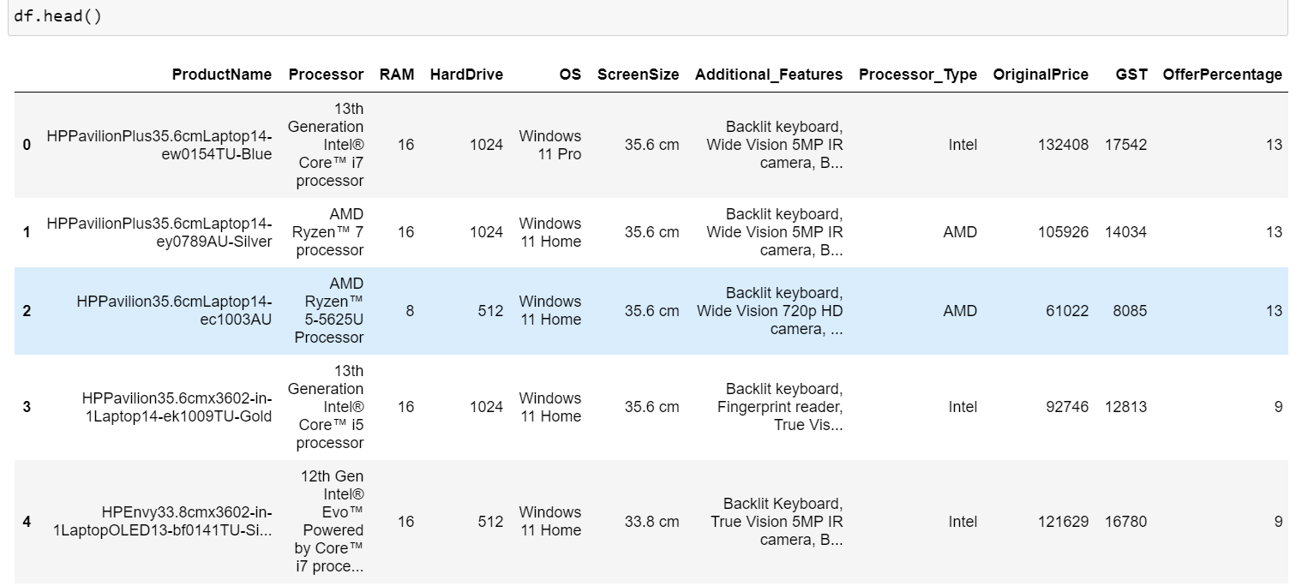
Cleaned Data

Slide 13
Data Visualization
Data visualization makes the data to be more understandable and interpretable.
Visualization can be done in usually three ways: Univariate, Bivariate and Multivariate analysis.
Univariate: In this type of analysis only one variable is used to do the analysis.
Bivariate: In bivariate analysis the analysis is done among two variables.
Multivariate: In multivariate analysis the analysis done using more than two variables.
Using this we can give relation to different data and draw some key observations and conclusions.

Slide 14
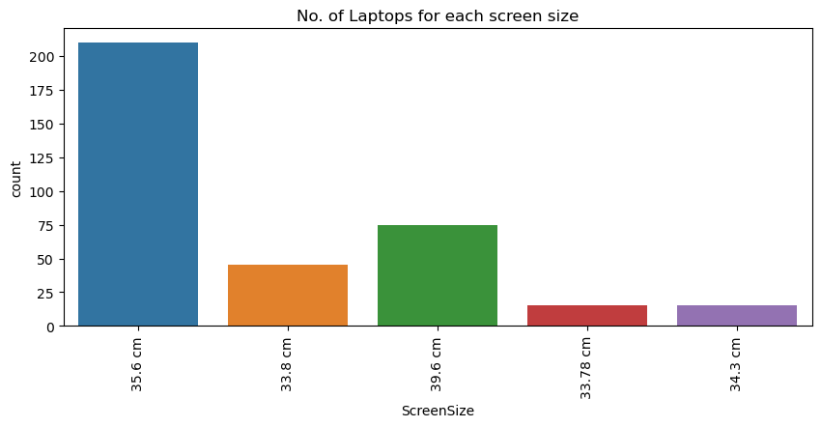
Univariate Analysis
From this we can easily identify how many laptops are there in required screen size.
Analysis: From this bar plot we can say that most of the laptops are manufactured with a screen size of 35.6 cm.

Slide 15
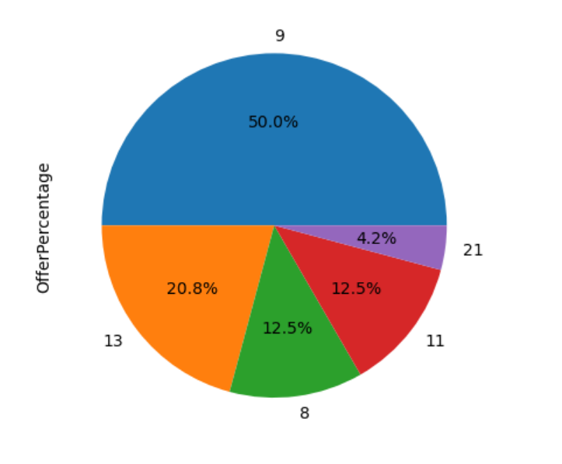
Pie Chart:
Here we plotted the percentage of laptops by taking the percentage column.
Analysis: From this plot we can say most of the laptops have an offer of 9%

Slide 16
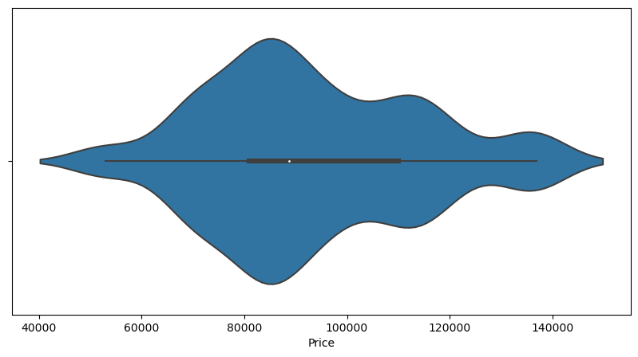
Violin plot:This plot is plotted using Price data. We can observe that most of the data is concentrated in the range 80000-100000.
Analysis: We can observe that most of the price data is concentrated in the range 80000-100000.

Slide 17
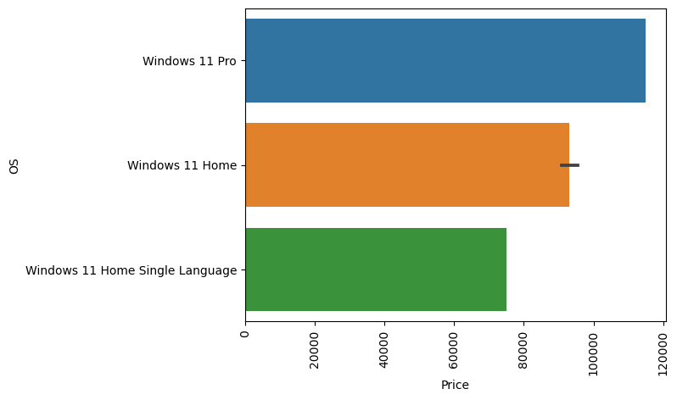
Bivariate Analysis
Bar plot: In this plot we can observe the price ranges of each Operating System.
Analysis: From this we can say that for Windows 11 Pro the price is more compared to other two OS.

Slide 18
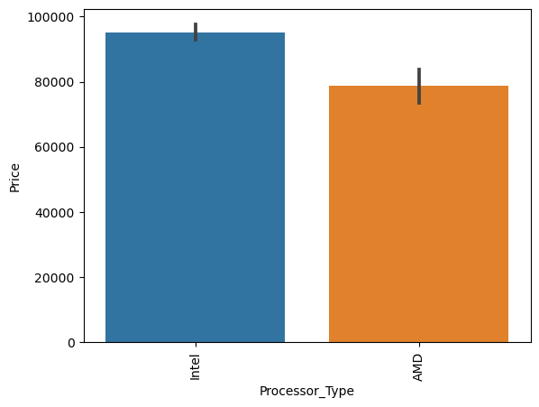
Bar Plot: Here Processor type and price columns are considered for plotting.
Analysis: From this we can observe that AMD processor type laptops have a lesser price compared to the laptops with Intel processor.

Slide 19
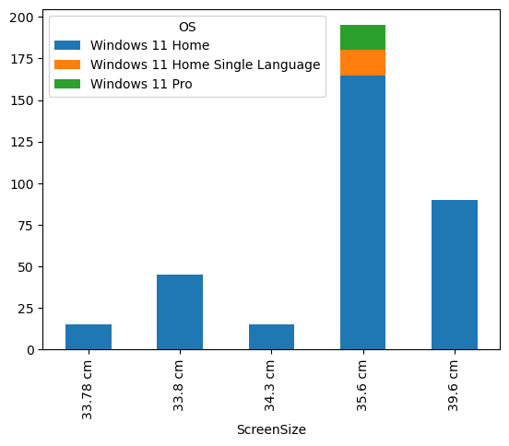
Stacked Bar Plot: for Screen Size and Operating System
Analysis: Here only for the screen size of 35.6 cm all types of OS hp is offering are available.

Slide 20
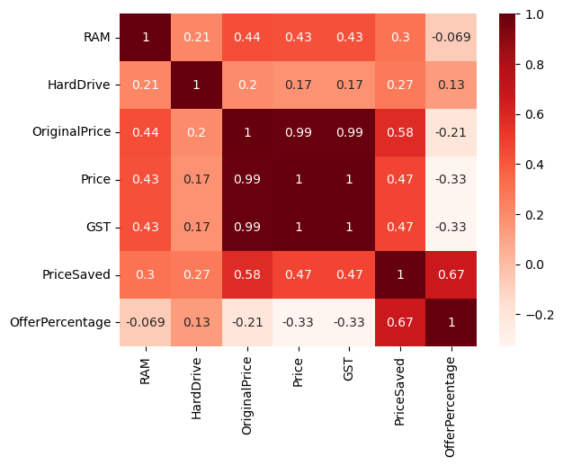
Multivariate Analysis
This Heat map gives the correlation between the columns used in DataFrame

Slide 21
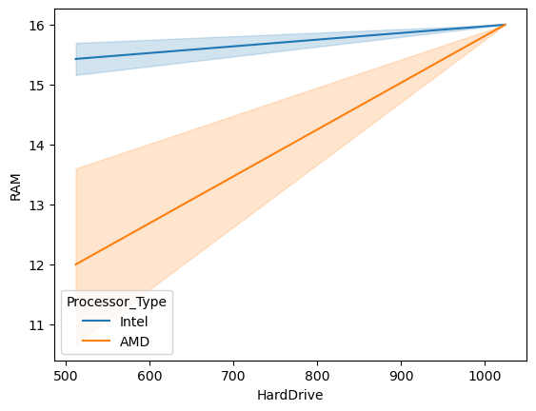
Line Plot: In this plot we considered RAM, Hard Drive and Processor type columns for plotting the graph.
Analysis: From this plot we can observe that compared to AMD, laptops with Intel processor have highest RAM even though they have a lesser storage. Meanwhile, for AMD the RAM and storage have increased linearly i.e., if RAM is increased simultaneously storage is also increasing.

Slide 22
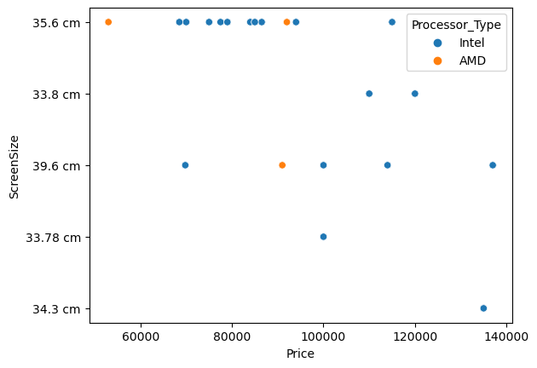
Scatter Plot: Scatter plot is plotted between Price, Screen size and Processor type.
Analysis: From the above plot we can depict that laptops with Intel processor with screen size of 35.6 cm are more concentrated in 65000 to 95000 price range.

Slide 23
Challenges Faced
Had same tags and values.
Losing data.
We were not able to extract data about the ratings and no. of reviews for a given product.
Solution
Collected Data in unordered way which is not readable and we converted into readable format by using regex.

Slide 24
Observations
The data columns(series) had mostly a strong correlation among them.
The plots were mostly linear since they had a proportional relation between them.
We can observe that most of the data is concentrated in the price range of 80000-100000.
From the bar plot in univariate analysis we can say that most of the laptops are manufactured with a screen size of 35.6 cm.
From the bar plot in bivariate analysis we can say that for Windows 11 Pro the price is more compared to other two OS.
From the scatter plot we can depict that laptops with Intel processor with screen size of 35.6 cm are more concentrated in 65000 to 95000 price range.

Slide 25
Conclusion
From this we can conclude several points:
Even if laptops with AMD processor has lower prices compared to Intel, it is better to buy a laptop with Intel processor, since there won’t be much of a difference in prices.
So if you are looking for a laptop with features like satisfactory RAM, a better storage with a lower price it is better to look for a laptop with AMD processor.
If you are looking for a laptop with highest price with a cutting-edge features then you can go for HPEnvy360 2-in-1 Laptop OLED 15-fe0014TX laptop.
If you want a laptop with lowest price with satifactory features then you can buy HPPavilionLaptop14-ec1003AU laptop.

Slide 26

THANK YOU

