Slide 1
Functions and types

Slide 2
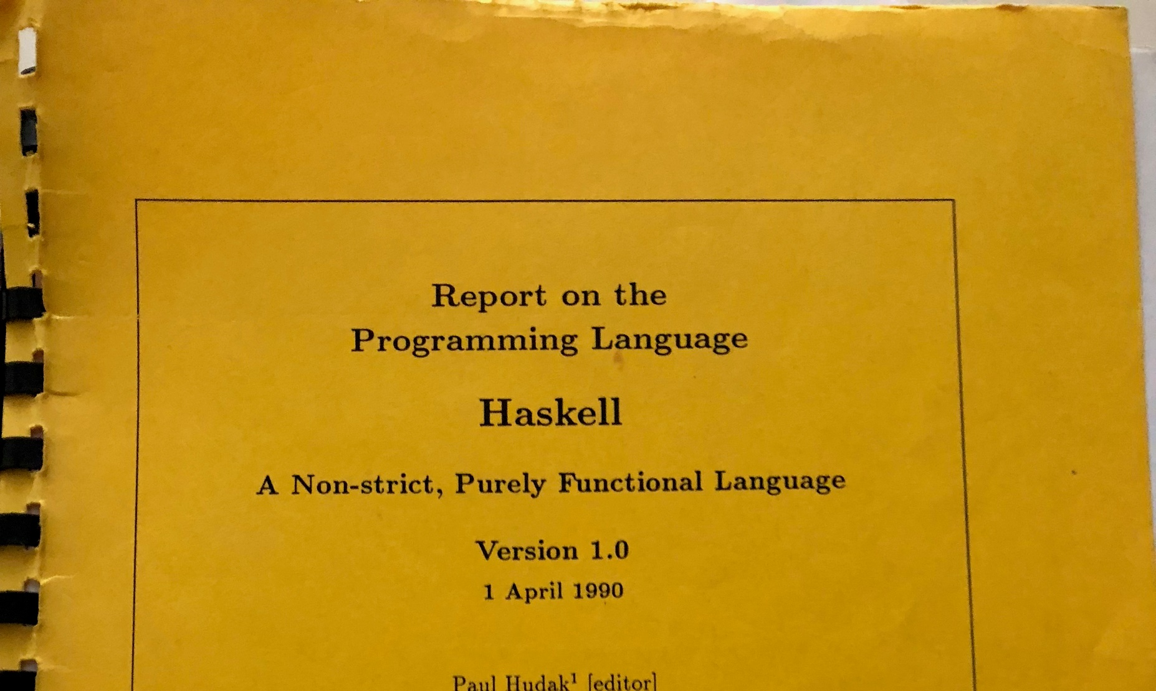
What is Haskell about?

Slide 3
What is Haskell?
Functional
Haskell is a language of expressions, not commands
Meaning of a Haskell program is given by evaluation, not execution
Functions are first-class values
Functional
Haskell is a language of expressions, not commands
Meaning of a Haskell program is given by evaluation, not execution
Functions are first-class values

Slide 4
Programming with functions
Lots of languages are “functional”:
auto twice(function<int(int)> f) {
return [=](int x) {
return f(f(x)); };
}
int bigger(int x) {
return x + x;
}
int main() {
cout << twice(bigger)(4) << endl;
return 0;
}
def twice(f, x):
return f(f(x))
def twicer(f):
return lambda x: f(f(x))
def double(x):
return x + x
print(twice(double, 4))
print(twicer(double)(4))

Slide 5
Programming with functions
Haskell makes programming with functions the “easy” way
Simplest syntax reserved for function application
Idioms use functions over other language constructs
def doubleAll(arr):
brr = list()
for a in arr:
brr.append(double(a))
return brr
doubleAll xs = map double xs

Slide 6
What is Haskell?
Functional
Haskell is a language of expressions, not commands
Meaning of a Haskell program is given by evaluation, not execution
Functions are first-class values
Functional
Haskell is a language of expressions, not commands
Meaning of a Haskell program is given by evaluation, not execution
Functions are first-class values
Pure
Result of a function depends only on its input
Side-effects (input/output, randomness, &c.) explicitly captured

Slide 7
What is Haskell?
Functional
Haskell is a language of expressions, not commands
Meaning of a Haskell program is given by evaluation, not execution
Functions are first-class values
Functional
Haskell is a language of expressions, not commands
Meaning of a Haskell program is given by evaluation, not execution
Functions are first-class values
Pure
Result of a function depends only on its input
Side-effects (input/output, randomness, &c.) explicitly captured
Non-strict
Expressions are only evaluated when needed
Enabled by purity

Slide 8
Non-strictness in action
Let’s think about when evaluation happens:
Simplifies thinking about programs: don’t need to worry about order of execution
Enabled by purity
def const(x, y):
return y
print(const(1/0, 5))
const x y = y
main = print (const (1 / 0) 5)

Slide 9
What is Haskell?
Functional
Haskell is a language of expressions, not commands
Meaning of a Haskell program is given by evaluation, not execution
Functions are first-class values
Functional
Haskell is a language of expressions, not commands
Meaning of a Haskell program is given by evaluation, not execution
Functions are first-class values
Pure
Result of a function depends only on its input
Side-effects (input/output, randomness, &c.) explicitly captured
Non-strict
Expressions are only evaluated when needed
Enabled by purity
Strongly typed
Types are the foundation of understanding Haskell programs
Types automatically calculated by the compiler
“Generic” types enable reuse, overloading

Slide 10
Where did Haskell come from?

Slide 11

General purpose programming
RADM Grace Murray Hopper (1906–1992)
American mathematician and computer scientist
Designer of various programming languages
“The Education of a Computer” (1952)
Describes the first compiler/linker
“Programming in English”—widely rejected when first proposed

Slide 12
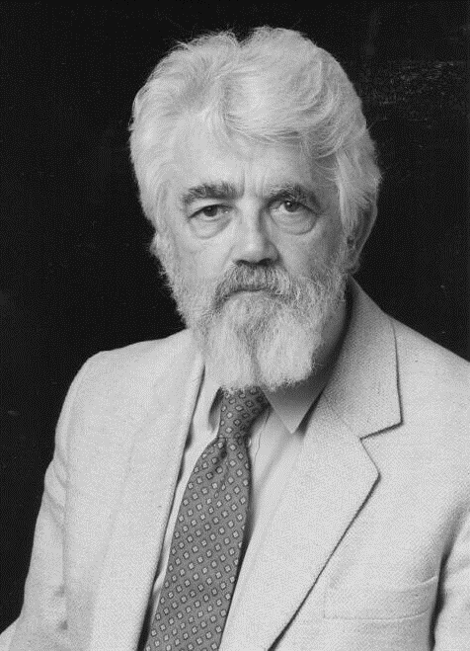

Programming with functions
John McCarthy (1927–2001)
American computer and cognitive scientist
Founder of artificial intelligence
“Recursive Functions of Symbolic Expressions and Their Computation by Machine” (1960)
Programming language based on the $λ$-calculus
Designed to facilitate AI experiments

Slide 13
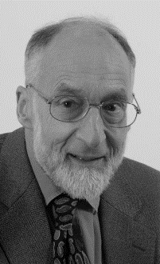
Functions and types
Arthur John Robin Gorell Milner (1934–2010)
English computer scientist
Foundational work in programming languages and theorem proving
The Definition of Standard ML (1990)
Defines the Meta Language for the Edinburgh LCF theorem prover
Combines functional programming with strong typing

Slide 14
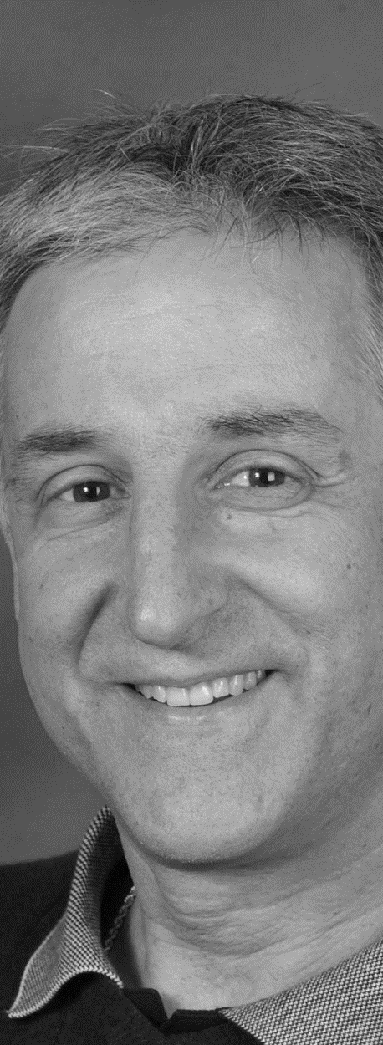
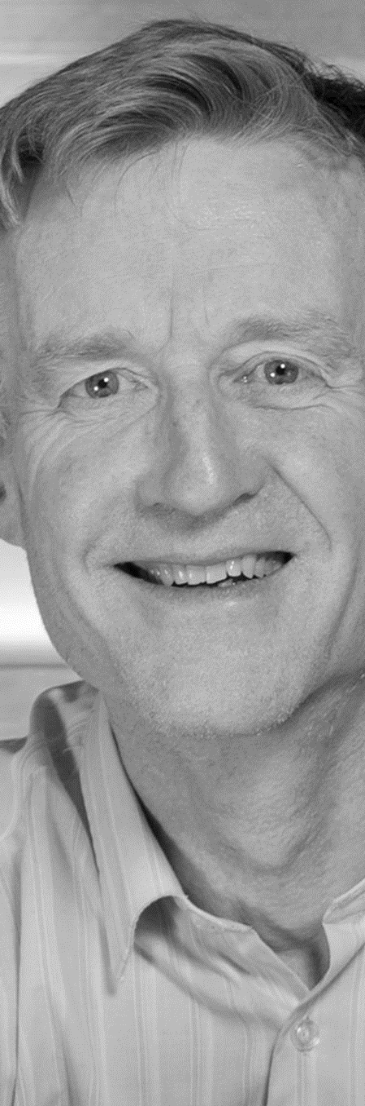

Programming purely with functions
Paul Hudak (1952–2015)
Simon Peyton Jones (1958–)
Philip Wadler (1956–)
“Report on the Programming Language Haskell: A Non-strict, Purely Functional Language” (1992)

Slide 15
What do Haskell programs look like?

Slide 16
Definitions
A Haskell file is a list of definitions
Evaluation not execution starts with main, or with an expression we provide
Each definition contains:
A type signature (optional)
A list of equations (not optional)

Slide 17

Expressions
Most Haskell expressions are function calls.
Function calls can be written either:
Infix: 1 + 2, 5 `div` 2
Prefix: length xs, map f xs, (+) 1 2
Why don’t function calls have parentheses?
What should a function call look like? $f(x)$, $\sin{x}$, $n!$, $n^{2}$…
Simplest syntax for the most common expression

Slide 18
Equations
An equation has a left-hand and right-hand side.
The left-hand side is a pattern
Single name: constant definition
Application: function definition
More to come!
The right-hand side is an expression
More to come!

Slide 19
Higher-order functions
A “higher-order” function is a function that operates on other functions.
Higher-order functions are completely pervasive in Haskell.
Prototypical example:
map :: (a → b) → [a] → [b]
BTW: strings are lists of characters.
BTW: Haskell types can be generic.

Slide 20
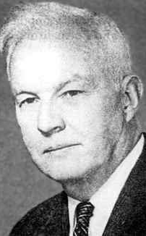
Currying
Haskell Brooks Curry (1845–1918)
American logician
Foundations of logic and mathematics
Combinatory logic
Reasoning without assumptions / Computation without variables
Transformations of functions
“He always hated the name ‘Haskell’”

Slide 21
Currying
“Multi-argument functions” are actually higher-order functions
map :: (a → b) → [a] → [b] map :: (a → b) → ([a] → [b]) map transforms an a → b function into an [a] → [b] function
map f xs (map f) xs Two function applications: first map to f, then the result to xs

Slide 22
Guards
Equations can be guarded
Guards set Boolean conditions on when a Haskell equation applies to its arguments
An equation can have as many guards as you want
The default condition is usually written otherwise

Slide 23
Local definitions
Equations can have local definitions
Introduced by where
List of definitions
Haskell source files are structured with layout
Layout introduced by some keywords: where, case, …
Layout depends on the column of the first thing following the keyword

Slide 24
Local definitions
Equations can have local definitions
Haskell source files are structured with layout
Layout introduced by some keywords: where, case, …
Layout depends on the column of the first thing following the keyword
More indented: part of the same definition
Same indentation: another definition in the same block
Less indented: end of the local definition block

Slide 25
What do Haskell programs mean? (informally)

Slide 26
Finding meaning
Here is a Python function:
def f(n):
x = 1
while (n > 1):
x *= n
n -= 1
return x
What does this function compute? How do you know?

Slide 27

What does a Haskell expression mean?
Intuitively, we know that
2 * 3 + 4 * 5 $=$ 26
But how does Haskell know? How do we capture our intuition?

Slide 28
Reduction
A Haskell expression is evaluated by reduction to its simplest form
Reduction: turns function calls into function results
Simplest form: when there aren’t any more reductions

Slide 29

Reduction
A Haskell expression is evaluated by reduction to its simplest form
Reduction: turns function calls into function results
Simplest form: when there aren’t any more reductions
E.g.: $2 ∗3+4 ∗5$
Reduction strategies:
Resolve non-determinism in reducing expressions
Not the same as order of operations….

Slide 30

Reducing functions
sq x = x * x
Reduce function applications ($\text{sq} 4$) in two steps:
Introduce local binding for argument: $\text{sq} 4 = \text{let} x=4 \text{in} x ∗x$
Substitute local binding into function body: $\text{let} x=4 \text{in} x∗x = 4 ∗4$

Slide 31

Reducing functions
sq x = x * x
Reduce function applications in two steps:
Introduce local binding for argument:
Substitute local binding into function body:
Still have multiple strategies in reducing function calls:
E.g.: $\text{sq} (2 ∗ 2)$
Innermost reduction: reduce function application as late as possible
Outermost reduction: reduce function application as early as possible

Slide 32
Reasoning about functions
Can reason about behavior of functions on arbitrary arguments.
Suppose we have:
id x = x
(f ∘ g) x = f (g x)
Can show:
f ∘ id = f = id ∘ f
f ∘ (g ∘ h) = (f ∘ g) ∘ h

Slide 33
Finding functions
f x y = 2 * x + y
Still need to find functions to reduce:
E.g.: f 2 (3 + 3)
Left-to-right or right-to-left.
For outermost reduction, right-to-left evaluation doesn’t make much sense…

Slide 34
Consequences of outermost reduction
Outermost reduction can have surprising results.
four x = 4
What’s the result of four (5 `div` 0)?

Slide 35
Haskell’s reduction strategy
Haskell uses lazy reduction
Reduction result indistinguishable from outermost reduction.
Evaluation time more like innermost reduction.
Some constant factors
Space usage can differ significantly
We’ll mostly assume outermost reduction

Slide 36
How are Haskell programs structured?

Slide 37

Types structure programs
Types structure values
Int: 1, 2, 42, -912
Char: 'a', 'b', '$⊢$'
Bool: True, False
Every value belongs to exactly one type
Caveat: one most general type

Slide 38

Types structure programs
Types structure values
Types structure expressions
Integer: 1,2,42,-912,2 + 2, negate 12, ord 'b', sum [2..]
Char: 'a', 'b', '$⊢$', chr 64, head "Test"
Bool: True, False, True && False, null [1,2,3]
An expression has a type if it reduces to a value of that type
So what about infinite loops?
Every expression belongs to exactly one most general type
Even if you didn’t write it down.

Slide 39
Two views of types
Types as classifiers
Meaning of programs independent of their typing
Types describe (but don’t limit) program behavior
E.g., Python, C (mostly), …
Types as structure
Programs have no meaning outside typing
Types limit program behavior
What does an Int → Int function do with a Boolean argument?

Slide 40
New values come from new types
Most types are introduced by datatype declarations:
data Bool = False | True
Simultaneously introduces new type Bool and values False, True of that type
Remaining types are primitive: functions, pointers, integers

Slide 41
Ingredients of a data type
Haskell’s data types follow sum of products construction
Alternatives (sum, coproduct): different ways to build values of a type
data Bool = False | True
Read | as “or”: a Bool can be either False or True

Slide 42
Ingredients of a data type
Haskell’s data types follow sum of products construction
Alternatives (sum, coproduct): different ways to build values of a type
A datatype can have any number of constructors
data Suit = Spades | Hearts | Diamonds | Clubs
data Empty
Datatypes can’t share constructors
data Bool = True | False
data SQLBool = True | False | Null

Slide 43
Ingredients of a data type
Haskell’s data types follow sum of products construction
Alternatives (sum, coproduct): different ways to build values of a type
Fields (product): a value can package other values
data Point = MkP Int Int
data MayBeInt = JustAn Int | Nopers
Fields behave like arguments: MkP 1 4 :: Point
Can name fields, but we aren’t going to

Slide 44
Programs follows types
Type signatures are specifications
data Bool = False | True
not :: Bool → Bool
not only operates on Boolean arguments
So not can be defined by cases over Bool

Slide 45
Definition by cases
Function definitions follow datatype definitions
data Bool = False | True
not :: Bool → Bool
not False = True
not True = False
Must be together in source file
Checked in order, independent from datatype declaration

Slide 46
Definition by cases
Equations can match on multiple arguments
and :: Bool → Bool → Bool
and True True = True
and True False = False
and False True = False
and False False = False

Slide 47
Variables
Variables match and bind any constructor
and :: Bool → Bool → Bool
and True b = b
and False b = False
We’ve been using pattern matching, we just didn’t realize it
Pattern matching and guards combine—if no guard is True, Haskell will try the next matching equation

Slide 48
Wildcards
Wildcards match any constructor
and :: Bool → Bool → Bool
and True True = True
and _ _ = False
Equations checked in order (just like guards)
No requirement that sets of equations be complete or exclusive

Slide 49
Constructors can package values
Patterns still follow constructors
data Several = Two Int Int | One Int | None
f :: Several → Int
f (Two x y) = x + y
f (One x) = x
f None = 0

Slide 50
Generic types and type constructors

Slide 51
Types from types
Type constructors build types from other types
data Maybe a = Just a | Nothing
data Either a b = Left a | Right b

Slide 52
Types from types
Maybe Int is a type
Values like: Just 1, Just 2, Nothing
Maybe Bool is a (different) type
Values like: Just True, Just False, Nothing
Not the same Nothing as was a value of Maybe Int (think: 1 is syntax for distinct integer and floating point values)
Maybe is not a type
Not a common supertype, or any such nonsense
No values of type Maybe

Slide 53
Generic types
Generic types range over a family of types
head :: [a] → a
Means that you can use:
head :: [Char] → Char
head :: [Int] → Int
head :: [[Bool]] → [Bool]
But not:
head :: [Char] → Int
head :: Int → Bool

Slide 54
Generic types
Generic types range over a family of types
map :: (a → b) → [a] → [b]
Means that you can use:
map :: (Int → Int) → [Int] → [Int]
map :: ([Char] → Int) → [[Char]] → [Int]
But not:
map :: (Int → Int) → [Char] → [Char]

Slide 55
Generic types
Read type variables as if universally quantified:
head :: [a] → a
means head :: for all a, [a] → a
map :: (a → b) → [a] → [b]
means map :: for all a and b, (a → b) → [a] → [b]

