Slide 1
Gautami Mehta
Json Web Token

Slide 2
INTRODUCTION
JWT, or JSON Web Token, is an open standard used to share security information between two parties as a JSON object — a client and a server.
A JWT is often used to secure RESTful APIs because it can be used to authenticate a client that wants to access the APIs.

Slide 3
Why should we use JWT ?
Authorization:
This is the most common scenario for using JWT. Once the user is logged in, each subsequent request will include the JWT, allowing the user to access routes, services, and resources that are permitted with that token.
Information Exchange:
JSON Web Tokens are a good way of securely transmitting information between parties.

Slide 4
Structure of a JSON Web Token
The token is mainly composed of header, payload, signature. These three parts are separated by dots(.).
Header:
It can also contain the data about the media/content type of the information we are sending. This information is present as a JSON object.
Payload:
The payload is the part of the JWT where all the user data is actually added.
Signature:
This is the third part of JWT and used to verify the authenticity.

Slide 5
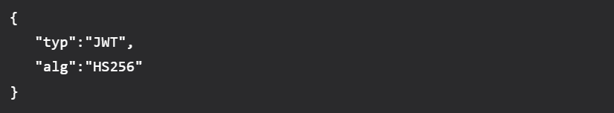
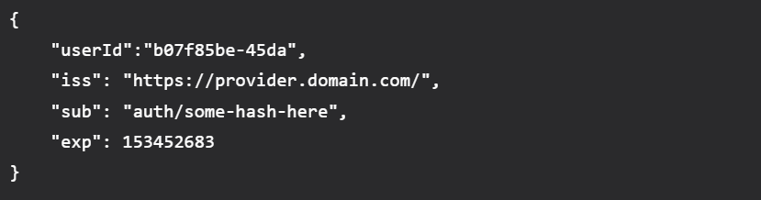

Slide 6
How do JSON Web Tokens work?
In authentication, when the user successfully logs in using their credentials, a JSON Web Token will be returned.
Whenever the user wants to access a protected route or resource, the user agent should send the JWT, typically in the Authorization header using the Bearer schema.

Slide 7
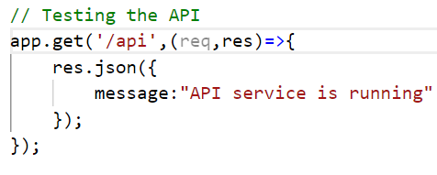
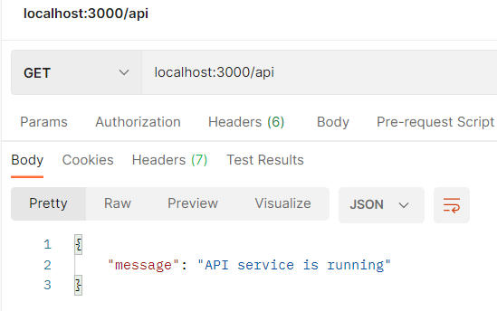
Code Snippets

Slide 8
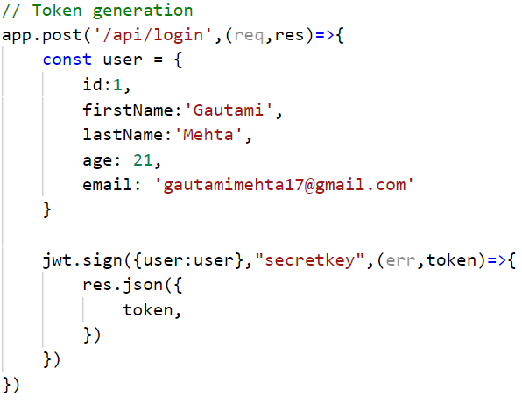
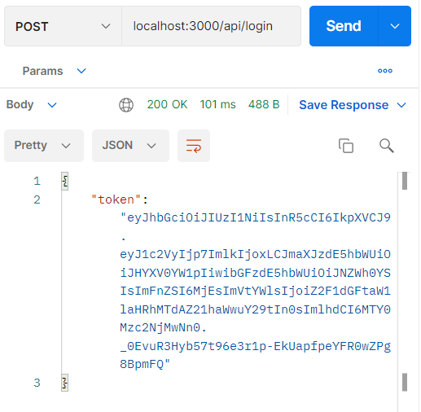

Slide 9
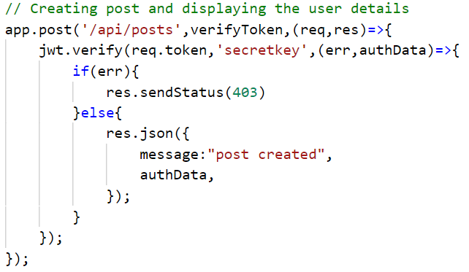

Slide 10
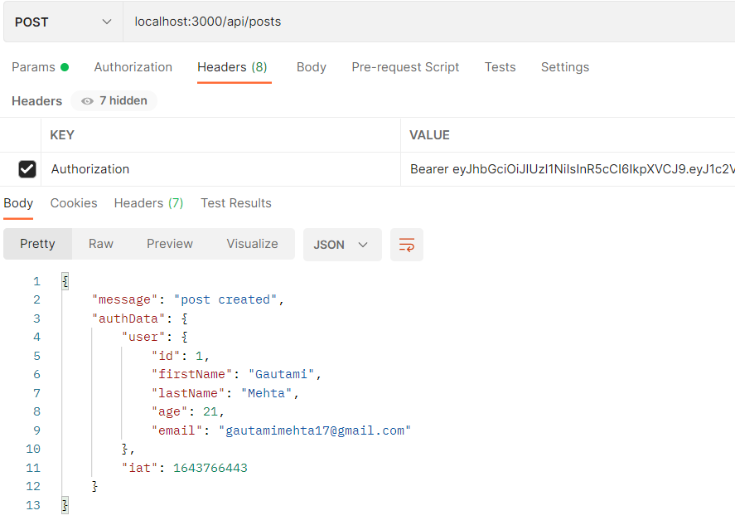

Slide 11
THANK YOU

