Slide 1
LECTURE - 3
SOUL IN THE MACHINE. – by Deepak Kumar

Slide 2

Hii, I’m Deepak Kumar. I am your educator. I’ve been
teaching computer science for 3 years,
This is my initiative for online computer classes. I started this because I saw that many people want to learn computers, but they don't get the right guidance.
Some think "computers are difficult," some say "I'm too old for this," and some are so afraid that they don't even try to learn. My mission is to reach these very people.
My belief is that learning computers is not difficult for anyone, it just needs to be taught in the right way. And this is what I am doing - starting from the very basics, in the simplest language, completely free.

Slide 3
Topic To Cover
NETWORKING.

Slide 4
NETWORKING
Networking is the connection of two or more computers or devices so they can communicate and share data or resources (like files, printers, or internet).
Example: A home Wi‑Fi network where your smartphone and laptop connect to the same router to browse the internet and share files.

Slide 5
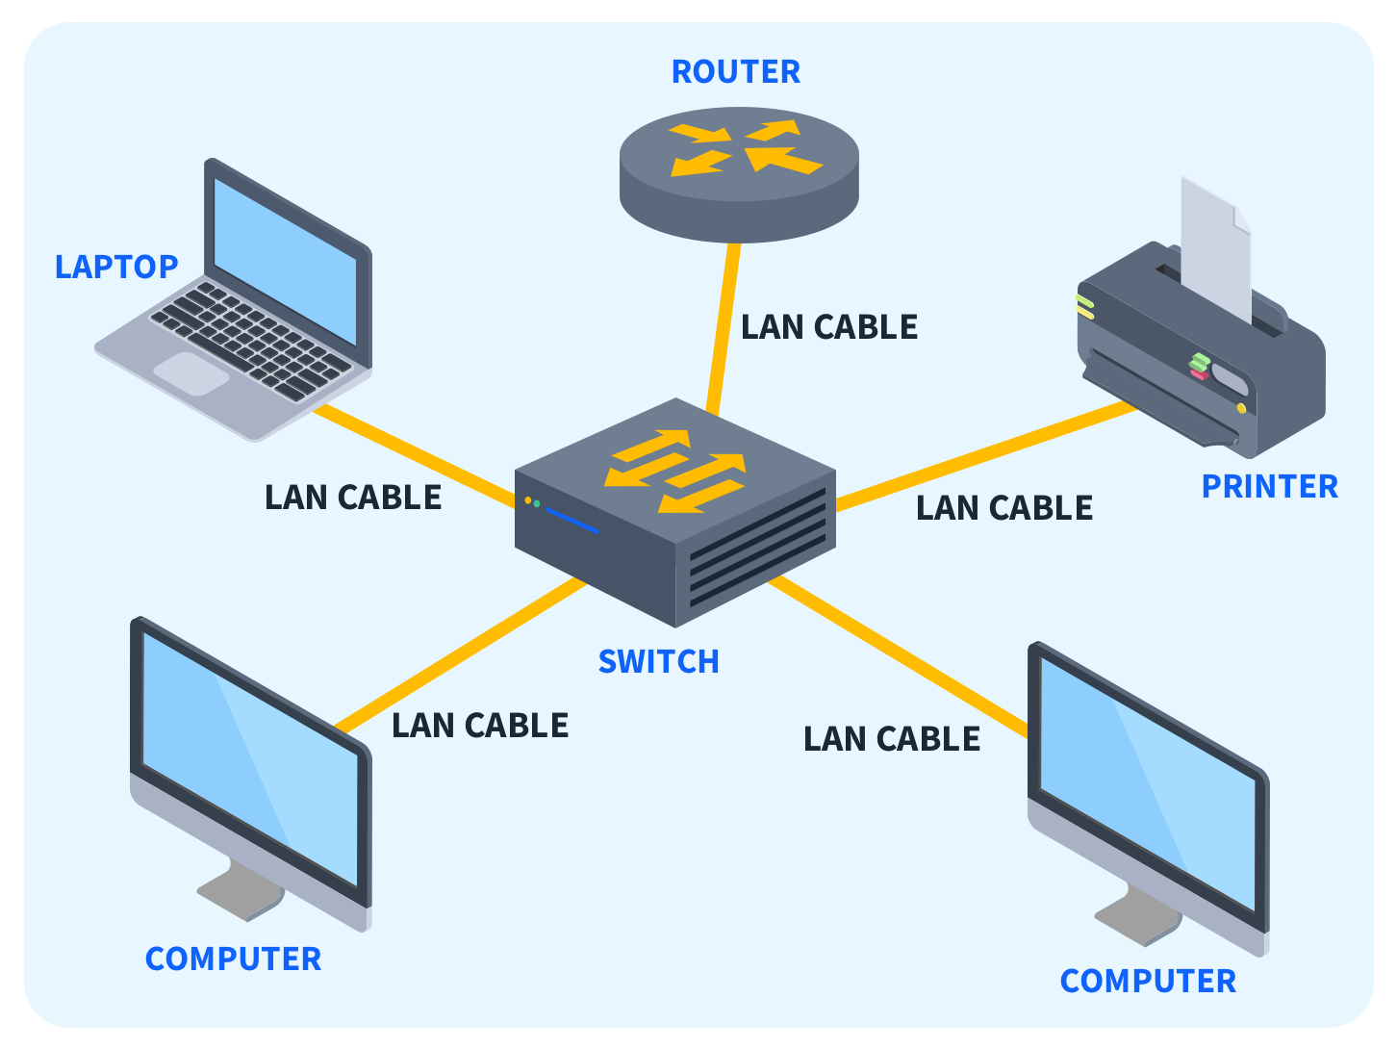

Slide 6
NETWORKING
TRANSMISSION MEDIA: IT IS A MEDIUM THROUGH WHICH WE CAN TRANSFER OUR DATA.
IT IS BASICALLY OF TWO TYPES:- 1. WIRE AND WIRELESS.
WIRE:- TWISTED PAIR CABLE, COAXIAL CABLE, OPTICAL FIBRE CABLE.
WIRELESS:- RADIOWAVE TRANSMISSION, INFRARED TECHNOLOGY, MICROWAVE TRANSMISSION.

Slide 7
NETWORKING
ADVANTAGES OF NETWORKING
1. COMMUNICATION
2. SHARING OF HARDWARE.
3. SHARING OF SOFWARE.
4. COST EFFECTIVE.
5. MAKE SHARING QUICKLY.

Slide 8
NETWORKING
DEVICE NEEDED FOR COMPUTER NETWORKING: -
1. MODEM
2. NIC
3. HUB
4. SWITCHES
5. ROUTER

Slide 9
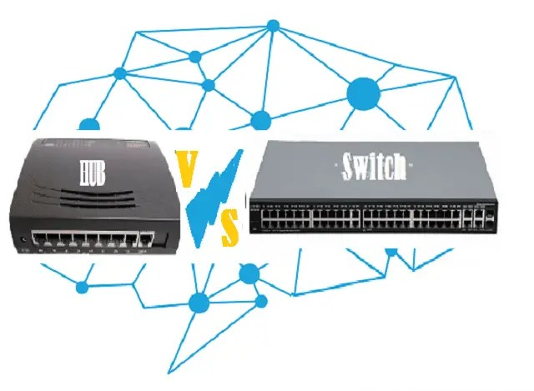

Slide 10
NETWORKING
TYPES OF COMPUTER NETWORKS
LAN (Local Area Network): Small area like a home, school, or office. Fast (Ethernet/Wi‑Fi), used for sharing files, printers, and internet within the site. Example: computers in a classroom.
MAN (Metropolitan Area Network): Covers a city or campus. Bigger than LAN but smaller than WAN. Connects multiple LANs for institutions or city services. Example: a university network spanning several buildings.

Slide 12
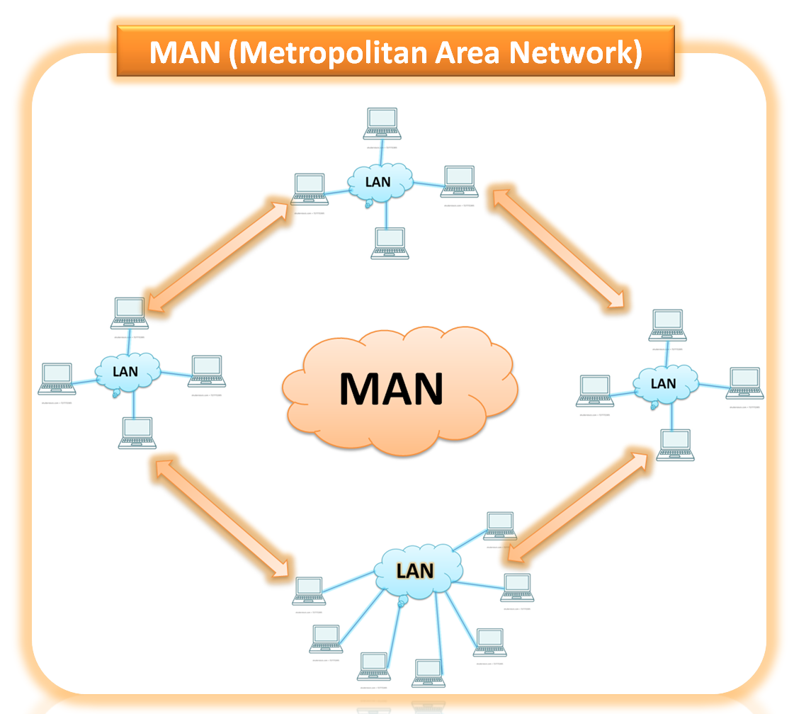

Slide 13
NETWORKING
WAN (Wide Area Network): Covers large geographic areas (states, countries). Connects multiple LANs/MANs over long distances using leased lines, internet, or satellite. Slower and more expensive than LAN. Example: the internet or a company connecting offices in different cities.
PAN (Personal Area Network): Very small network around one person (a few meters). Connects personal devices like phone, laptop, headset using Bluetooth or USB. Example: smartphone connected to wireless earbuds.

Slide 14
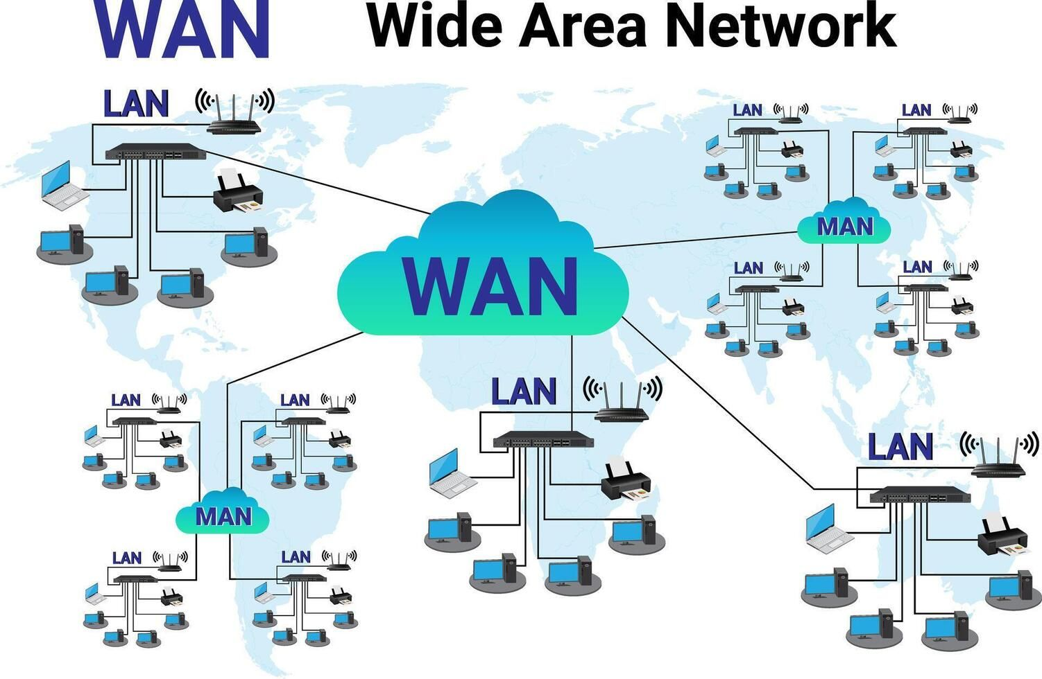

Slide 15
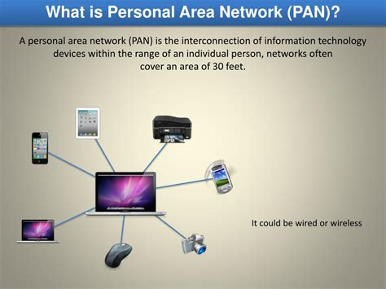

Slide 16
THANK YOU

