Slide 1
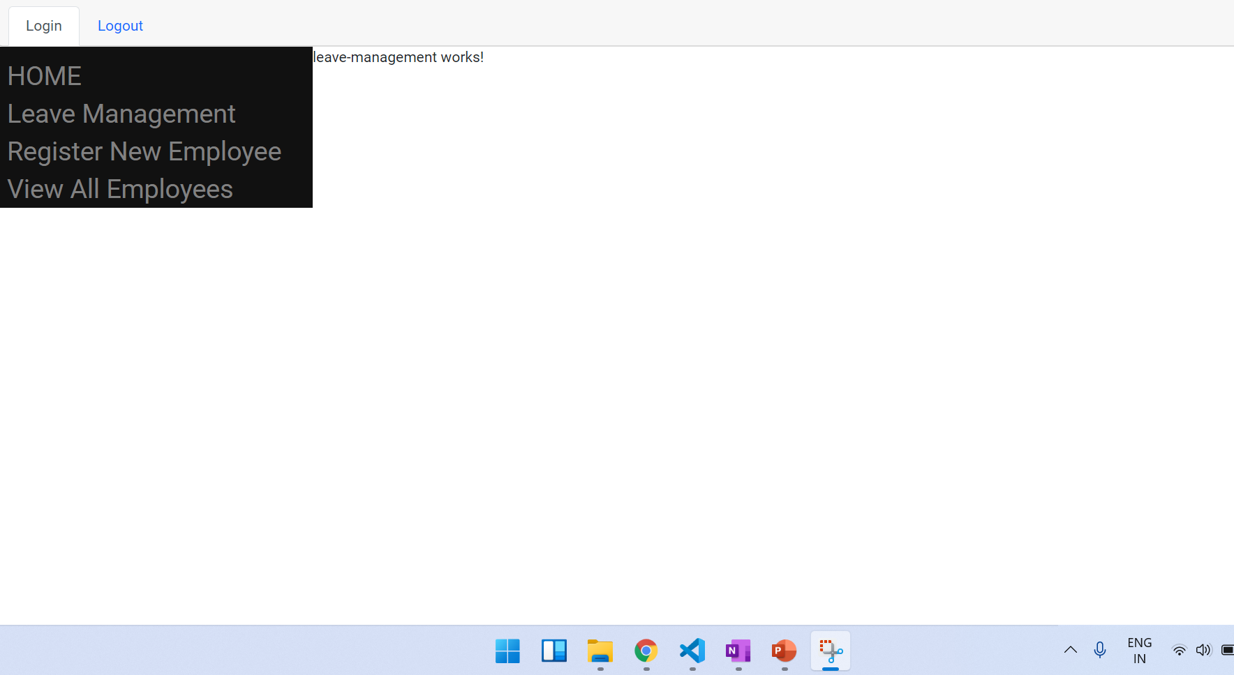
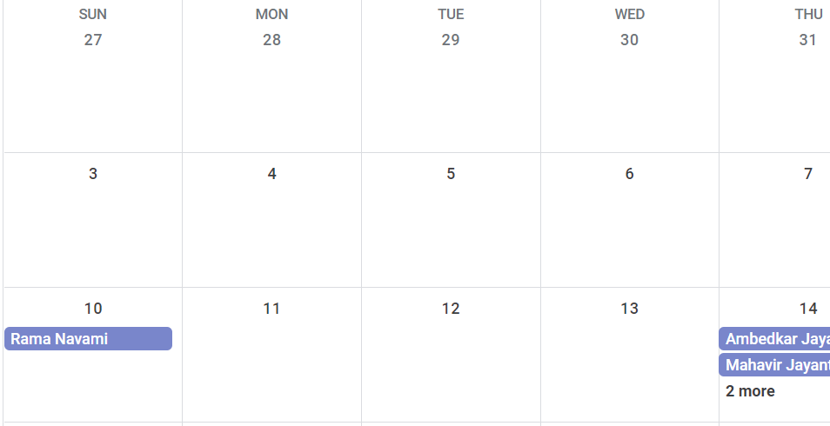
Insert Angular Calendar PlugIn
Text box, Click, Calendar POP UP
Text box, Click, Calendar POP UP
Display From Calendar here
Display TO Calendar here
Dropdown for Leave Type
SUBMIT

Slide 2
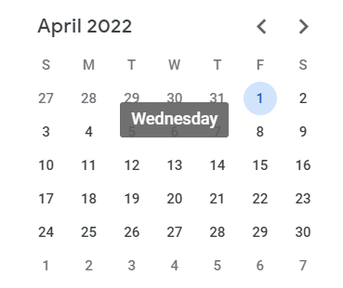
Apply LEAVE Button
Display balance.
Apply leave
Text box, Click, Calendar POP UP
Text box, Click, Calendar POP UP
Text box, Click, Calendar POP UP
Display From Calendar here
Display TO Calendar here
Dropdown for Leave Type
SUBMIT

Slide 3

Create NEW Model for LeaveManagement.
fields in Backend
Owner – Many to ONE – USERS.
Leave_type – Integer Field.
From Date
To Date – Datefeild
Leave applied on – Date field – DateTime now
Create NEW Model for LEAVE TYPE
KEY
VALUE – Personal, Casual, etc
Display Name – Pers LEAVE, Cas LEAVE, etc
Create NEW Model for LEAVE BALANCE
Owner – Many to ONE – USERS.
Personal – Integer Field(default value)
Casual -
…..
….
…..
Update This table every time a Leave is applied.

Slide 4
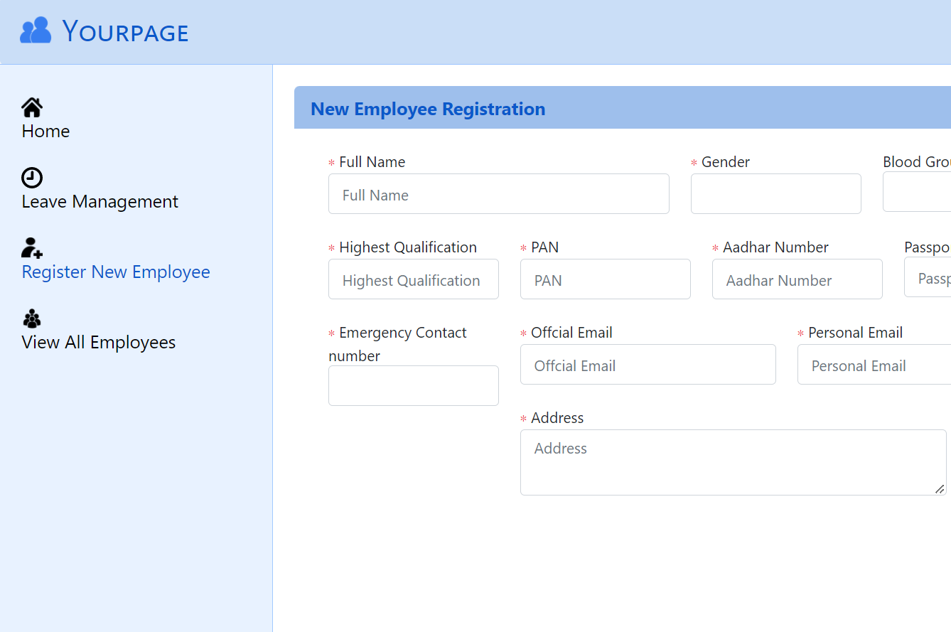

16 hours
Remove Register New Employee from the sidebar component.
Rename View ALL Employees as Employee management.
Introduce a button to add a new Employee under this Menu

Slide 5
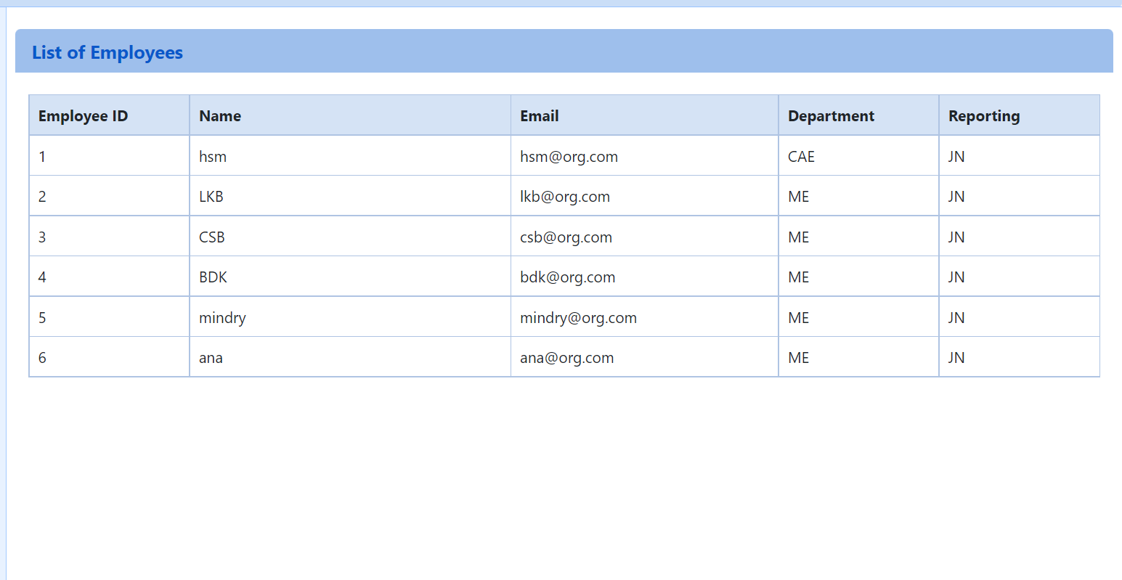
On Click ADD EMPLOYEE Button, form should popup
ADD EMPLOYEE

Slide 6
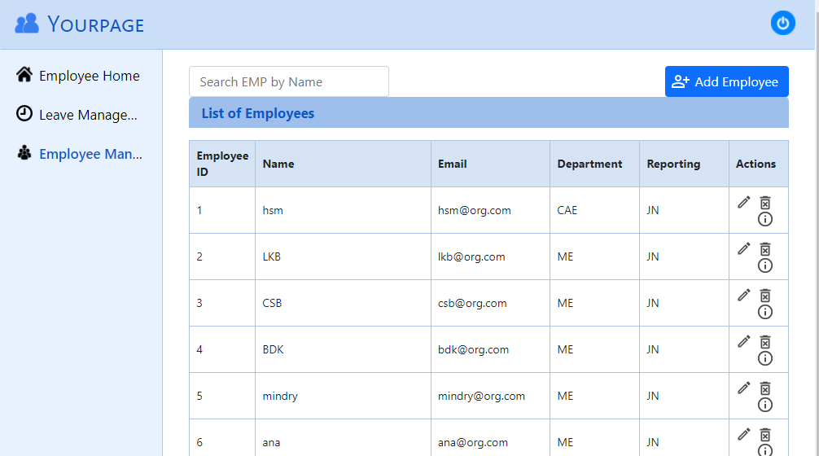
Search by Emp ID
Search by Name
Search by EMail
Search Dropdown for Department & Reporting
SELECT distinct department FROM your_project.employees_employeeregistration;
SELECT distinct reporting FROM your_project.employees_employeeregistration where reporting != "";

Slide 7
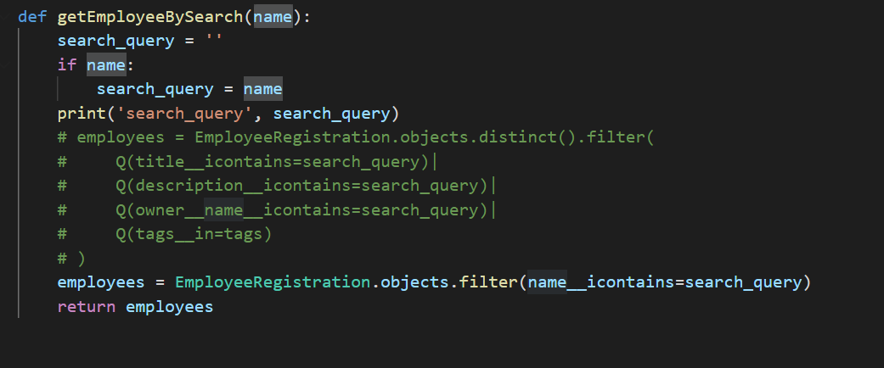
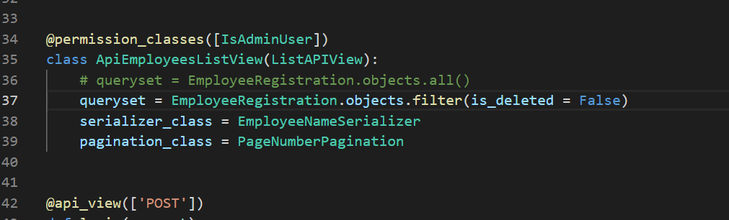
Request should be an object instead of a single name
Build a query which can be either any one filed or set of fields.
SELECT distinct department FROM your_project.employees_employeeregistration;
SELECT distinct reporting FROM your_project.employees_employeeregistration where reporting != "";
Link these two

