Slide 1

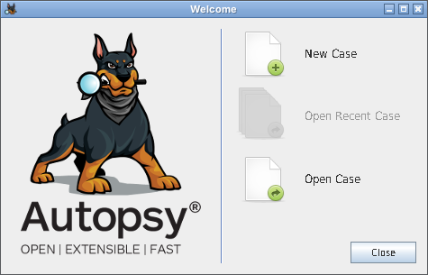
DIGITAL FORENSICS TOOL DEMONSTRATION
Autopsy
Storage Drive Evidence Analysis
Team 1 · Gautham (1MS23EC040) · Archana (1MS24EC400)
Introduction to Digital Forensics (23CIOE09) · 27 Oct 2026
Faculty: Dr. Rajeshwari S B · Ramaiah Institute of Technology
Notes:
Introduce the team and the tool. Autopsy is the first tool in the schedule, so we set the stage: it's the open-source standard for disk and storage-drive forensics. Today we analyse a seized USB pen drive image live.

Slide 2
What is Autopsy?
Open-source digital forensics platform — a GUI on top of The Sleuth Kit (TSK)
Maintained by Sleuth Kit Labs; created by Brian Carrier
Runs on Windows (MSI), Linux and macOS; written in Java
Reads raw/dd, E01, VHD, VMDK images, physical disks and logical files
File systems: NTFS, FAT, exFAT, ext2/3/4, HFS+, APFS, ISO 9660
Never writes to the evidence — everything lives in a separate case folder
Free
open source, Apache 2.0
4.23.1
latest release (2026)
20+
built-in ingest modules
Notes:
Key point: Autopsy is the graphical front-end; the heavy lifting of parsing file systems is done by The Sleuth Kit. Because it's open source, results can be independently verified — important in court. Latest version 4.23.1; 4.23.0 (April 2026) added an MCP server for AI-assisted summaries.

Slide 3
How an Autopsy investigation flows
1
2
3
4
5
6
Case
Data source
Ingest modules
Blackboard
Review
Report
folder + database
disk image, read-only
automatic analysis
results stored
tree, timeline, search
HTML / Excel / KML
Ingest modules we use today
File Type Identification
Extension Mismatch Detector
Embedded File Extractor
Picture Analyzer (EXIF)
Keyword Search
PhotoRec Carver
Data Source Integrity
Notes:
Walk the pipeline: we create a case, add the image read-only, ingest modules run in parallel and post findings to the blackboard, then we review and report. The modules in the chips are exactly the ones we enable in the live demo.

Slide 4






Where Autopsy is used
Law enforcement
Corporate / insider threat
Incident response
Seized PCs, drives and memory cards
IP theft and data-leak cases
Triage of compromised hosts
Media & geolocation
Mobile artifacts
Education & training
EXIF, GPS, camera details
Android / iOS extractions
Free, standard workflow
Notes:
Our scenario sits in the corporate / insider-threat box: an employee suspected of leaking a confidential design.

Slide 5



Installing Autopsy
Windows (easiest)
Linux (Ubuntu)
Download the 64-bit MSI from autopsy.com
Run as administrator → Install
Java and Sleuth Kit are bundled
Launch → Welcome screen → New Case
Quick: sudo snap install autopsy
Latest: install Java 21 + Sleuth Kit 4.15
Run install_application.sh with the ZIP
Start ~/autopsy/bin/autopsy
Gotchas we hit on Linux: 4.23.1 needs Java 21 (Java 17 fails with UnsupportedClassVersionError); untick the Windows-only aLEAPP, iLEAPP and YARA modules or ingest won't start.
Notes:
On Windows it's a one-click MSI. On Linux the snap is quickest; the official ZIP gives the latest version but needs Java 21 and The Sleuth Kit. Mention the two real issues we ran into while preparing.

Slide 6

The case: Project Falcon leak
A (fictional) employee is suspected of leaking a confidential drone design to a competitor. A USB pen drive was seized and imaged.
Evidence: USB_Evidence_RM01.dd · 64 MB · FAT32
MD5: bacea5569e56c15fd14d6a4f7023c006
Notes:
Set up the story. Questions to answer: Is Falcon material on the drive, including hidden or deleted files? Who was it going to? When and where did it happen? All names and domains are fictional; .test is a reserved domain.

Slide 7
Three questions the drive must answer
Q1
Q2
Q3
What Falcon material is on the drive?
Who was it going to?
When and where did it happen?
Including anything deleted, renamed or compressed
Any contact, address or plan linking it to an outsider
Timestamps, photo metadata, sequence of events
Answers on the last slide.
Notes:
These three questions drive the whole demo. Every finding we show answers one of them; the conclusion slide gives the answers.

Slide 8
Live demo: what we will do
1
Create case
2
Add image
3
Keyword list
case number + examiner
IST time zone + MD5/SHA-256
falcon · confidential · transfer
4
Run ingest
5
Review results
6
Timeline + report
7 modules, ~30 seconds
deleted, mismatch, hits, EXIF
sequence of events, HTML
Case: RIT-DF-2026-01_Falcon_Leak
Image MD5: bacea5569e56c15fd14d6a4f7023c006
Keyword list: Falcon_Case = falcon, confidential, transfer (substring)
E-mail regex: [a-z0-9._%+-]+@[a-z0-9.-]+\.[a-z]{2,}
Notes:
DEMO SCRIPT: 1) Case → New Case, name RIT-DF-2026-01_Falcon_Leak, number RIT-DF-2026-01, examiners. 2) Add Data Source → Disk Image or VM File → USB_Evidence_RM01.dd, time zone Asia/Calcutta, paste MD5 bacea5569e56c15fd14d6a4f7023c006. 3) Ingest screen → Keyword Search → Global Settings → New List 'Falcon_Case' → New Keywords falcon / confidential / transfer as Substring Match. 4) Tick the modules and Finish. Ingest takes under a minute on this 64 MB image. Backup plan if anything fails live: use the screenshots on the next slides.

Slide 9
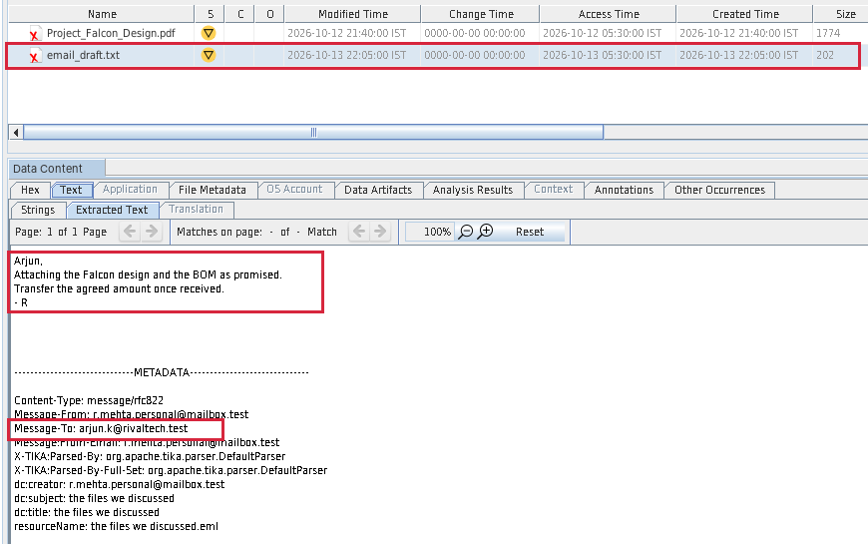
Deleted files are not gone
Q1
DELETED · RECOVERED
Deleted Files lists 2 files marked with a red X
email_draft.txt: “Attaching the Falcon design and the BOM… transfer the agreed amount”
Addressed to arjun.k@rivaltech.test
FAT only marks the entry deleted — data stays until overwritten
Notes:
Click File Views → Deleted Files → File System. Select email_draft.txt and show the Text tab. Then select Project_Falcon_Design.pdf — 'CONFIDENTIAL – NEXORA LABS'. PhotoRec also carved a second copy of the PDF under $CarvedFiles.

Slide 10
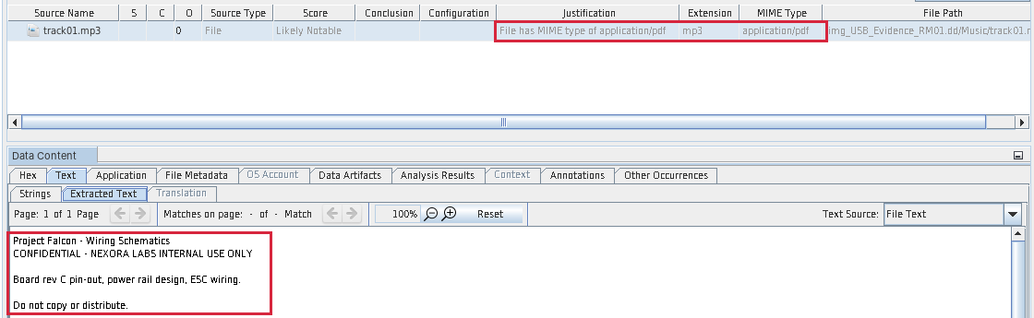
A PDF pretending to be music
Q1
DISGUISED FILE
track01.mp3 flagged Likely Notable
Detected MIME type: application/pdf
Content: Project Falcon – Wiring Schematics
Type comes from the file signature (%PDF), not the extension
Notes:
Analysis Results → Extension Mismatch Detected. Explain file signatures / magic bytes: Autopsy identifies type from content, not the extension. Optional: open the Hex tab to show %PDF at offset 0.

Slide 11
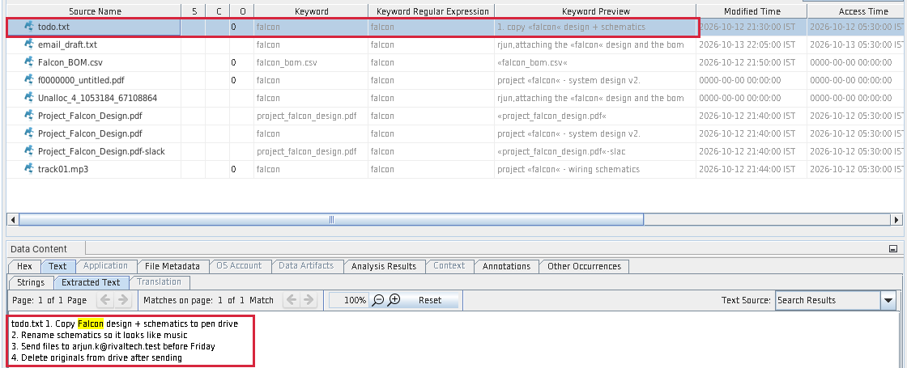
Keyword search connects the dots
Q2
14 KEYWORD HITS
falcon (9), confidential (3), transfer (2)
Hits inside the deleted draft, the ZIP, file slack and unallocated space
todo.txt is the plan: copy → rename → send → delete
Notes:
Analysis Results → Keyword Hits → Falcon_Case → falcon. Select todo.txt — the highlighted hit shows the 4-step plan.

Slide 12
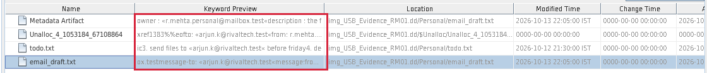
A regex finds who it was going to
Q2
E-MAIL ADDRESSES
Pattern: [a-z0-9._%+-]+@[a-z0-9.-]+\.[a-z]{2,}
Recipient: arjun.k@rivaltech.test
Sender: r.mehta.personal@mailbox.test
Found in todo.txt, the deleted draft and unallocated space
Notes:
Toolbar Keyword Search box → Regular Expression → paste the pattern → Search. The built-in Email Addresses list ignores the reserved .test domain, which is why a custom regex is used.

Slide 13
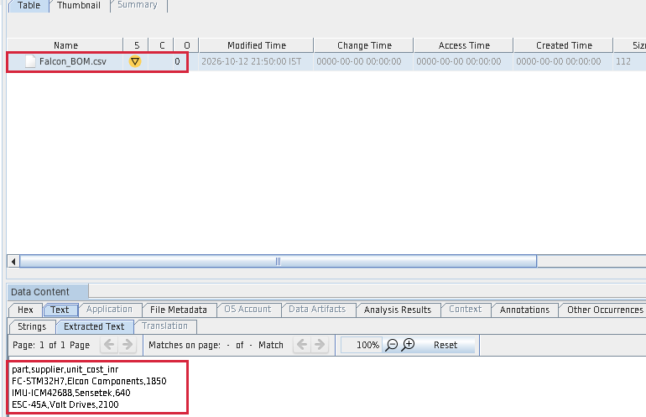
Photos and archives tell more
Q3
EXIF + GPS
Samsung Galaxy S23 photos
11 Oct 18:02 — whiteboard of the Falcon design (12.97 N, 77.59 E)
13 Oct 17:30 — café in Indiranagar, hours before the e-mail
ZIP UNPACKED
backup_oct.zip → Falcon_BOM.csv: parts, suppliers, costs
Notes:
Analysis Results → EXIF Metadata. Point to date, latitude and longitude. If internet is available, click Geolocation to show both pins on the map. Then Data Sources → Archive → backup_oct.zip to show the extracted CSV.

Slide 14
Three days, in order
Q3
18:02
Whiteboard photo of the Falcon design
21:40
Design PDF copied
21:52
BOM zipped into backup_oct.zip
22:05
E-mail draft to the rival
11 Oct
12 Oct
13 Oct
21:30
todo.txt — the plan
21:44
Schematics saved as track01.mp3
17:30
Café photo, Indiranagar
Built from Autopsy’s Timeline (List view, 37 events): file-system times plus EXIF capture times. After this the PDF and e-mail were deleted.
Notes:
DEMO: Toolbar → Timeline → List view and scroll 11 → 13 Oct, then come back to this slide to tell the story. FAT stores only the access date, which is why access events show 05:30 IST. The 23 Oct entries in Autopsy are the folder entries created when we prepared the image.

Slide 15
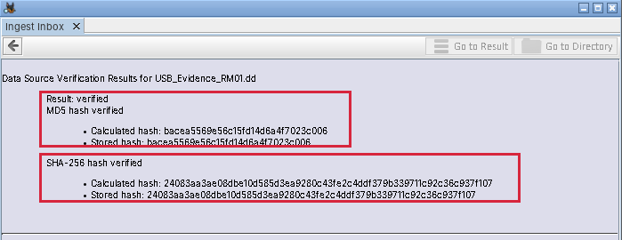
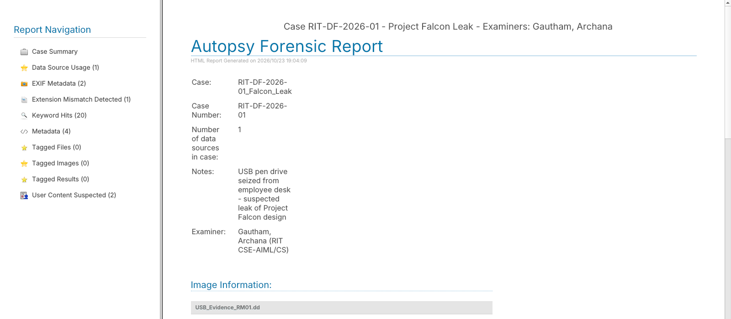


Proving integrity and reporting
Hashes verified. Autopsy recomputed MD5 and SHA-256 — both match the acquisition values, so the evidence is unchanged.
One-click report. Generate Report → HTML gives the case summary and every result category for the case file.
Notes:
Envelope icon (Ingest Inbox) → 'Integrity of USB_Evidence_RM01.dd verified'. Then Generate Report → HTML Report → All Results → open report.html in the browser.

Slide 16
What the drive told us
Q1
Falcon design (deleted), wiring schematics (disguised as MP3) and parts list (inside a ZIP).
Q2
arjun.k@rivaltech.test at a rival firm, in return for “the agreed amount”.
Q3
11–13 Oct 2026 in Bengaluru; the café photo and the e-mail draft fall on the same evening.
Evidence integrity proved with matching MD5 and SHA-256 hashes.
Thank you — questions?
Notes:
Answer the three questions from the start of the case. One 64 MB image and under a minute of ingest answered all three while keeping evidence integrity provable. Likely questions: How is deleted data recovered? (FAT directory entry marked 0xE5; clusters not wiped). Can Autopsy recover overwritten data? (No.) Recovery vs carving? (Carving uses file signatures in unallocated space without metadata — PhotoRec.)

