Slide 1
DATA 608 – Developing Big Data Applications
Project: Stock Market Data Analysis
Gautham Nagaraj
Franco Ken Doi
17/07/2025 – Winter 2025

Slide 2
Introduction
Stock market movements are volatile and can be difficult to predict
The aim of the project is to analyze real-time data analysis using technologies like Kafka, AWS and Python
The data used here will be simulated through Python to mimic stock market data flow

Slide 3
Methodology
Kafka Setup – Installing and configuring on an EC2 instance
Python – Interact with the Kafka stream
Data Streaming Pipeline – Develop a data pipeline and store the data in AWS S3
Real-Time data analysis – Analyze the ‘live data’ to gain insights into market trends and patterns
Application development – Combine the components to build an application for gathering insights from the data

Slide 4
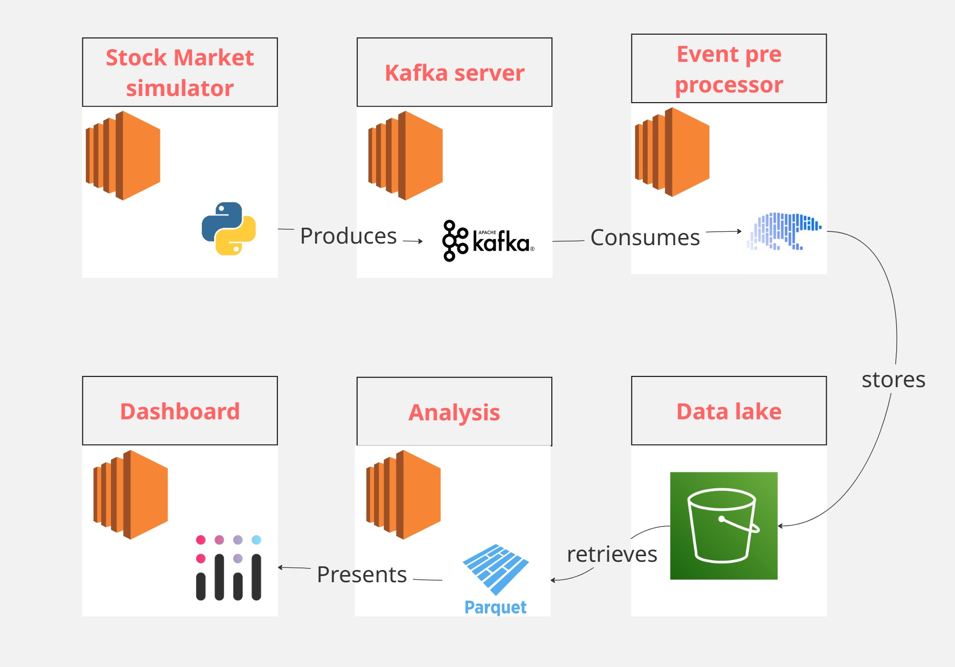
Methodology Visualized

Slide 5
Further development
The image from the previous slide depicts the initial workflow of the project
Usage of technology can vary based on feedback/suggestions

