Slide 1
IMARTICUS LEARNING
KPMG
DATA SCIENCE PRODEGREE CAPSTONE PROJECT
WIN PREDICTION ANALYTICS
ARUN KUMAR
DEEPALI SINGH
GAUTHAM R
MANOJ SAHU
NEHA PURANIK

Slide 2
TABLE OF CONTENTS
1 | PROBLEMS AND OBJECTIVES
2 | UNDERSTANDING DATA
3 | EDA
4 | DATA VISUALIZATION
5 | DATA CLEANING
6 | MODEL BUILDING
7 | TESTING AND CROSS-VALIDATION
8 | RECOMMENDATIONS
9 | INSIGHTS INTO DATA
10 | CONCLUSION
Tableau
Python
SQL

Slide 3
PROBLEM STATEMENT AND OBJECTIVES
To predict the probability of Winning a Deal.
The engagement teams can prioritize the most attractive options and pipeline opportunities towards them.
By knowing in advance, Deal Engagement Manager can ensure the resources are available for the most profitable deals.
1:Predictive Analytics - Build a ML model to predict the probability of win/loss for bidding
activities for the potential client.
2:Prescriptive Analytics - Identify variable/s that are most likely to help in converting an
opportunity into a win.

Slide 4
UNDERSTANDING DATA
Features of the given Dataset :
Initial Lookup:
41 different Industries
67 types of Solutions
25 unique Sectors.
13 Locations.
43 Senior Managers.
278 Managers.
Dataset Contains
10,061 Rows x 9 Columns
Column Name | Description
Client Category | Industry in which the client works
Solution Type | The solution group the client requires
Deal Date | The date the opportunity was created
Sector | The sector for which the solution is to be provided
Location | Client location
VP Name | Sr. Manager or VP who is dealing with the client
Manager Name | Manager of the team working on the project
Deal Cost | The initial cost of the deal
Deal Status Code | Final status of the deal (Won/Lost)

Slide 5
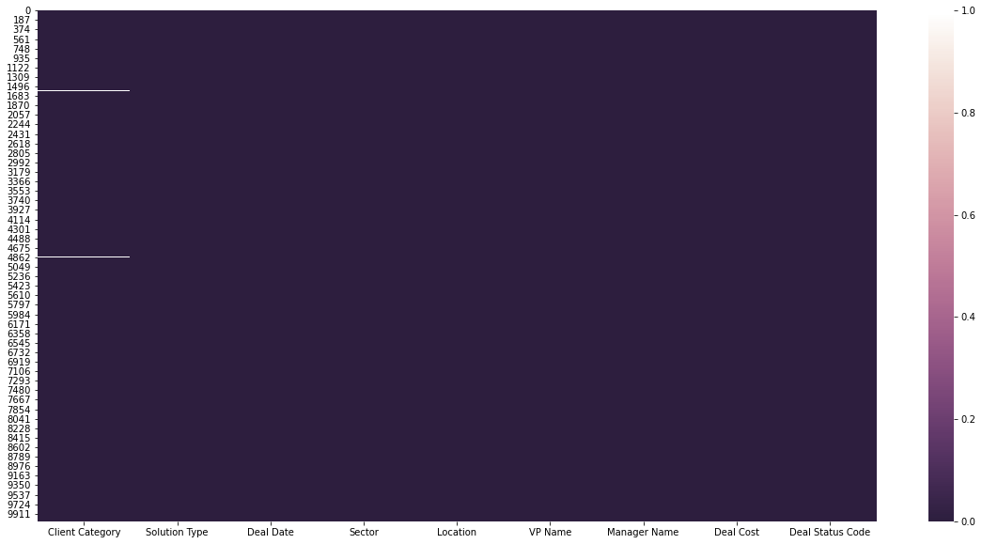
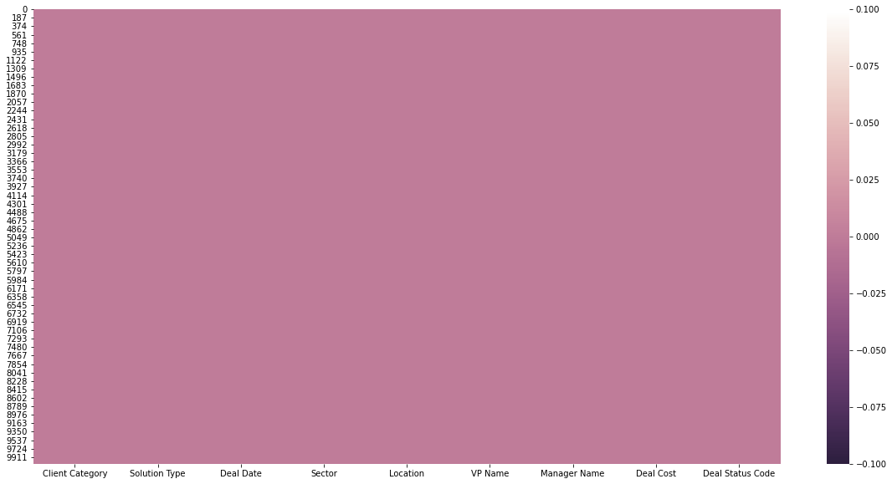
EXPLORATORY DATA ANALYSIS
Missing Value Treatment
The Client Category contained 79 missing values, for which the categories mode value was chosen for replacement.
Heatmap of the Dataset
Before
After

Slide 6
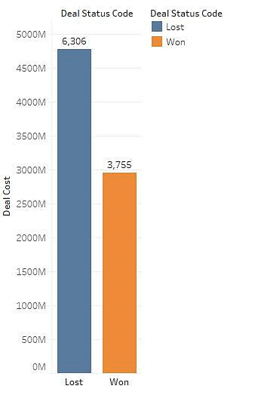
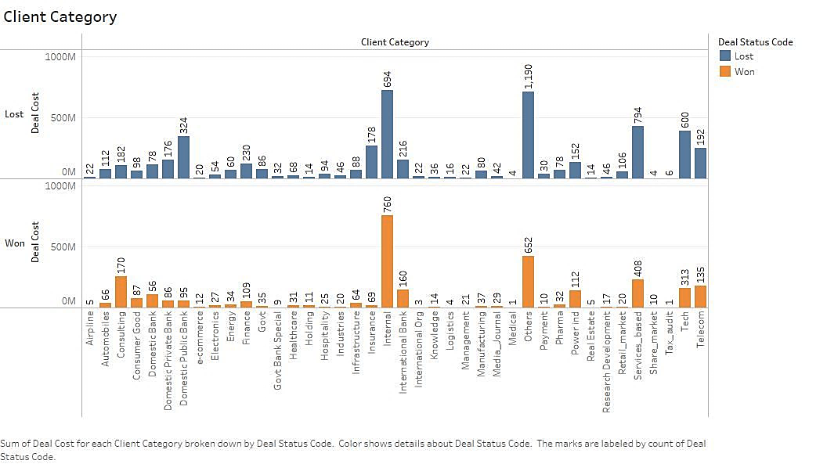
DATA VISUALIZATION
Deal Status Code
Client Category
62.8% -Lost
37.2% -Won
Internal
Others
Services_based

Slide 7
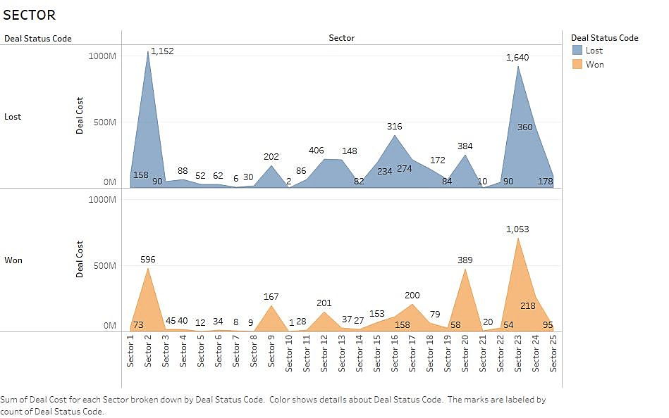
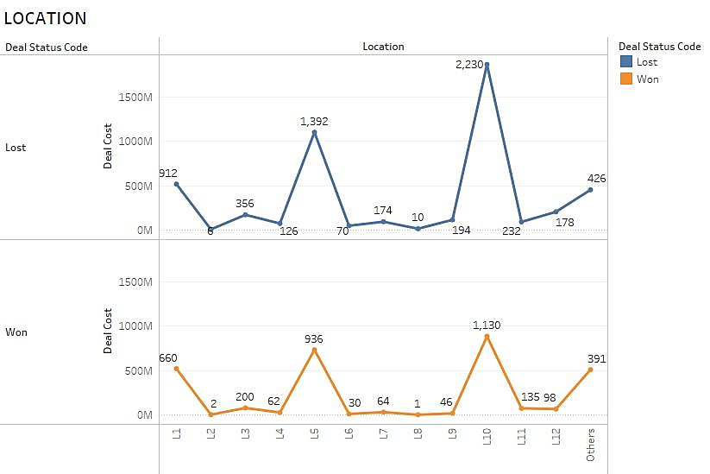
DATA VISUALIZATION
Sector
Location
Sector 23
Sector 2
Sector 20
Location 10
Location 5
Location 1

Slide 8
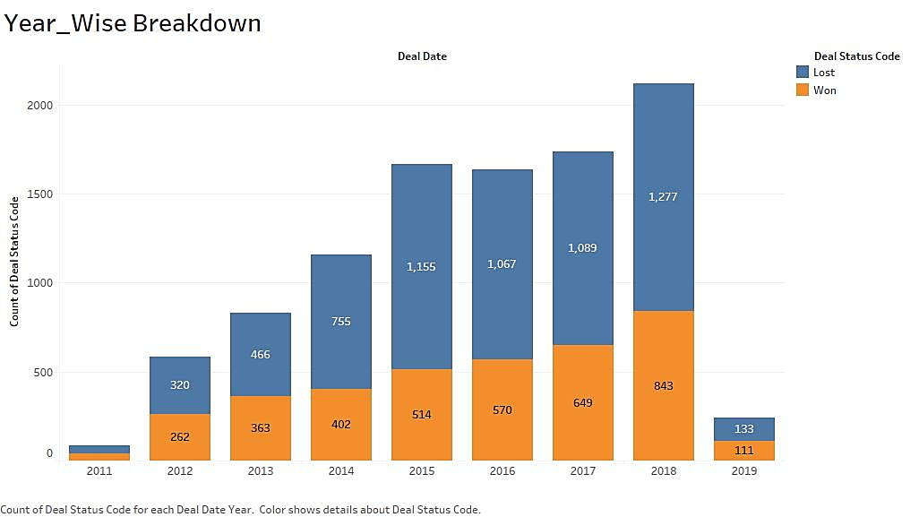
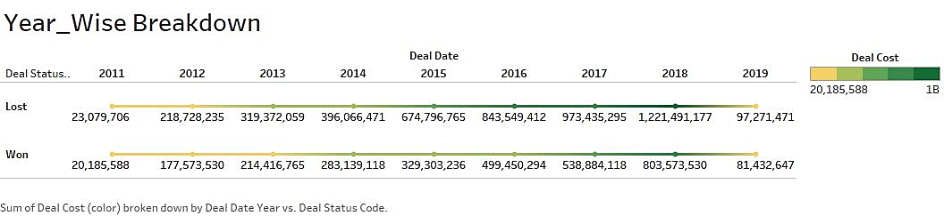
DATA VISUALIZATION
Deal Date
2018- Good Year!
2018- Good Year!

Slide 9
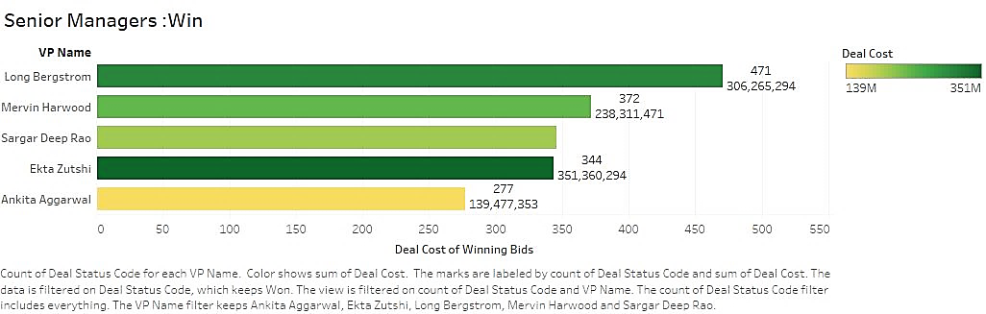
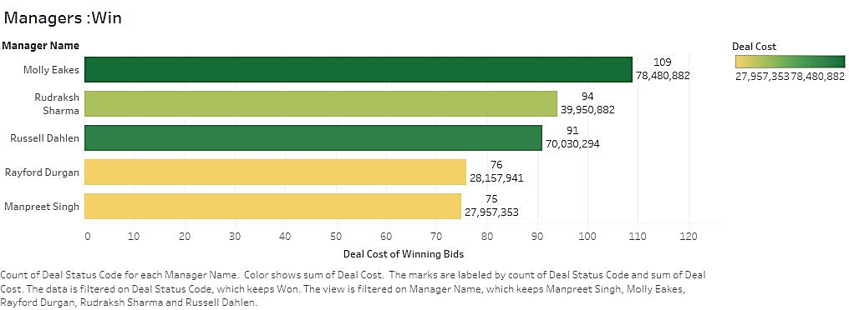
DATA VISUALIZATION
Manager
Vp / Senior Manager
Highest
Bids Won!
Highest
Bids Won!

Slide 10
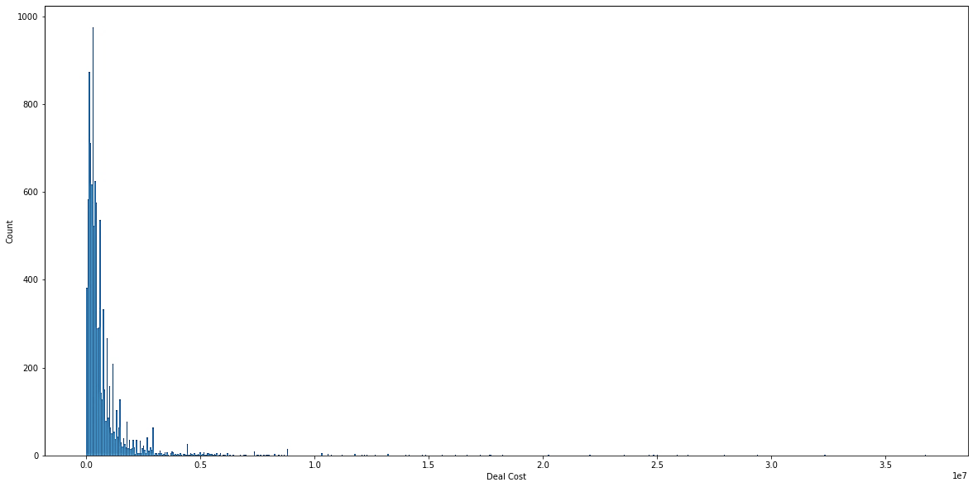
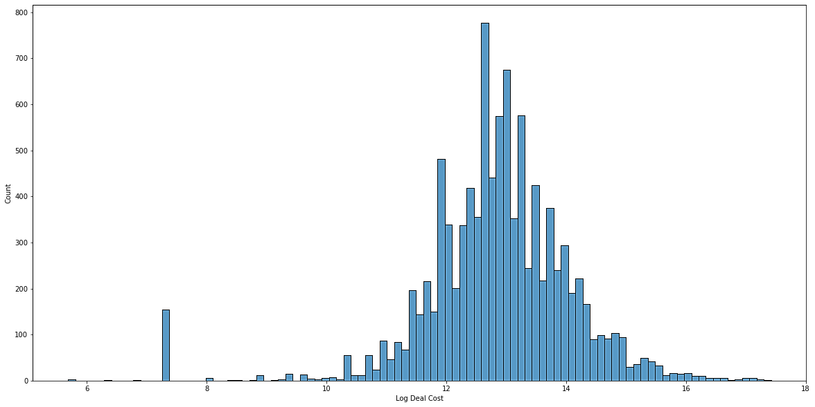
DATA CLEANING
Handling Skewed data: Deal Cost
The Deal Cost column consisted of 246 zero values, which was treated by replacing them with median value. (3,82,352.9)
The Deal Cost was Right Skewed, thus the Log Value of Deal Cost column was preferred for
normalizing the data.
After
Before

Slide 11
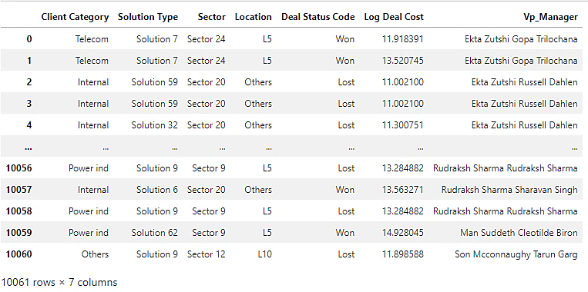
DATA CLEANING
Dropping Columns: Deal Date, Deal Cost, VP Name, Manager Name
Since the Target was to obtain the Best bidding pairs of VP & Managers the respective columns were merged into single column and the previous ones removed.
Deal Date is dropped, as it does not serve valued purpose in model building.
Deal Cost is dropped, as the Log value of it is considered. Thus dataset finally looks like:
Sample!

Slide 12
MODEL BUILDING
Feature Engineering
Trial Phase - I
All Categorical data was replaced using Dummy Variables(pandas) Data set was split into Train and Test at 70:30 ratio.
Trial Phase - II
Categorical data values were replaced with Dummy Variable Creation. Tree- Based Feature Selection was used to shortlist top features in the dataset. Data set was split into Train and Test at 70:30 ratio.
Final Approach
Categorical data was numerated using Target Encoding method. All the features in the data set was retained to get the best output. Data set was split into Train and Test at 70:30 ratio.
From 1094 to 229!

Slide 13
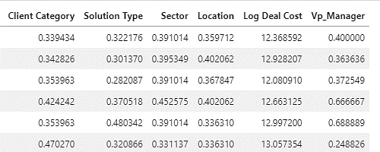
MODEL BUILDING
The Final dataset for Model Building is completely converted from Categorical dataset into numerical form.
Final
Sample!
The dataset was split into 70:30 as Train: Test respectively, having 6 variable features.
Train set has 7042 rows.
Test set has 3019 rows.

Slide 14
TESTING AND CROSS-VALIDATION
Predictive Analytics
Each Model Creation process involved Prediction and Fit of the Model and generation of Confusion matrix of the same along with plotting of a ROC-AUC curve.
Some models were tuned based on Hyper-Parametric Tuning Process.
True Loss is calculated based on the value of Revenue Lost when a Deal is Predicted as False-Negative.

Slide 15
TESTING AND CROSS-VALIDATION
Predictive Analytics
*Weighted
Average!
**M USD
Model Name | Precision* | Recall* | Accuracy | Roc-Auc | True-Loss**
Logistic Regression | 0.73 | 0.73 | 0.73 | 0.80 | 3.99 x 10⁶
Decision Tree | 0.82 | 0.82 | 0.82 | 0.99 | 2.676 x 10⁶
Random Forest | 0.83 | 0.83 | 0.83 | 0.99 | 2.654 x 10⁶
XgBoost | 0.81 | 0.81 | 0.81 | 0.97 | 2.689 x 10⁶
Best
Model!

Slide 16
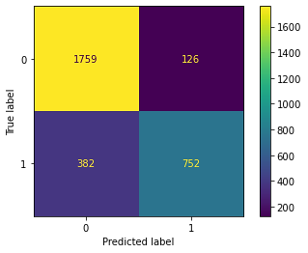
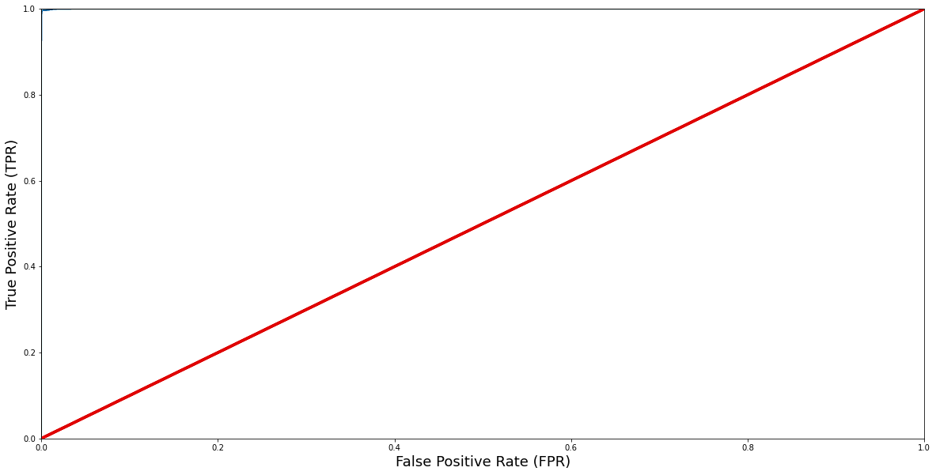
TESTING AND CROSS-VALIDATION
Random Forest
The Confusion matrix yielded for Random Forest
0’s Predicted = 1759
1’s Predicted = 752
The Roc_Auc Curve is scored at 99.9%

Slide 17
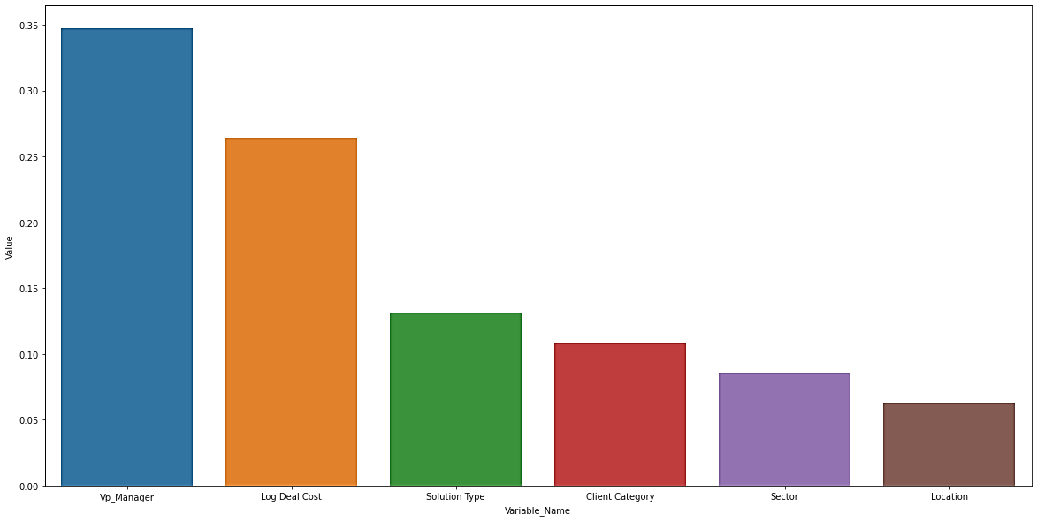
RECOMMENDATIONS
Prescriptive Analytics
The important variables in the dataset that most likely help in converting an opportunity into a win (based on it’s Feature Importance).
VP_Manager (.34)
Deal Cost (.26)
Solution (.13)
Client (.10)
Sector (.08)
Location (.06)

Slide 18
RECOMMENDATIONS
Prescriptive Analytics
Top 5 Recommendation of VP and Manager is based on the following:
I ) Win % (Total deals won by pair/ Total deals done by pair)
II) Consistency (Total deals won by pair/ Total number of won deals)
III) Efficiency (Win% x Consistency)
Our recommendation is based on Efficiency, for unbiased selection over deals and win numbers and vice-versa.

Slide 19
RECOMMENDATIONS
Top 5 Recommendation of VP and Manager
Sr. No | VP Name | Manager | Total Deals | Total Wins | Win % | Consistency | Efficiency
1 | Long Bergstrom | Russell Dahlen | 105 | 75 | 71.42 | 0.01997 | 1.4266
2 | Ekta Zutshi | Neeraj Kumar | 46 | 40 | 86.95 | 0.01065 | 0.9263
3 | Neeraj Kumar | Vinay Kumar | 75 | 51 | 68 | 0.01358 | 0.9235
4 | Neeraj Kumar | Molly Eakes | 144 | 62 | 43.05 | 0.01651 | 0.7109
5 | Rahul Bajpai | Rudraksh Sharma | 198 | 72 | 36.36 | 0.01917 | 0.6972

Slide 20
INSIGHTS INTO DATA
Bonus: Suggestions for better Decisions …
The Deals bid by the Company are in majority under 2 M USD(approx. 9000 bids).
Hence, we recommend Top 3 Performing Senior Manager’s and Manager’s bidding under 2Mil.
Senior Manager’s:
Long Bergstrom
Ekta Zutshi
Sagardeep Rao
Manager’s:
Rayford Durgan
Molly Eakes
Rudraksh Sharma

Slide 21
CONCLUSION
Corporate project bids are a valuable part for functioning of the business.
Our ML model assists in predicting the win or loss of a bid, for a potential client.
From our Analysis, the VP and Manager partnership form a significant influence over the probability of deal to win/lose, followed by Deal Cost and the rest of the variables forming minimal significance.
Thus it is imperative for the Organization to staff VP and Manager’s with higher efficiency to deals which pose higher significance.
Further, the Organization can capture the feedback behind a Win/Loss of a bid, thus enabling us to analyze the reasons for a bid’s success/ failure, and thereby helping the organization enhance its chances.

Slide 22
THE END !!!
THANK YOU

