Slide 1
Veltris Vehicle Shipment
Cost Modeling
Data Preprocessing • Feature Reduction • EDA • Predictive Modeling
Dataset: Veltris-Vehicle.xlsx | Target: TotalCost (USD) | 2026-08-29

Slide 2
Executive Summary
305,838 raw shipments → 24 predictive features → 18 models compared
83%
0.947
$86
18
dimensionality reduction
(145 → 24 features)
best test R²
(Overall, XGBoost)
MAE on Overall model
(XGBoost, raw target)
models trained & SHAP-explained
(3 algorithms x 2 transforms x 3 segments)
The best model (XGBoost, raw target) explains 94.7% of cost variance overall and 94.9% for the Turvo segment. Historical lane cost and physical distance are the strongest, most consistent drivers of cost across correlation, Boruta and SHAP analysis. A key data-quality finding — the entire Magnus segment is lost under simple missing-value deletion — was solved with a dedicated imputation pipeline.
2

Slide 3
Data Overview
One raw file, two carrier-sourcing segments
Attribute | Value
Source file | Veltris-Vehicle.xlsx (single sheet 'result')
Raw rows / columns | 305,838 rows x 145 columns
Target variable | TotalCost (USD)
Segments (SourceName) | Turvo: 287,860 rows (94.1%) | Magnus: 17,978 rows (5.9%)
Feature domains present | Distance, Equipment, Fuel Price, Historical Lane Cost, Market Conditions, Seasonality, Carrier, Customer
94.1%
Turvo share
of shipments
5.9%
Magnus share
of shipments
145
raw attributes
per shipment
3

Slide 4
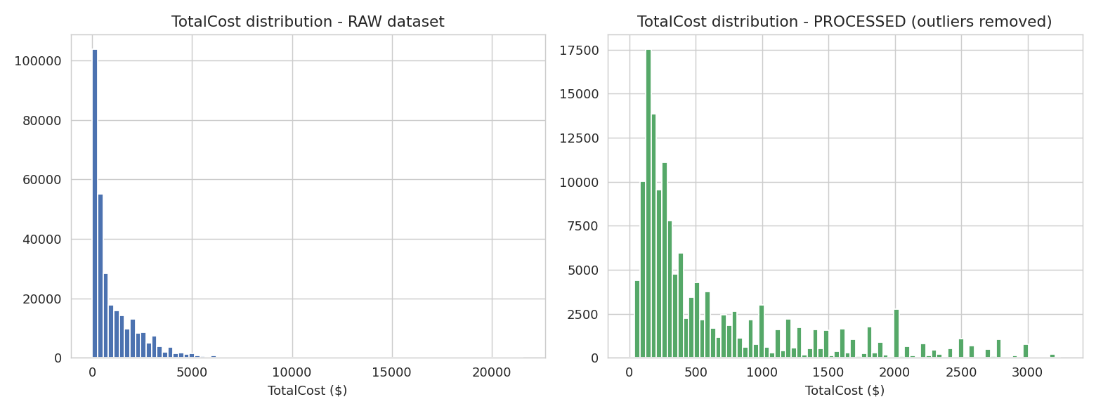
Data Preprocessing Pipeline
305,838 → 147,621 clean rows (Turvo); Magnus handled separately (see slide 9)
1. Drop unusable columns
2. Remove duplicates
3. Remove missing rows
4. Remove outliers
18 columns removed: >50% missing, target leakage,
high-cardinality IDs, redundant raw dates
→
115 exact-duplicate rows removed
→
133,030 rows (43.5%) dropped for missing values
in the retained columns
→
25,072 rows (14.5%) removed via 1.5x IQR rule on
TotalCost, TotalMiles, TotalWeight, HaversineMiles
Result: 147,621 rows x 127 columns (fully-observed, outlier-trimmed Turvo dataset)
4

Slide 5
Multicollinearity Reduction & Feature Selection
VIF (statistical redundancy) + Boruta (all-relevant importance)
Step 1 — VIF elimination
Step 2 — Boruta selection
120 numeric candidates (12 zero-variance columns dropped first)
Iteratively remove the highest-VIF feature until all VIF < 10
42 features removed — including TotalMiles itself (near-perfect collinearity with HaversineMiles)
66 numeric features survive
Random-Forest shadow-feature test on the 66 VIF survivors + 5 categorical features (71 candidates)
15 features Confirmed, 9 Tentative (kept), 47 Rejected as noise
Final reduced feature count: 24 — all numeric
83% reduction from the original 145 raw columns
5

Slide 6
Feature Groups
Every selected feature mapped to one of 8 business-meaningful groups
Distance
Historical Lane Cost
Equipment
Market Conditions
5 features
12 features
4 features
3 features
Physical geography of the move
What this lane has cost recently
Vehicle & trailer specifications
Macro & regional labor backdrop
Fuel Price
Seasonality
Carrier
Customer
0 selected*
0 selected*
0 selected*
0 selected*
Gas/diesel pass-through cost
Calendar & demand-cycle effects
Sourcing channel & operational flags
Origin/destination geography (categorical)
*Not selected by Boruta on this dataset in isolation, once Distance & Historical Lane Cost are known — still reported in the full EDA and available for future iterations.
6

Slide 7
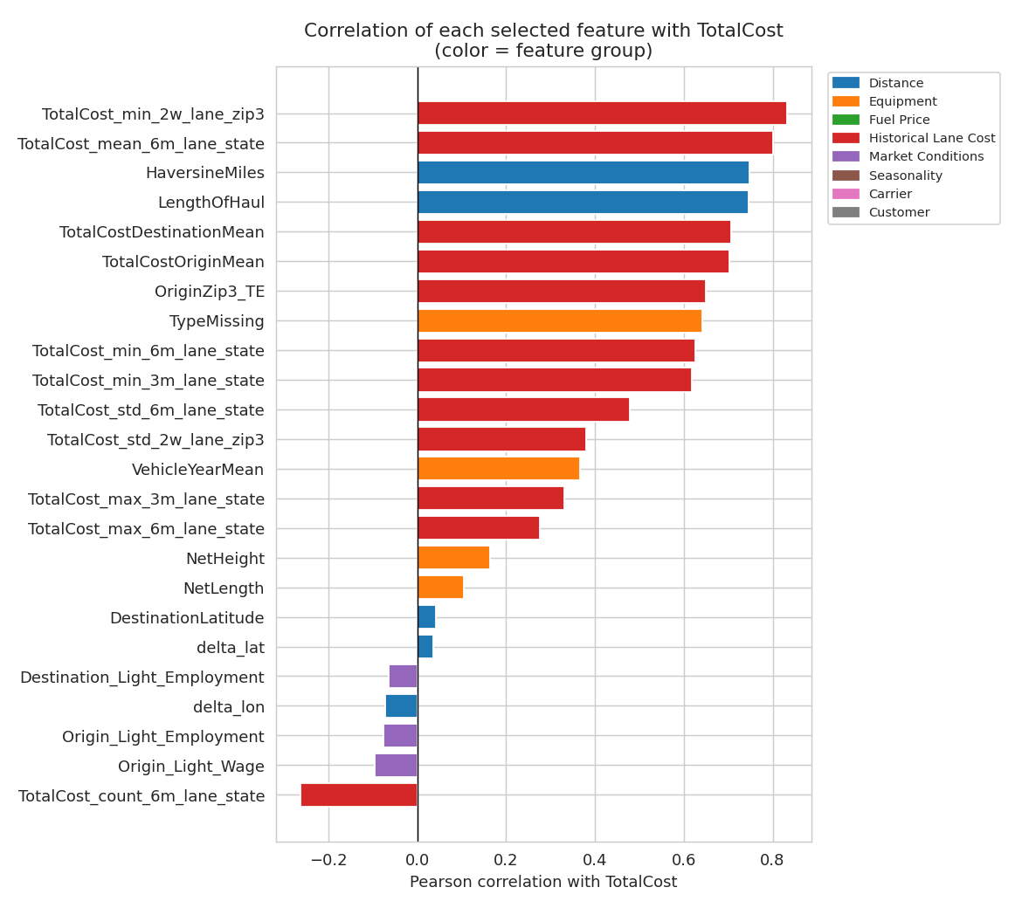
EDA: What Drives Shipment Cost
Correlation of each selected feature with TotalCost, by feature group
7

Slide 8
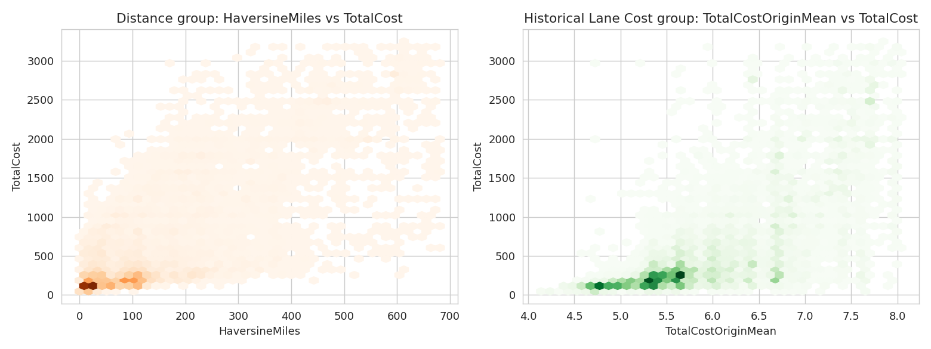
EDA: Top Feature Relationships
Distance and lane-history features show the clearest relationship with cost
8

Slide 9
The Magnus Imputation Problem
A data-quality finding that required a dedicated segment pipeline
⚠ Finding
Dataset | Rows | Notes
Turvo | 147,621 | Fully observed; no imputation needed
Magnus | 14,203 | 13 of 24 features imputed
Overall | 161,824 | Turvo + Magnus + segment indicator
Standard listwise deletion of missing values removes 100% of the Magnus segment. EquipmentType and Enclosed are never populated for Magnus shipments (100% missing), and several historical lane-cost fields are 17–34% missing specifically for Magnus.
✓ Solution
A dedicated Magnus pipeline applies the same cleaning logic but IMPUTES missing values (median for numeric, mode for categorical, fit on Magnus's own distribution) instead of dropping rows. 13 of 24 selected features required imputation.
9

Slide 10
Modeling Methodology
18 models: 3 algorithms x 2 target transforms x 3 segments
Split
80% train / 10% validation / 10% test, stratified by segment, fixed seed
Algorithms
XGBoost, LightGBM, CatBoost (400 trees, depth 6, lr 0.05, early stopping)
Target transform
Each algorithm trained on raw TotalCost AND log1p(TotalCost); log1p
predictions transformed back with expm1 before scoring for fair comparison
Explainability
SHAP TreeExplainer summary plots for all 18 models (500-row test sample)
Metrics
MAE, MAPE, RMSE, R² on held-out test data for every model
10

Slide 11
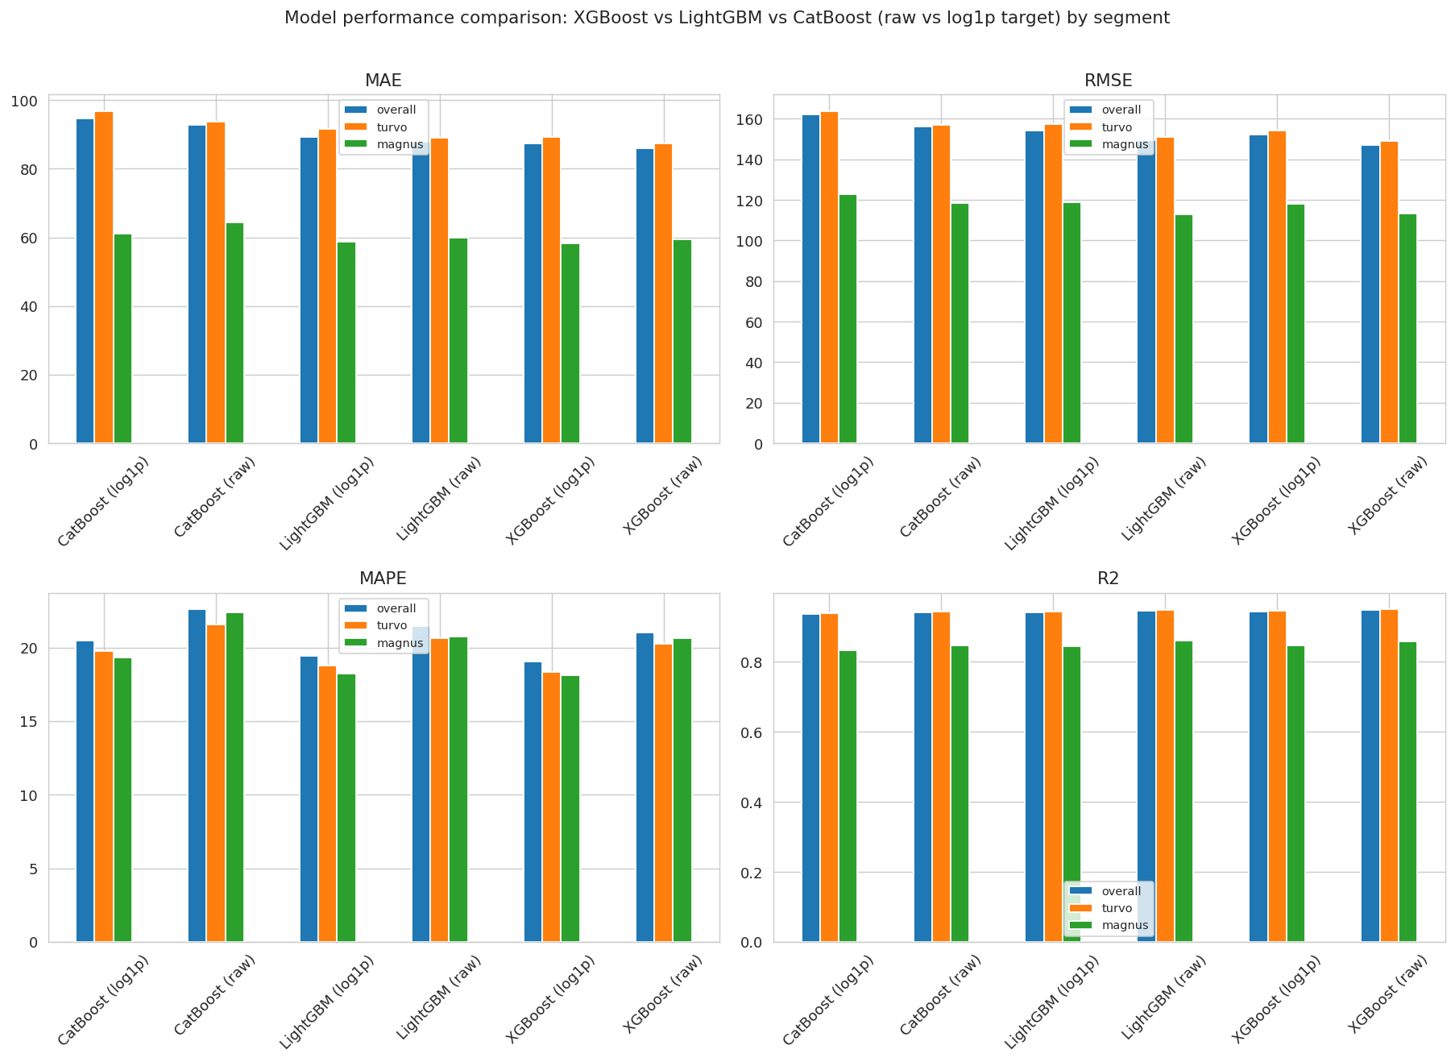
Model Performance Comparison
XGBoost (raw target) is the best model in every segment
Segment | Best Model | MAE | RMSE | MAPE | R²
Overall | XGBoost (raw) | $85.9 | $147.1 | 21.0% | 0.947
Turvo | XGBoost (raw) | $87.3 | $148.9 | 20.2% | 0.949
Magnus | LightGBM (raw) | $59.9 | $112.7 | 20.7% | 0.860
log1p transform: improves MAPE (−2pp avg) but worsens MAE/RMSE/R² — a business trade-off between percentage and dollar accuracy.
XGBoost > LightGBM > CatBoost consistently, though the XGBoost–LightGBM gap is small (<2 R² points).
11

Slide 12
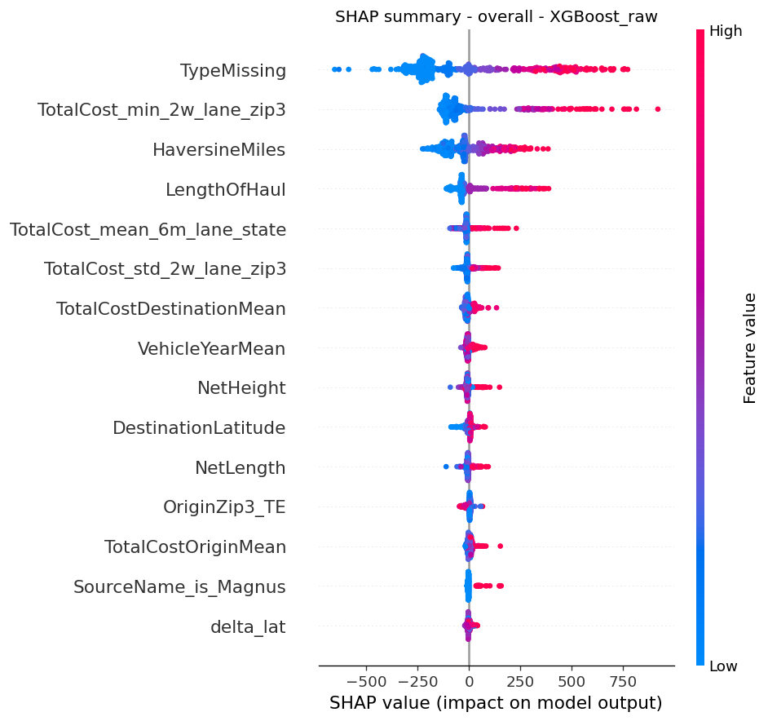
SHAP Explainability
Three independent methods agree: lane history & distance drive cost
Historical Lane Cost features (TotalCostOriginMean, TotalCostDestinationMean, TotalCost_mean_6m_lane_state, OriginZip3_TE) are consistently the top SHAP drivers
Distance features (HaversineMiles, LengthOfHaul) rank second across every one of the 18 models
This agrees with the Pearson-correlation EDA (slide 7) and the Boruta group composition (slide 6) — three independent methods, one consistent answer
Best overall model — SHAP summary
12

Slide 13
Recommendations & Next Steps
✓
Deploy
XGBoost on the raw target as the primary cost-prediction model (Overall scope); use Turvo/Magnus segment models where segment-level accuracy matters more than a unified pipeline
✓
Fix data capture
Populate EquipmentType/Enclosed for Magnus shipments — would remove the need for imputation and likely close part of the Turvo–Magnus R² gap
✓
Extend to the tail
Consider a hurdle or quantile-regression approach for the very-high-cost shipments removed by IQR outlier filtering, if the business needs those predictions too
✓
Retrain periodically
Historical Lane Cost features are rolling time windows and Market Conditions are macro series — both will drift and need refresh
13

