Slide 1
Clustering In Geo Social Networks
Done By
B.Gautham -181CO212
V.V.Sai Tarun -181CO257

Slide 2
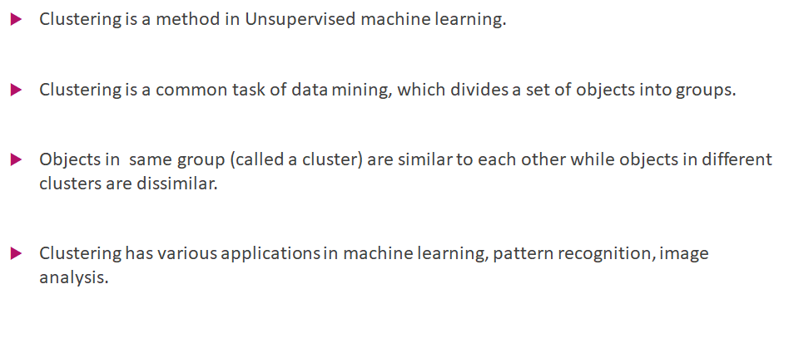
CLUSTERING:

Slide 3
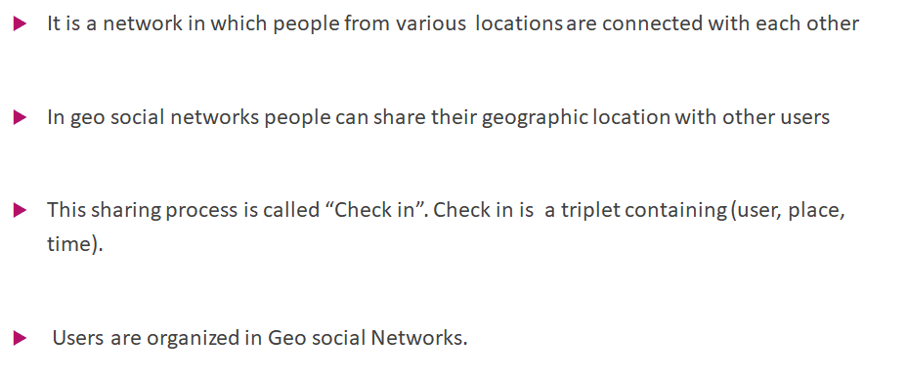
GEO SOCIAL NETWORKS:

Slide 4
Clustering In Geo Social Networks:
Clustering in Geo social networks is done based on the check in data for various places.
It is done using the DBSCAN(Density Based Spatial Clustering of Application with Noise) algorithm.
Spatial Clustering is done first based on the longitudes and latitudes of different places.
Later we are going to calculate social distance between every place in each clusters obtained.
Finally we are going to apply some constraints on social distance to obtain the final Geo Social Clusters.

Slide 5
DBSCAN :
Clusters are dense regions in the data space, separated by regions of the lower density of points. The DBSCAN algorithm is based on this intuitive notion of “clusters” and “noise”. The key idea is that for each point of a cluster, the neighborhood of a given radius has to contain at least a minimum number of points.
DBSCAN algorithm requires two parameters :
epsilon : It defines the neighborhood around a data point i.e. if the distance between two points is lower or equal to ‘eps’ then they are considered as neighbors.
MinPts: Minimum number of neighbors (data points) within eps radius. Larger the dataset, the larger value of MinPts must be chosen.

Slide 6
In this algorithm, we have 3 types of data points.
Core Point: A point is a core point if it has more than MinPts points within eps.
Border Point: A point which has fewer than MinPts within eps but it is in the neighborhood of a core point.
Noise or outlier: A point which is not a core point or border point.
DBSCAN Algorithm:
Find all the neighbor points within eps and identify the core points or visited with more than MinPts neighbors.
For each core point if it is not already assigned to a cluster, create a new cluster.
Find recursively all its density connected points and assign them to the same cluster as the core point. A point a and b are said to be density connected if there exist a point c which has a sufficient number of points in its neighbors and both the points a and b are within the eps distance. This is a chaining process. So, if b is neighbor of c, c is neighbor of d, d is neighbor of e, which in turn is neighbor of a implies that b is neighbor of a.
Iterate through the remaining unvisited points in the dataset. Those points that do not belong to any cluster are noise.

Slide 7
Approach:
First we have chosen a reference paper http://www.cs.uoi.gr/~nikos/TKDEGeosocialClustering.pdf
We get to know what is geo social clustering and terminologies related to the topic like social distance,spatial distance etc.. from the reference paper.
Unlike given in the reference paper we had done something different to cluster the places based on their social distance and spatial distance which will be discussed later.
Finally at last we will be able to find strong community of places at a given location based on their social distance.

Slide 8
Gathering the Data:
There are three main datasets for this project they are check-in data,User Friendship data and location data.
Check-in data will be having the attributes userid,placeid,date and time which gives the information when a particular user visits a particular place.
User Friendship data have only two attributes userid1,userid2 which helps to calculate the social distance between places.
Location data gives the longitude and latitudes of all the placeids which will be useful of initial place clustering.
We had cleaned the datasets and merge check-in data and Location data and had removed the duplicates to obtain the final required dataset.

Slide 9
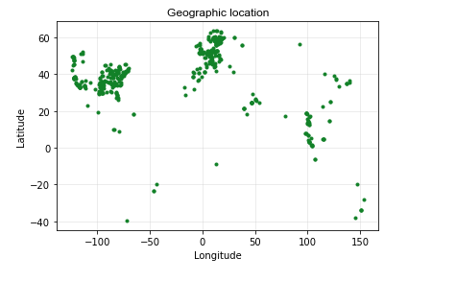
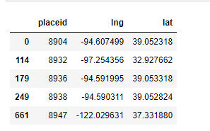
Final Dataset:
This is the graphical representation of the places based on latitudes and longitudes.(We had selected only 500 places for faster computation).

Slide 10
Place clustering Using DBSCAN:
After getting the final sample dataset we are going to find the clusters based on their spatial distance using their latitudes and longitudes.
For clustering we have used the DBSCAN model which is already there in the sklearn module with an epsilon value 0.25 and minimum points of 5 which is mentioned in the reference paper.
After applying the clustering model we get a clusters_df dataframe which contains all the clusters and outliers_df dataframe which contains all the outliers.
Now we are plotting the graph using the two dataframes we have obtained and model.labels which will obtained from the DBSCAN model.

Slide 11
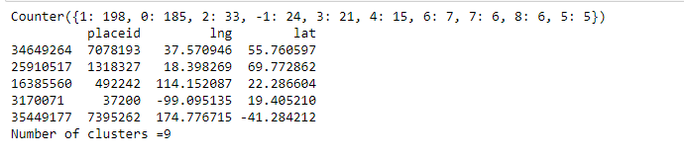
Clusters that we obtained after place clustering:
This is the output we had obtained after applying the DBSCAN model for the final dataset.
First line give number of places are there in each cluster and counter with -1 gives the outliers count and the dataframe below gives the outiers_df.

Slide 12
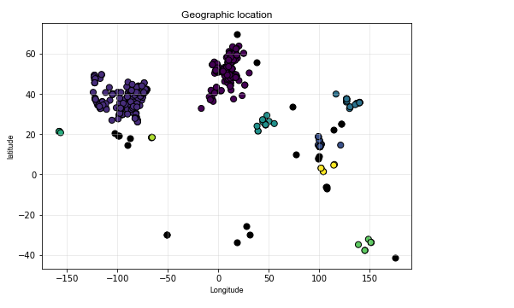
Plot after place clustering
x axis is longitude and y axis is latitude.
Here all the different clusters are represented by different colors as shown in the plot.
Outliers are colored with black color.

Slide 13
Social Distance calculation:
After getting the place clusters we need to find the social distance between every two places in each cluster that we obtained(We can exclude all the outliers).
Social distance is calculated by the given equation:​
DS=|CU|/( u1 U u2 ) ​
where CU is number of contributing users for the places and u1 and u2 are the users visited places P1 and P2.
To calculate U1 and U2 we need to develop a set from the check-in dataset by appending all the unique users visited places P1 and P2 irrespective of date and time.

Slide 14
After calculating the sets U1 and U2 we need to calculate the contributing users.
Contributing users means if a user visits both places or if user1 visited place “1” and user2 visited place “2” and if user1 and user2 are friends then they are also contributing users.​
CU can be calculated using the User Friendship dataframe and the sets U1,U2.
Union of U1 and U2 is equal to U1+U2-Intersection of(sets U1,U2).
After calculating all the parameters between two places we calculate the social distance between these two places.
The value of social distance between any two places lies 0 and 1.

Slide 15
Social Distance Constraints:
We applied some constraints on the social distance to identify different type of communities like strong communities,Active Social clusters.
Strong Communities: In order to find the strong communities we are going to calculate the social distance between every two points in each cluster that we obtained by doing place clustering.And we will include all the places whose social distance is not equal to zero with any place in the same cluster.
The number of places in the strong communities is much lower than compared to place clustering plot because it is a hard constraint which will eliminate most of the points.

Slide 16
Active Social Clusters:
Active Social Clusters : In order to find Active Social clusters we need to find mean of social distance of every point in each cluster with respective all the other points in the same cluster.We are going to define this value as ℑ.
We are going to apply various value constraints to ℑ to obtain different plots which will be discussed later.
We remove the places whose mean social distance value is less than ℑ from the place clusters that we obtained before.
After obtaining new cluster points we are going to plot them in a new plot with a different ℑ values.

Slide 17
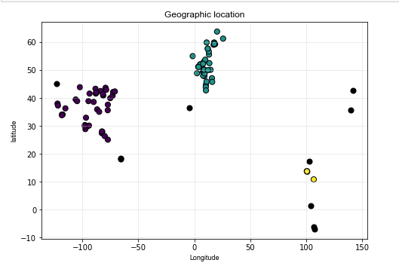
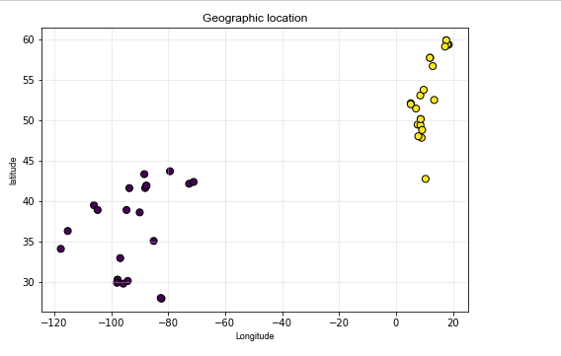
The plot on the right side is the clustering plot after applying the constraints with ℑ value 0.001 on 100 places in a given location.

Slide 18
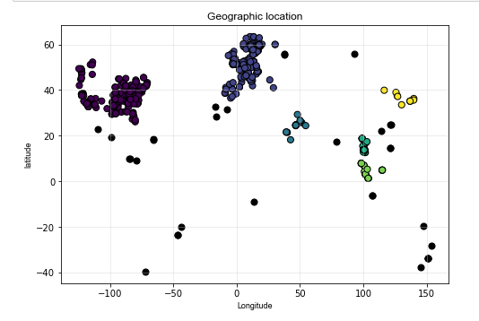
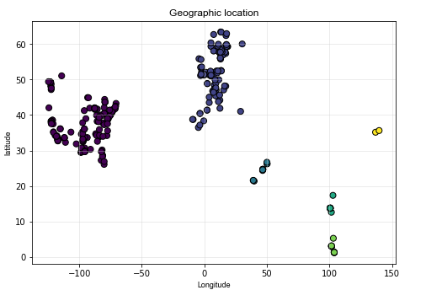
500 places in a given location with ℑ greater than 0.001

Slide 19
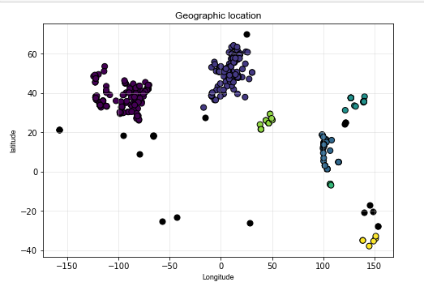
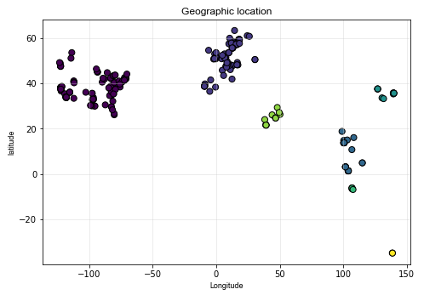
500 places with ℑ value greater than 0.002

Slide 20
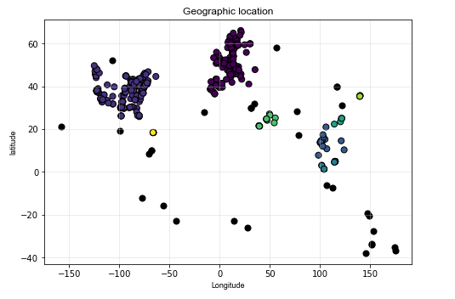
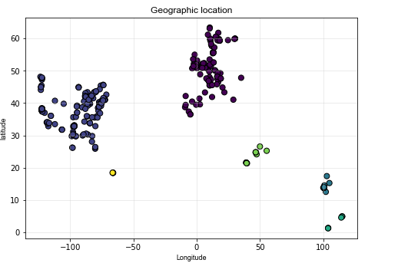
500 places with ℑ value greater than 0.0001

Slide 21
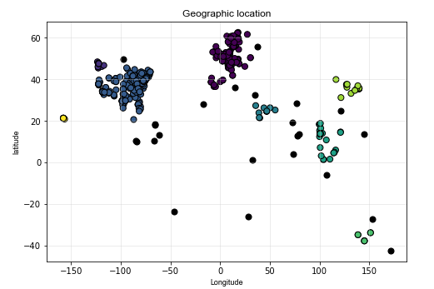
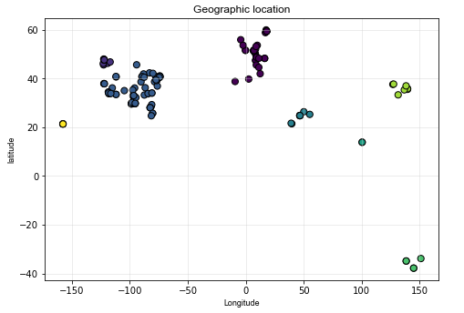
500 places with ℑ value greater than 0.01

Slide 22
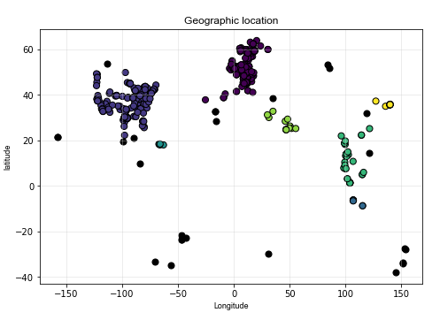
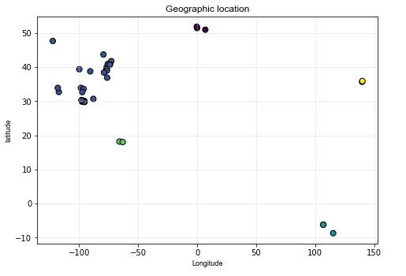
500 places with ℑ value greater than 0.05

Slide 23
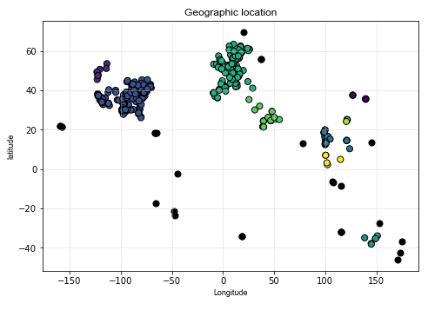
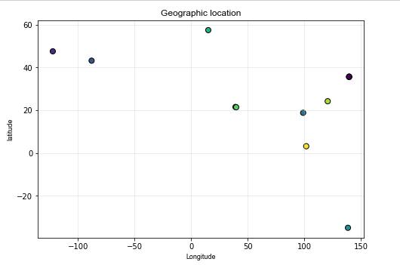
STRONG COMMUNITIES:

Slide 24
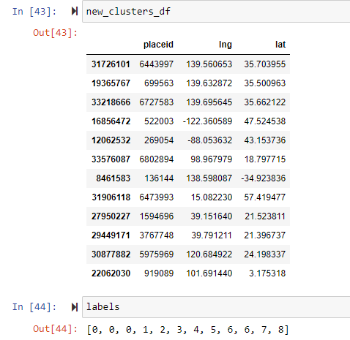
Old Clusters=({2: 192, 5: 189, 3: 33, 6: 24, 1: 9, 0: 7, 4: 6, 7: 6, 8: 5})
New cluster members=({0: 3, 6: 2, 1: 1, 2: 1, 3: 1, 4: 1, 5: 1, 7: 1, 8: 1})

Slide 25
References:
http://www.cs.uoi.gr/~nikos/TKDEGeosocialClustering.pdf
https://www.geeksforgeeks.org/dbscan-clustering-in-ml-density-based-clustering/
https://developers.google.com/machine-learning/clustering/overview
https://scikit-learn.org/stable/modules/generated/sklearn.cluster.DBSCAN.html
https://sklearn.org/modules/generated/sklearn.cluster.dbscan.html

Slide 26
THE END

