Slide 1
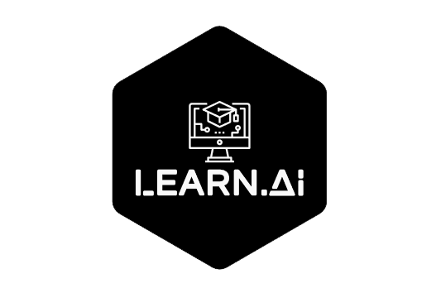
Learn The Way It’s Meant To Be Learnt!

Slide 2
Gautham. A
Eathindhar. M
Dinesh. V
Subramania Bharathy. S
Department Of Computer Science and Engineering
Sri Manakula Vinayagar Engineering College, Puducherry.
Notes:
Gautham
Good Morning/Afternoon Everyone.
We are Eathindhar and Gautham of CSE Department from Sri Manakula Vinayagar Engineering college,
Lets talk about the Change Needed in Education.
Learn.AI

Slide 3
Agenda
Preview
Abstract
Current Services
The Past, The Present and The Future.
Learn.AI
The Five Digital Forces
Architecture
Features
Future Flow
Future Implementation
Notes:
Gautham
Here’s what we are going to cover.

Slide 4
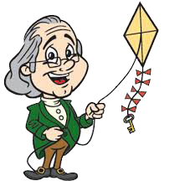
Are You Bored Of Old Learning Methods?
“Tell me and I forget.
Teach me and I remember.
Involve me and I learn. “
-Benjamin Franklin
Notes:
Gautham
would you like to change the Teacher-centric classrooms to a Student-Centric Classrooms?
Teachers in the mode of knowledge dispensers rather than facilitators
Chalk , talk and walk methods
Lack of collaboration and group learning
“If you want to be intelligent, you have to learn how to be intelligent”
Student Centered Learning
Task based learning
Exploration of concepts learnt.
It should be Experience to Exam instead of Book to exam

Slide 5
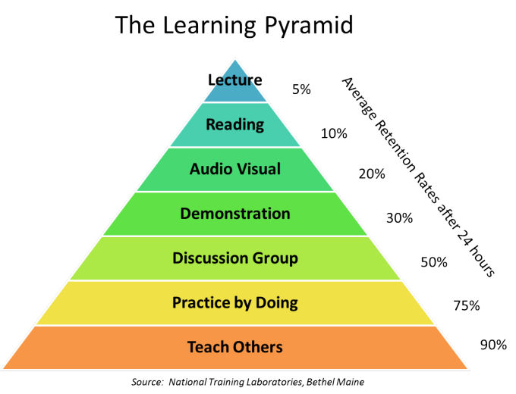
Learning Curve
Passive learning
Active Learning
Notes:
Eathindhar
Reports Says that most students stop paying attention to lectures in 10-20 minutes , after it has started.
Some Listen for a 5 minutes or so.
Active learning methods need to be the prime focus.
Involving students into activities and also providing them with experiences are a great way to
help our budding Nation.
Passive learning methods such as these are adopted in classrooms and once student leave their classrooms, most of the Students “Stop Learning”
These techniques were once effective, now with new technologies and to the current scenario where students have more resources than teachers, it’s a shout into the void.
Its time we bring a Change.

Slide 6
The Change Needed
Gamification - Learn while you play.
Instill Curiosity.
Self Study.
Explore rather than learn.
Notes:
Eathindhar
The Current Education system lacks these important factors while imparting knowledge.
Lab sessions are restricted to 9-12 hours a week
Most Teenagers use phone a lot, we cant force them to not use it and to some extent we can control them too.
But what we can do is make sure that their time spent on their mobile phones/ gadgets is productive.
The number of innovations – Life changing inventions are less when compared to the yesteryears

Slide 7
Notes:
Gautham - Eathindhar
Chatbots :
Lets what is a chatbot first
I will define chatbot as “Converse with 0 and 1”
The current chatbot implemetations are (even we have find (love chatbots)
And a special thanks to Hike’s Natasha.
NLP to NLU [understanding]
Mitsuku, Rose, RightClick
NLU is a subdomain of NLP of AI that deals with machine reading comprehension. NLU is considered as Ai-Hard problem
AR:
Augmented reality is using a virtual object to interact with a physical object and its surroundings. Thus augmenting the reality which are in.
We can say that future of human Interaction will be AR. Ex could be Endiran and Blade Runner 2049.
Using that we can visualize beyond what we imagine without a specific hardware.
AR will be the User Interface for most products in the future of learning, gaming, marketing etc.,
Now social medias are working towards incorporating AR to their platform ex. SnapChat, Instagram. AR games like Stack It AR etc. Not Pokemon Go though

Slide 8
The Past, The Present and The Future
Pictures and Cartoons
Gurukulam
Learn.AI
1000 Years
500 Years
250 Years
Now
Future
Text Books
Videos, audios and animation
Notes:
Gautham
Gurukulam 1000 years where in students studied under one teacher where lessons were based on real life experiences
Text Books - Then a documented form of study materials were used, over time textbooks became instruction manuals and we started doing what we do with any instruction manual. Has only the writer’s perspective.
Later Pictures and cartoons were used to attract kids into learning,, it went fine till television became popular. These were 2D representation of the actual events, which gave no idea on how the event occurred.
Videos – then teachers used resources from YouTube- videos and animation and also used resources from SmartClass solutions, which weren’t smart as they claim to be. These were like monologues, not interactive.
The future is Learn.AI making Students the Prime Focus and giving them the tool to rip it and build it.

Slide 9
Learn.AI
Notes:
Eathindhar
Learn.AI Incorporates the two trends in Computer Science Industry. AR And AI to give them a refreshing way to learn new things.
It is a learning supplement because Learning starts with the students and not us.
Our uniqueness is
Chatbots are used to practice language – dulingo
AR is used in showing ppl the human anatomy etc.

Slide 10





Five Digital Forces
The user can access a vast library of information.
Chatbots are used are used to help students learn their courses
Data is stored in cloud platform, for ease of access.
Application can be accessed from anywhere.
One step signup Process.
Notes:
Gautham

Slide 11
Future Flow
Gamification of Learning!
Learning environment will be more Interactive.
Self-Based learning is encouraged.
Use Of New Technology instills Curiosity.
Notes:
Eathindhar

Slide 12
Demo
Let’s see a short Demo of our Application.
Notes:
Eathindhar

Slide 13
Got Questions? Shoot’em ;)

Slide 14
Thank You
Notes:
Gautham - Eathindhar

