Slide 1
CMPE 207 Network Programming and Applications

Slide 2
Audio/Video Streaming Services
Typically sensitive to delay, but can tolerate packet loss
Data contains audio and video content (“continuous media”)
Example applications
Streaming stored media: RealAudio/RealVideo
Unidirectional real-time: online course broadcast
Interactive real-time: video conference
Notes:
Streaming stored audio/video:
- Clients request audio/video files from servers and pipeline reception
over the network and display
- Interactive: User can control operation (similar to VCR: pause, resume,
fast forward, rewind, etc)
- Delay: from client request until display start can be 1 to 10 seconds
- Example: RealAudio/RealVideo
Streaming live audio/video (Unidirectional):
- Similar to existing TV and radio stations, but delivery on the network
- Non-interactive, just listen/view
- Example: online course broadcast
Streaming live audio/video (Interactive)
- Phone conversation or video conference
- More stringent delay requirement than Streaming and Unidirectional
because of interactive real-time nature

Slide 3
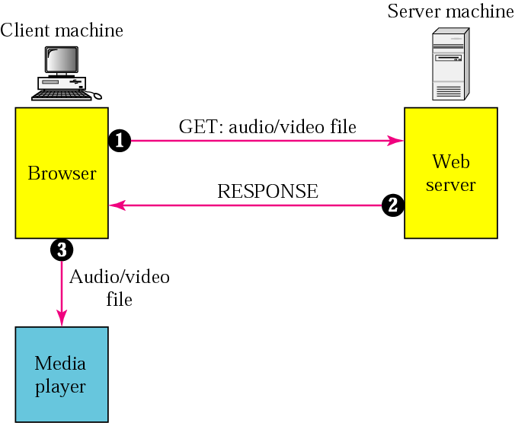
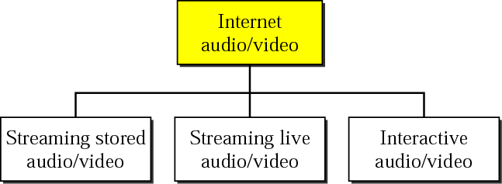
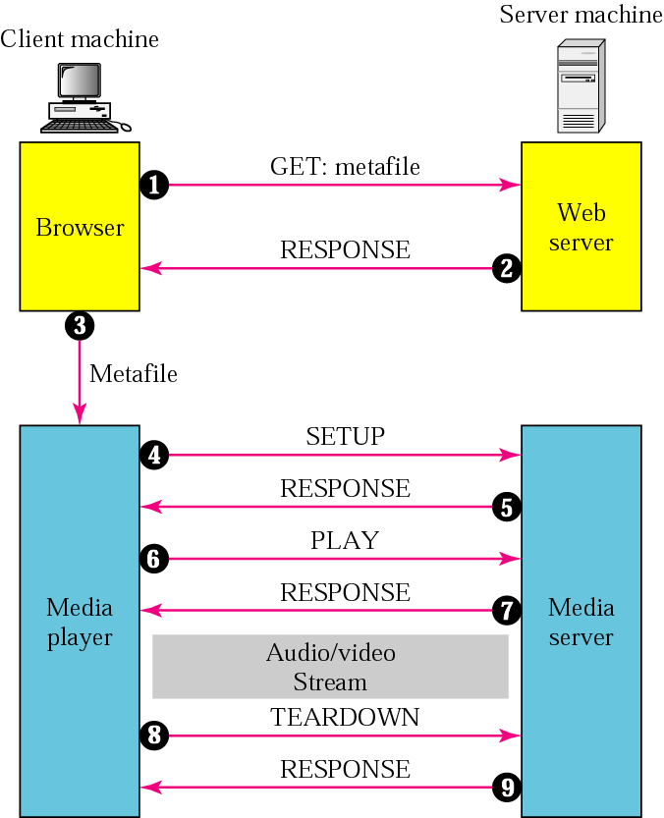
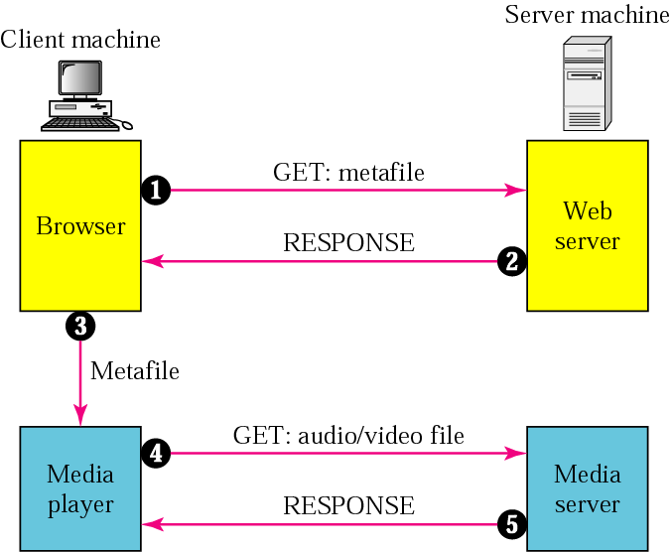
Internet Audio/Video Applications

Slide 4
Real Time Delivery (Audio/Video)
Packet network nature
Delay, unpredictable delay
Loss
Consequences ➔ countermeasure
Pkts arrive out of order ➔ reordering
Pkts arrive out of sync ➔ jitter buffer
Pkts lost ➔ acknowledgement and retransmission
Real time delivery: No retransmission
Mechanism
Order – sequence number – used in packet handling
+1 each packet ➔ gaps = loss
Time – encoding timestamp – used in playback
Encoding time, arrival time and playback time
Can also be used for delay & jitter calculation

Slide 5
Interactive Audio/Video
Sending Side
A sequence number on each packet is required
An encoding timestamp is required on each packet
Even if there is no packets transmitted (e.g. silence), encoding timestamp is always ticking
Same timestamp may appear on multiple packets
Receiving Side
A playback buffer is required for jitter processing
In general, packet receiving time is different from packet playback time (delayed playback)
Packet playback time is based on the “encoding timestamp”
If packet is not available during playback, concealment methods are used to fill the gap (packet loss recovery)
Real-time traffic needs the support of multicasting
Translation means changing the encoding of a payload to a lower quality to match the bandwidth of the receiving network
Mixing means combining several streams of traffic into one stream (conferencing)

Slide 6
Audio/Video Transport Protocols
TCP, with all its sophistication, is not suitable
UDP is more suitable
However, we need the services of RTP, another transport layer protocol, to make up for the deficiencies of UDP.
RTP (Real-time Transport Protocol)
Data transfer protocol to handle real-time traffic
RTP does not have a delivery mechanism; it must be used with UDP.
RTCP (RTP Control Protocol)
A companion protocol of RTP for control information communication

Slide 7
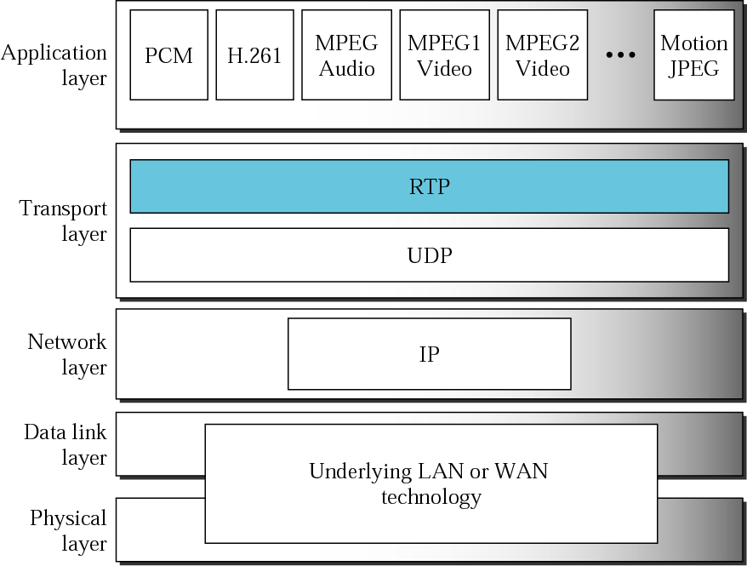
RFC 1889
(RTP, RTCP) pair
RTCP

Slide 8
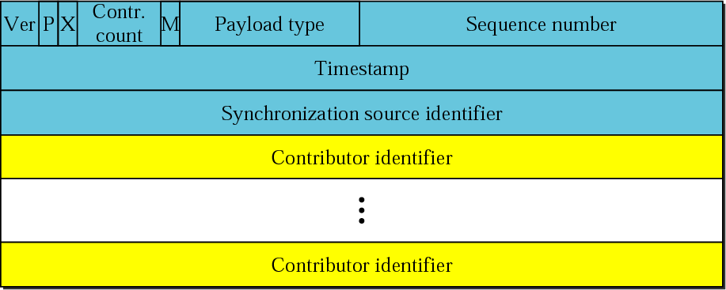
RTP Packet Header
ver 2
# contributor
granularity determined by payload type
if this RTP stream is mixed

Slide 9
Timestamp, SSRC, CSRC
Timestamp – encoding time
Clock granularity determined by payload type
Initial timestamp is a random number chosen by the sending application
Support silence suppression
If no packets are sent during periods of silence, the next RTP packet may have a timestamp significantly greater than the previous RTP packet.
Synchronization Source (SSRC)
32-bit identifier
The entity setting the sequence number and timestamp
Normally the sender of the RTP packet
Chosen randomly, independent of the network address
Meant to be globally unique within a session
May be a sender or a mixer
Contributing Source (CSRC)
Used to identify the original sources of media behind the mixer
0-15 CSRC entries

Slide 10
RTCP (RTP Control Protocol)
A companion control protocol of RTP
Separate data (RTP) and control (RTCP)
RTCP allows endpoints to periodically exchange control information
For quality-related feedback and other meta-information
A third party can also monitor session quality and detect network problems
Using RTCP and IP multicast
RTP port
Typically even-numbered UDP port, not fixed port
RTCP port = RTP port (even) + 1
Default RTP/RTCP uses UDP port 5004/5005
Typical UDP size limited to few hundred bytes
Typical: one media (audio, video, …) per port pair
RTCP is optional

Slide 11
RTCP Types
VER | P | RC | PTYPE | LENGTH
Data Area …
Sender Report (SR): 200
Time info for each SSRC and bytes sent
Timestamp ➔ synchronization among multiple RTP streams (e.g. audio/video)
Reception Reports (RR): 201
Report number of packets received and expected ➔ loss, jitter, round-trip delay
Source Description (SDES): 202
Description of user who owns source
Separate from SSRC which might change
Explicit Leave (BYE): 203
Who leaves session, in addition to time-out
Extensions (APP): application-specific

Slide 12
RTSP (Real Time Streaming Protocol)
RTSP establishes and controls either a single or several time-synchronized streams of continuous media such as audio and video
Interactive control
Play, stop, pause, fast-fwd, rewind, etc (aka network remote control)
Media retrieval
The client can request a presentation description and ask the server to set up a session to send the requested media data
Adding media to an existing session
The server or the client can notify each other about any additional media becoming available to the established session.
Provides means for choosing delivery channels
UDP, multicast UDP, or TCP
Default RTSP control channel port number: 554
RTSP is similar to HTTP/1.1 in terms of syntax and operation, but
RTSP is stateful
RTSP works in both directions, both client and server can initiate requests

Slide 13
RTP and RTSP
RTSP provides users VCR-style control
RTSP allows two-way communication; that is, viewers can communicate with the streaming server and do things like rewind the movie, go to a chapter, and so on
E.g. QuickTime automatically translates the viewer interaction with the on-screen movie controller into the proper RTSP requests
By contrast, RTP is a one-way protocol used to send live or stored streams from the server to the client.
RTSP doesn’t include transmission of streaming data itself
RTSP servers often use RTP/RTCP for media stream delivery

Slide 14
RTSP Directives
DESCRIBE | Retrieves the description of a presentation
ANNOUNCE | Change the description (can go either direction)
GET_PARAMETER | Retrieves the value of a parameter
OPTIONS | Queries the available methods
PAUSE | Streams delivery is halted temporarily
PLAY | Starts sending data
RECORD | Starts receiving data
REDIRECT | Informs to connection another server location
SETUP | Specifies the transport mechanism
SET_PARAMETER | Requests to set the value of a parameter
TEARDOWN | Stops the stream delivery and frees the resources

Slide 15
RTSP Usage Example
Client queries request types Server accepts
Client → Server:
OPTIONS rtsp://192.168.1.1:8554/demo.mp3 RTSP/1.0
CSeq: 2
Client ← Server:
RTSP/1.0 200 OK
Content-Length: 0
Cseq: 2
Public: DESCRIBE,SETUP,TEARDOWN,PLAY,PAUSE,GET_PARAMETER

Slide 16
RTSP Usage Example
Client retrieves the description of a presentation
DESCRIBE rtsp://192.168.1.1:8554/demo.mp3 RTSP/1.0
CSeq: 3
Accept: application/sdp
RTSP/1.0 200 OK
Content-type: application/sdp
Content-Base: rtsp://192.168.1.1:8554/demo.mp3
Content-length: 343
Cseq: 3
v=0
…
a=control:rtsp://127.0.0.1:8554/demo.mp3
m=audio 0 RTP/AVP 14
b=AS:128
b=RR:0
a=rtpmap:14 MPA/90000/2
a=control:rtsp://192.168.1.1:8554/demo.mp3/trackID=2

Slide 17
RTSP Usage Example
Client specifies RTP as the transport mechanism
SETUP rtsp://192.168.1.1:8554/demo.mp3/trackID=2 RTSP/1.0
CSeq: 4
Transport: RTP/AVP;unicast;client_port=59030-59031
RTSP/1.0 200 OK
Transport: RTP/AVP/UDP:unicast;client_port=59030-59031;server_port=53481-53482;ssrc=8E199999;mode=play
Session: 609e2146c2f29e5d;timeout=60
Content-length: 0
Cseq: 4

Slide 18
RTSP Usage Example
Client requests to play the stream
PLAY rtsp://192.168.1.1:8554/demo.mp3 RTSP/1.0
CSeq: 5
Session: 609e2146c2f29e5d
Range: npt=0.000-
RTSP/1.0 200 OK
RTP-Info: url=rtsp://192.168.1.1:8554/demo.mp3/trackID=2;seq=55364;rtptime=1893179874
Range: npt=781.257806-
Session: 609e2146c2f29e5d;timeout=60
Content-length: 0
Cseq: 5

Slide 19
RTSP Usage Example
After a while, Client terminates the stream session
TEARDOWN rtsp://192.168.1.1:8554/demo.mp3 RTSP/1.0
CSeq: 9
Session: 609e2146c2f29e5d
RTSP/1.0 200 OK
Session: 609e2146c2f29e5d;timeout=60
Content-length:0
Cseq: 9

