Slide 1
Docker
Means of packaging applications within lightweight containers
Gautham Goli
GitHub

Slide 2
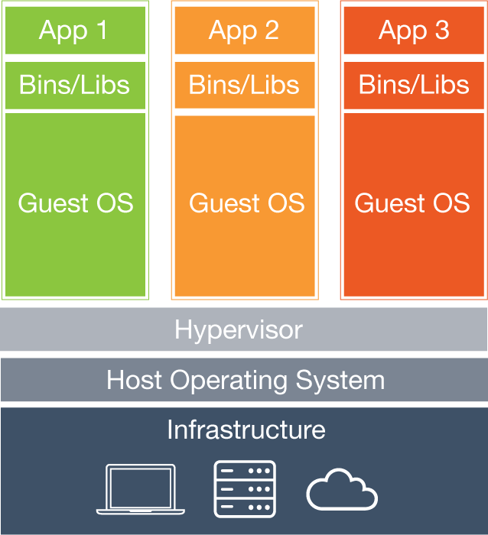
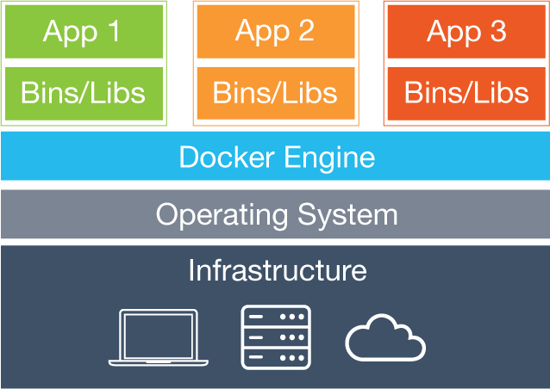
VM and Containers
Containers share the OS with other containers unlike Virtual Machines.

Slide 3
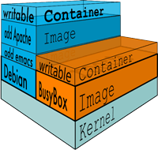
Images and Containers
Virtual Machines : Images
Docker containers : Docker Images
Docker Images are read-only templates.
A Container is loaded with a Docker Image and launched.
Technically, a container consists of isolated group of processes running in it.
Docker Images are built from base images , as specified in a Dockerfile
Dockerfile is a text file containing sequence of instructions to build an image.

Slide 4
Workflow
Write a Dockerfile
Build Docker Image from the Dockerfile
Run the Image in a container.
Share the Image with others by pushing the Image into DockerHub
Others will pull the Image and 3.

Slide 5
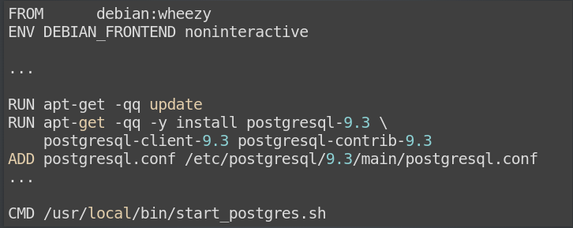
Dockerfile
Syntax:
INSTRUCTION arguments
Notes:
Dockerfile is where the apps environmnet is defined

Slide 6

Build an image named tutum/postgres
Running the docker image in a container
Mounting data from host to container
Linking containers
Notes:
linking : creates an entry with alias in /etc/hosts

Slide 7
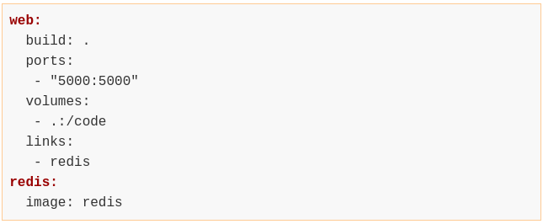
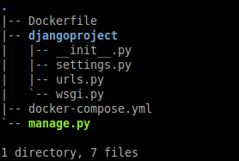
Docker Compose
Run multiple containers , define link them, mount volumes, forward ports
specify commands and more.
Reference: https://docs.docker.com/compose/yml/
Notes:
Define the services that make up the app in docker-compose.

Slide 8
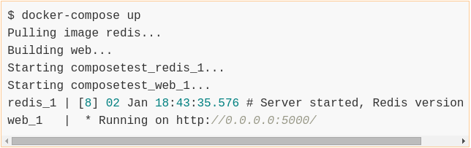
Running the app with compose

Slide 9


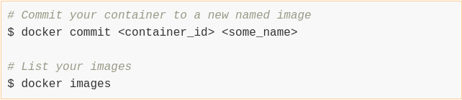
Managing containers

Slide 10
Useful references
Docker Basics: https://docs.docker.com/articles/basics/
Dockerfile reference: https://docs.docker.com/reference/builder/
Packaging django applications in Docker: http://michal.karzynski.pl/blog/2015/04/19/packaging-django-applications-as-docker-container-images/

