Slide 1
MICRO PROJECT
FOSS.

Slide 2

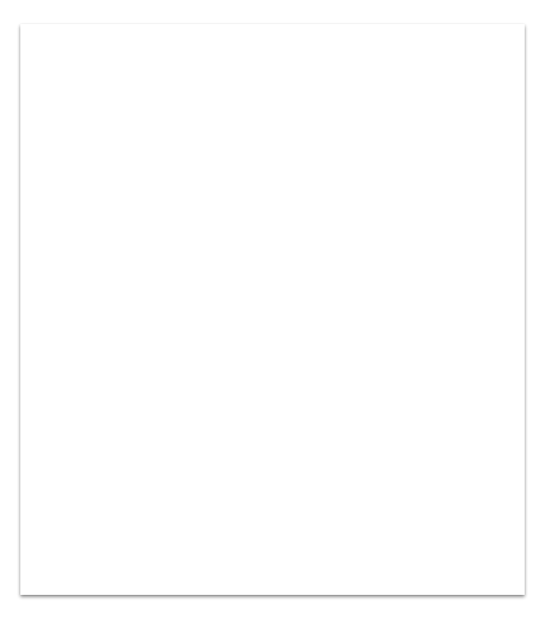
Index.
1.Topic
2.introduction
3.Design
4.Implementation
5.Team Info

Slide 3
TOPIC: Display kernel info in human readable form.

Slide 4
INTRODUCTION: this program displays kernel information including system information so that the casual user can understand these informations.

Slide 5
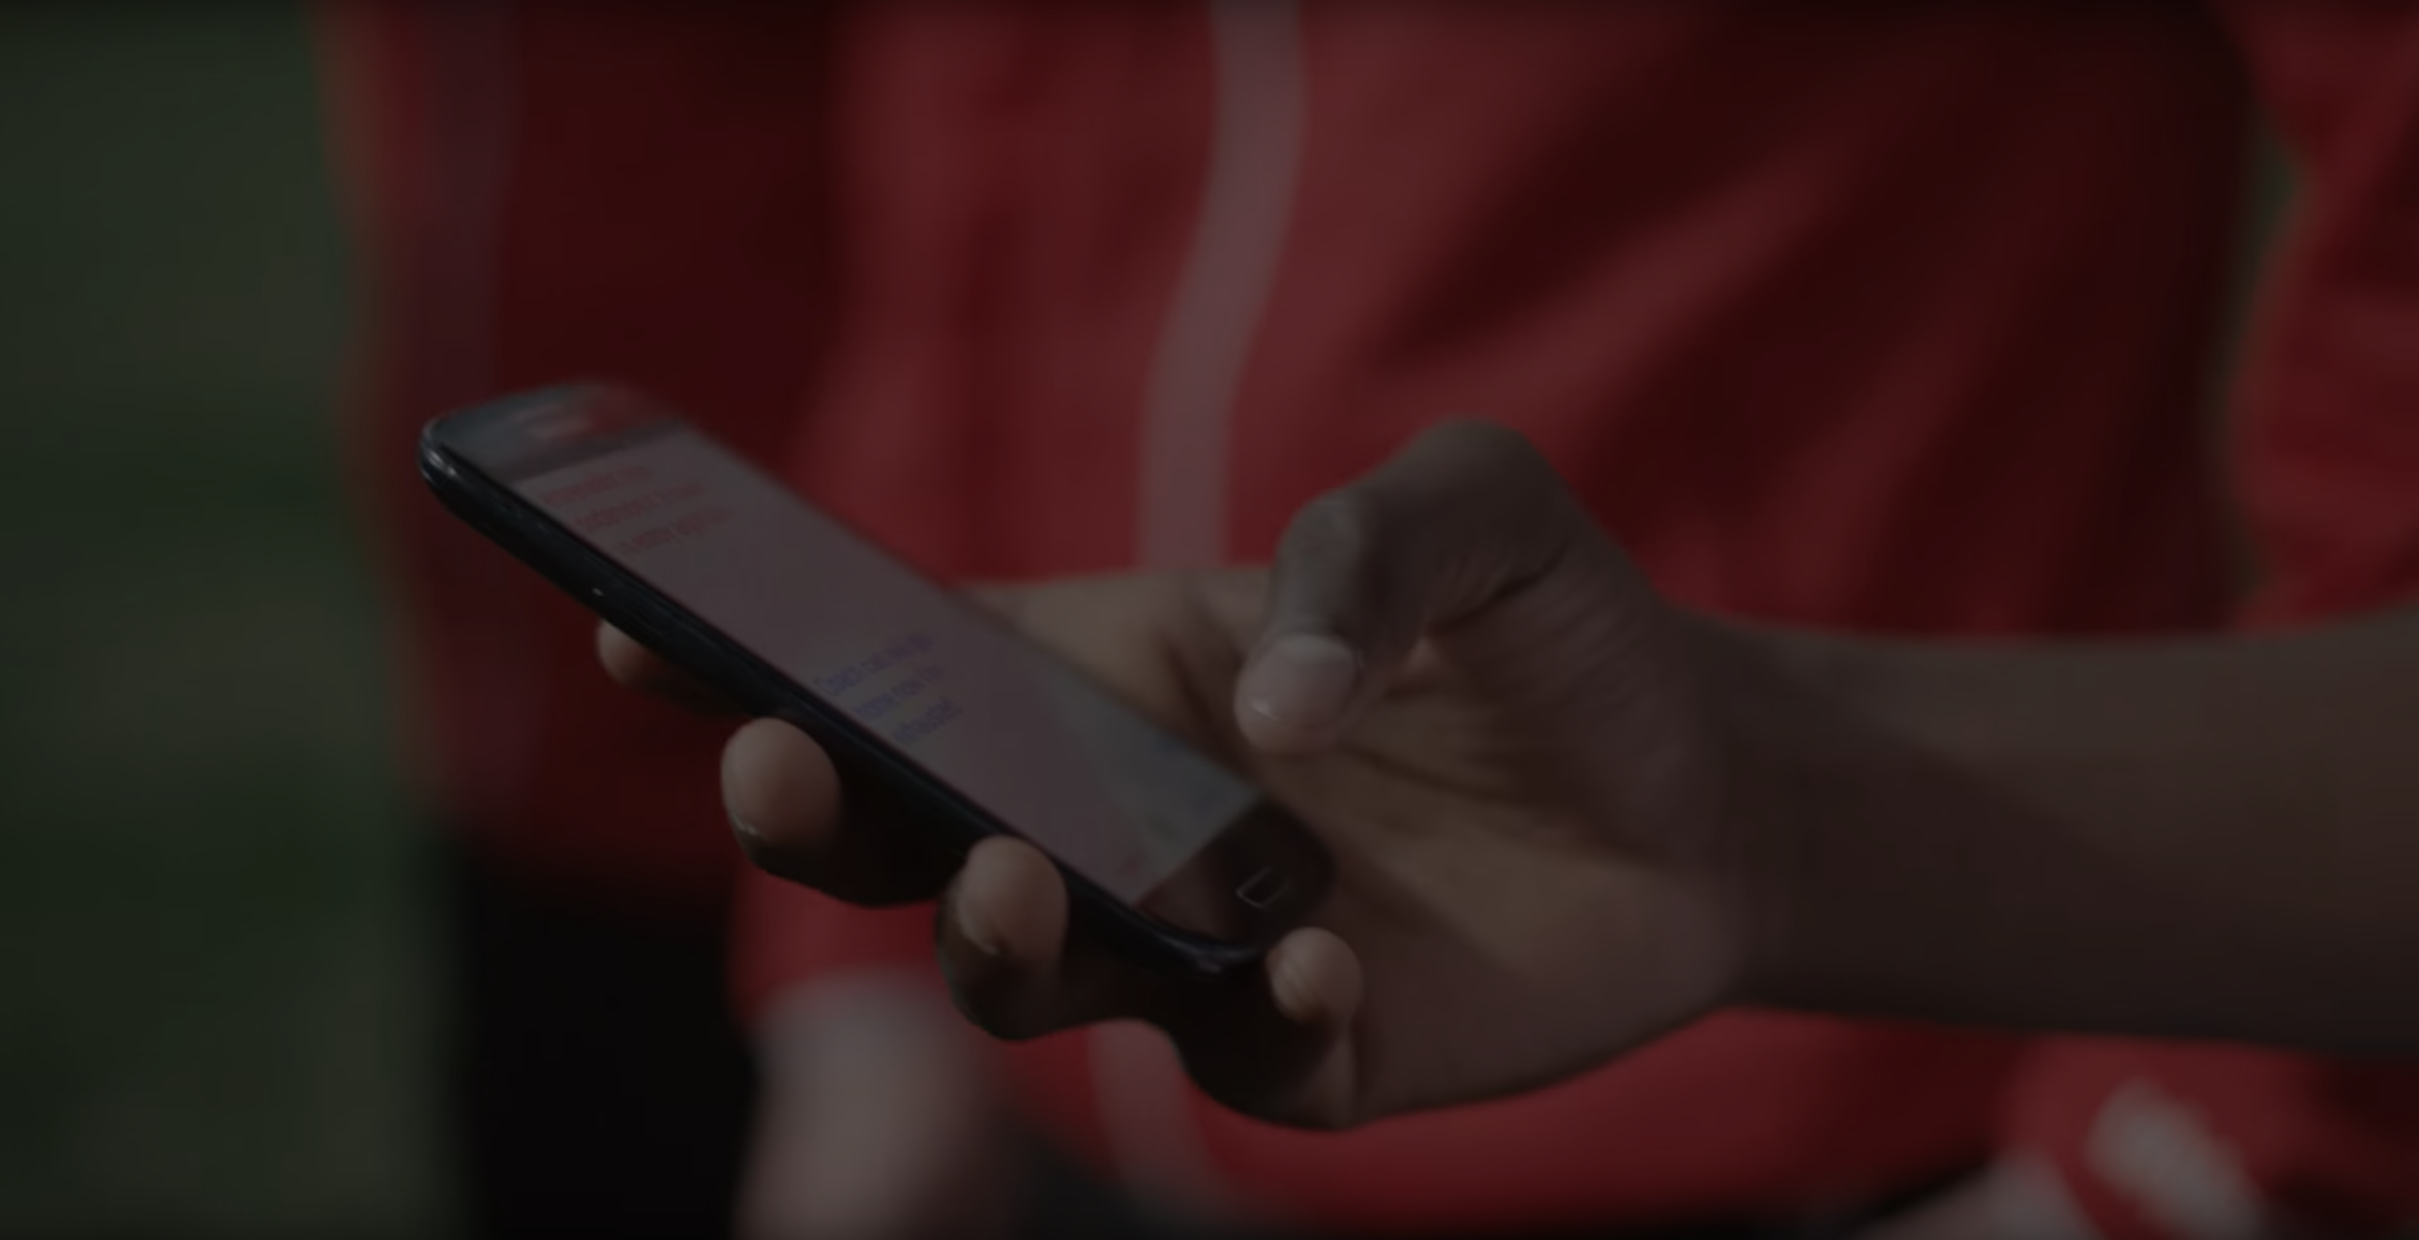
Design: the program is created using python, the GUI is made using Tkinter library available in python. The python codes retrieve system info including Kernel data and display them in a pop-up box.

Slide 6
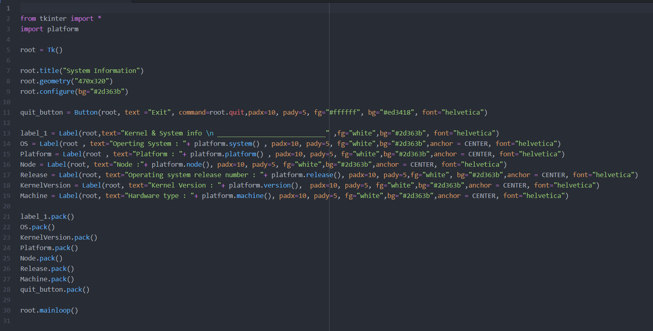
Program < script >

Slide 7
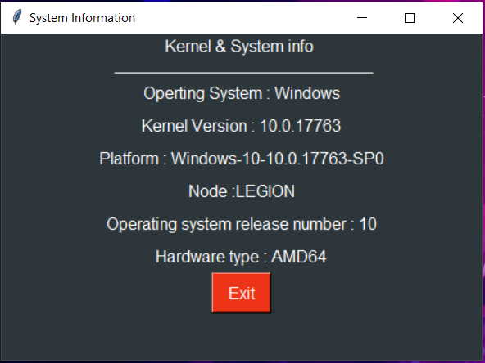
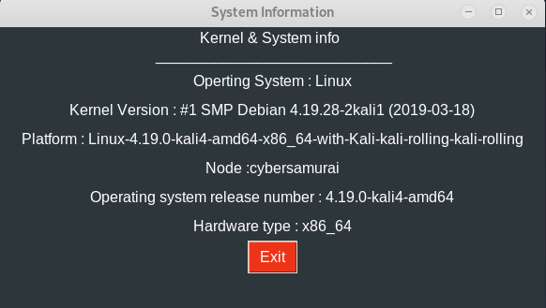
OUTPUT :

Slide 8
Team Members.
45: Don Sebastian
46: Eldho Varghese
47: Gautham Krishna.S
48: Gautham Kartha

Slide 9
THE END.

