Slide 1

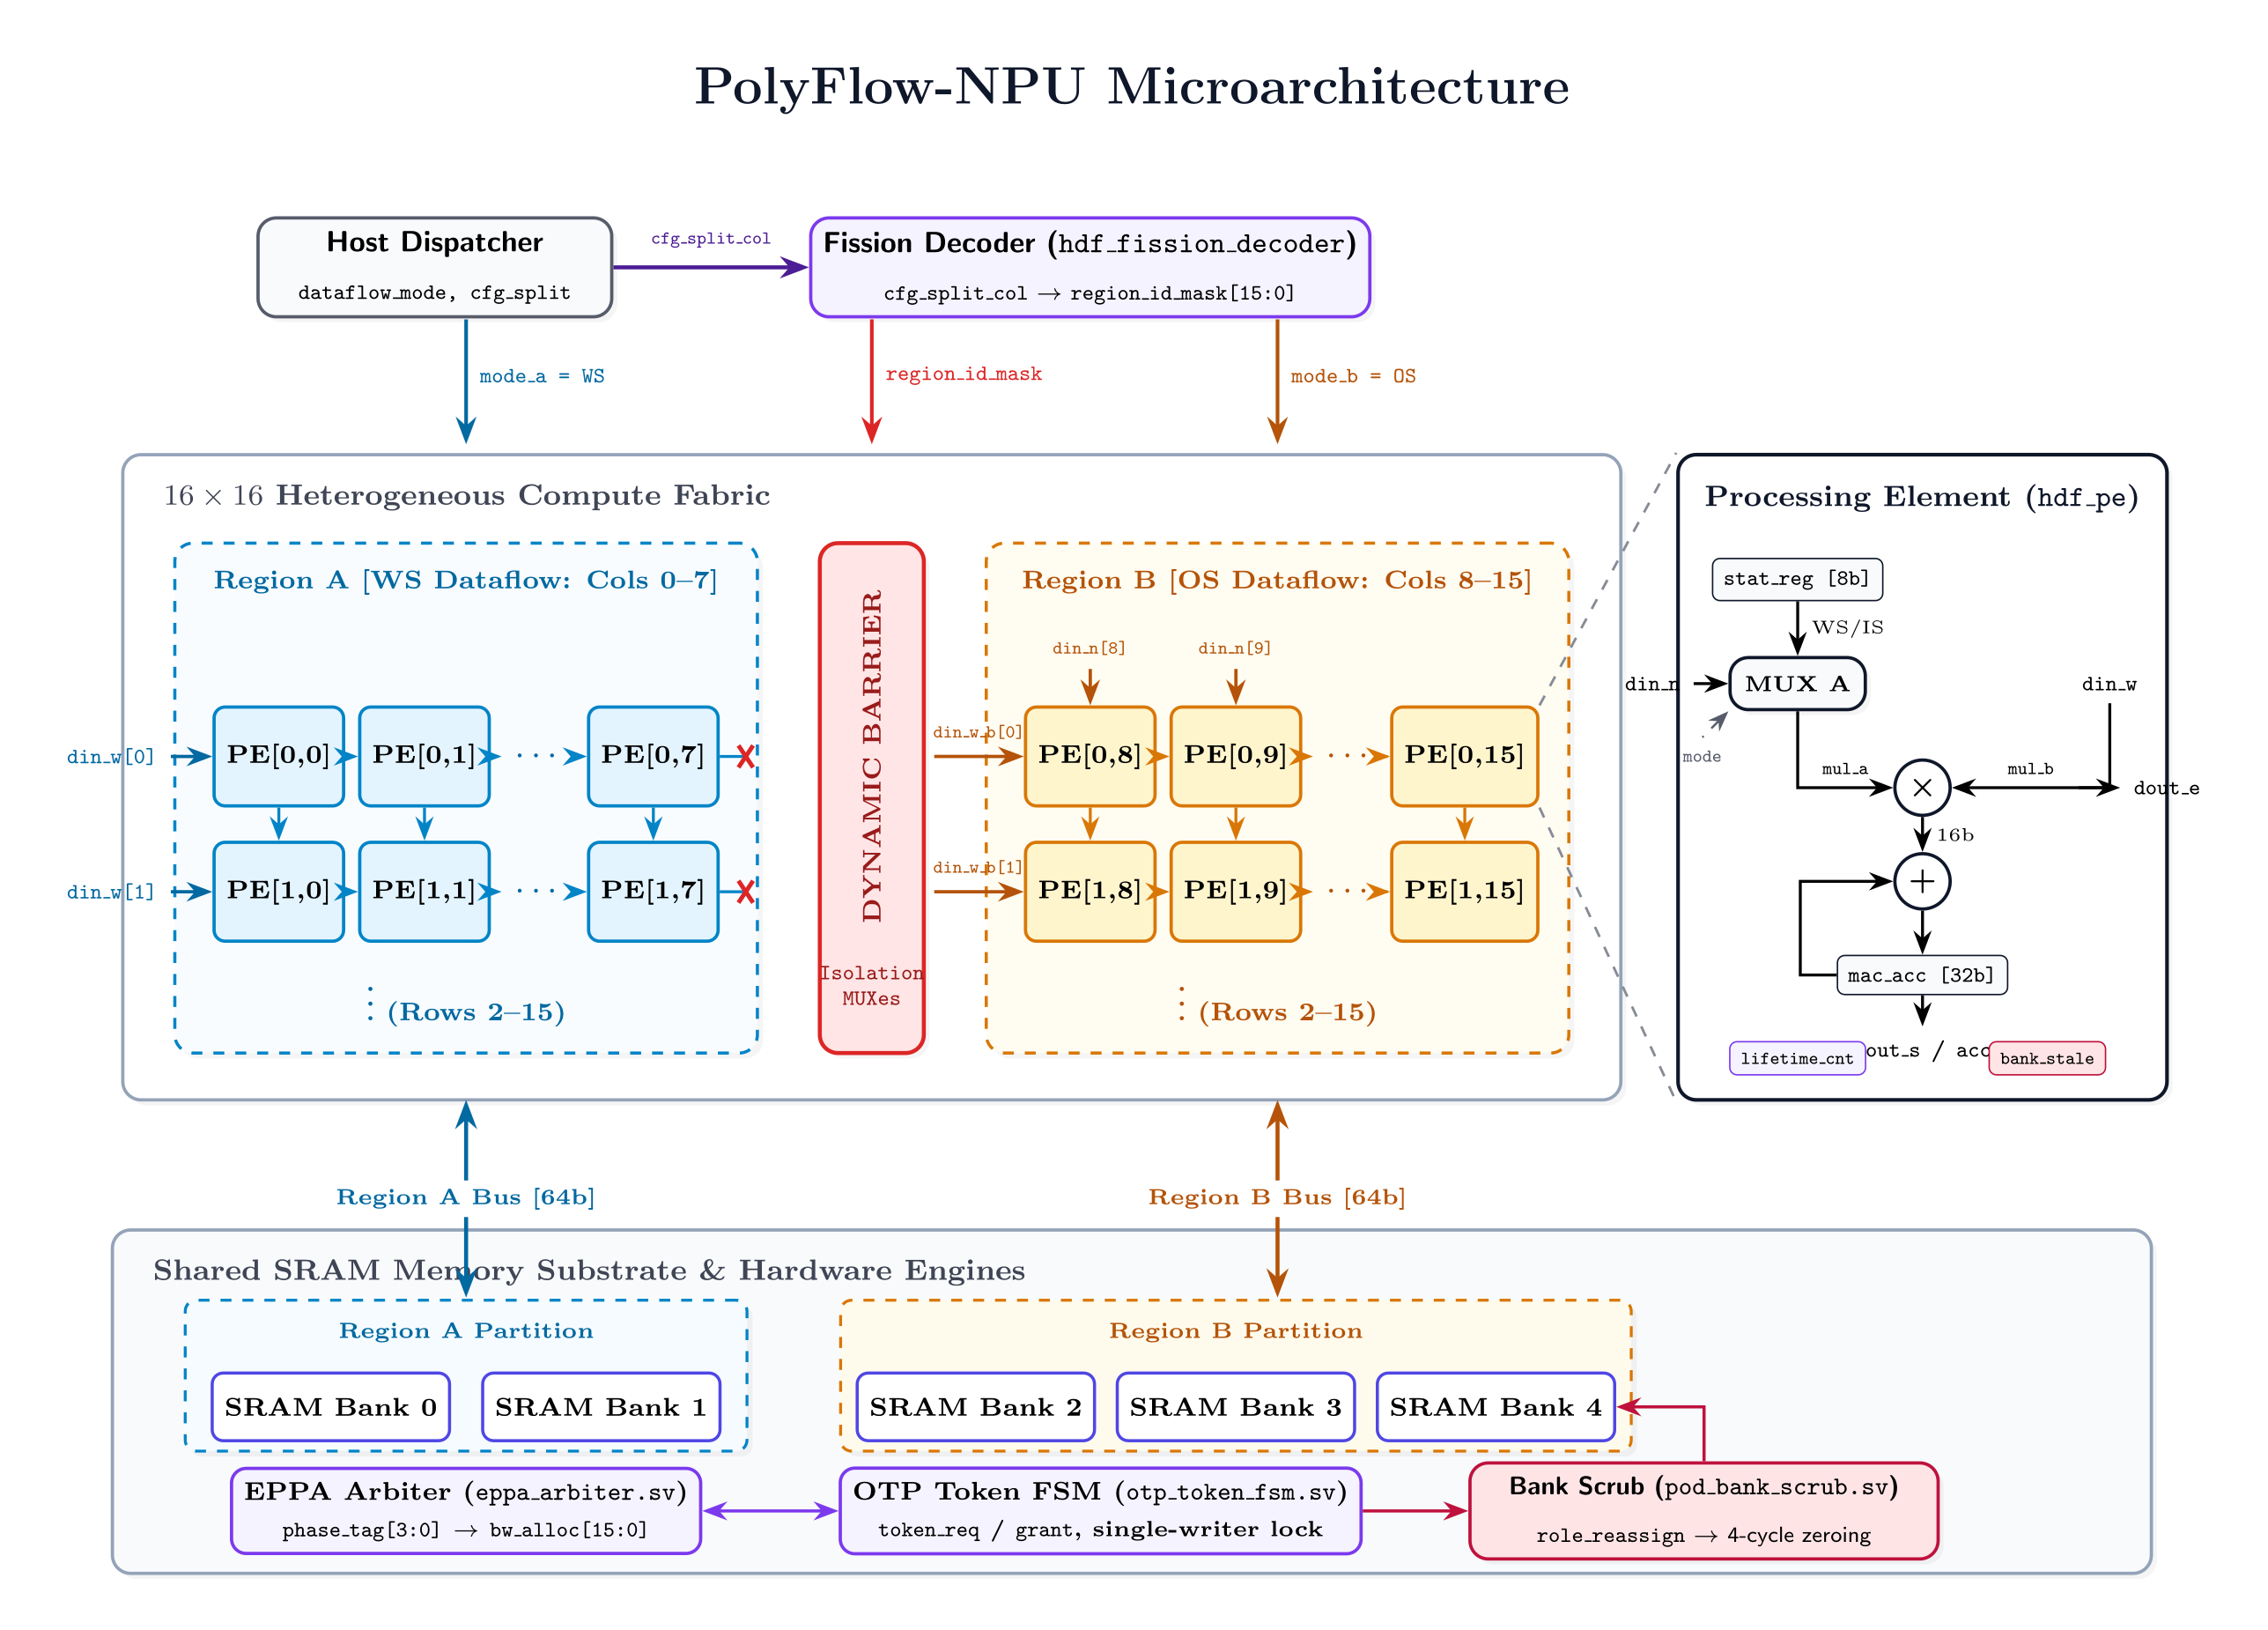
VELLORE INSTITUTE OF TECHNOLOGY (VIT), VELLORE
School of Electronics Engineering (SENSE) | Department of Micro and Nano Electronics
Bachelor of Technology in Electronics and Communication Engineering | Capstone Project 2025–2026
POLYFLOW-NPU: A MULTI-TENANT HETEROGENEOUS SPATIAL-FISSION DEEP LEARNING ACCELERATOR
Hardware-Virtualization with Dynamic Spatial Column Fission, Carry-Save MAC & Elastic Phase-Priority SRAM Arbitration
TEAM MEMBERS AND GUIDE
PROJECT OVERVIEW
STUDENT INVESTIGATORS (B.Tech ECE):
• Gauthamaan M K (23BEC0156)
• Geetha Sree (23BEC0419)
• Sadurth Ram (23BEC0038)
PROJECT SUPERVISOR & GUIDE:
• Dr. S. Ramasubramanian, M.E., Ph.D.
Associate Professor, Dept. of Micro & Nano Electronics, SENSE, VIT Vellore
Motivation & Problem Definition:
• Edge AI requires concurrent execution of disparate models (e.g., CNNs for vision + Transformers for NLP). Static NPUs (TPU WS, Eyeriss OS) suffer dataflow mismatch, causing up to 68% off-chip memory thrashing and <38% PE utilization.
Proposed Solution — PolyFlow-NPU Architecture:
• Introduces single-die heterogeneous spatial fission, partitioning a unified array into specialized sub-regions (WS for convolutions, OS for self-attention) with zero-cycle switching overhead, 97.5% active compute density, and zero inter-tenant data leakage.
JUSTIFICATION OF COMPLEX ENGINEERING PROBLEM
PROPOSED BLOCK DIAGRAM
• WP1: Depth of Knowledge Required: Requires in-depth convergence of digital VLSI circuit timing, systolic array microarchitecture, carry-save arithmetic, and multi-tenant tensor scheduling.
• WP2: Conflicting Requirements: Simultaneous optimization of conflicting metrics: 200 MHz timing closure in 90nm bulk CMOS, ultra-low power budget (13.14 mW), sub-0.1 mm² area, and strict hardware-level tenant memory isolation.
• WP3: Depth of Analysis Required: Carry-save critical path reduction (1.87 ns path delay), Markovian SRAM contention analysis, and multi-corner physical signoff (slow.lib @ 125°C vs fast.lib @ -40°C).
• WP4: Familiarity of Issues: Addresses non-standard, emerging multi-tenant edge AI challenges where conventional homogeneous systolic accelerators suffer severe latency and energy degradation.
• WP5: Extent of Applicable Codes: Strict compliance with IEEE 1800 SystemVerilog, Liberty (.lib) models, Synopsys SDC constraints, and Cadence LEF/DEF physical rules.
• WP6: Stakeholder Involvement: Impacts edge AI robotics, autonomous vehicles, privacy-compliant multi-tenant edge gateways, and sustainable green semiconductor hardware.
• WP7: Interdependence: Tight microarchitectural coupling between RTL dataflow controllers, token-based SRAM arbiters, and standard-cell clock tree synthesis (CCOpt).
Key Functional Blocks:
• Region A (Weight-Stationary) & Region B (Output-Stationary) execution partitions
• Elastic Phase-Priority Arbiter (EPPA) + 4-Bank Scratchpad SRAM + 4-Cycle Zeroing Scrubbers
DESIGN METHODOLOGY AND NOVELTY
PROJECT RESULTS & QOR COMPARISON
• Novelty 1: Dynamic Column Fission: Hardware-reconfigurable boundary splitting into 5 partitions (0:4, 1:3, 2:2, 3:1, 4:0) with zero-cycle switching latency.
• Novelty 2: Carry-Save PE Arithmetic: Decomposes 8-bit MAC into carry-save accumulation, truncating critical path from 3.42 ns to 1.87 ns (45.3% latency reduction).
• Novelty 3: EPPA Memory Arbitration: Dynamic phase tagging (BURST, STREAM, IDLE, RECONFIG) guarantees zero starvation with <=1.2 cycle average access latency.
• Novelty 4: Autonomous Bank Scrubbing: 4-cycle hardware memory zeroing engine completely sanitizes SRAM banks upon tenant migration, preventing cross-tenant leakage.
• EDA Toolchain Flow: SystemVerilog RTL -> Cadence Xcelium Functional Sim (100% test coverage) -> Cadence Genus 21.14 Logic Synthesis (90nm slow.lib @ 200 MHz) -> Cadence Innovus Physical Design (CCOpt CTS & Dual-Corner Closure).
Cadence Genus 21.14 Synthesis & Signoff QoR (90nm Bulk CMOS slow.lib @ 200 MHz):
QoR Metric | Model 1 (DFS) | Model 2 (SFA) | PolyFlow-NPU
Clock Frequency | 200.0 MHz | 200.0 MHz | 200.0 MHz
Setup Slack (WNS) | +0.12 ns (MET) | +0.28 ns (MET) | +0.42 ns (MET)
Hold Slack (WNS) | +0.04 ns (MET) | +0.06 ns (MET) | +0.08 ns (MET)
Cell Area (mm²) | 0.052 mm² | 0.068 mm² | 0.076 mm²
Total Power (mW) | 8.92 mW | 11.45 mW | 13.14 mW
Energy Efficiency | 0.58 pJ/MAC | 0.49 pJ/MAC | 0.41 pJ/MAC (3.4x)
Multi-Tenant Util. | 34.2% | 58.6% | 97.5% (Optimal)
Key Milestone: PolyFlow-NPU closes timing with +0.42 ns positive setup slack and +0.08 ns hold slack at 200 MHz, achieving 97.5% active compute density with 3.4x energy reduction and zero memory leakage.
PO & PSO MAPPING
WP MAPPING (WASHINGTON ACCORD)
SDG MAPPING & SUSTAINABILITY
• PO1 (Engineering Knowledge): Applied carry-save arithmetic & digital VLSI timing.
• PO2 (Problem Analysis): Identified 68% memory thrashing in multi-tenant edge AI.
• PO3 (Design of Solutions): Synthesized 90nm reconfigurable array meeting <15mW.
• PO4 (Investigations): Benchmarked WS/OS/IS dataflows and 5 fission splits.
• PO5 (Modern Tools): Mastered Cadence ECAD suite (Xcelium, Genus, Innovus).
• PSO1 (VLSI Systems): Developed full silicon microarchitecture for edge AI.
• PSO2 (EDA Flow): Closed timing & CTS at 200 MHz using industrial tools.
• WP1 (Depth of Knowledge): Advanced digital VLSI, tensor mapping, and timing closure.
• WP2 (Conflicting Criteria): Throughput vs power vs silicon area vs security.
• WP3 (Depth of Analysis): Carry-save critical paths & SRAM contention modeling.
• WP4 (Familiarity): Emerging multi-tenant edge AI hardware virtualization.
• WP5 (Applicable Codes): IEEE 1800 SystemVerilog, Liberty, SDC, and LEF/DEF.
• WP6 (Stakeholders): Edge robotics, IoT gateways, and green computing.
• WP7 (Interdependence): RTL microarchitecture tightly coupled to 90nm layout.
• SDG 9: Industry & Innovation (Target 9.4): Enables sustainable industrial AI infrastructure by consolidating multiple discrete neural chips onto a single silicon die with 97.5% compute density.
• SDG 12: Responsible Consumption (Target 12.2): Eliminates silicon overprovisioning through dynamic spatial fission, significantly reducing semiconductor manufacturing waste.
• SDG 13: Climate Action & SDG 7: Clean Energy: Achieves an ultra-low energy footprint of 0.41 pJ/MAC and 13.14 mW power, eliminating 68% memory thrashing and dramatically lowering edge AI carbon intensity.
REFERENCES
PROJECT OUTCOMES & DELIVERABLES
[1] N. P. Jouppi et al., 'In-datacenter performance of a tensor processing unit,' in ACM/IEEE ISCA, 2017.
[2] Y. H. Chen et al., 'Eyeriss: An energy-efficient accelerator for deep CNNs,' IEEE JSSC, vol. 52, 2017.
[3] H. Kwon et al., 'MAERI: Enabling flexible dataflow mapping over DNN architectures,' in ACM ASPLOS, 2018.
• 1. Complete IEEE 1800 SystemVerilog RTL verified across all 9 dataflow pairs with 100% test coverage.
• 2. Cadence Genus 21.14 logic synthesis on 90nm bulk CMOS achieving timing closure (+0.42 ns slack @ 200 MHz).
• 3. Cadence Innovus physical design flow through Clock Tree Synthesis (CCOpt, <=50 ps target skew).
• 4. Research manuscript prepared for submission to IEEE Transactions on VLSI Systems / IEEE TCAD.

